Slide 1
A Study of Fibers and Textiles
SFS1. Students will recognize and classify various types of evidence in relation to the definition and scope of Forensic Science
SFS2. Students will use various scientific techniques to analyze physical and trace evidence.
b. Analyze the morphology and types of hair, fibers, soil and glass.
All Rights Reserved South-Western / Cengage Learning © 2009

Slide 2
Introduction and How Forensic Scientists Use Fibers
Fibers are considered class evidence.
Fibers often fall off and are picked up during normal activities.
In an investigation, collection of fibers within 24 hours is critical.
Fiber evaluation can show such things as the type of fiber, its color, the possibility of violence, and point of origin.

Slide 3
Fiber Classification Natural Fibers
woven wool textile
Animal fibers (made of proteins):
Wool from sheep, cashmere and mohair from goats, angora from rabbits, and hair from alpacas, llamas, and camels are commonly used in textiles.
Shimmering silk from caterpillar cocoons is longer and not as easily shed.

Slide 4
Fiber Classification Natural Fibers
Plant fibers (made of the polymer cellulose):
can absorb water.
are very resistant to damage from harsh chemicals.
can only be dissolved by strong acids.
can be common at crime scenes because they become brittle over time.

Slide 5
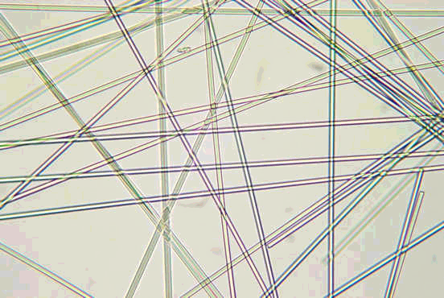
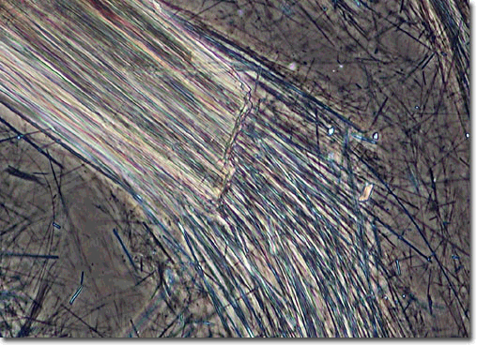
Fiber Classification Natural Fibers
Mineral Fibers:
Fiberglass is a fibrous form of glass.
Asbestos is a naturally occurring mineral with a crystalline structure.

Slide 6
Fiber Classification Synthetic Fibers
Until the twentieth century only plant and animal fibers were used to make clothes and textiles.
Half the products produced today are artificially produced.

Slide 7
Filament Cross-Sections
Synthetic fibers are forced out of a nozzle when they are hot, and then they are woven. The holes of the nozzle are not necessarily round; therefore, the fiber filament may have a unique shape in cross-section.

Slide 8
Fiber Classification Synthetic Fibers
Regenerated Fibers (derived from cellulose):
Rayon is the most common of this type of fiber. It can imitate natural fibers, but it is stronger.
Celenese® is cellulose chemically combined with acetate and is often found in carpets.
Polyamide nylon is cellulose combined with three acetate units, is breathable, lightweight, and used in performance clothing.

Slide 9
Fiber Classification Synthetic Fibers
Polymer Fibers:
Petroleum is the basis for these fibers, and they have very different characteristics from other fibers.
They have no internal structures, and under magnification they show regular diameters.

Slide 10
Fiber Classification Synthetic Fibers
Examples of polymer fibers:
Polyester—found in “polar fleece,” wrinkle-resistant, and not easily broken down by light or concentrated acid; added to natural fibers for strength.
Nylon—easily broken down by light and concentrated acid; otherwise similar to polyester.
Acrylic—inexpensive, tends to “ball” easily, and used as an artificial wool or fur.
Olefins—high performance, quick drying, and resistant to wear.

Slide 11
Fiber Comparison
Can you tell the difference(s) between the cotton on the left and the rayon on the right?

Slide 13
Fabric Production
Fabrics are composed of individual threads or yarns, made of fibers, that are knitted, woven, bonded, crocheted, felted, knotted or laminated. Most are either woven or knitted. The degree of stretch, absorbency, water repellence, softness and durability are all individual qualities of the different fabrics.

Slide 14
Weave Terminology
Yarn—a continuous strand of fibers or filaments, either twisted or not
Warp—lengthwise yarn
Weft—crosswise yarn
Blend—a fabric made up of two or more different types of fiber.

Slide 15
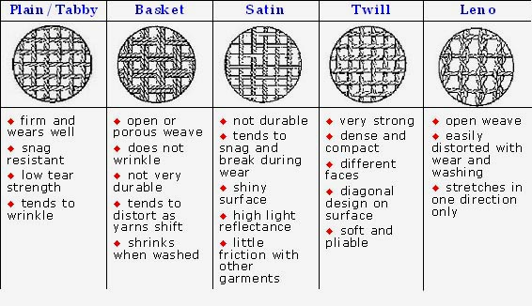
Weave Patterns

Slide 16
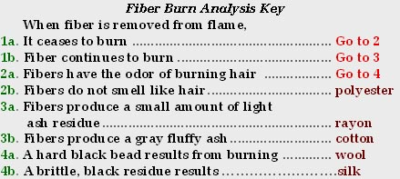
Sampling and Testing
If a large quantity of fibers is found, some can be subjected to destructive tests such as burning them in a flame or dissolving them in various liquids.
Crimes can be solved in this way by comparing fibers found on different suspects with those found at the crime scene.

Slide 17
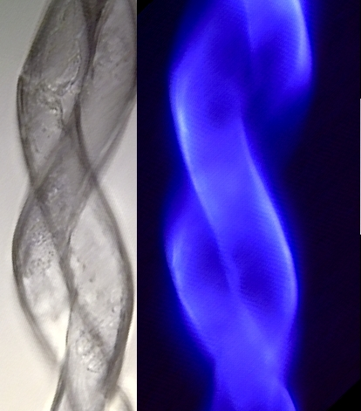
Testing for Identification
Microscopic observation
Burning – put in a flame and see how it behaves
Thermal decomposition – what happens when heated but not burned
Chemical tests – does it change when put in chemicals like acetone, bleach, water
Density – different yarns have different densities
Fluorescence

Slide 18
Dyes
Components that make up dyes can be separated and matched to an unknown.
There are more than 7000 different dye formulations.
Chromatography is used to separate dyes for comparative analysis.
The way a fabric accepts a particular dye may also be used to identify and compare samples.

Slide 19
Collection of Fiber Evidence
Bag clothing items individually in paper bags.
Make tape lifts of exposed skin areas of bodies and any inanimate objects

Slide 20
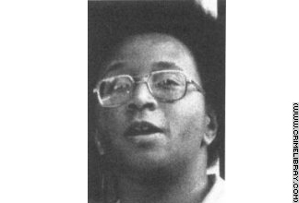
Fiber Evidence
Fiber evidence in court cases can be used to connect the suspect to the victim or to the crime scene. In the case of Wayne Williams, fibers weighed heavily on the outcome of the case. Williams was convicted in 1982 based on carpet fibers that were found in his home, car and on several murder victims.

