Slide 1
Fingerprints
Some of this ppt came from Kristen Kohli and several pics came from the FBI.

Slide 2
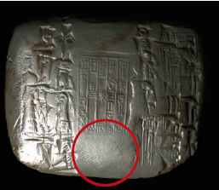
History of Fingerprinting
First known use: In China nearly 4000 years ago as signatures on clay tablets.
In ancient Babylon (dating back to 1792-1750 B.C.), fingerprints pressed into clay tablets marked contracts.

Slide 3
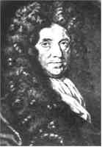
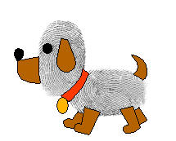
The earliest written study (1684) is Dr. Nehemiah Grew’s paper describing the patterns he saw on human hands under a microscope, including the presence of ridges.

Slide 4
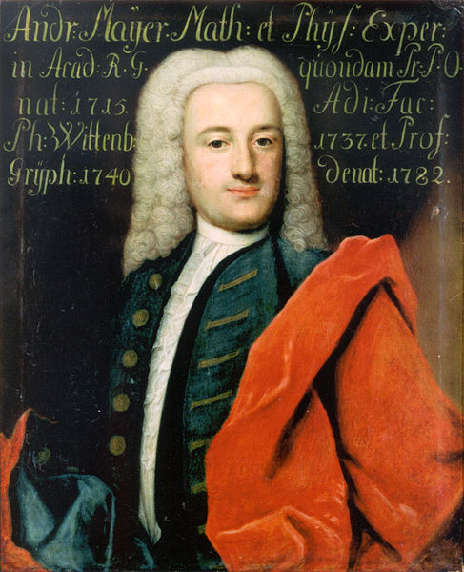
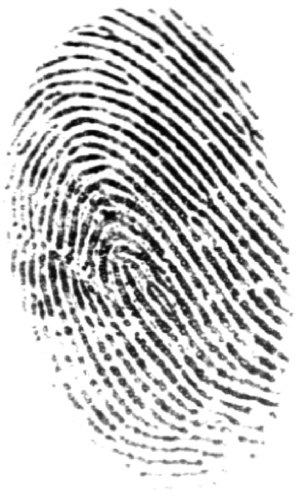
History of Fingerprinting
In 1788, Johann Christophe Andreas Mayer was the first to note that no two fingerprints are the same.

Slide 5
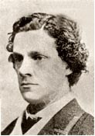
History of Fingerprinting
Sir William Herschel, in 1856, began the collection of fingerprints and noted they were not altered by age.

Slide 6
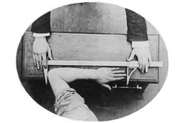
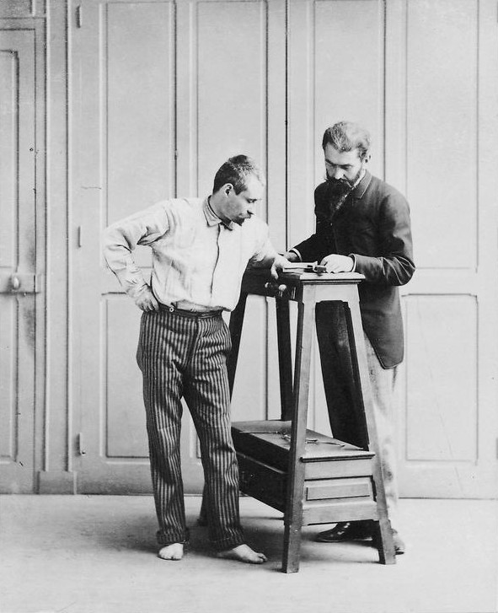
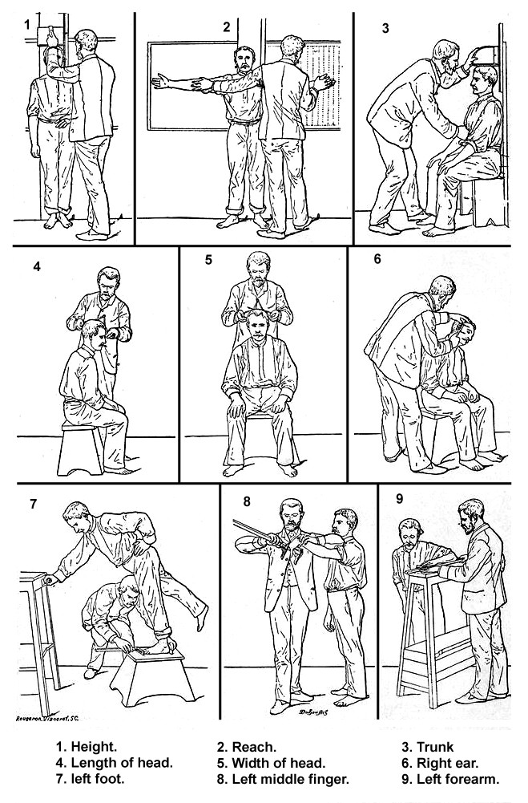
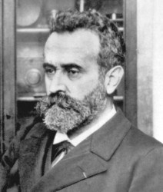
History of Fingerprinting
In 1879, Alphonse Bertillon began keeping measurements of criminals in police files.

Slide 7
Bertillon’s Mug Shot
Bertillon also invented the mug shot.

Slide 10
Bertillon Measurements
Here are some of the measurements:
Height
Stretch: Length of body from left shoulder to right middle finger when arm is raised
Bust: Length of torso from head to seat, taken when seated
Length of head: Crown to forehead
Width of head: Temple to temple
Length of right ear
Length of left foot
Length of left middle finger
Length of left cubit: Elbow to tip of middle finger
Width of cheeks
Length of left little finger

Slide 12
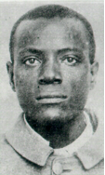
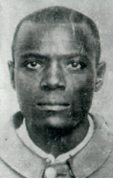
The Wests
Will West's Bertillon Measurements 178.5; 187.0; 91.2; 19.7; 15.8; 14.8; 6.6; 28.2; 12.3; 9.7
William West's Bertillon Measurements 177.5; 188.0; 91.3; 19.8; 15.9; 14.8; 6.5; 27.5; 12.2; 9.6;

Slide 14
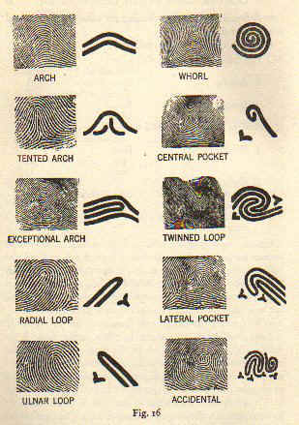
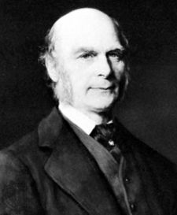
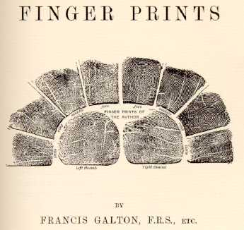
History of Fingerprinting
In 1888, Sir Francis Galton (Charles Darwin’s cousin) published a paper and 3 books on fingerprints. He came up with probability calculations for people having the same prints and he came up the specific patterns we use today.

Slide 15
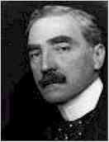
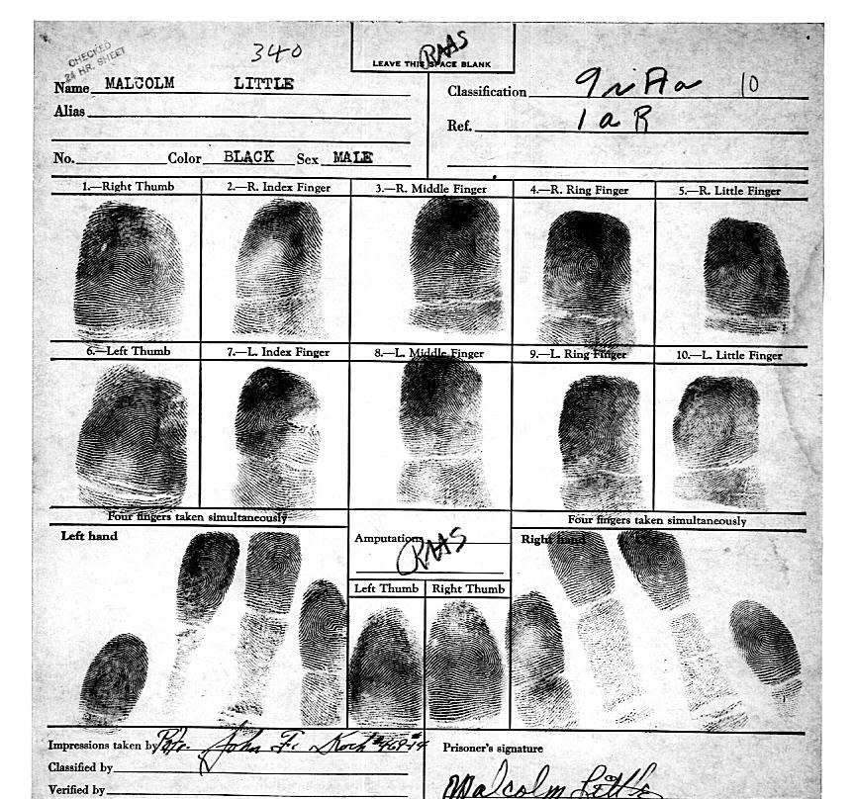
History of Fingerprinting
In 1888, Sir Edmund Richard Henry came up with the fingerprint classification system that is still in use in the United States.
In 1896, with the help of two colleagues, he created a system that divided fingerprints into groups. Along with notations about individual characteristics, all ten fingerprints were imprinted on a card (called a ten card).
Link to FBI’s fingerprinting page

Slide 16
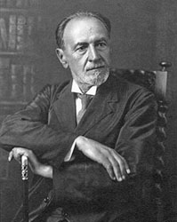
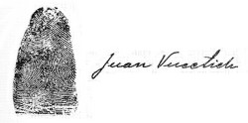
History of Fingerprinting
In 1891, Juan Vucetich an Argentine Police Official was the first to file fingerprints using Galton’s pattern types and added them to Bertillon’s system. This system spread all over the world. In 1892, he was able to positively match the prints in a criminal case where a woman killed her 2 children and blamed an intruder.

Slide 17
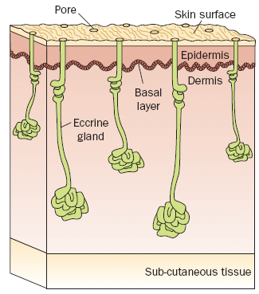
What is a Fingerprint?
Our skin has ridges on the surface to help us grip things.
Water, oil, and salt from our glands mix with dirt in the environment and stick to everything we touch.

Slide 18
Fundamental Principles of Fingerprints
A fingerprint is an individual characteristic.
A fingerprint will remain unchanged during an individual’s lifetime.
Fingerprints have general characteristic ridge patterns that permit them to be systematically classified.

Slide 19
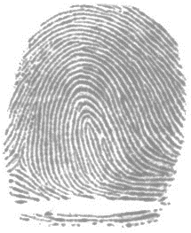
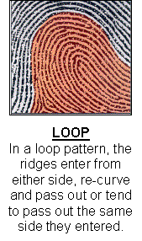
Characteristics of Fingerprints
Three main types:
Loop - most common, about 65% of all prints
If the loop opens toward the little finger, it is called an ulnar loop.
If the loop opens toward the thumb, it is called a radial loop.

Slide 20
Characteristics of Fingerprints
Whorls – About 30% of all prints patterns
Can be plain (looks like a bullseye), central pocket (looks like a peacock feather), double loop (kinda looks like an S), or accidental.

Slide 21
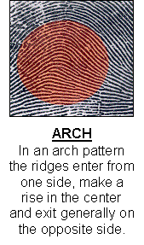
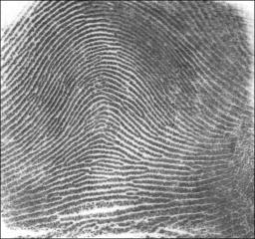
Characteristics of Fingerprints
Arches – About 5% of all fingerprints. Can be plain or tented.

Slide 22
Make your 10 Card
Need to roll all 10 fingers. Also do the simultaneous section but do not worry about inking full fingers.
Use a hand lens (magnify glass) or use your phone and determine the pattern of each print. Label your sheet with the pattern. Try not to write large as we will add to these tomorrow.
Remember if open part of a loop points toward
little finger = ulnar loop
toward thumb = radial loop

Slide 23
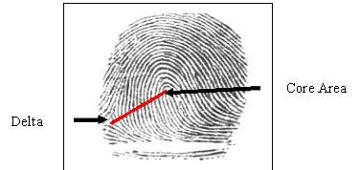
Characteristics of Fingerprints
Forensic examiners look for the presence of a core (the center of a whorl or loop) and deltas (triangular regions near a loop or whorl). Arches do not have these features.
A ridge count is another characteristic that distinguishes one fingerprint from another. The count is made from the center of the core to the edge of the delta.

Slide 24
Ridge Characteristics
Minutiae—characteristics of ridge patterns

Slide 25
Fingerprint Minutiae

Slide 26
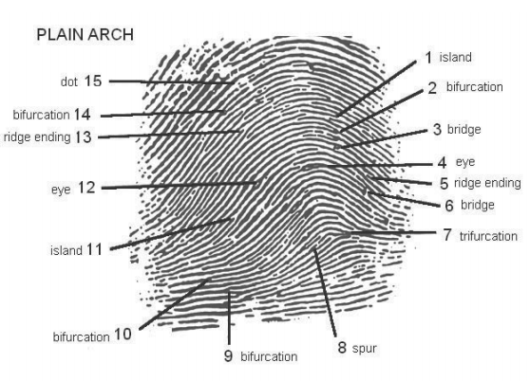
Fingerprint Minutiae

Slide 27
Comparison
There are no legal requirements in the United States on the number of points. Generally, criminal courts will accept 8 to 12 points of similarity.

Slide 28
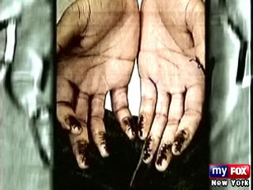
Can Fingerprints Be Changed?
Many criminals have tried, using chemicals or fire.
Most end up with even more recognizable prints because of differences in the scarring patterns.

Slide 29
Minutiae
ID 10 minutiae (ridge characteristics) for 5 prints.
You may repeat minutiae
When you are done you should have the following to show me:
all 10 prints labeled with their pattern and 5 prints labeled with 10 minutiae

Slide 30
AFIS: Automated Fingerprint Identification System
A computer system for storing and retrieving fingerprints
Began in the early 1970’s to:
Search large files for a set of prints taken from an individual
Compare a single print, usually a latent print developed from a crime scene

Slide 31
AFIS and IAFIS
By the 1990’s most large jurisdictions had their own system in place. The problem - a person’s fingerprints may be in one AFIS but not in others.
It could take 3 months to run a search.
IAFIS—the FBI’s Integrated Automated Fingerprint Identification system which is a national database of all 10-print cards from all over the country became operational in 1999.

Slide 32
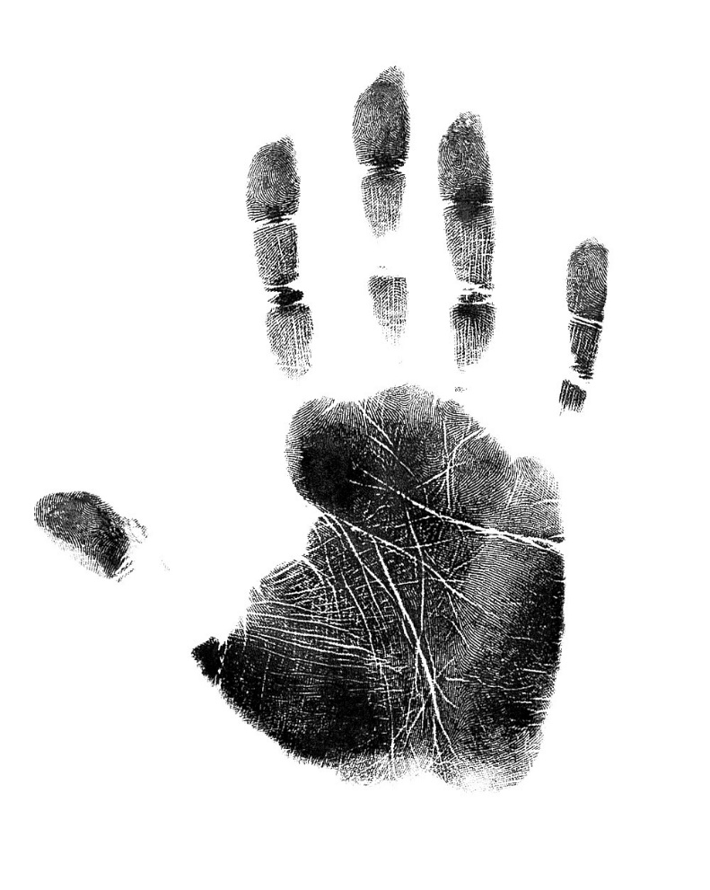
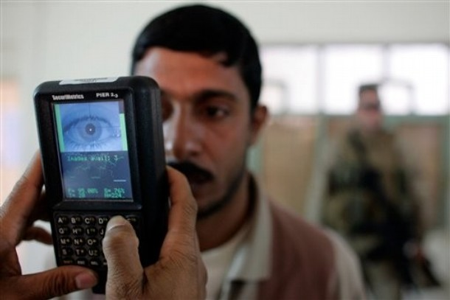
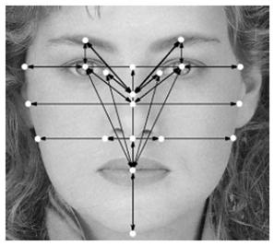
NGI: Next Generation Identification
Began in 2011--FBI’s newest identification system, replaced IAFIS
Uses wide array of biometric identification methods –scars, tattoos, facial, voice, and iris recognition
http://www.fbi.gov/about-us/cjis/fingerprints_biometrics/ngi

Slide 33
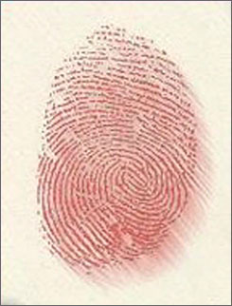
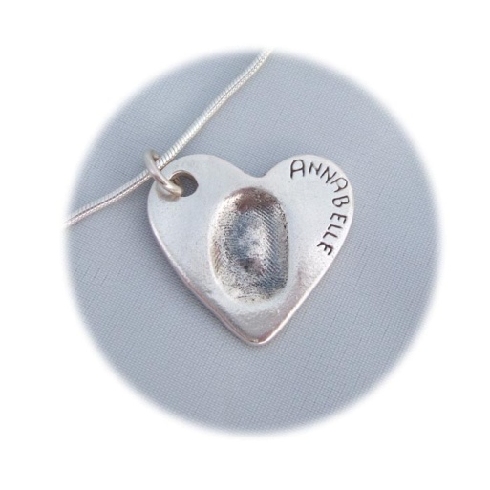
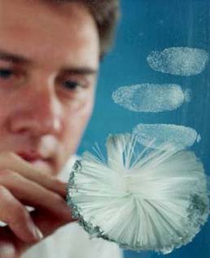
Evidence Types
Three types of prints can be found:
Patent fingerprints –visible prints left when fingers have a liquid (such as blood) on them.
Plastic fingerprints – actual indentations made in soft material like clay.
Latent fingerprints – hidden prints that can be made visible with special techniques
All are individual evidence.

Slide 34
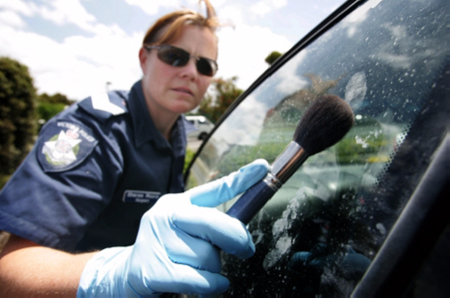
Methods to Collect Fingerprints
Latent prints can be made visible with carbon or talc, and then collected on tape.

Slide 35
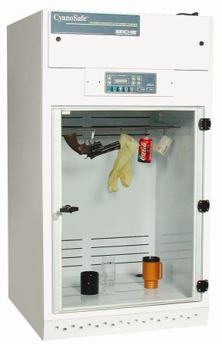
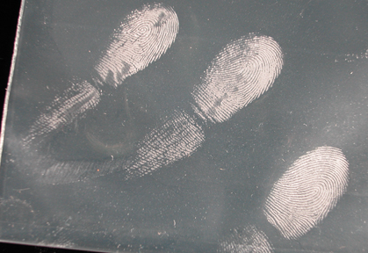
Methods to Collect Fingerprints
Cyanoacrylate (super glue) can be heated in a vapor tent. It sticks to amino acids to get fingerprints on glass, plastic, metal, and skin.

Slide 36
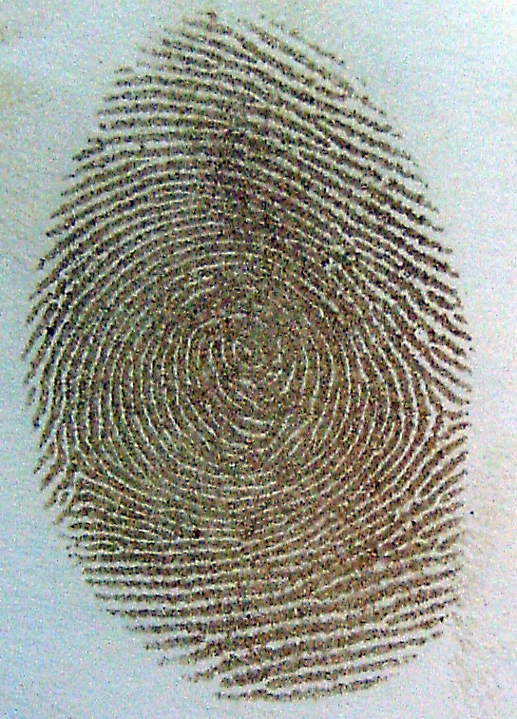
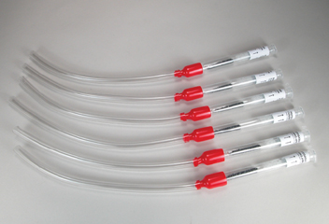
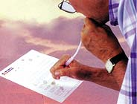
Methods to Collect Fingerprints
Iodine can be heated in a vapor tent or a fuming gun to get prints off of paper, cardboard, and unpainted surfaces. It fades and must be photographed.

Slide 37
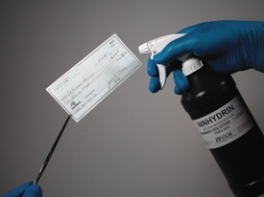
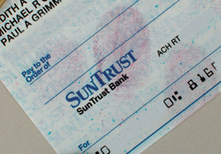
Methods to Collect Fingerprints
Ninhydrin can be sprayed on paper. It reacts with amino acids in sweat to leave a purple print.

Slide 38
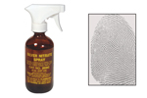
Methods to Collect Fingerprints
Wood or Styrofoam objects can be dipped or sprayed with silver nitrate. It reacts with chloride in the salty sweat to show a print.

Slide 39
