Slide 1
Forensic Odontology

Slide 2
Introduction
Odontology—the study of the anatomy and growth of teeth and diseases associated with the teeth and gums.
Forensic Odontologist uses knowledge of the teeth to:
Identify victims of mass disasters
Help police in criminal investigations
Verify signs of abuse

Slide 3
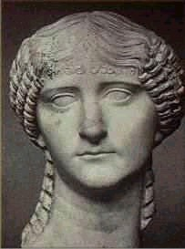
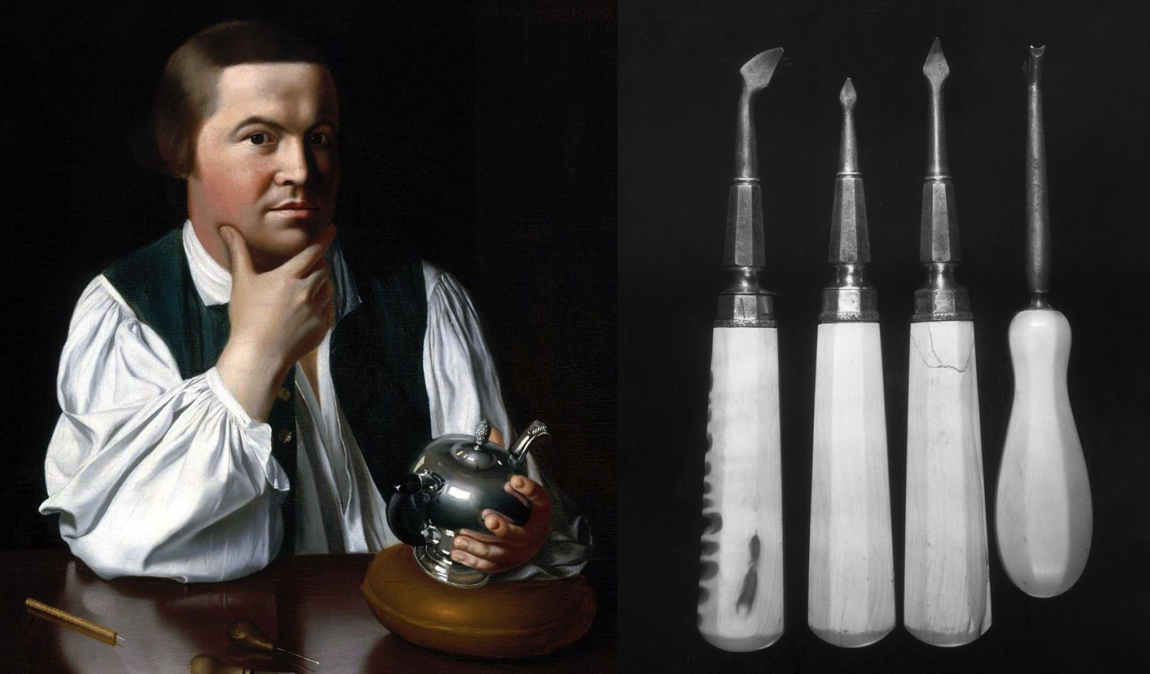
History of Forensic Odontology
66AD – First body identified using teeth
Lollia Paulina
Revolutionary War
Paul Revere was the 1st forensic dentist in the United States
1849 - Dental evidence is first admitted into court system in US
1954 – First recorded criminal conviction based on bitemark. Doyle v. The State of Texas – bitemark in cheese

Slide 4
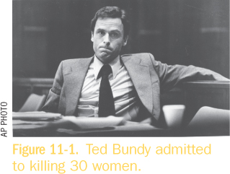
Ted Bundy 1974 - 1978
College women begin missing at the rate of about one per month.
No clues until TB failed to stop for police
Items in his car and apartment lead to his arrest for murdering two women.
TB escapes to Florida and murders two more women, leaving bite marks on one victim.
TB arrested again and brought to trial.
He confessed to killing 30 women before he was executed.
4

Slide 5
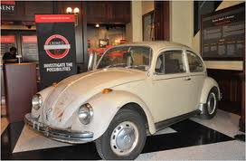
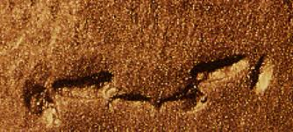
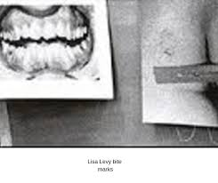
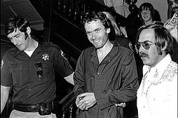
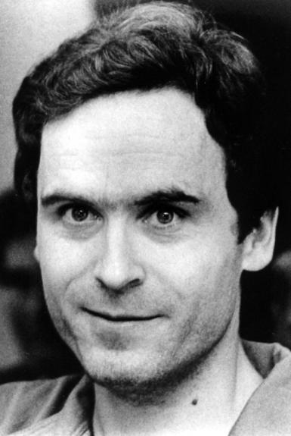
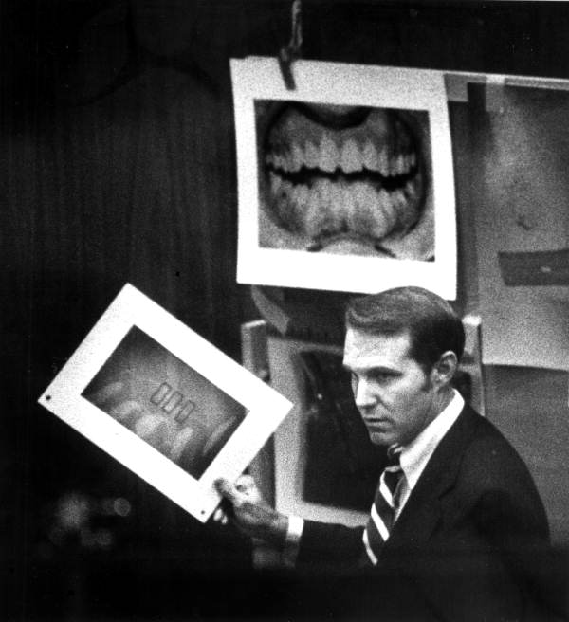
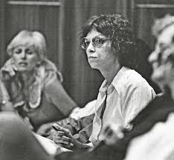
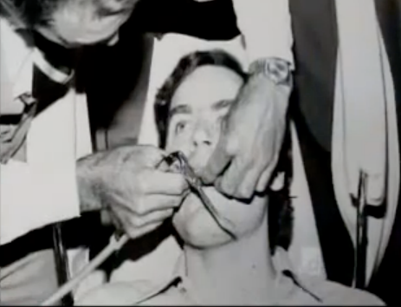
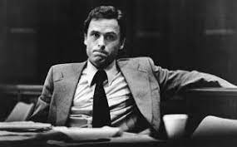
State of Florida v. Ted Bundy

Slide 6
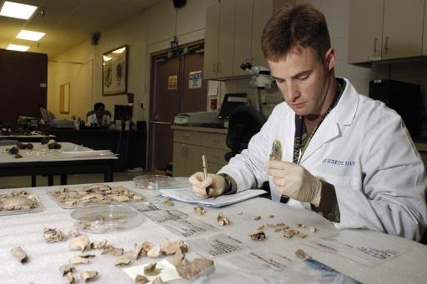
Who practices Forensic Odontology and what do they do?
Forensic Odontologists
Must have DDS degree
Should have specialized training in the field through lectures (not required)
Forensic Odontologists help:
Identify human remains
Analyze bite marks
Bite marks are compared to known teeth molds to find origin of bite injuries
Estimate age of the victim and/or perpetrator
Trace dental malpractice
Top: Forensic Odontologist analyzing animal teeth for comparison.
Side: Seal for American Board of Forensic Odontology.
From ppt by Jessica Wong

Slide 7
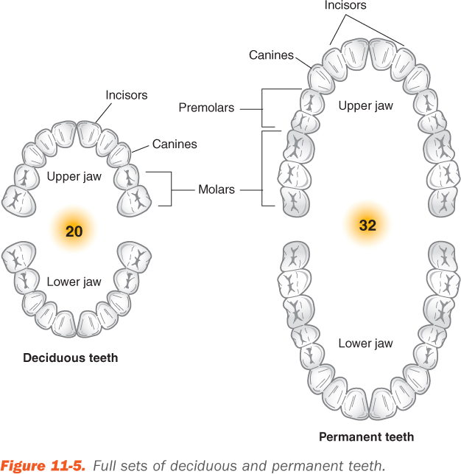
Structure & Function of Teeth
20 deciduous (baby) teeth
32 permanent (adult) teeth
Age can be estimated based on which teeth are present. You can also look at the wear patterns on teeth to help determine age.

Slide 8
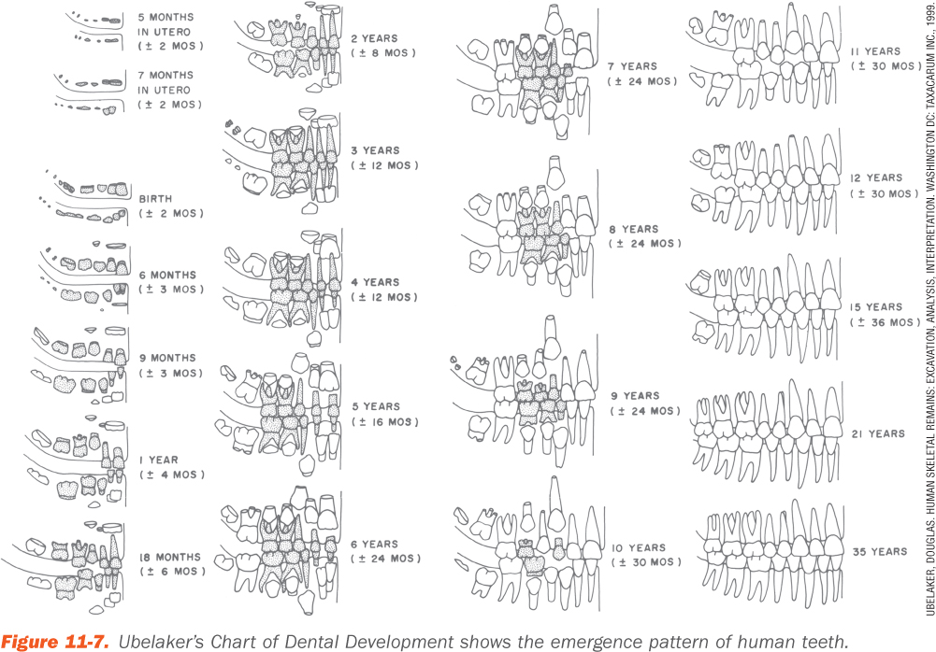
Age Estimation

Slide 9
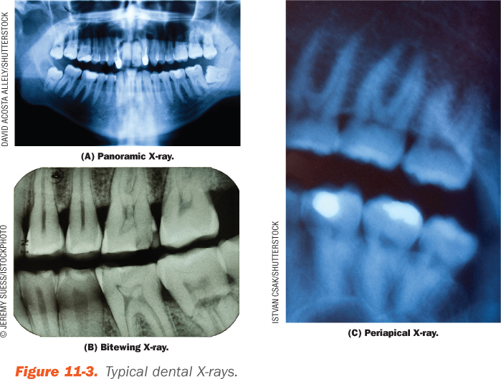
Structure & Function of Teeth

Slide 10
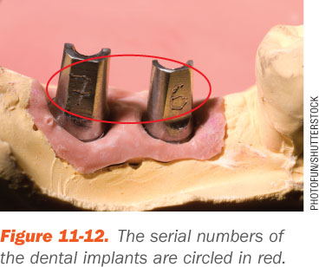
Dental Records
Forensic Odontologist compares
The antemortem records (take during life)
The postmortem records (recorded after death)
Especially helpful
Fillings
Bridgework
Dental implants

Slide 11
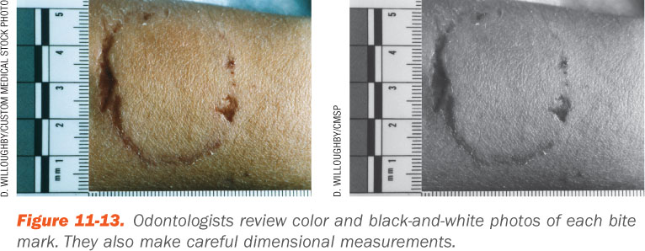
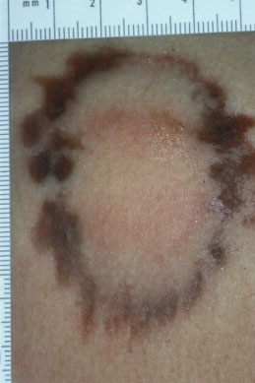
Human Bite Marks
Bite marks look different in soft and stretchy substances like skin versus hard substances like a pencil
When the bite occurs antemortem
The area bruises and swells
Typical bite has a double horseshoe pattern
Animal bites tend to look different

Slide 12
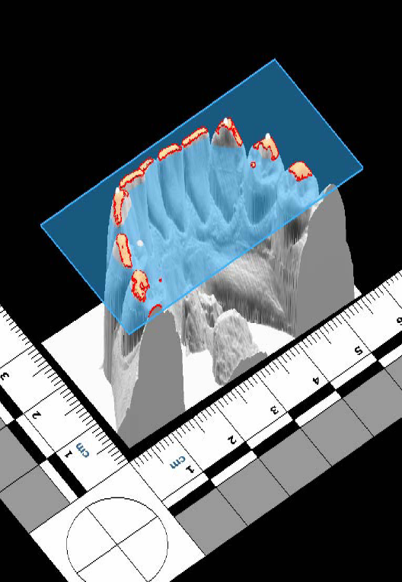
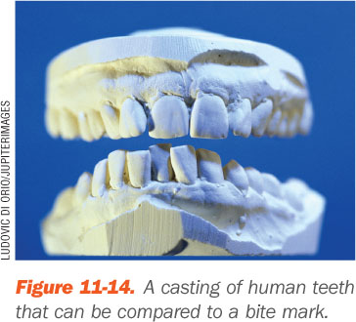
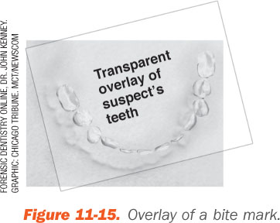
Human Bite Marks
Swelling and inflammation can deform bite marks
Trace bite marks
Cast deep bites
Compare with impressions from a suspect

Slide 13
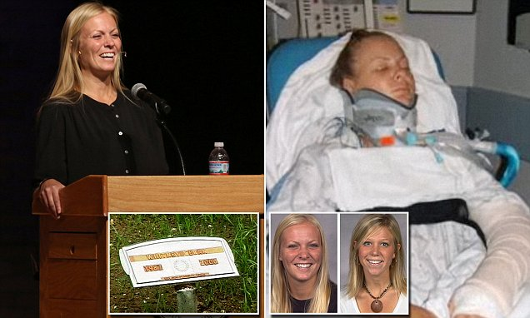
Determining Positive Identification
Presumptive identification
Personal effects
Family ID
Location of the body
Positive identification
Fingerprints
DNA
Medical and dental records

