Slide 1
The Study of Hair
SFS2. Obtain, evaluate, and communicate information on various scientific techniques to analyze physical, trace, and digital evidence.
a. Plan and carryout an investigation to determine the value of physical and trace evidence.
b. Plan and carryout an investigation to analyze the morphology and types of hair, fibers, soil and glass evidence in order to make a physical match examination.
.

Slide 2
Introduction
Human hair is one of the most frequently found pieces of evidence at the scene of a violent crime.
From hair one can determine:
If the source is human or animal
Race (sometimes)
Origin of the location on the source’s body
Whether the hair was forcibly removed
If the hair has been treated with chemicals
If drugs have been ingested

Slide 3
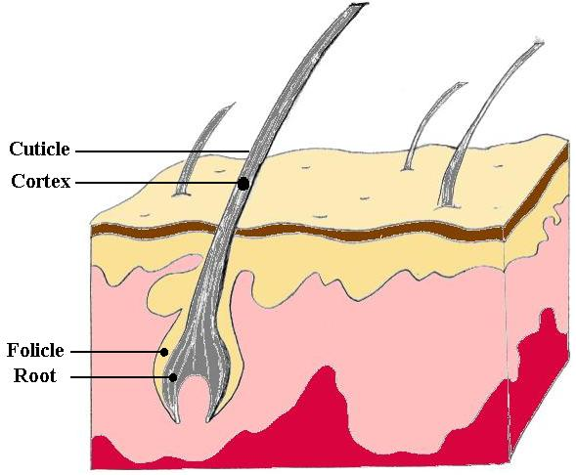
The Structure of Hair
The actively growing base of the hair is called the follicle, and contains DNA and living cells.

Slide 4
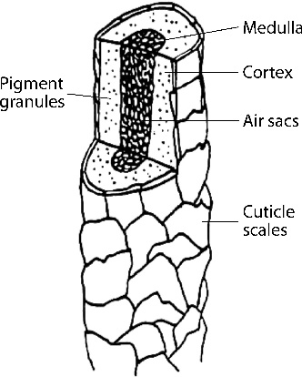
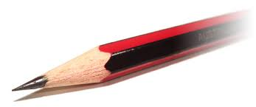
The Structure of Hair
Hair is often compared to a pencil.

Slide 5
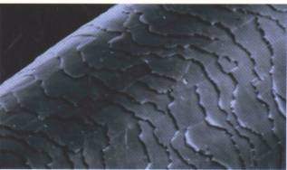
The Structure of Hair
The cuticle is made of scales that overlap and protect the inner layers of the hair. The edges of the scales always point away from the root.

Slide 6
The Structure of Hair
The cortex is the largest part of the hair. It is filled with pigment called melanin that gives hair its color.
It also determines shape.

Slide 7
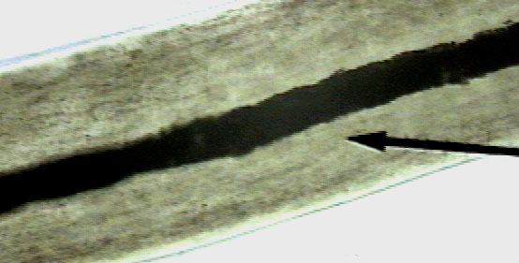
The Structure of Hair
The medulla is the center of the hair. It can be a hollow tube, or filled with cells.
The medulla may be continuous, interrupted, fragmented, or absent.

Slide 8
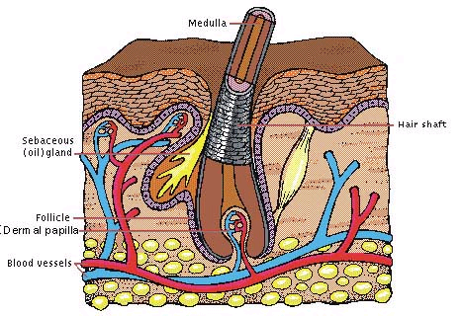
What Can We Find Out From Hair?
Hair with follicle cells is individual evidence.
It can be used to make a DNA match.
Hair is class evidence without follicle cells.
It can be used to identify a class a people with certain hair characteristics.

Slide 9
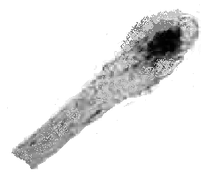
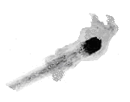
The Root
Human roots look different based on whether they have been forcibly removed or if they have fallen out. If they have been forcibly removed, they will have some tissue attached to the end. This is called a follicular tag. This is where DNA can be found.
Fallen out
Forcibly removed

Slide 10
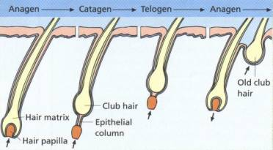
The Life Cycle of Hair
Anagen – Hair grows.
80 – 90% of hair in this phase
Length of this phase varies from person to person, and on different parts of the body

Slide 11
The Life Cycle of Hair
Catagen – Growth slows, and then stops
Phase lasts only a couple of weeks
Follicle shrinks and root breaks away.
Telogen – Hair rests, no active growth
Lasts five to six weeks
Root begins to grow a new hair (in anagen), pushing the old hair out.

Slide 12
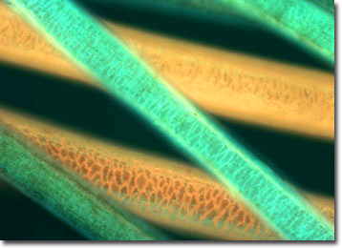
What Can We Find Out From Hair?
Phase contrast microscopy and fluorescent microscopy can make it easier to determine the presence of a dye or other treatment.

Slide 13
Treated Hair
Hair that has been bleached or dyed can make hair brittle and disturb the cuticle.
Dying changes the color of both the cuticle and the cortex.
Time since last treatment can be used to help identify hairs from the same person.

Slide 14
Hair Lab Day 1 You will be looking at your hair and other people’s hair under the microscope. If you are willing, pull out a hair.
You will look at your hair and at least 4 other people’s hair. Try to look at different colors of hair and different races.
Make a wet mount of the hair: get a blank slide and cover slip
Put a drop of water on the slide then put hair in the water
Put on coverslip and look under microscope on RED objective first, then YELLOW. Please do not use the BLUE as it can crack slides.
For each hair sample (total of 4):
draw the sample as seen under YELLOW
label the parts as best you can
label defining features (split ends, stuff on hair, how the root looks)

Slide 15
Day 2: Hair Impressions – Which part of the hair??
Get a blank slide (NO COVERSLIPS!)
Using clear nail polish, paint a few strokes on the slide.
Put a hair or two in the polish
Let dry – make sure it dries COMPLETELY
Peel out the hair and throw it away
Look at the impression under the microscope.
Look at other people’s impressions.

Slide 16
Animal Hair vs. Human Hair
 | Animal | Human
cuticle | Crowns (cornal) or petals (spinous) or inbricate | flattened and narrow (imbricate)
pigment | denser towards medulla | denser towards cuticle
color | Can be multiple colors on one strand of hair | Tends to be one color on a strand
medullary index The ratio of the diameter of the medulla to the diameter of the entire hair | ½ or more | 1/3 or less

Slide 17
What Can We Find Out From Hair?
Neutron activation analysis (NAA) can identify fourteen specific elements in hair, greatly increasing the accuracy of matches.
Hair can be used to detect exposure to poisons or narcotics.
The average hair grows 1.3 cm each month, allowing forensic chemists to determine when exposure occurred.

Slide 18
DNA from Hair
The root contains nuclear DNA. If the hair has been forcibly removed, some follicular tissue may be attached containing DNA. Individual evidence
The hair shaft contains abundant mitochondrial DNA, inherited only from the mother. This process is more difficult and costly than using nuclear DNA. Class evidence

Slide 19
Other Hair Info
Number of hairs on typical heads
Redheads = ~80,000
Dark hair = ~100,000
Blondes = ~120,000

Slide 20
For the hair lab, you need to record the following samples….
Already made slides:
Animal
MUST DO cat, deer, mouse or rat, and bat
CHOOSE 2 MORE from the following: sheep, horse, dog, goat, cow, opossum, pig, rabbit, muskrat, wooly mammoth
Look at the prepared Human slides
Slides you need to make:
Human (The 4 done yesterday)
DO 2 Animal: dog, cat, rat or any you brought
For each hair sample:
draw the sample
label the parts as best you can
label defining features

