Slide 1
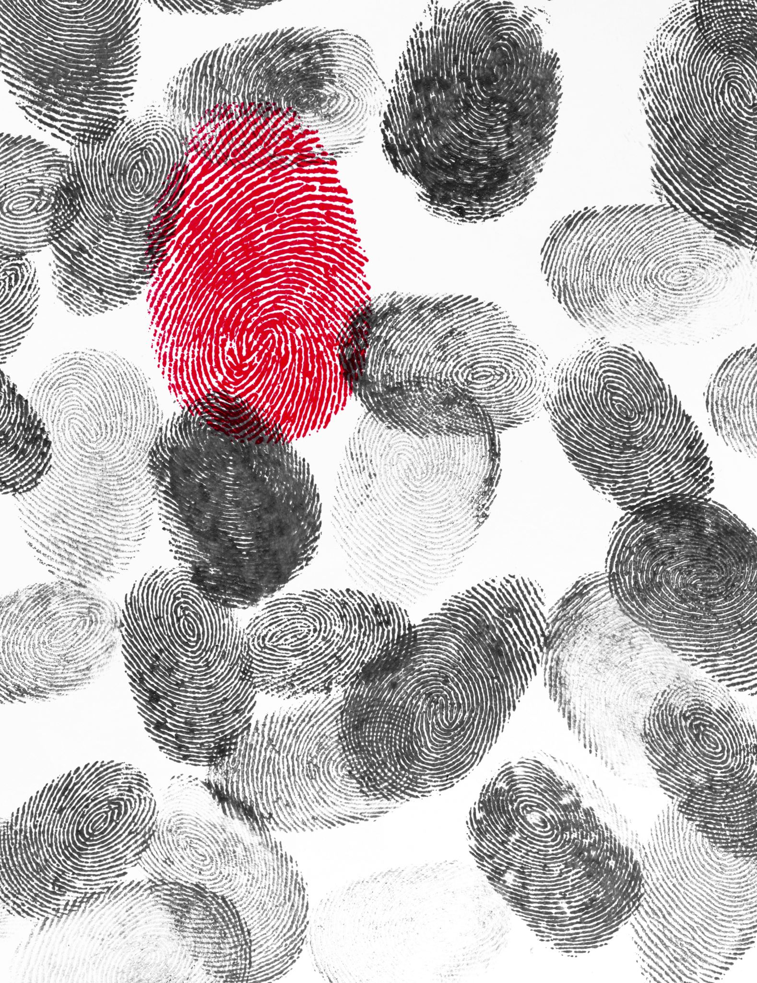
Review of Fingerprints
Assume all prints are from the left hand

Slide 2
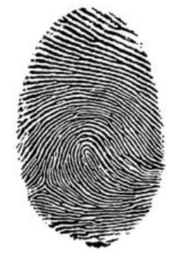
Radial Loop
Made with left hand

Slide 3
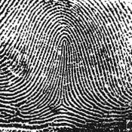
Tented Arch

Slide 4
Bifurcation
Which minutiae is this?

Slide 5
Galton
He came up with the fingerprint patterns we still use today.

Slide 6
Central Pocket Whorl

Slide 7
Delta
Which minutiae is this?

Slide 8
Mayer
He said that no 2 prints were alike.

Slide 9
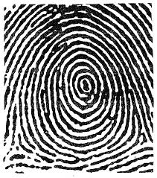
Plain Whorl

Slide 10
Bridge
Which minutiae is this?

Slide 11
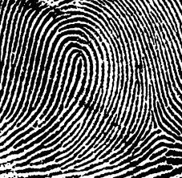
Ulnar Loop
Made with left hand

Slide 12
Ridge ending
Which minutiae is this?

Slide 13
Grew
He was the first to publish a paper about fingerprints.

Slide 14
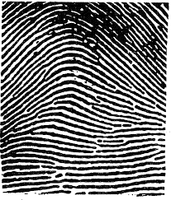
Plain Arch

Slide 15
Short Ridge or Island
Which minutiae is this?

Slide 16
NGI
The current FBI system that stores all kinds of information such as fingerprints, palm prints, voice prints, and iris scans.

Slide 17
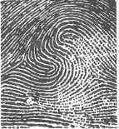
Double Loop Whorl

Slide 18
Vucetich
He was a police analyst who worked in Argentina and incorporated fingerprints into the Bertillon measurement system. He was the first to solve a crime using prints.

Slide 19
Radial Loop
Made with left hand

Slide 20
AFIS
The local computer system that stores fingerprints for investigators to search for matches from crime scenes

Slide 21
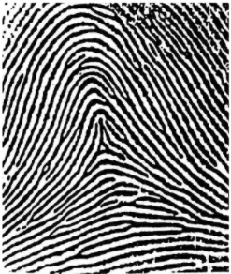
Tented Arch

Slide 22
Enclosure or eye
Which minutiae is this?

Slide 23
Plastic Prints
Prints made as indentations in something like clay.

Slide 24
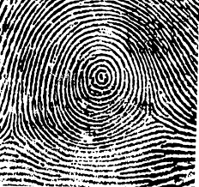
Plain Whorl

Slide 25
Locard
He came up with the Exchange Principle.

Slide 26
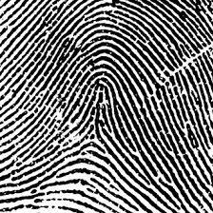
Tented Arch

Slide 27
IAFIS
The FBI computer system that was created to integrate all the fingerprint databases.

Slide 28
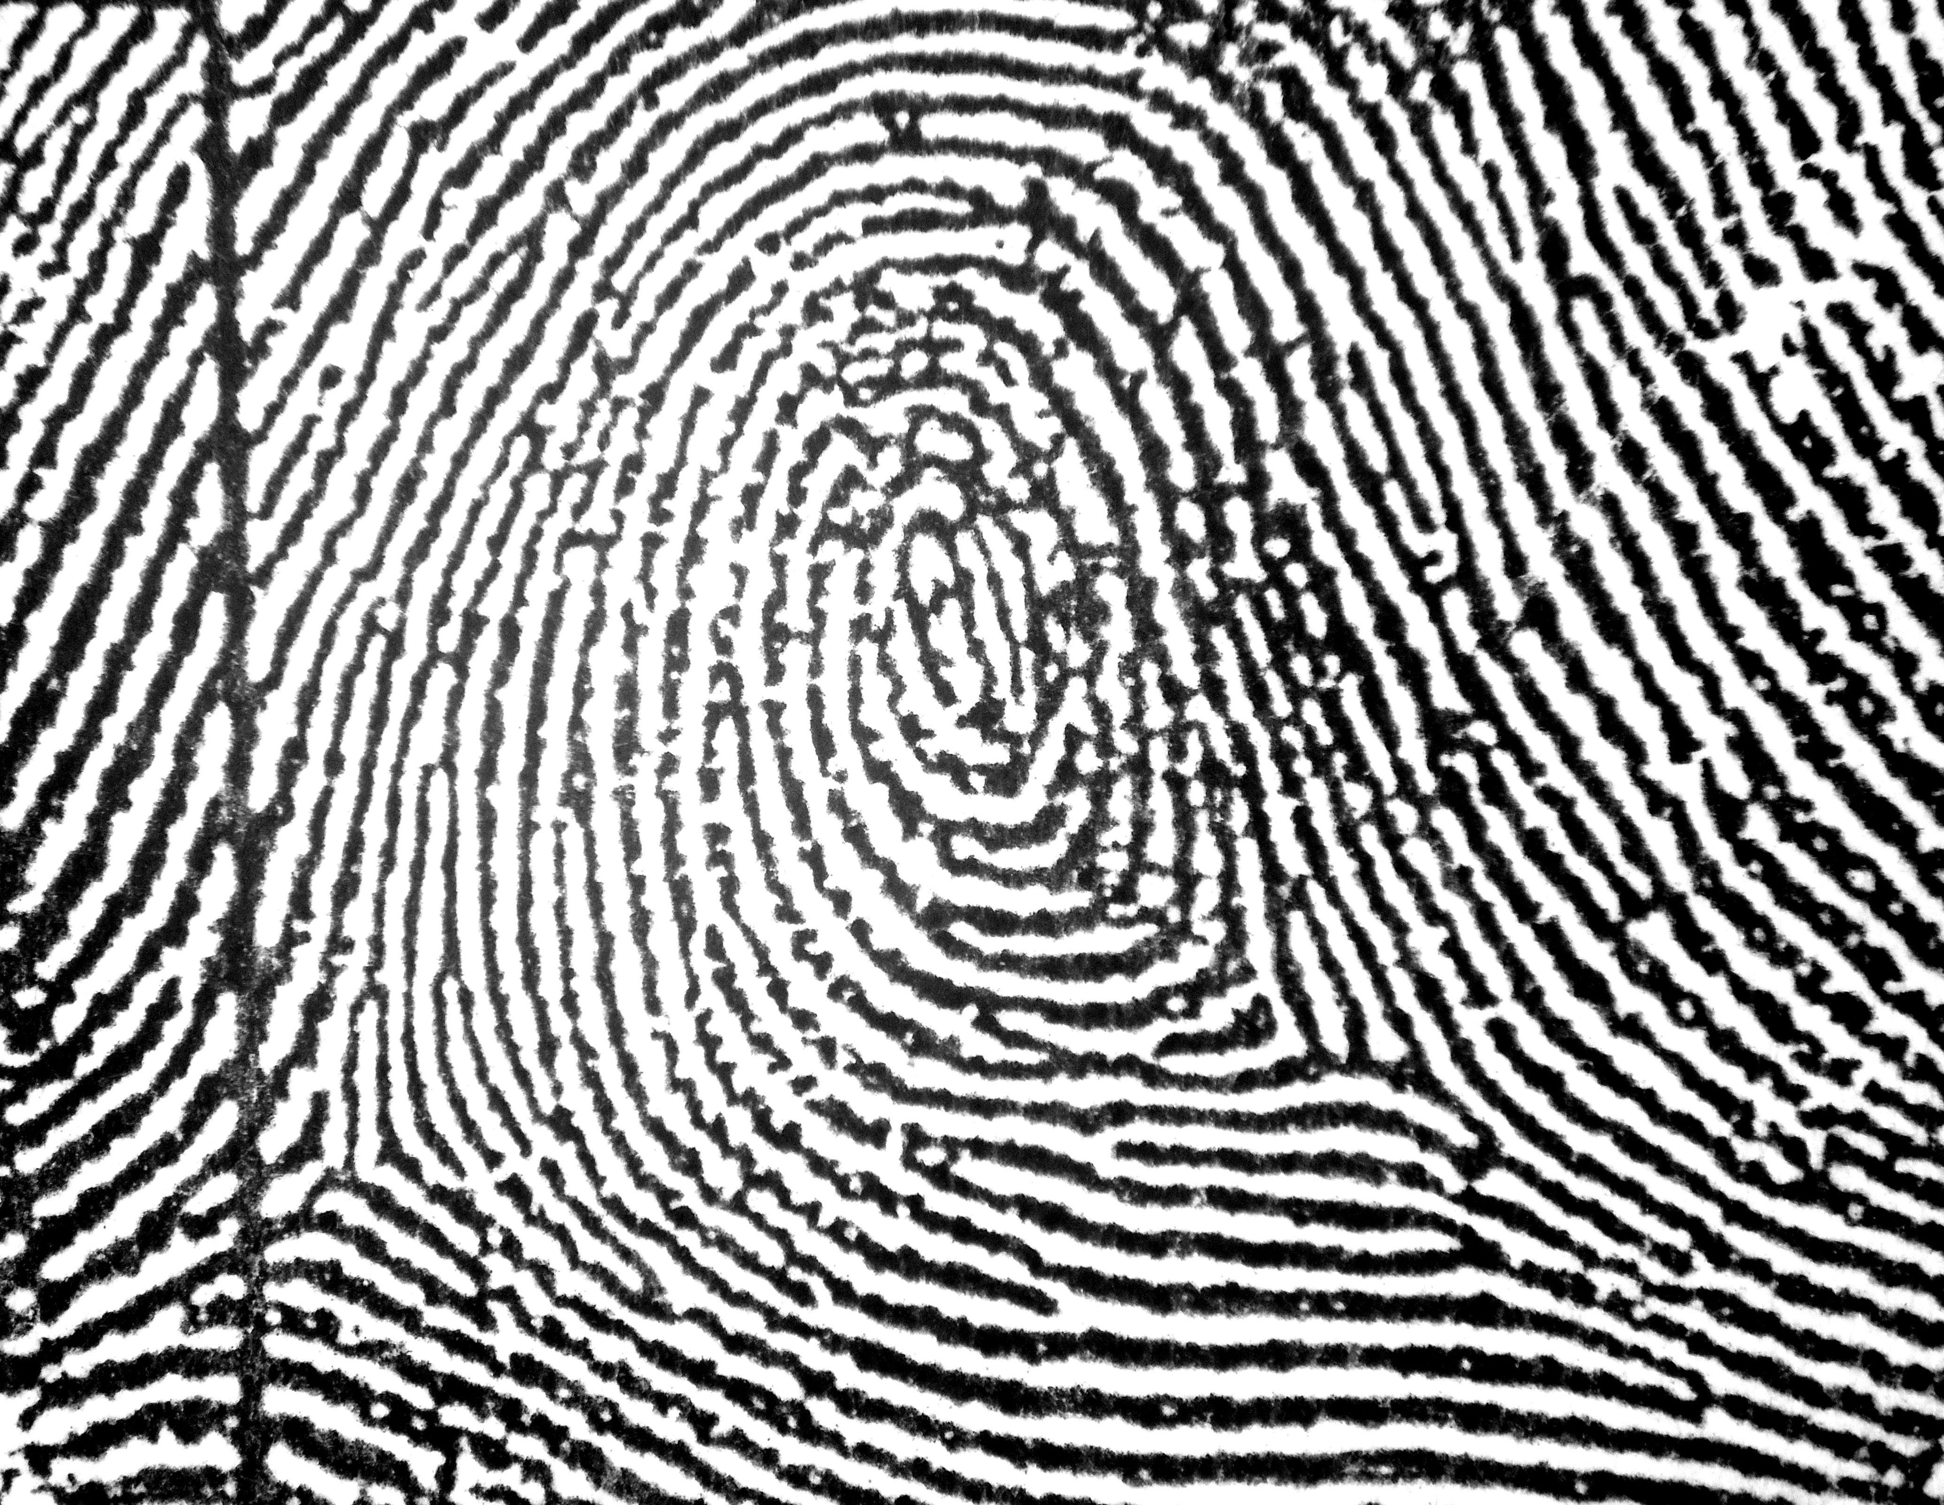
Central Pocket Whorl

Slide 29
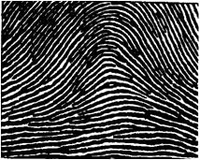
Plain Arch

Slide 30
Herschel
He said that fingerprint patterns do not change as we age.

Slide 31
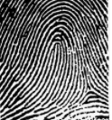
Radial Loop
Made with left hand

Slide 32
Basal layer
The layer in your skin that forms fingerprints.

Slide 33
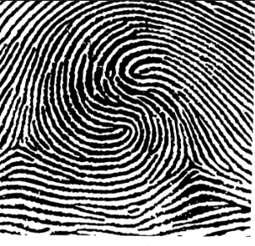
Double Loop Whorl

Slide 34
Bertillon
He came up with the anthropological measurement system that measured people who were being processed for jail.

Slide 35
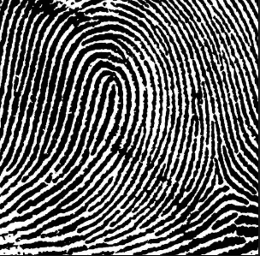
Ulnar Loop
Made with left hand

Slide 36
core
Which minutiae is this?

Slide 37
Patent Prints
Prints you can clearly see like your 10 card.

Slide 38
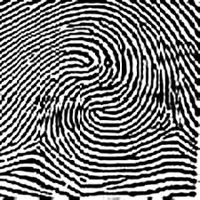
Double Loop Whorl

Slide 39
latent Prints
Prints that are not clearly visible. You have to do something like dust them or use chemicals such as super glue.

Slide 40
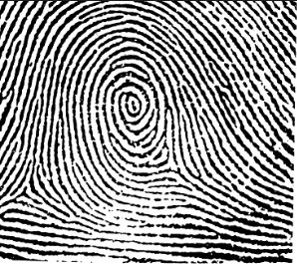
Central Pocket Whorl

Slide 41
Henry
He came up with the classification system and the 10 card we still use today.

Slide 42
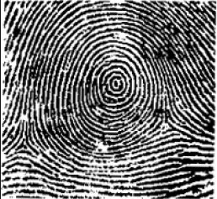
Plain Whorl

