Slide 1
Can you determine Gender and Height?
Use the worksheet and your notes from the forensic anthropology ppt to determine the gender and height of the following skeletons

Slide 2
Fill out your answers on the worksheet. You need to do this for all 4 skeletons. Feel free to write them all on the same sheet. At the end you should have the height and gender for all 4.

Slide 3
How to determine gender with a pelvis

Slide 4
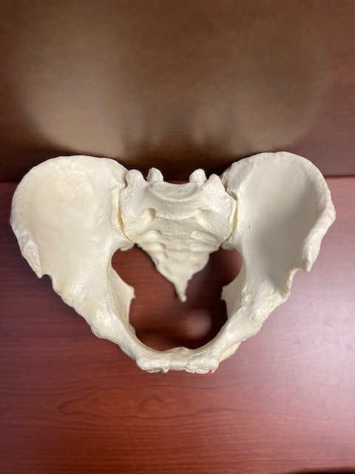
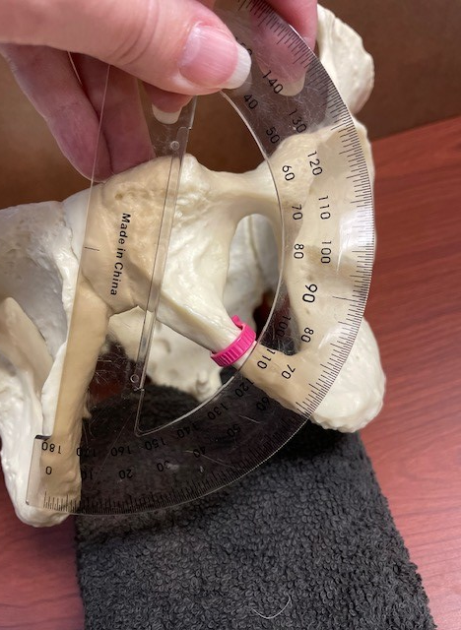
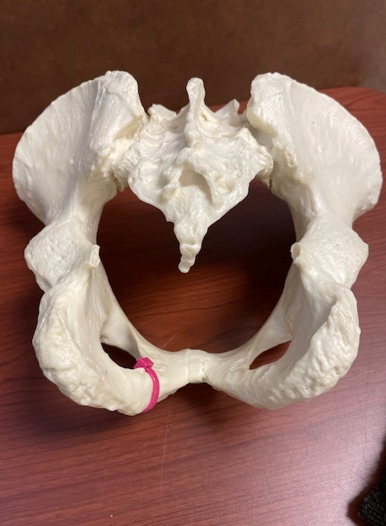
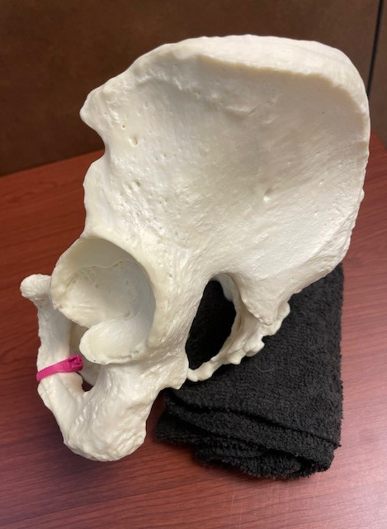
Pelvis #1

Slide 5
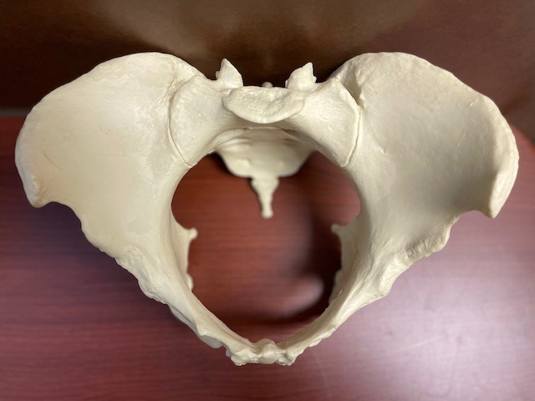
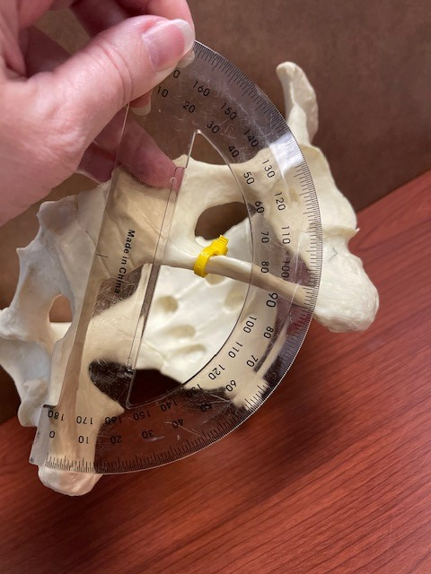
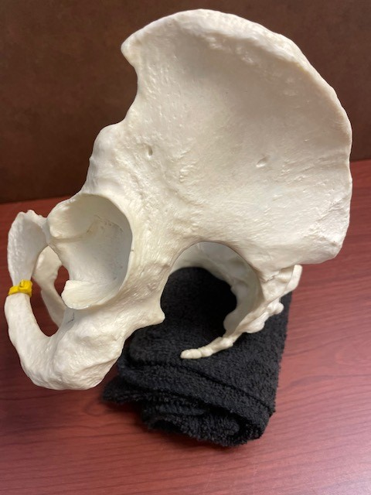
Pelvis #2

Slide 6
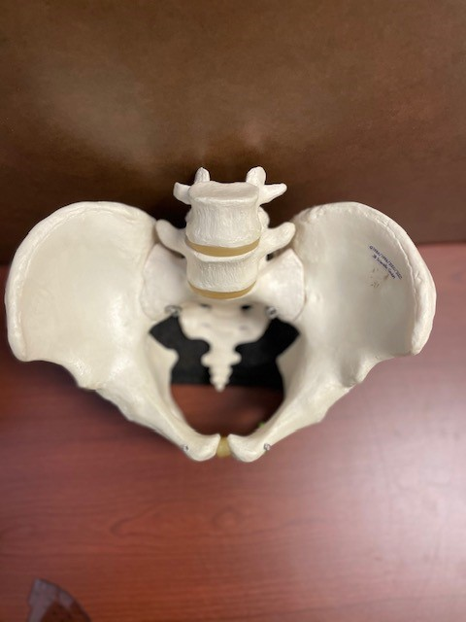
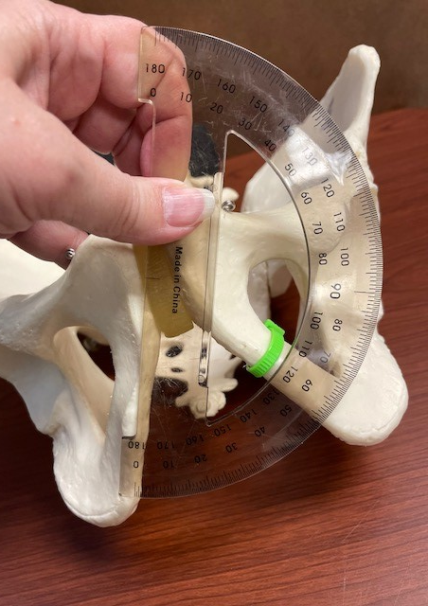
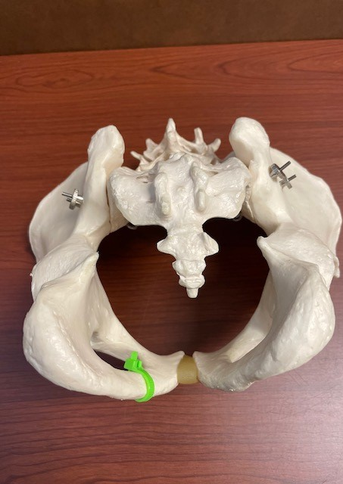
Pelvis #3

Slide 7
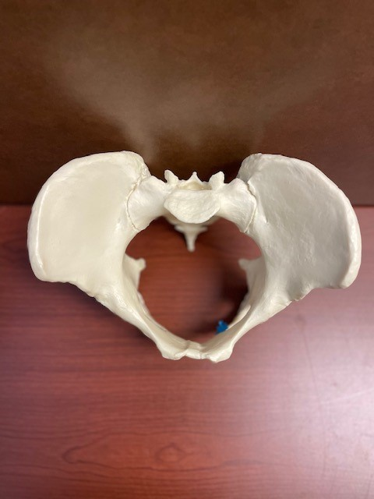
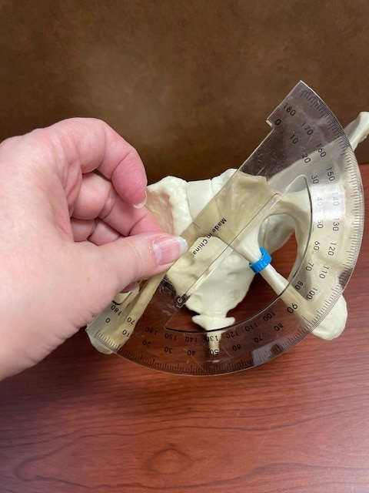
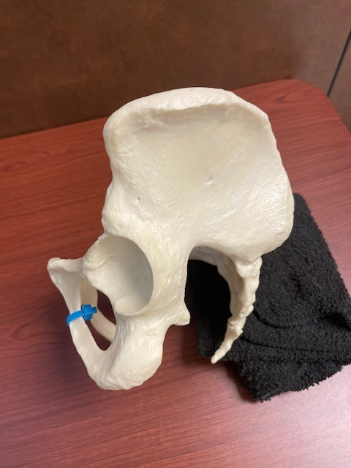
Pelvis #4

Slide 8
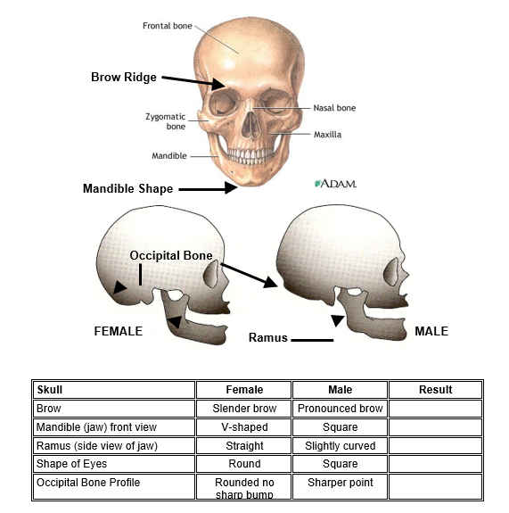
How can you determine gender with a skull?

Slide 9
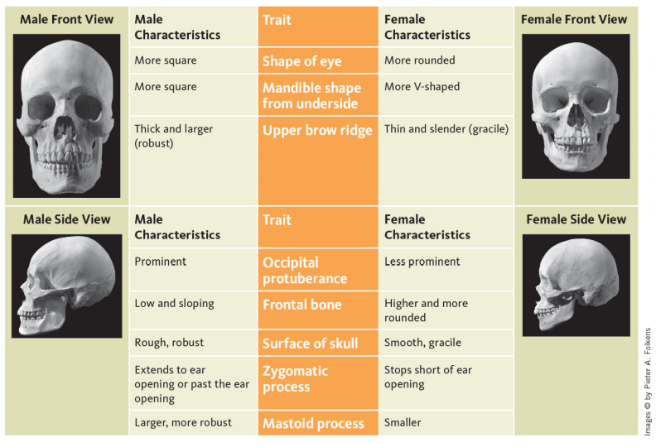

Slide 10
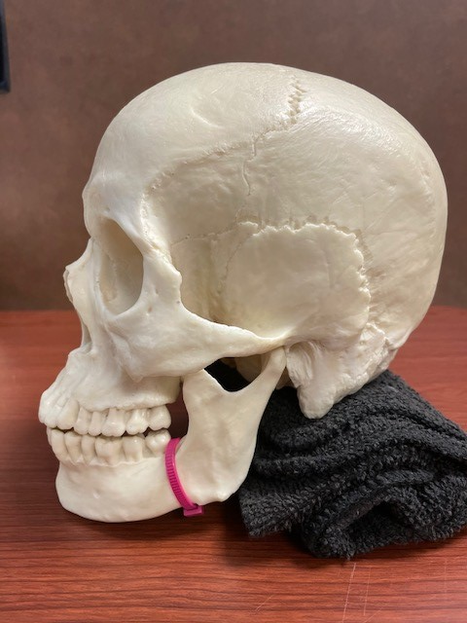
Skull #1

Slide 11
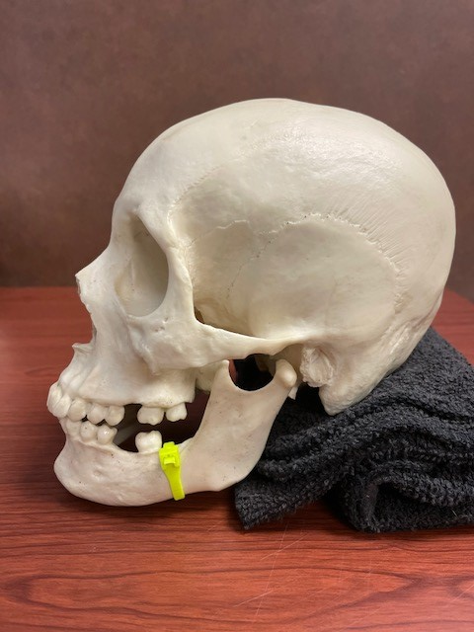
Skull #2

Slide 12
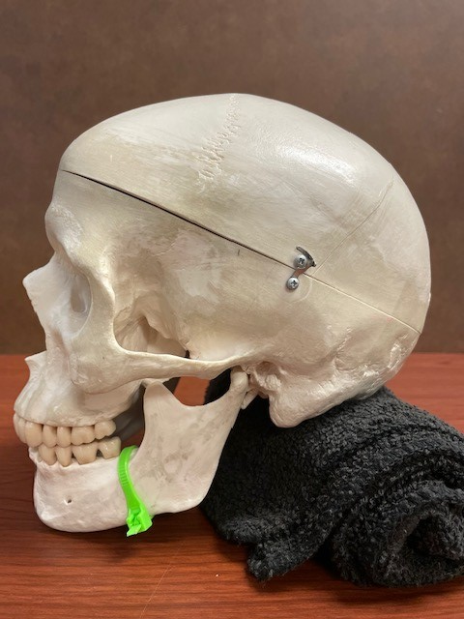
Skull #3

Slide 13
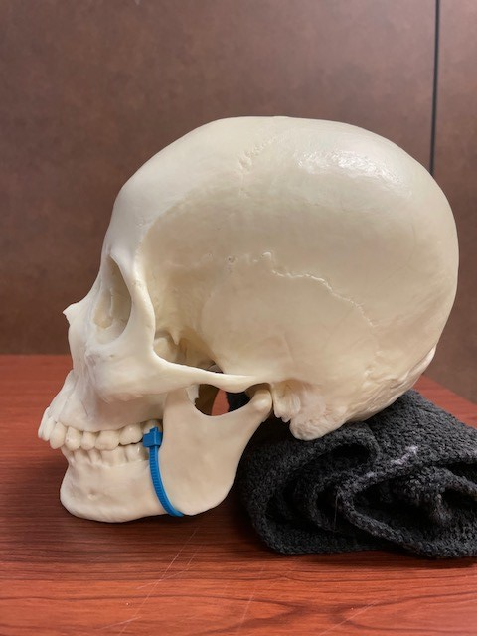
Skull #4

Slide 14
How to calculate height from a femur
Measure the bone in cm then plug into the appropriate formula. Do this AFTER you determine gender.
Look at the pictures to read the ruler.
$$=$$
$$=$$

Slide 15
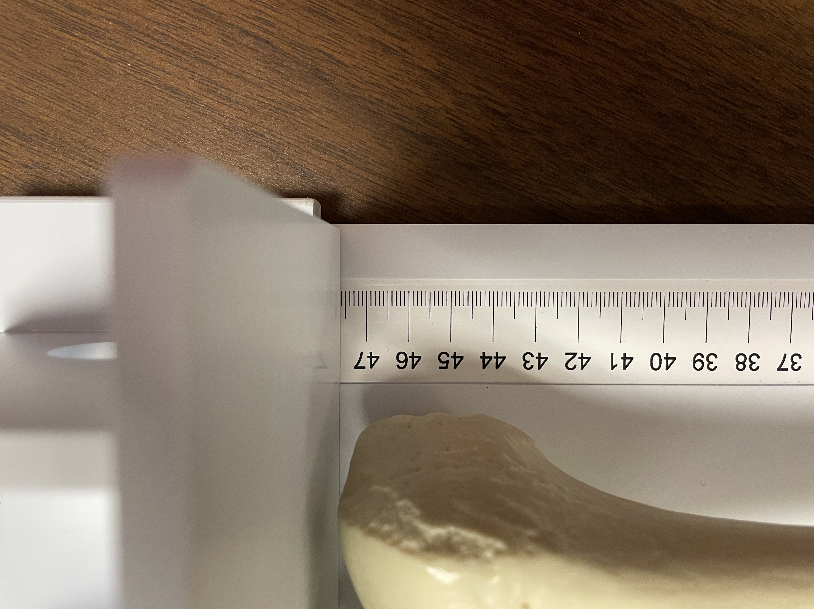
Femur #1

Slide 16
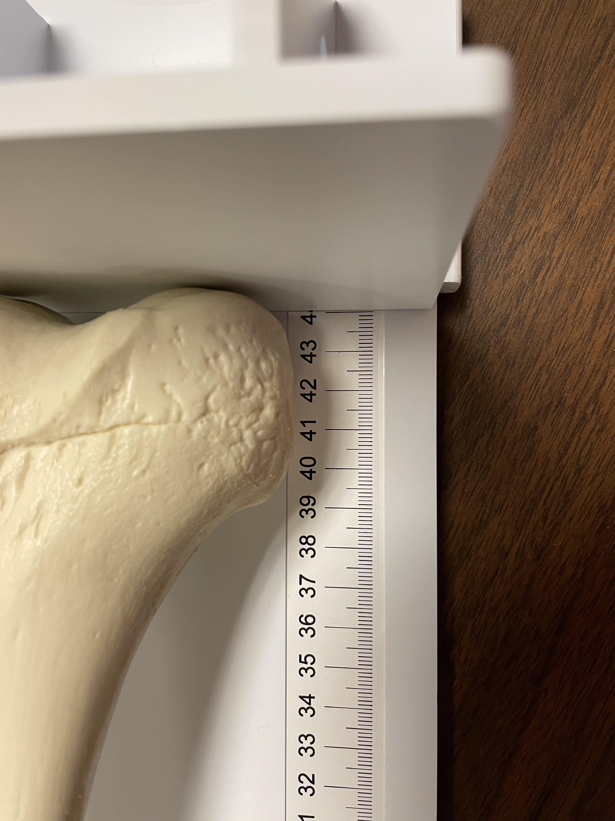
Femur #2

Slide 17
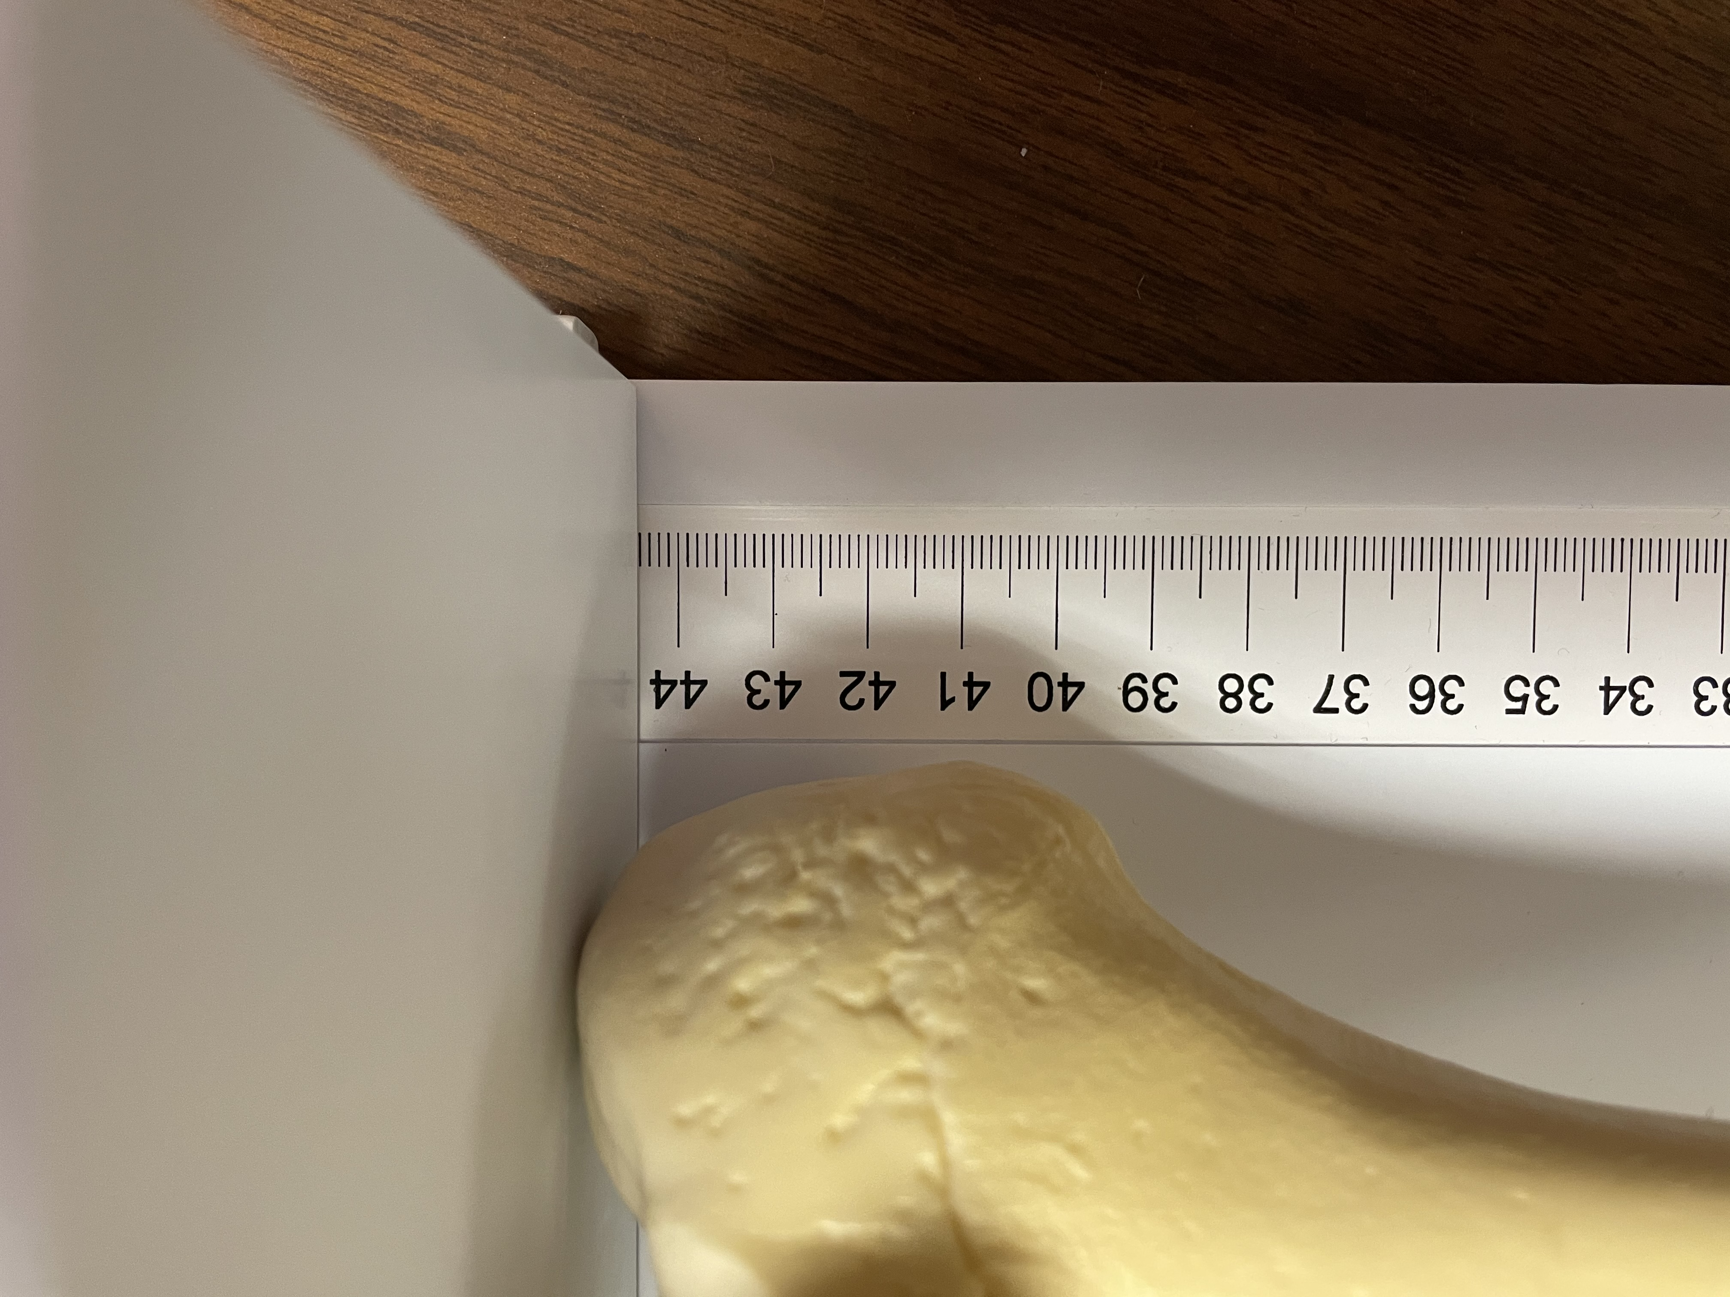
Femur #3

Slide 18
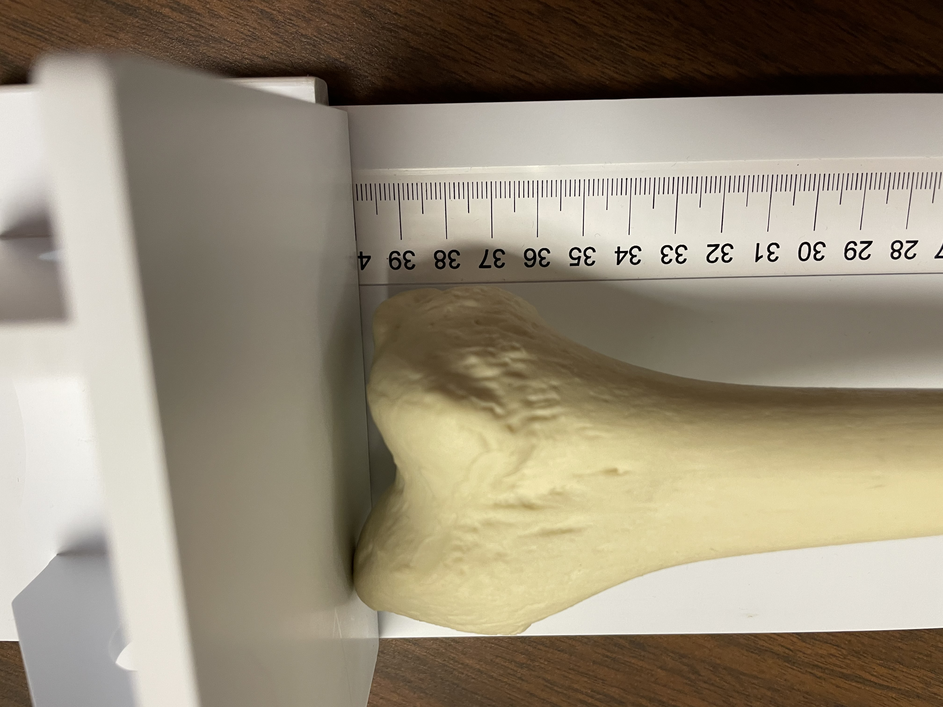
Femur #4

