Slide 1
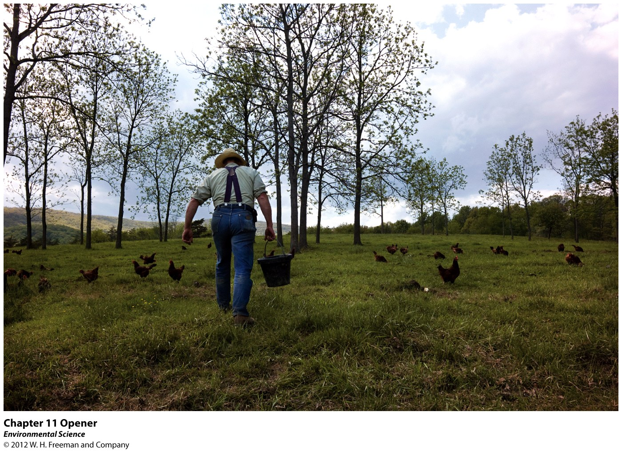
Feeding the World

Slide 2
Nutritional Requirements
Undernutrition- not consuming enough calories to be healthy.
Malnourished- a persons diet lacks the correct balance of proteins, carbohydrates, vitamins, and minerals even though they get enough calories.
Overnutrition- too many calories and improper foods that causes a person to become overweight.

Slide 3
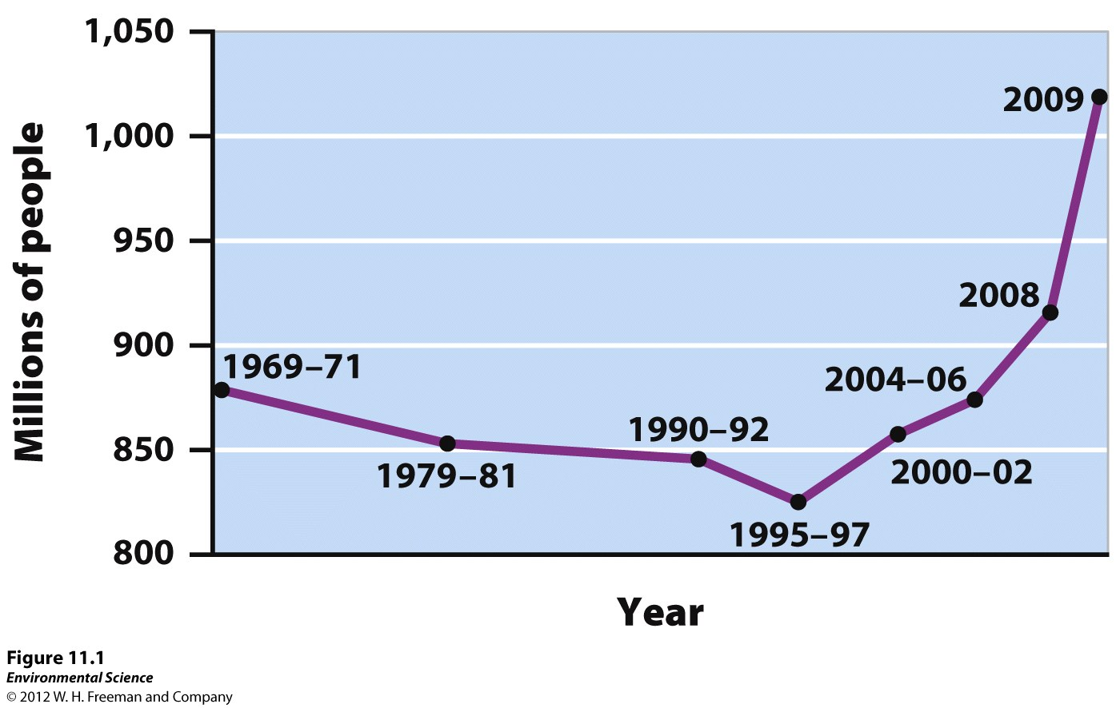
Global Undernutrition

Slide 4
Reasons for Undernutrition and Malnutrition
Poverty
Political and economic factors
Political unrest
Agricultural resources being diverted to feed livestock and poultry rather than people
Ecological Distress

Slide 5
The Green Revolution
New management techniques and mechanization as well as the triad of fertilization, irrigation, and improved crop varieties. This has increased food production dramatically.
1940’s -1970 – began in Mexico
High yield varieties – domesticated plants bred specifically to respond to fertilizers
Increasing the amount of calories produced per acre of agriculture

Slide 6
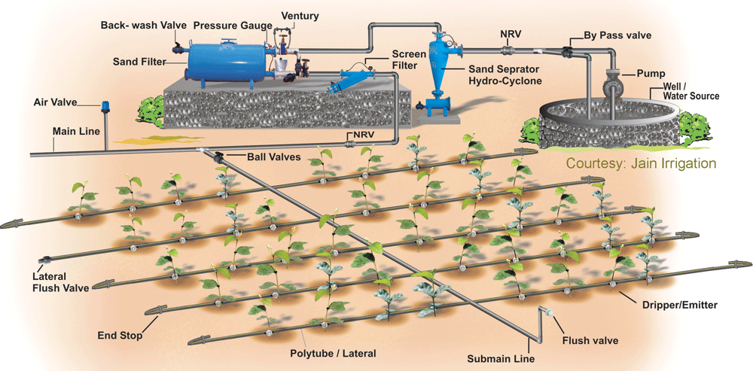
Irrigation Methods
Furrow Irrigation
Flood Irrigation
Spray Irrigation
Drip irrigation

Slide 7
Irrigation Problems
Waterlogging- when the soil remains under water for prolonged periods which impairs root growth because the roots cannot get oxygen.
Salinization- when the small amounts of salts in irrigation water become highly concentrated on the soil surface through evaporation.

Slide 8
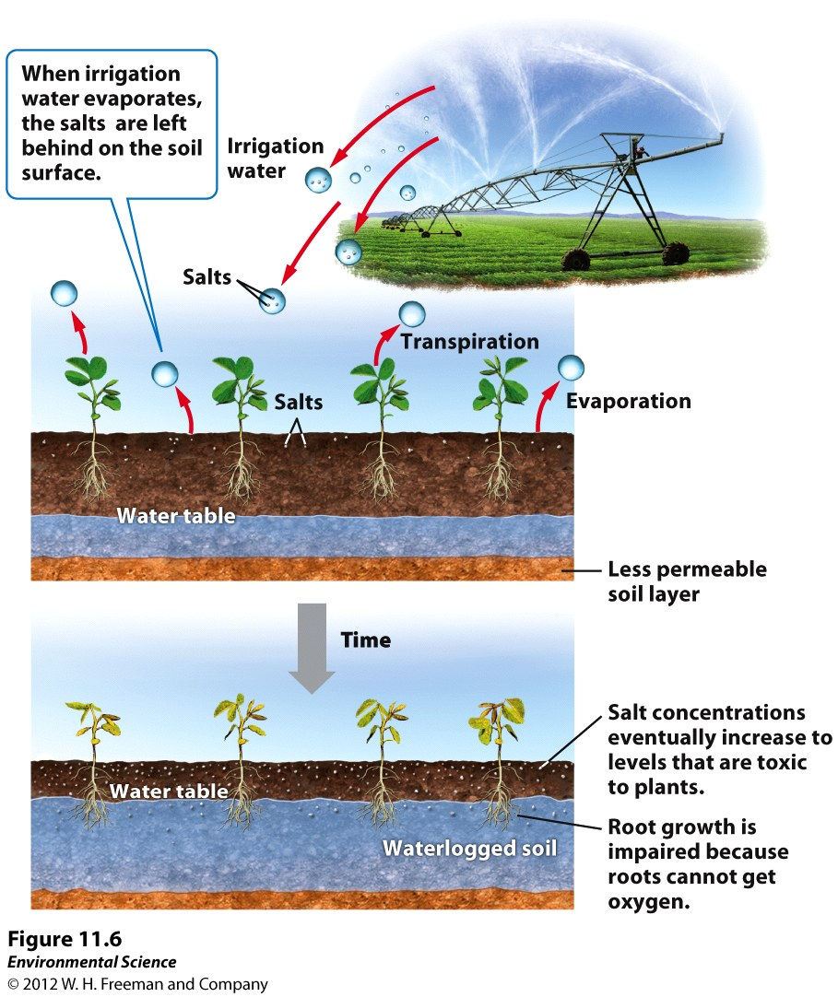

Slide 9
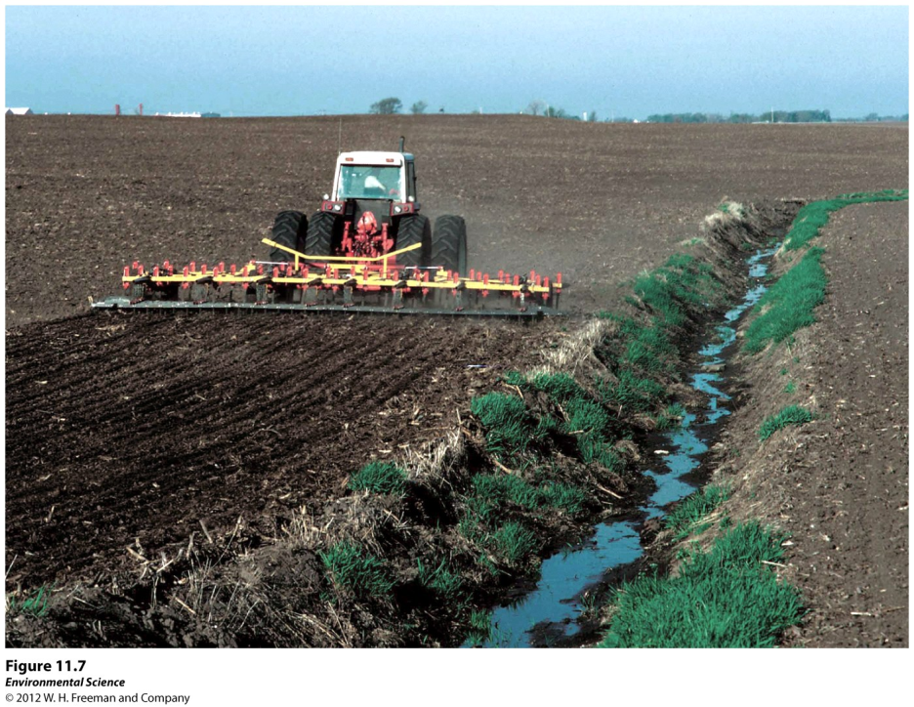
Fertilizers
Organic fertilizers- organic matter from plants and animals. Typically made from animal manure that has been allowed to decompose.
Inorganic fertilizers (synthetic)- fertilizers that are produced commercially. This is usually done by combusting natural gas, which allows nitrogen from the atmosphere to be fixed and captured in fertilizer.

Slide 10
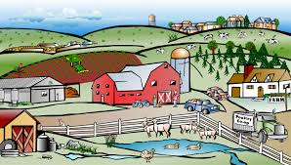
Farming Methods
Conventional agriculture
Traditional farming
Shifting agriculture
Nomadic grazing

Slide 11
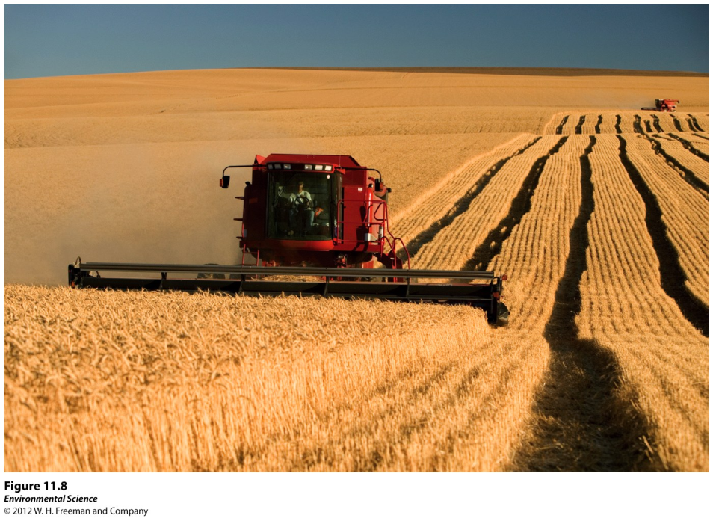
Conventional Agriculture
Conventional/Industrial agriculture- industrial agriculture where labor is reduced and machinery is used.
Monocropping/Monoculture- Growing a large amount of a single species of plant.

Slide 12
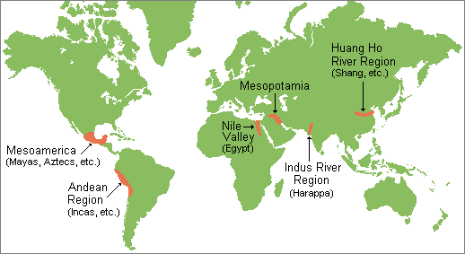
Traditional Subsistence Farming
Traditional farming- still used in the developing world where human labor is used and not machinery.

Slide 13
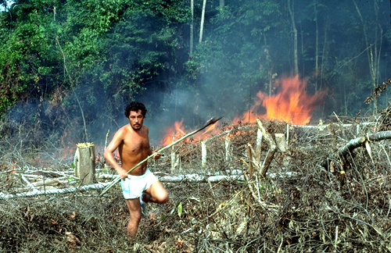
Shifting Agriculture
Shifting agriculture- used in areas with nutrient poor soils. It involves planting an area for a few years until the land is depleted of nutrients and then moving to another area and repeating the process.

Slide 14
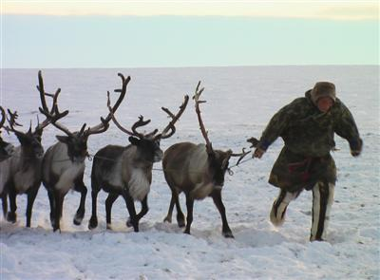
Nomadic Grazing/Herding
Nomadic grazing- moving herds of animals to find productive feeding grounds.

Slide 15
Farming Environmental Concerns
Soil Erosion
Pollution – water & air
Lack of Water due to irrigation
Overgrazing by Livestock - desertification
Overfishing – stock reductions
Loss of Ecological Services

Slide 16
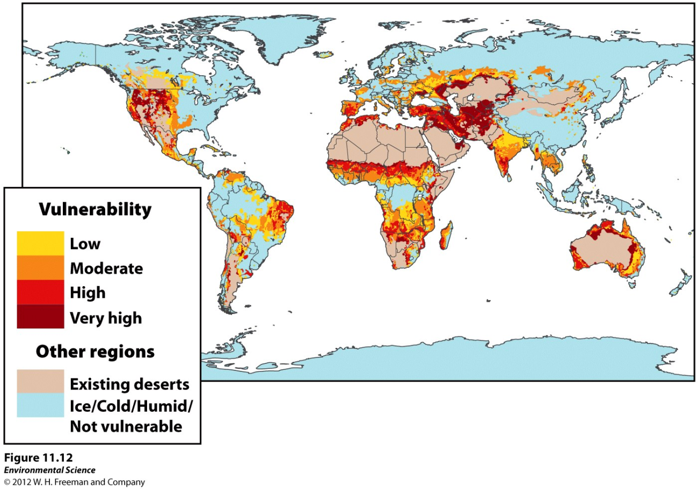
Desertification
Desertification- When soil is degraded by agriculture to the point at which they are not longer productive.

Slide 17
Pesticides
Pesticide- a substance that kills or controls organisms that people consider pests.
Insecticide- target insects
Herbicides- target plants

Slide 18
Pesticides
Broad-spectrum pesticides- designed to kill many different types of pests.
Selective pesticides- designed to kill a narrower range of organisms.

Slide 19
Pesticides
Persistent- pesticides that remain in the environment a long time.
Nonpersistent- pesticide that breaks down relatively rapidly, usually in weeks to months.

Slide 20
Pesticides
“PERFECT PESTICIDE”
Easily biodegrade into safe elements
Narrow Spectrum - kill target species only
Remain put in applied location in environment

Slide 21
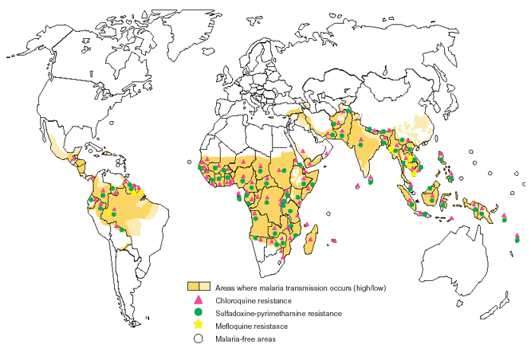
Pesticides
Benefits
Crop production ($3-5 in savings for every $1 pesticides)
Disease control
Malaria
½ world population at risk

Slide 22
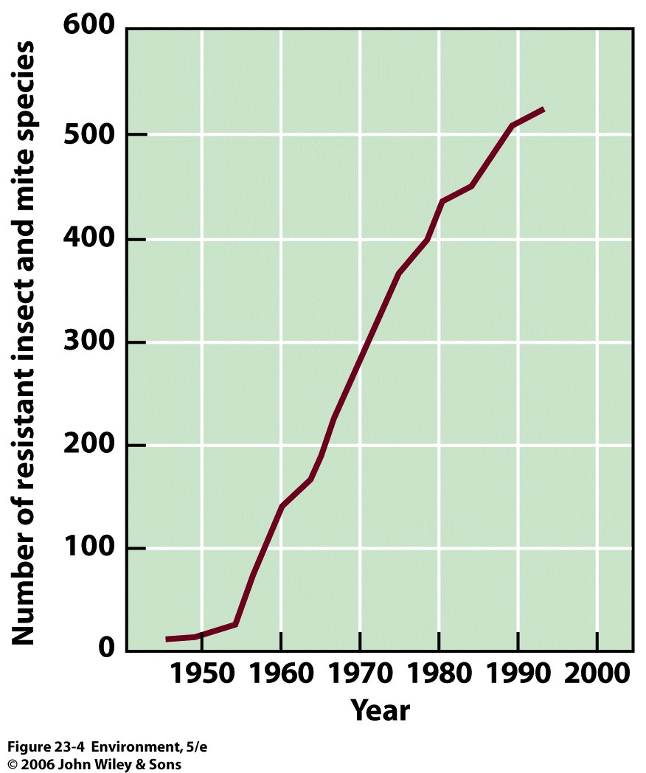
Pesticides
Concerns
Resistance- pest populations may evolve resistance to a pesticide over time. These are said to be resistant.

Slide 23
Pesticides
Concerns
Pesticide treadmill- the cycle of pesticide development followed by pest resistance, followed by development of a new pesticide.
Kills most pests
Resistant survive
INCREASE
Pesticide application
Numbers increase
EVEN MORE
New population genetically resistant

Slide 24
Pesticides
Concerns
Bioaccumulation- some pesticides are found to build up over time in the fatty tissues of predators.
An example was DDT.
When an organism containing the pesticide is eaten, the chemical is transferred to the consumer.
This eventually leads to very high pesticide concentrations at high trophic levels.
Rachel Carson – Silent Spring 1962

Slide 25
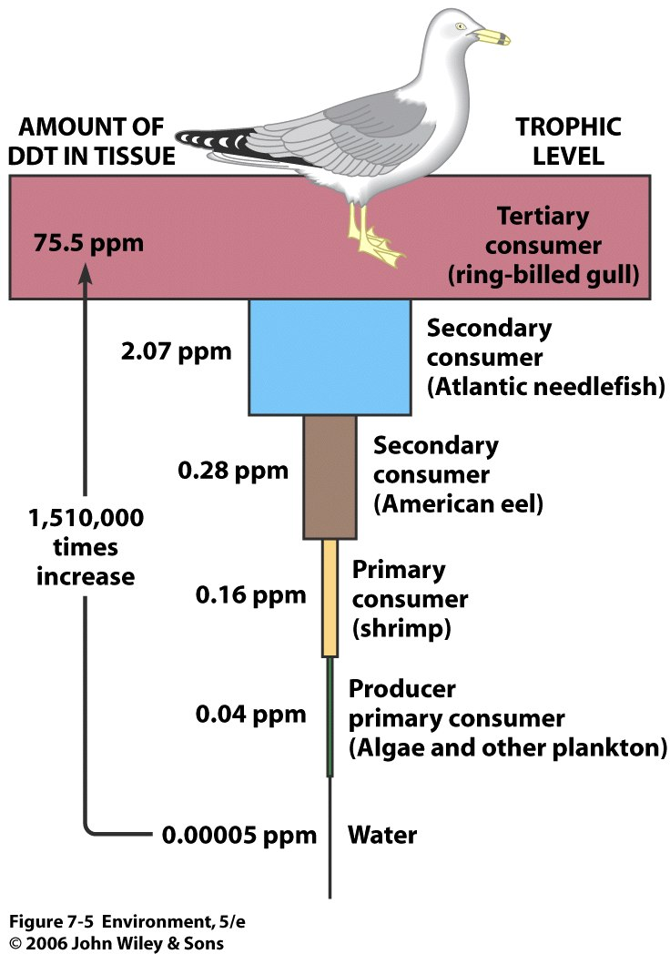
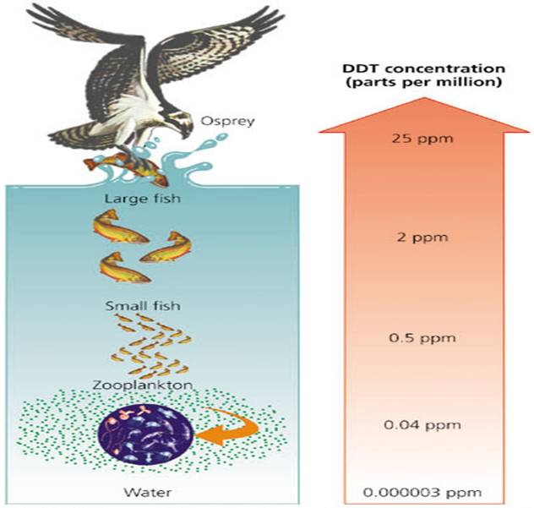
Pesticides

Slide 26
Regulation of Pesticide Use
Food, Drug, and Cosmetics Act (1938) - recognized need to regulate pesticides in food
Federal Insecticide, Fungicide, and Rodenticide Act (1947) - regulated effectiveness of pesticides
Pesticide Chemicals Amendment (1954) - set standards & testing for pesticides in food
Delaney Clause (1958) - no cancer causing agent may be used
Food Quality Protection Act (1996) - amended Delaney and reduced time to ban pesticide from 10 years to 14 months

Slide 27
The Second Green Revolution
Genetically Modified Organisms
Examples:
Golden Rice
Human hormone Producing plants
Roundup Ready Corn, Soybeans, Cotton
Bt Corn & Potatoes – insect dies of septicemia
Arctic Char gene in strawberries – antifreeze
Rapid growing fish

Slide 28
Benefits of Genetic Engineering
Pesticide Alternatives
Biological Controls
Naturally occurring diseases, parasites, & predators
Pheromone and Hormone Traps
Reproductive Controls - Sterile-male technique
Quarantine - if foreign pest detected
Notes:
Release high numbers of males that have been sterilized with radiation

Slide 29
Concerns about Genetically Modified Organisms
Safety for human consumption
Effects on biodiversity
Regulation of genetically modified organisms

Slide 30
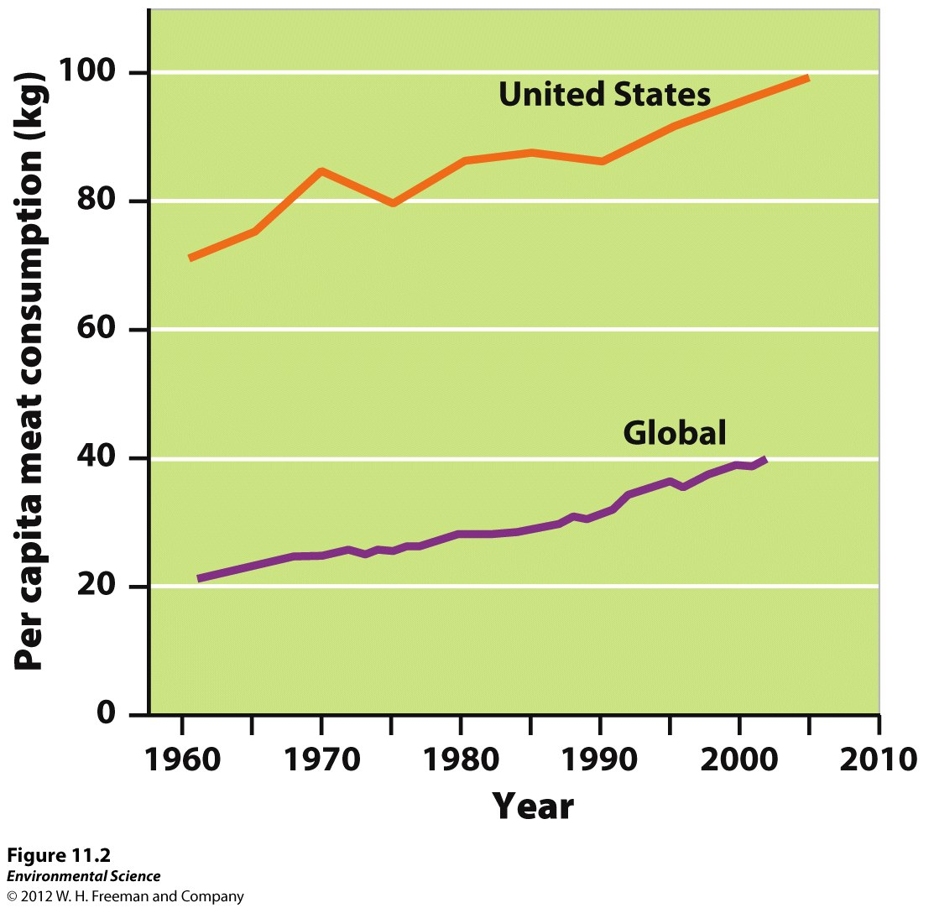
Annual Meat Consumption

Slide 31
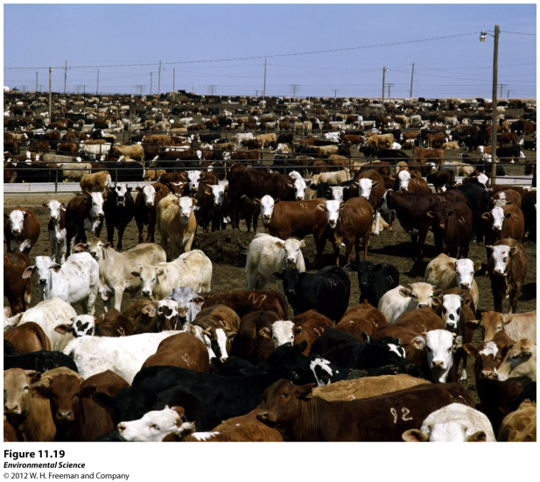
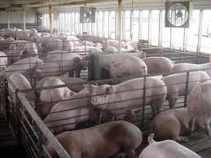
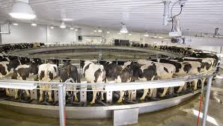
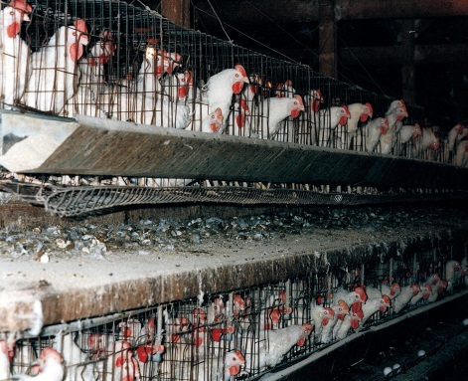
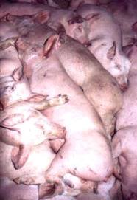
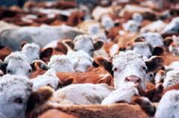
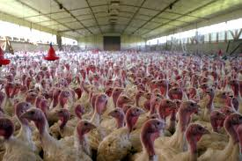
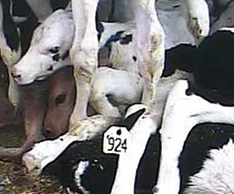
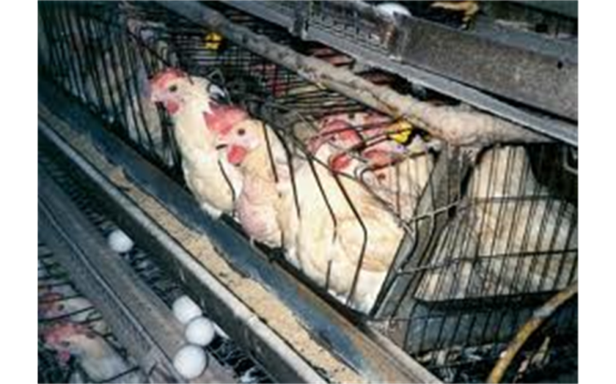
High-Density Animal Farming
CAFOs (concentrated animal feeding operations)- large structures where animals are being raised in high density numbers.

Slide 32
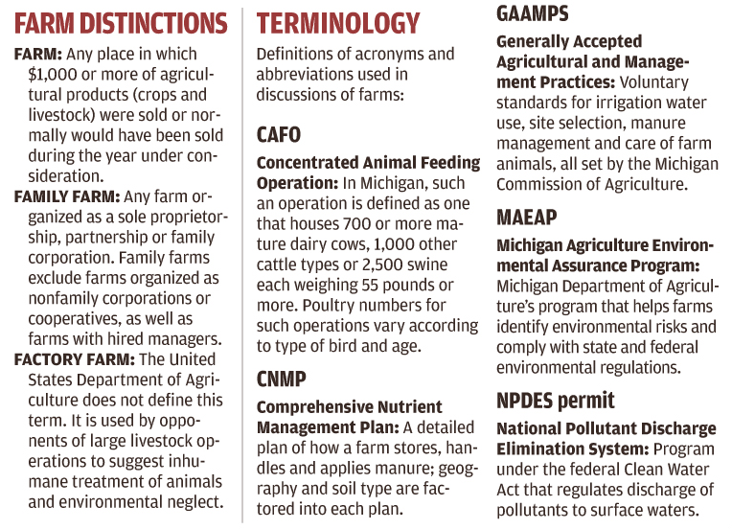

Slide 33
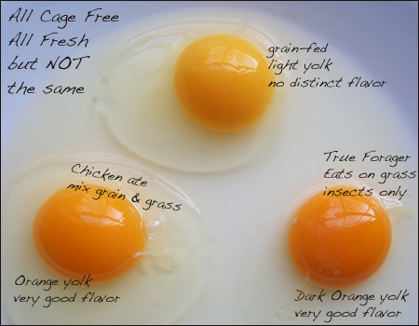
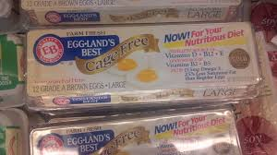
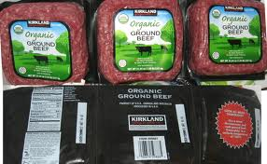
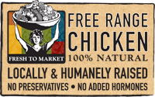
CAFO Alternatives
Grass-based livestock and poultry
Free-range livestock and poultry
Pastured livestock and poultry

Slide 34
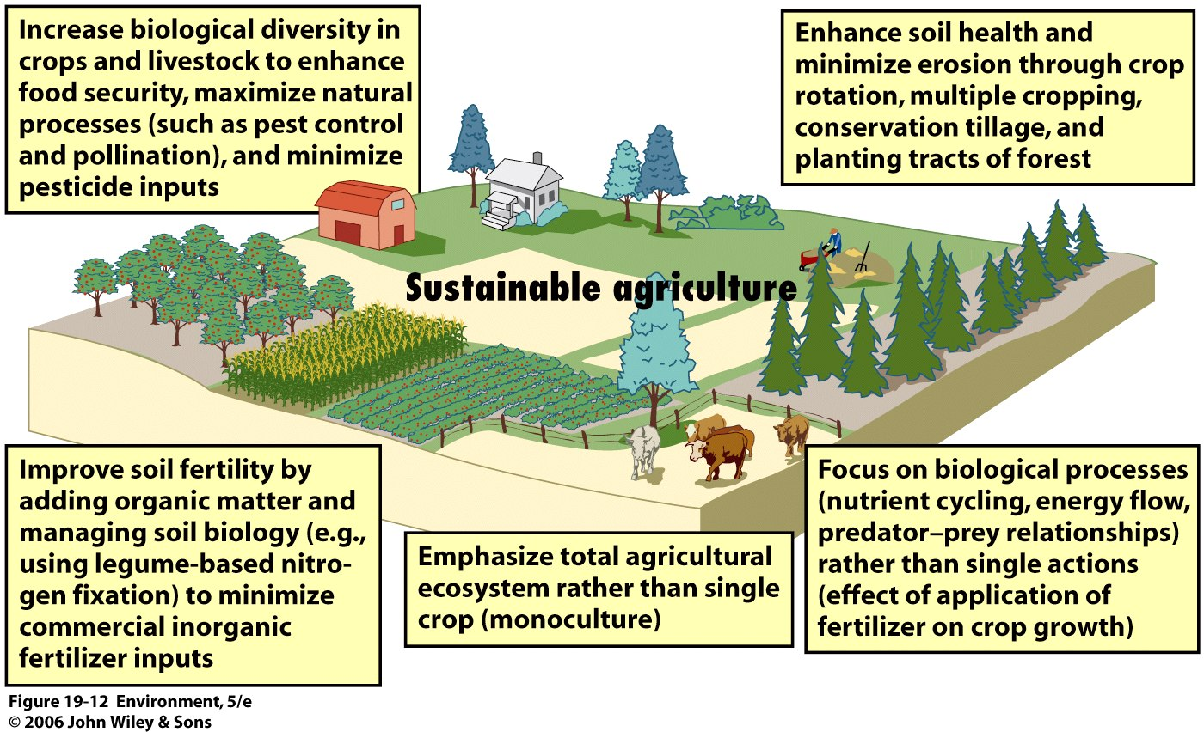
Sustainable Agriculture

Slide 35
Sustainable Agriculture
Sustainable agriculture- producing enough food to feed the world’s population without destroying the land, polluting the environment, or reducing biodiversity.
Intercropping- two or more crop species are planted in the same field at the same time.
Crop rotation- rotating crops species from season to season.
Agroforestry- intercropping trees with vegetables.
Contour plowing- plowing and harvesting parallel to the land to prevent erosion.

Slide 36
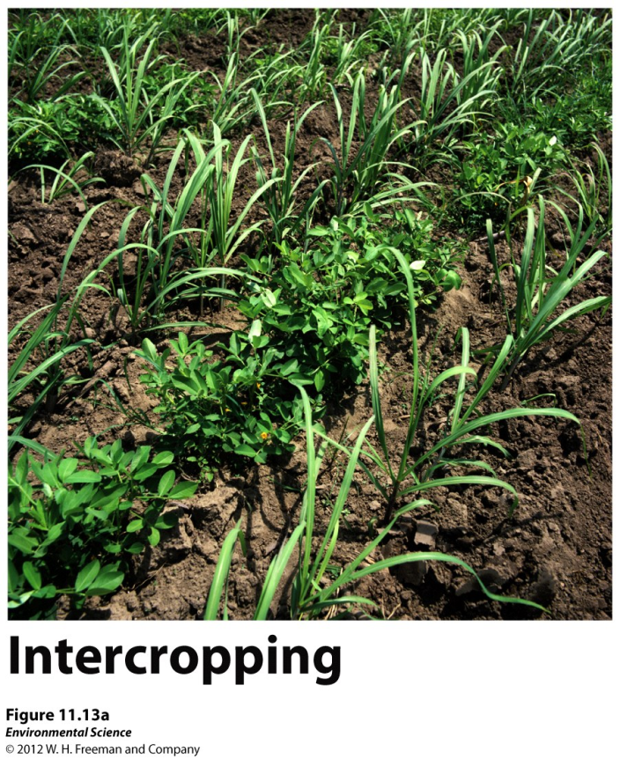
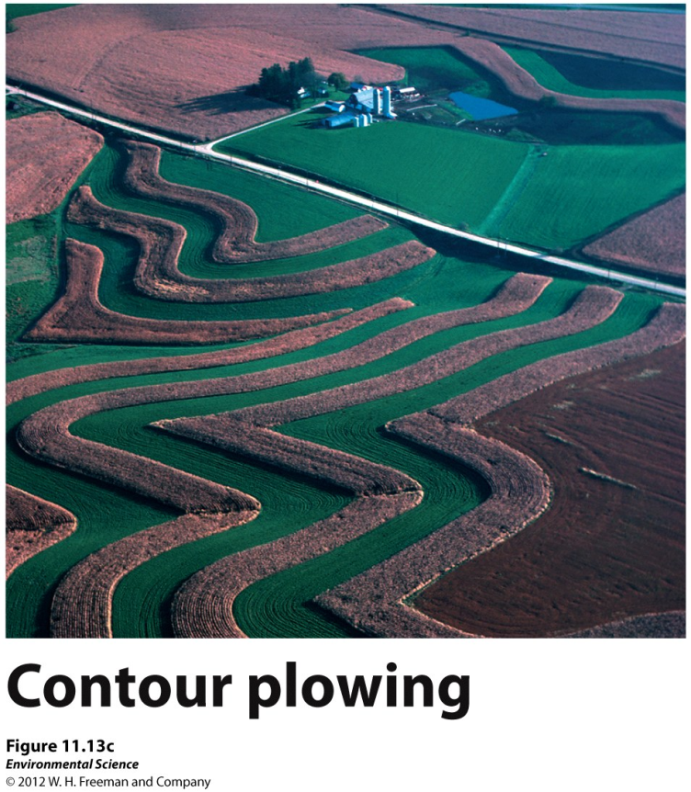
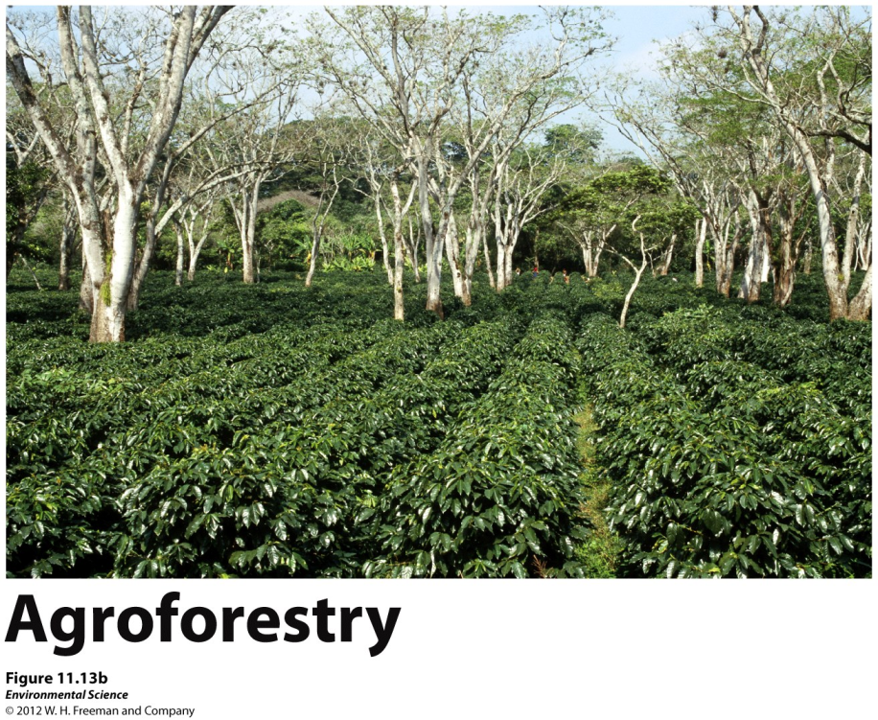

Slide 37
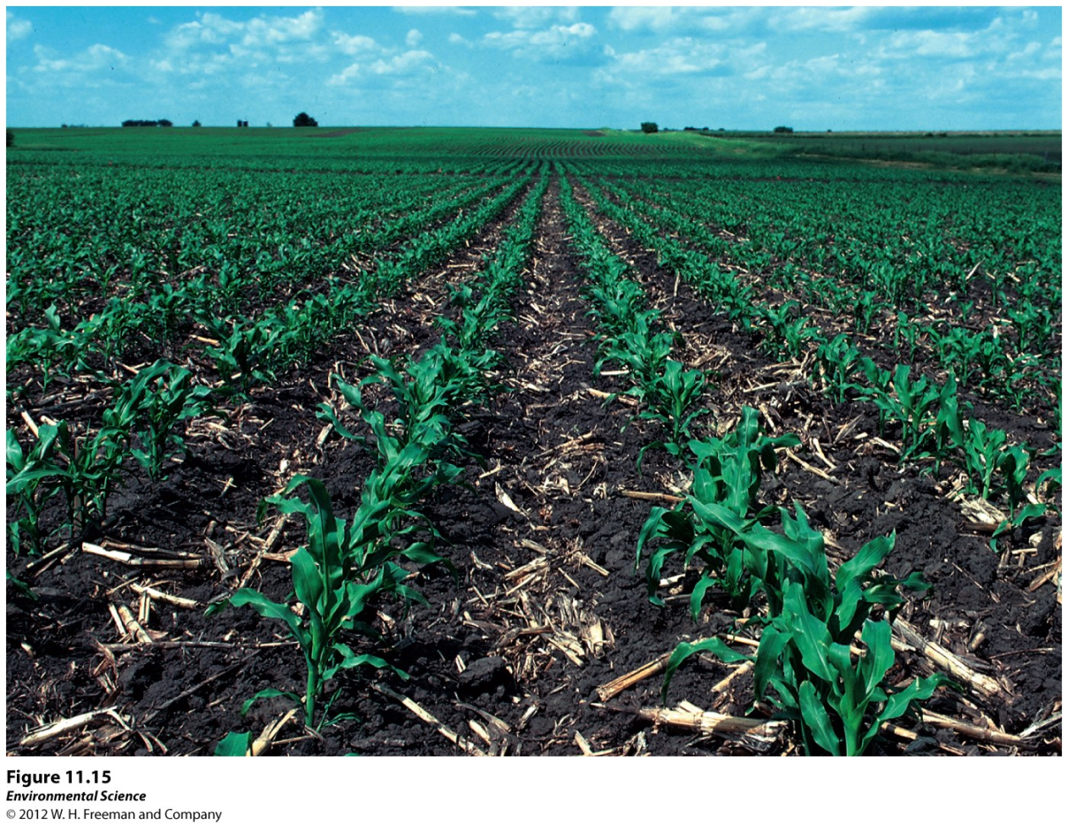
No-till Agriculture
No-till agriculture- helps to stop soil degradation by leaving crop residues in the fields and not tilling the land after each harvest.

Slide 38
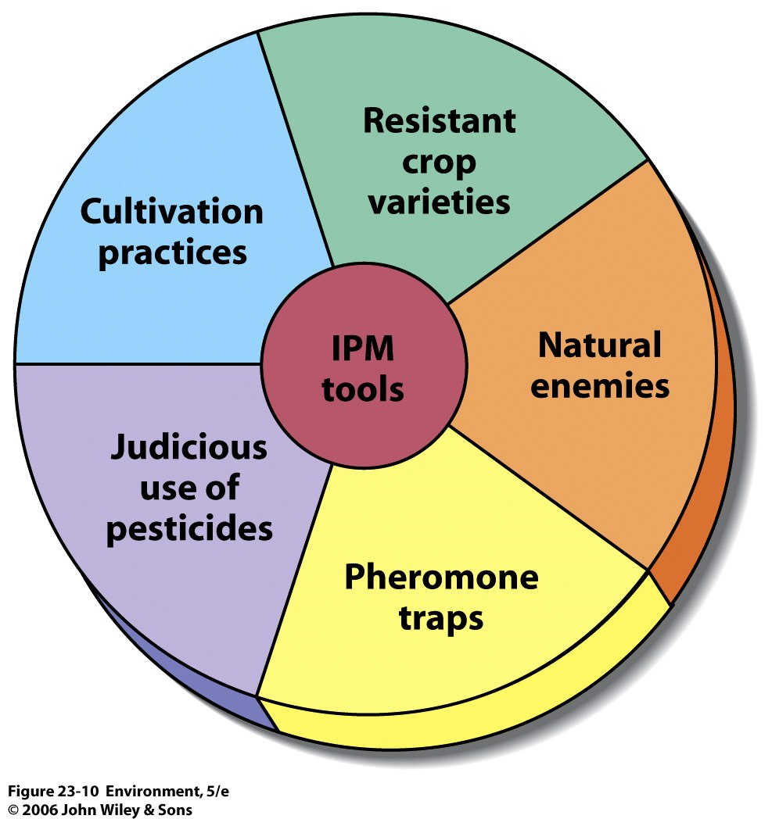
Integrated Pest Management
Integrated pest management- using a variety of techniques designed to minimize pesticide inputs.
Crop rotation
Intercropping
Planting pest resistant crop varieties
Creating habitats for predators
Limited use of pesticides

Slide 39
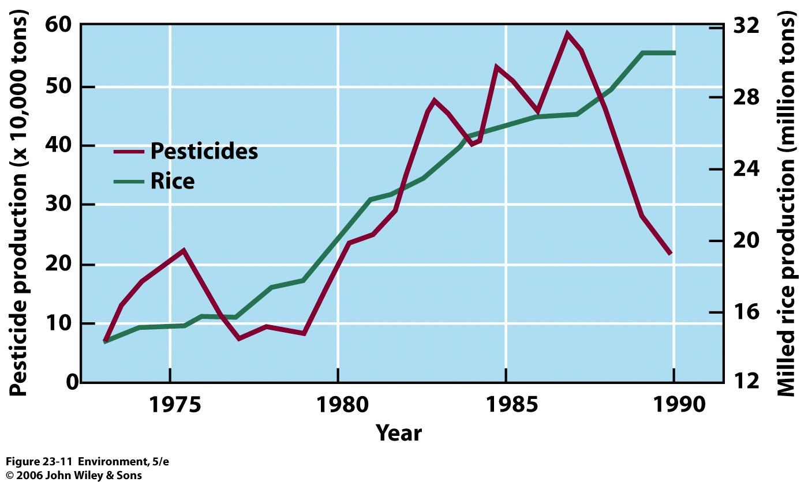
Integrated Pest Management
Integrated Pest Management
IPM introduced
Rice Production in Indonesia

Slide 40
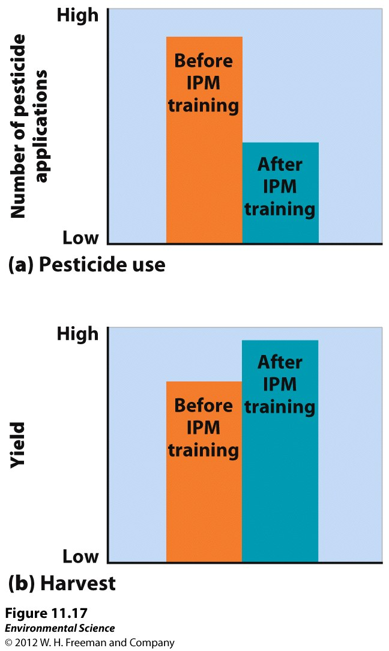

Slide 41
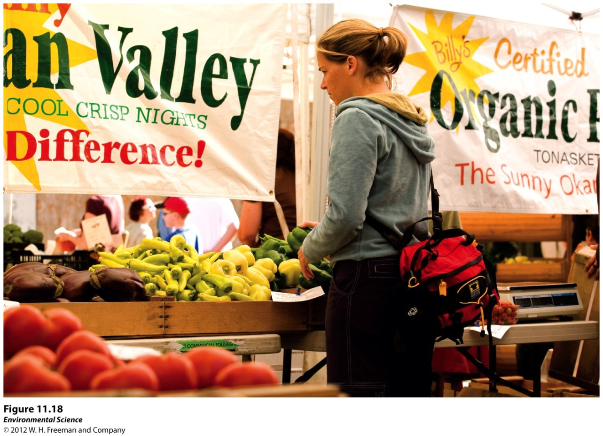
Organic Agriculture
Organic agriculture- production of crops without the use of synthetic pesticides or fertilizers.

Slide 42
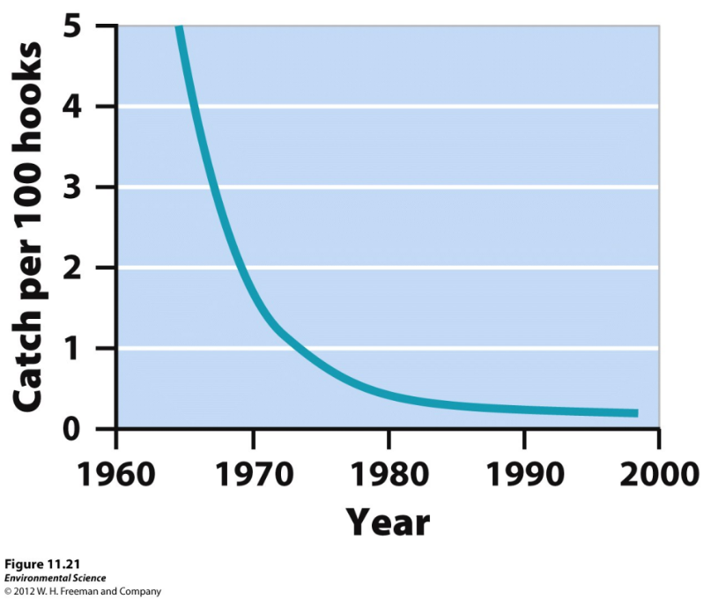
Harvesting of Fish and Shellfish
Fishery- a commercially harvestable population of fish within a particular ecological region.
Fishery collapse- the decline of a fish population by 90% or more. Atlantic Cod Industry Collapse
Bycatch- unintentional catch of non-target species.
Quotas- Limits are set as far as the amount of fish that can be caught per season.

Slide 43
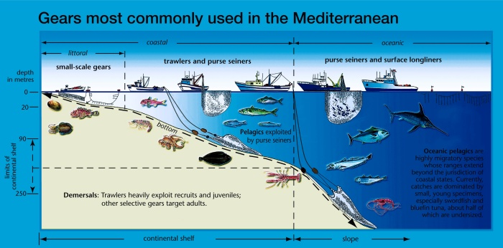
Harvesting of Fish and Shellfish
Fishery Types
Trawling Hook and Line
Longlining Gillnetting

Slide 44
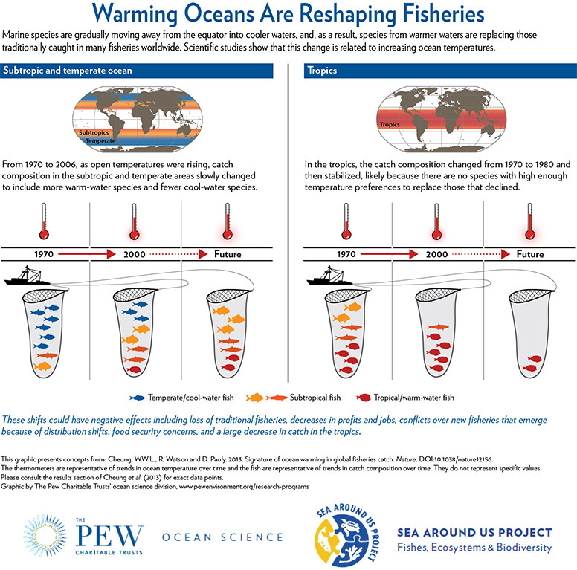

Slide 45
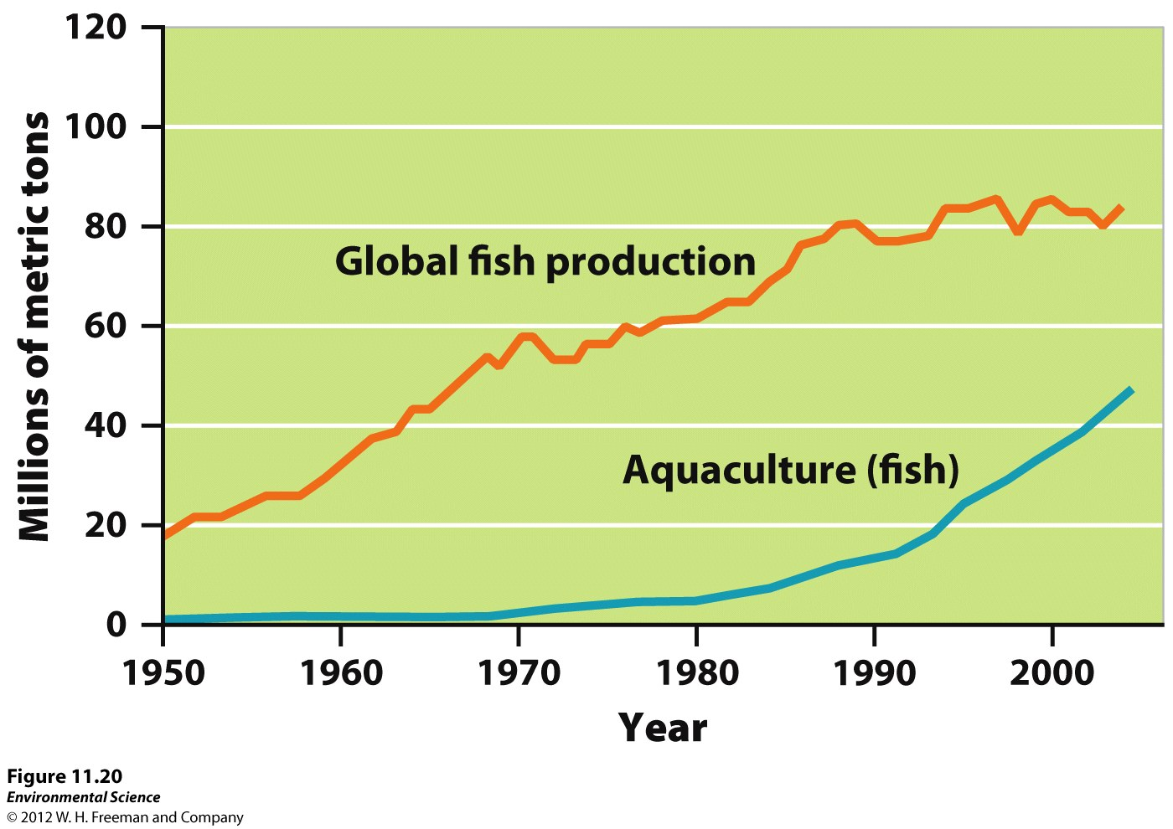

Slide 46
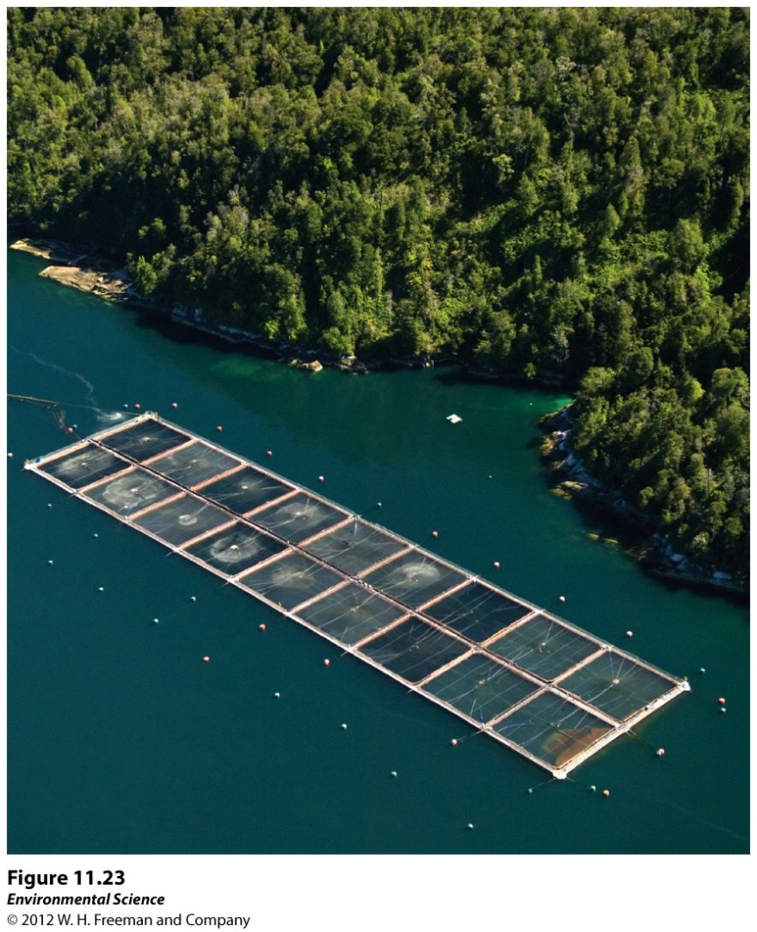
Aquaculture
Aquaculture- the farming of aquatic organisms such as fish, shellfish, and seaweeds.
Major drawbacks: its expensive, disease, genetic mixing, introduced species, pollution, habitat loss & alteration

Slide 47
Smart Seafood Choices

