Slide 1
“Out damned spot! Out I say
Here’s the smell of the blood still.
All the perfumes of Arabis will not
Sweeten this little hand. Oh, Oh, Oh!”
Shakespeare
(Macbeth)

Slide 2
What do you know about blood?
On your table, come up with facts about blood.

Slide 3
Introduction
Blood typing can provide class evidence; whereas DNA profiling can provide individual evidence.
A blood spatter pattern can give information about the truthfulness of an account by a witness or a suspect.
It also can provide information about the origin of the blood, the angle and velocity of impact, and type of weapon used.

Slide 4
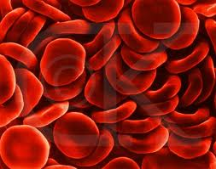
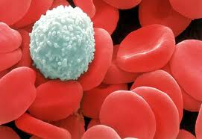
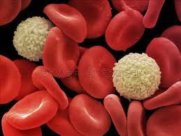
Composition of Blood
Whole blood carries cells and plasma—the fluid with hormones, clotting factors, and nutrients.
Red blood cells carry oxygen to the body’s cells and carbon dioxide away.
White blood cells fight disease and foreign invaders and, alone, contain cell nuclei.
Platelets aid in blood clotting and the repair of damaged blood vessels.

Slide 5
Some Blood Factoids
On average, blood accounts for 8% of total body weight
5 to 6 liters of blood for males
4 to 5 liters of blood for females
A 40% blood volume loss, internally or/and externally, is required to produce irreversible shock (death).
There are about one billion red blood cells in two to three drops of blood. For every 600 red blood cells, there are about 40 platelets and one white cell.

Slide 6
What are blood types?
Blood typing is quicker and less expensive than DNA profiling.
It produces class evidence but can still link a suspect to a crime scene or exclude a suspect.
There are 3 alleles or genes for blood type: A, B, & O. Since we have 2 genes, there are 6 possible combinations.
Blood Types
OO = Type O
AA or AO = Type A BB or BO = Type B AB = Type AB
www.redcrossblood.org/learn-about-blood/blood-types

Slide 7
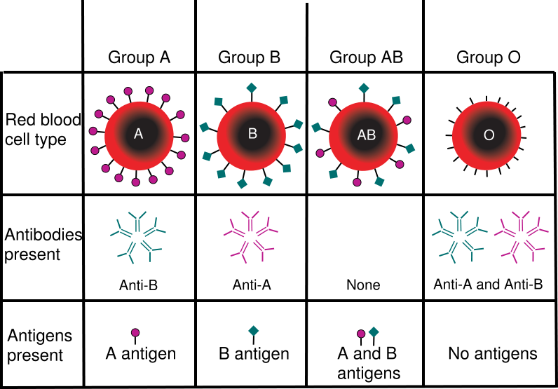
Blood Types

Slide 8
Blood Donors
Type
Antigen
Antibody
Can Give
Blood To
Can Get
Blood From
A
A
B
A, AB
O, A
B
B
A
B, AB
O , B
AB
Neither
A nor B
A and B
AB
A, B, O, AB
O
Neither
A nor B
A and B
A, B, O, AB
O

Slide 9
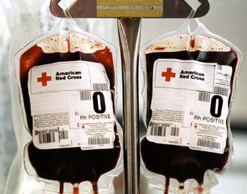
Blood Donors
When someone receives a blood transfusion, no plasma is in the transfused blood. This means that no antibodies are in it.
Type O is the universal donor.
Type AB is the universal receiver.

Slide 10
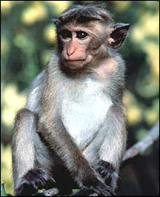
Historical Perspective of Blood Typing
Around 1900, Karl Landsteiner discovered that there are four different types of human blood based on the presence or absence of specific antigens found on the surface of the red blood cells.
In 1940, Landsteiner and Weiner reported the discovery of the Rh factor by studying the blood of the Rhesus monkey. 85% of Caucasians, 94% of Black Americans and 99% of all Asians are Rh positive.

Slide 11
Forensic Use of Blood Types
Although DNA analysis has replaced most conventional serology tests, there is still some useful information in the blood
About 80% of the population are secretors
Secretors secrete their blood antigens into their tears, sweat, semen and saliva
Knowing the blood type allows you to rule out suspects rather than identify them.

Slide 12
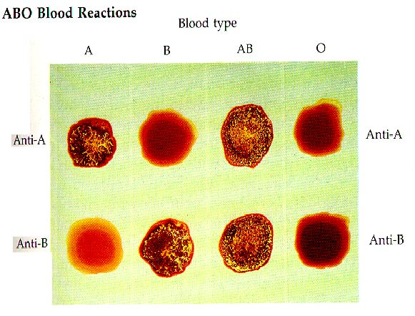
Blood Types - Testing

Slide 13
Blood Typing Lab
A
Use the results shown to determine the blood type for each sample.
Rh
B
Blood Type: ___
+ = present
A
A
A
- = absent
Rh
Rh
Rh
B
B
B
Blood Type: ___
Blood Type: ___
Blood Type: ___

Slide 14
Blood – a Liquid
Blood is nothing more than a liquid
As such, it behaves in predictable ways (fluid dynamics)

Slide 15
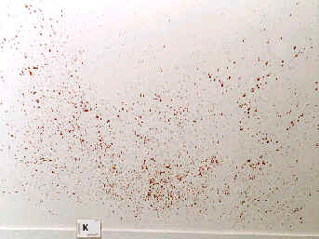
Conditions Affecting Shape of Blood Drops
Size of the droplet
Angle of impact
Velocity at which it left its origin
Height
Texture of the target surface

Slide 16
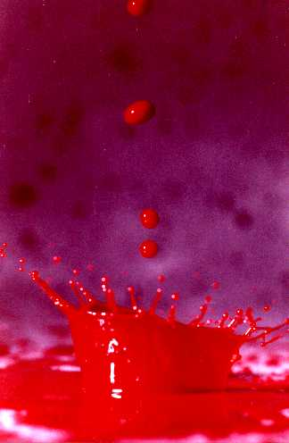

Slide 17
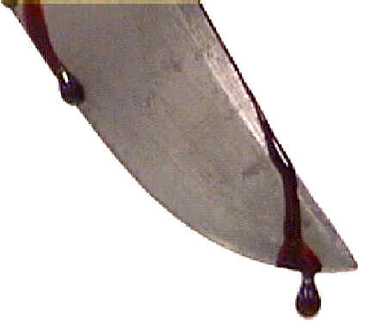
passive or gravity drop

Slide 18
Determining the Distance Blood Falls
Drops form circle when hitting surface
Size depends on speed of blood drop
Faster drop = larger diameter
Higher distance = larger diameter
However, size of drop also depends on the volume of the drop. Volume depends on object blood originated from (needle = small; bat = large)

Slide 19
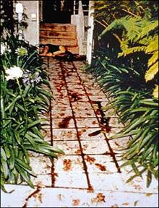
Blood Spatter
Since the volume of blood in a drop is generally unknown…
It is not possible to establish with a high degree of accuracy the distance that a passive blood drop has fallen

Slide 20
Bloodstain Terminology
Angle of impact—angle at which blood strikes a target surface.
Bloodstain transfer—when a bloody object comes into contact with a surface and leaves a patterned blood image on the surface
Backspatter—blood that is directed back toward the source of energy
Cast-off—blood that is thrown from an object in motion
Directionality—relates to the direction a drop of blood traveled in space from its point of origin

Slide 21
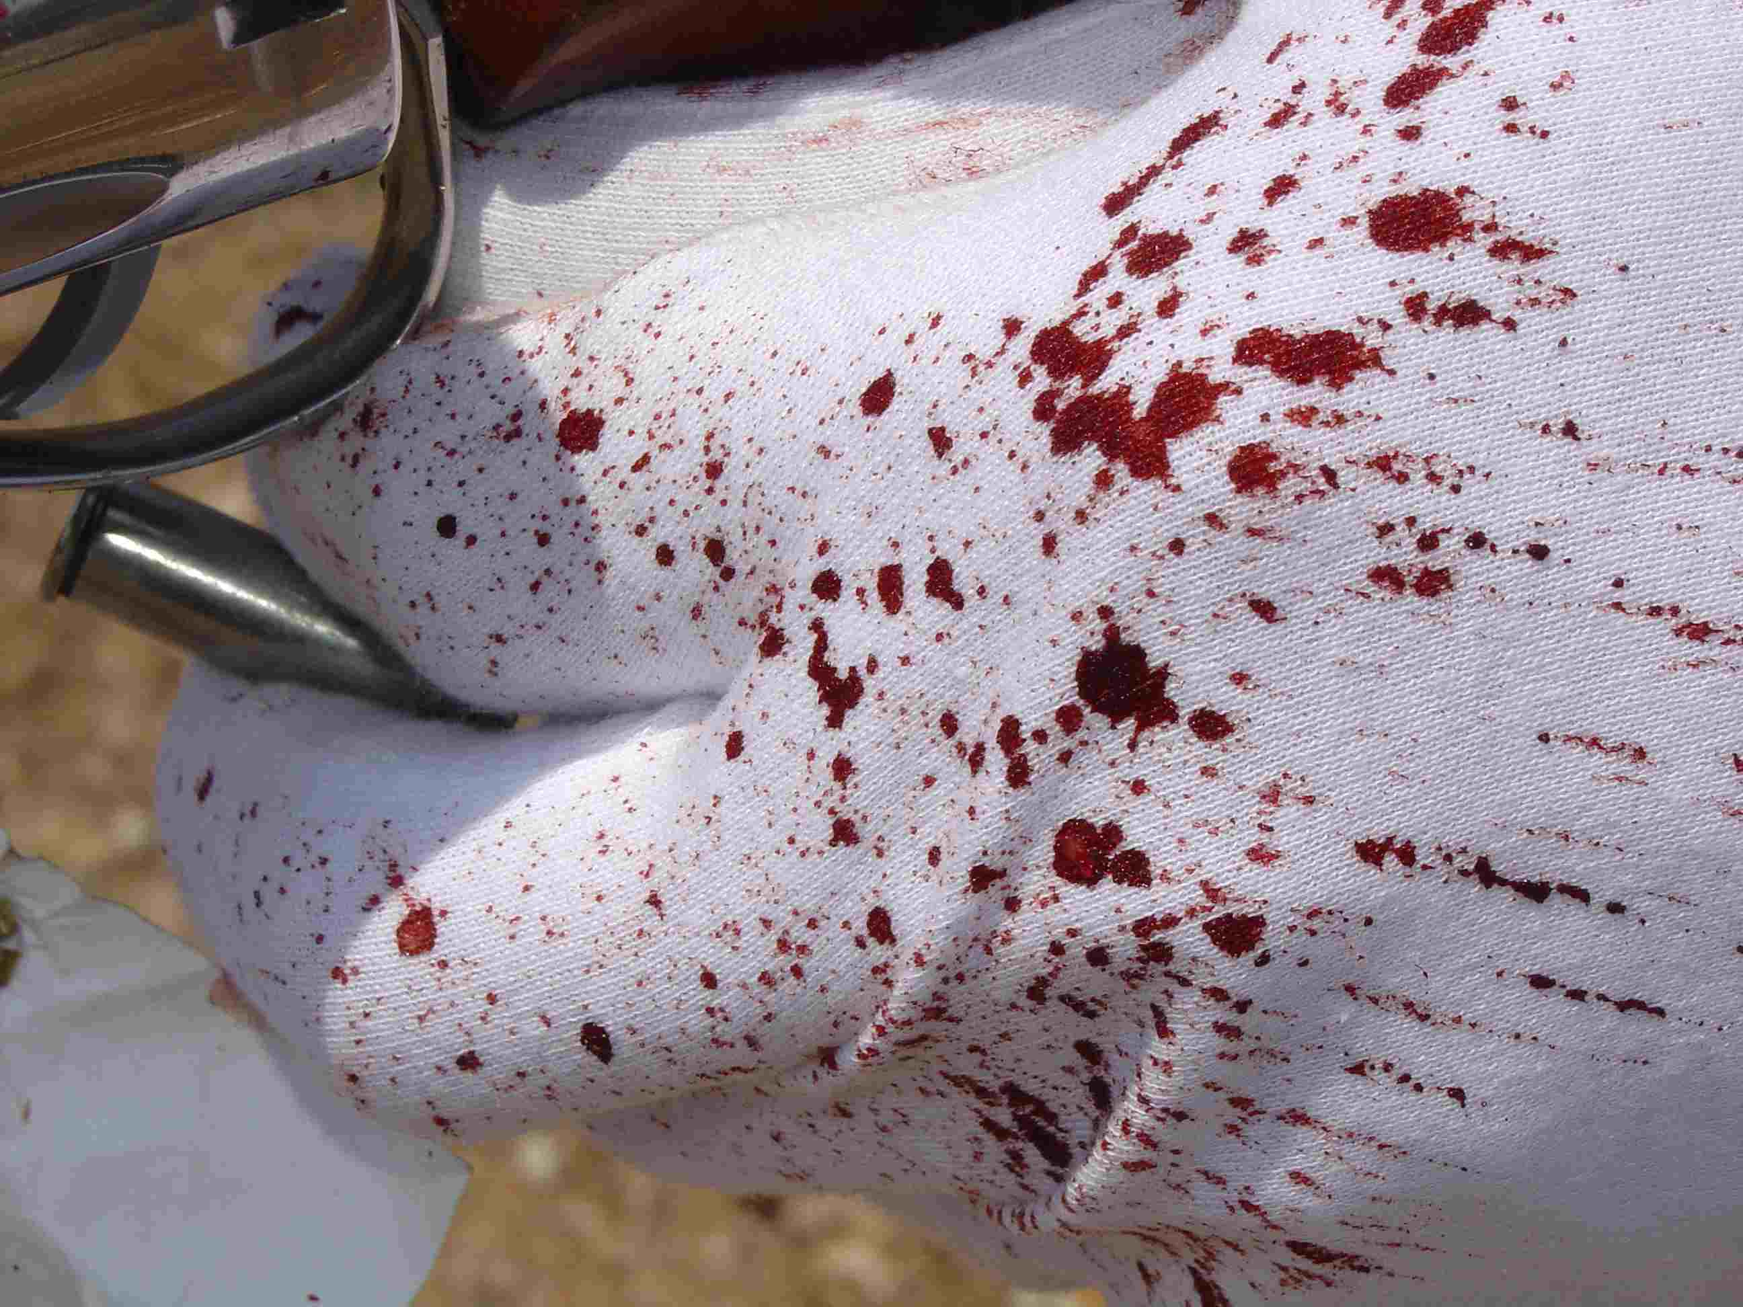
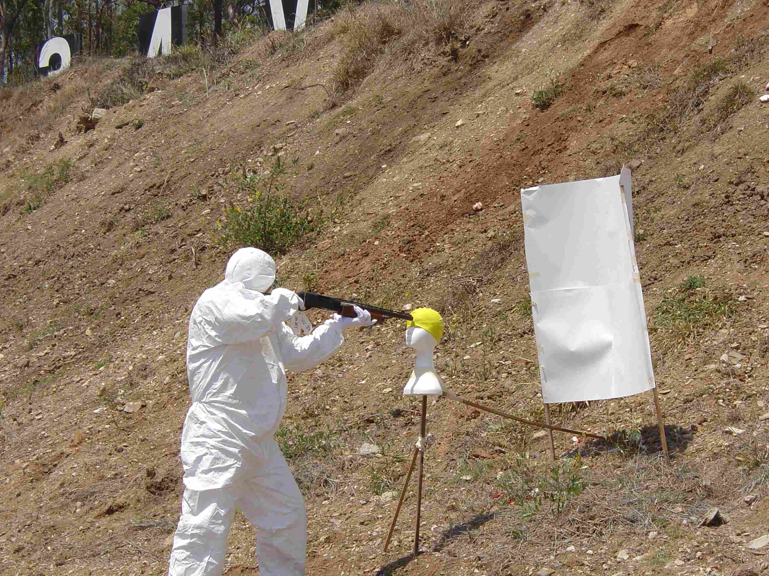
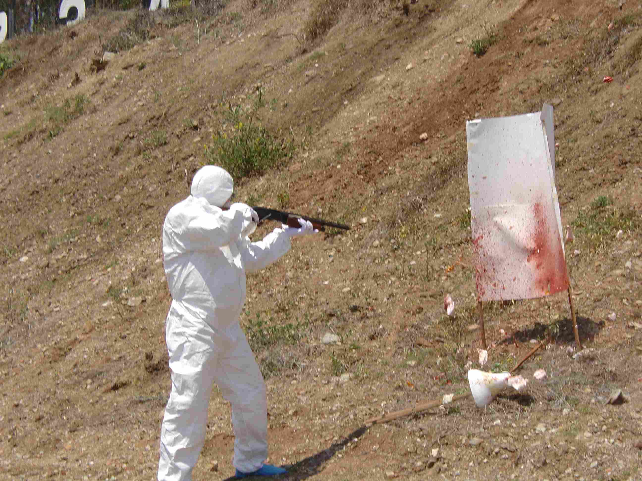
Forward Spatter

Slide 22
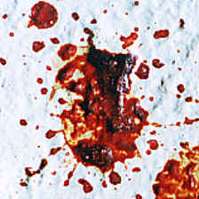
Surface and Blood Spatter
The type of surface the blood strikes affects the amount of resulting spatter, including the size and appearance of the blood drops.

Slide 23
Drying Time
Drying begins at periphery and proceeds inward
Drying time is affected by
Surface type
Amount of blood
Climatic conditions
Skeletonization
Partially dry stains leave a ring that outlines original spatter
The drier the stain, the less skeletonization shown

Slide 24
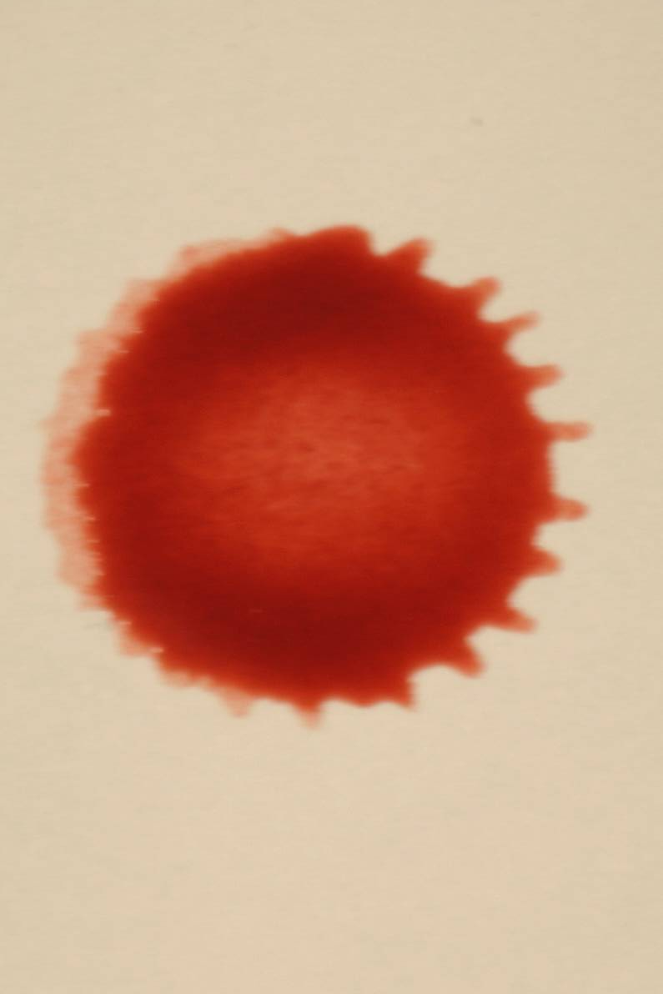
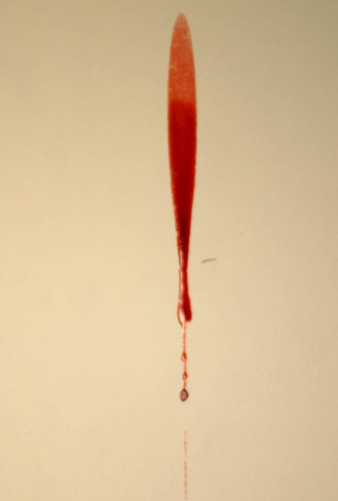
Blood Spatter
When a drop hits at an angle other than 90º, it will form a tear drop shape on the surface it hits
Narrow end of a blood drop will point in the direction of travel.

Slide 25
Blood Spatter
Passive: gravity is the only force involved
Projected: created when a blood source is subjected to an action or force, greater than the force of gravity
Arterial gush
Low velocity (cast off spatter)
Medium velocity cast off spatter (beatings)
High velocity spatter (gunshots)

Slide 26
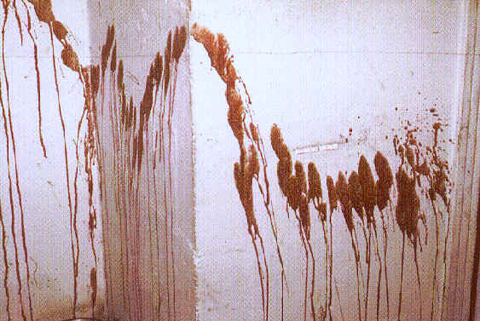
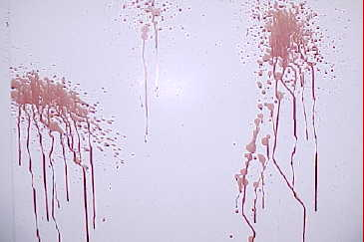
Projected – Arterial Spray
Arterial Spurt / Gush: Bloodstain pattern resulting from blood exiting the body under pressure
Large volume projected from arterial pressure

Slide 27
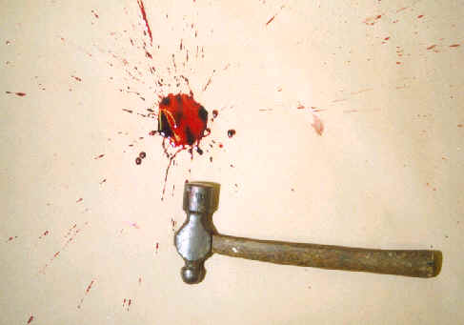
Low impact
Low impact is really blood under the influence of gravity - it just falls.
Relatively large stains 4 mm in size and greater. Impact velocity up to 5 feet/sec
Image courtesy UWA PhD research student Mark Reynolds.

Slide 28
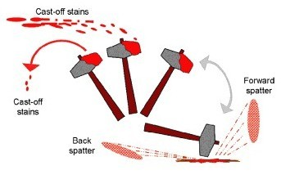
Projected – Cast Off Low Velocity
Cast-off Stains: Blood released or thrown from a blood-bearing object in motion
Usually found on ceilings – formed by the upstroke of a weapon containing blood (bat, crowbar, etc)
Number indicates number of blows, plus one

Slide 29
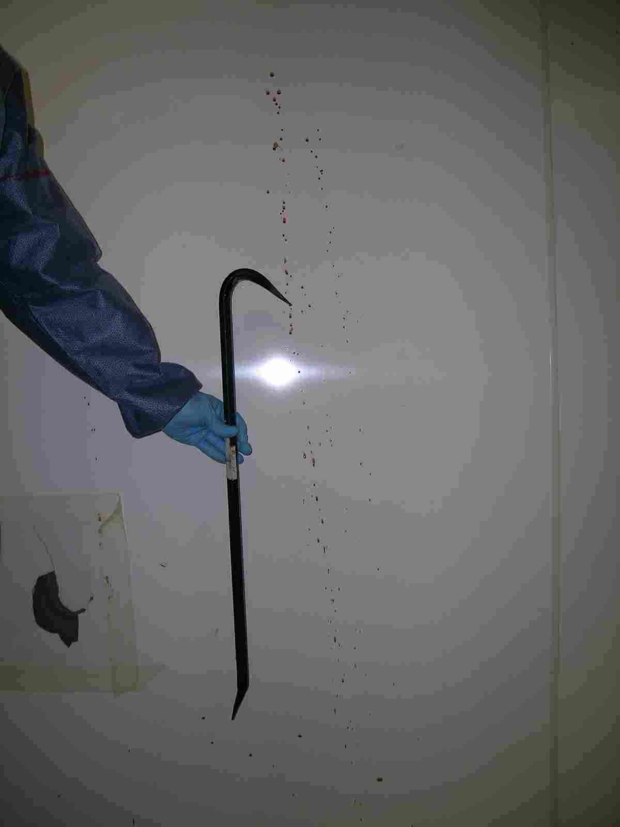
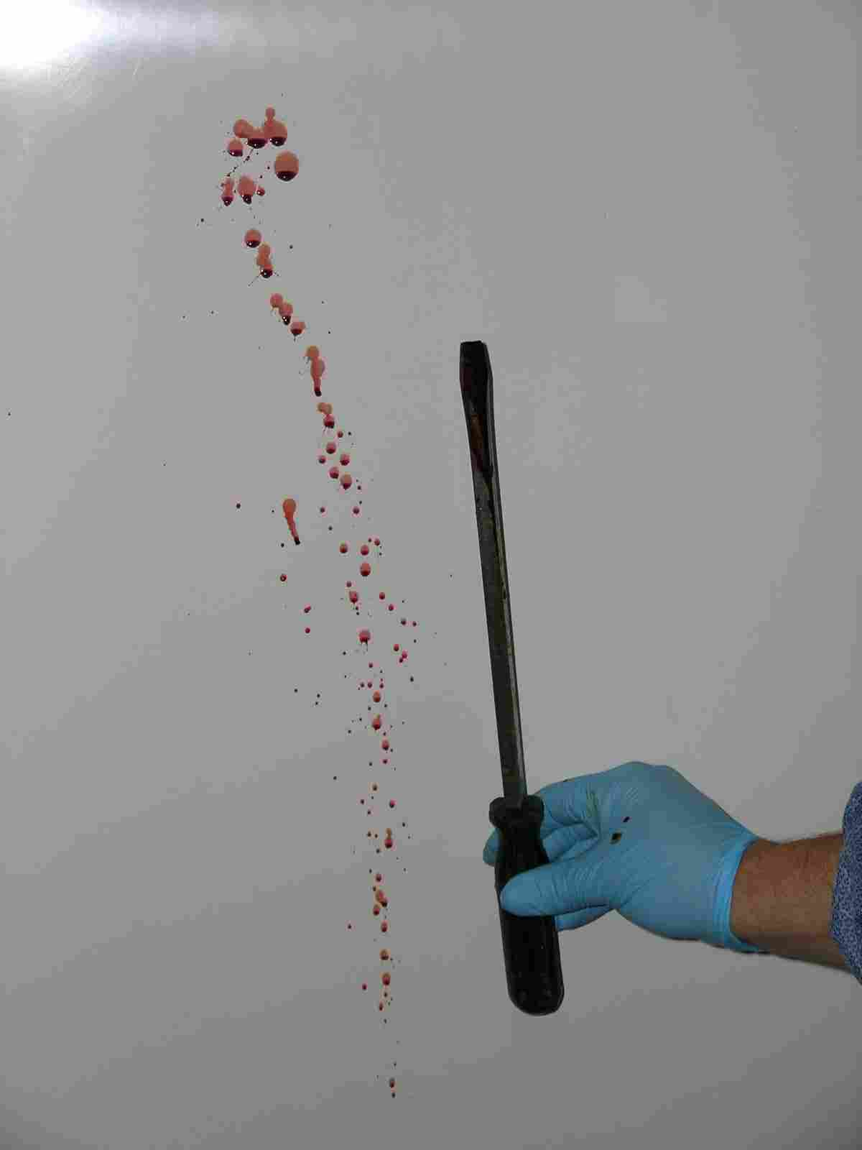
Cast off patterns

Slide 30
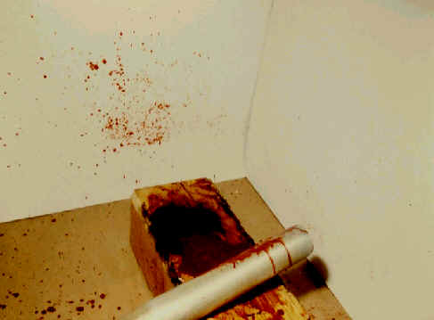
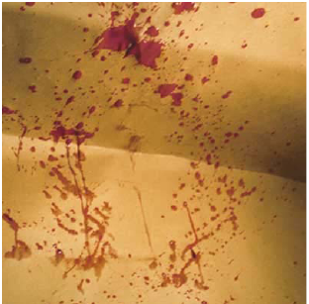
Projected – Medium Velocity
These type of spatters are normally smaller than those from low-velocity droplets
Blood is typically traveling between 5 -25 feet per second

Slide 31
Medium impact
Medium impact occurs when a force such as a bat is applied.
Image courtesy UWA PhD research student Mark Reynolds.

Slide 32
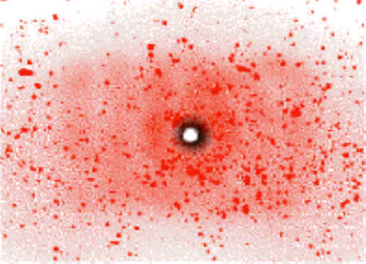
Projected – High Velocity
High velocity blood spatter occurs when a strong, explosive force projects blood in a aerosolized spray
Usually produced by a gunshot
The very small drops of blood are in a mist and do not have much horizontal movement (less than 5ft)
Blood is traveling 100 ft/sec or more
Gunshots result in back spatter (where bullet enters) and forward spatter (where bullet exits)

Slide 33
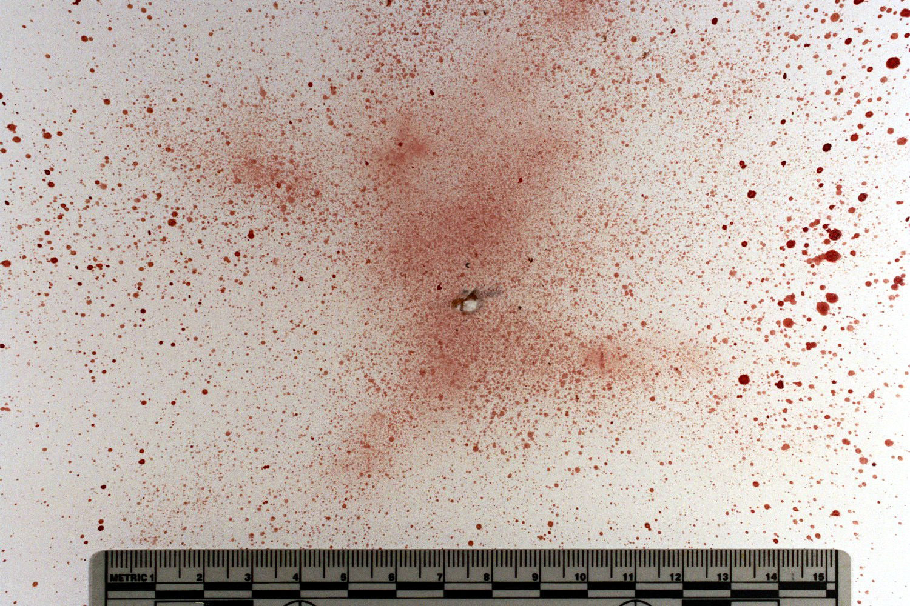
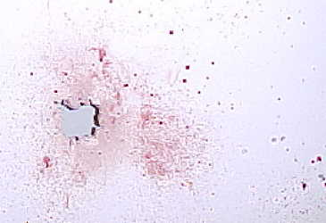
High Velocity Impact (HVI)
Stain size 1 mm in size and smaller. Mist like appearance.
Impact velocity of 100 feet/sec and greater.

Slide 34
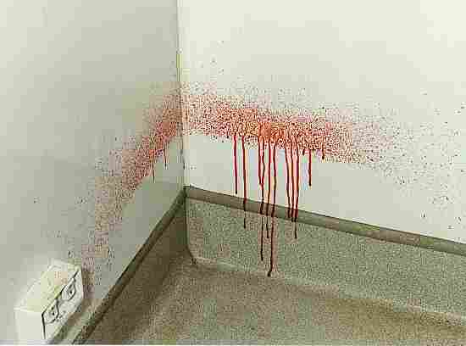
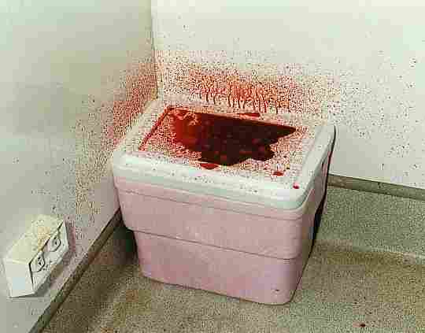
Voids

Slide 35
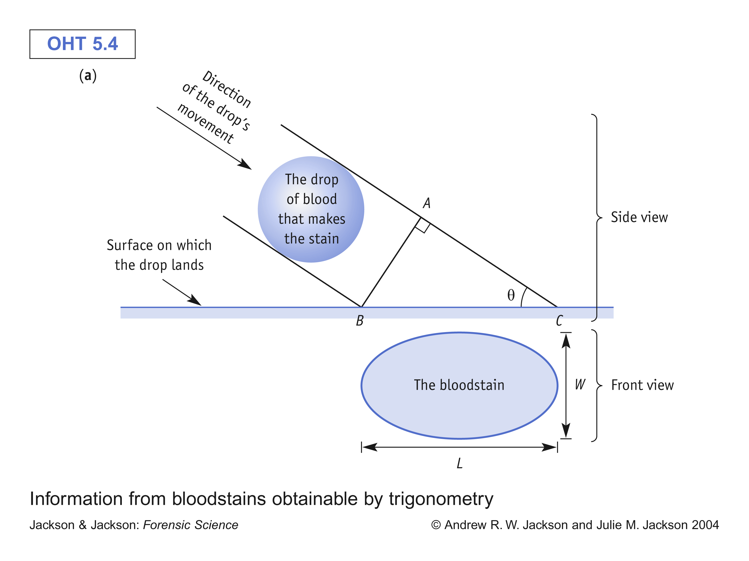
sin θ = W / L
W
L
The closer you get to a drop
falling vertically, the more
the drop should have W=L
sin θ = 1 → θ = 90°
Drop is a circle!

Slide 36
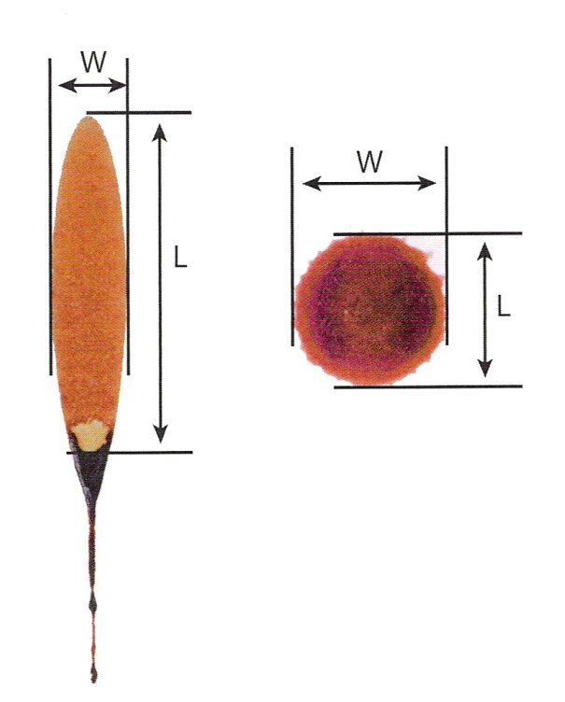
Determining Direction of Blood
The angle can be determined mathematically.
Width/Length, then take the inverse sin (sin⁻¹).
This number is the impact angle (90 = perpendicular to surface; <10 at a sharp angle)

Slide 37
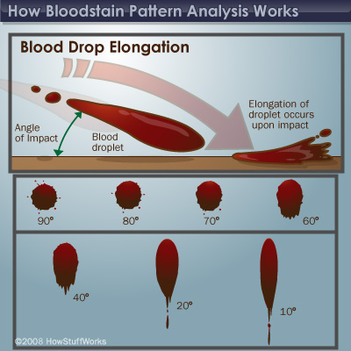

Slide 38
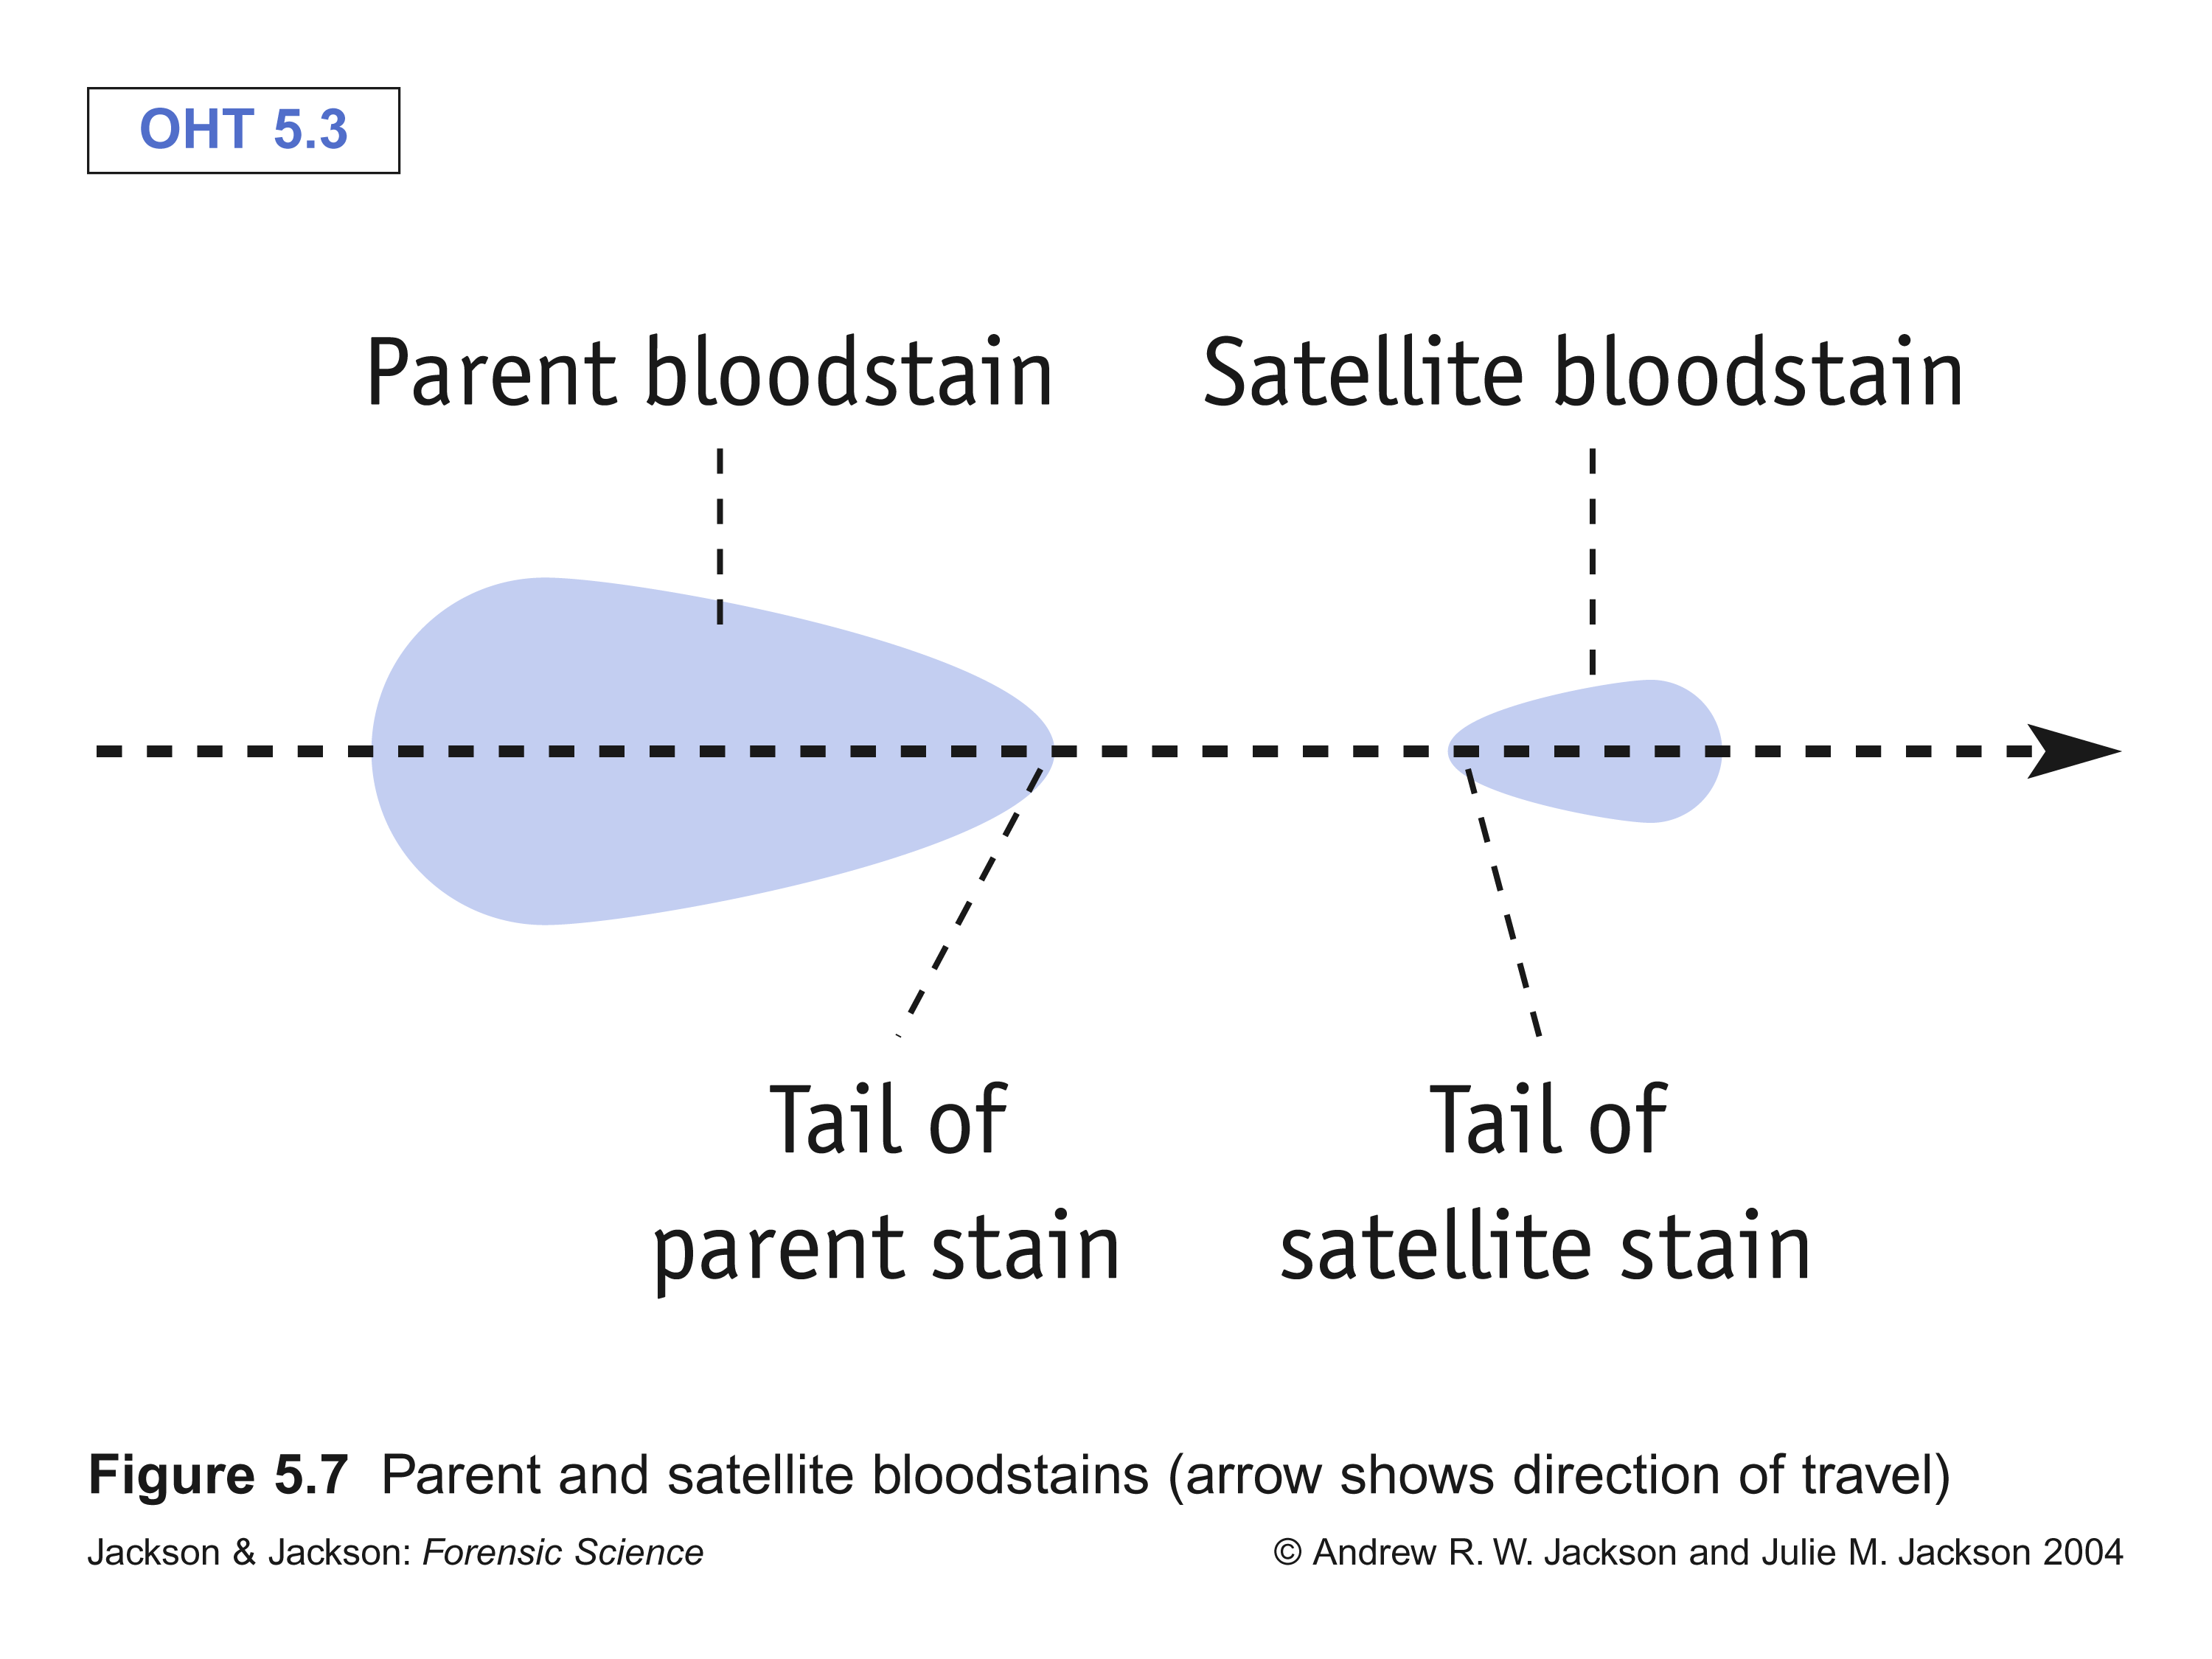
Direction of Blood
one exception!
tail points in
direction of
travel

Slide 39
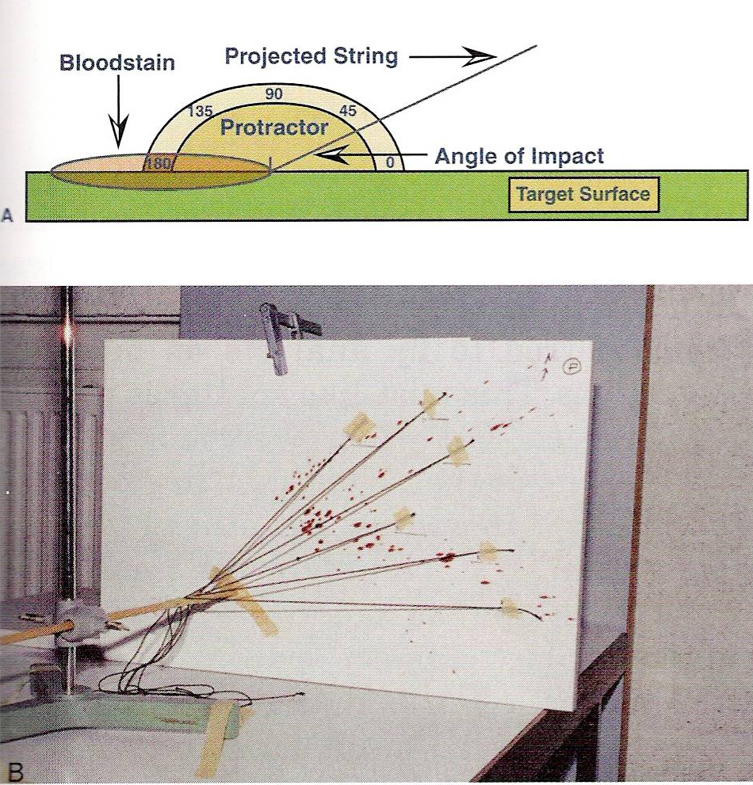
Blood Spatter
If more than one drop (from spatter) results, the point of origin can be determined
This is a 2-dimensional point of origin.
It is possible to determine the 3-D point of origin

Slide 40
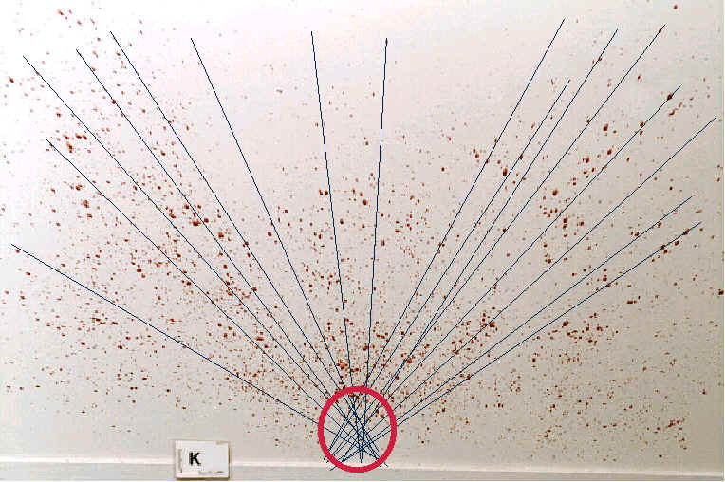
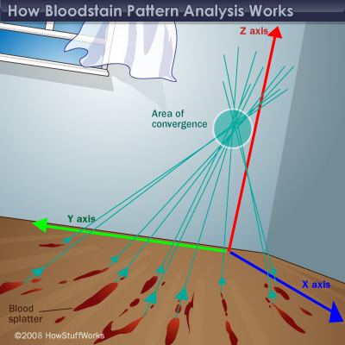

Slide 41
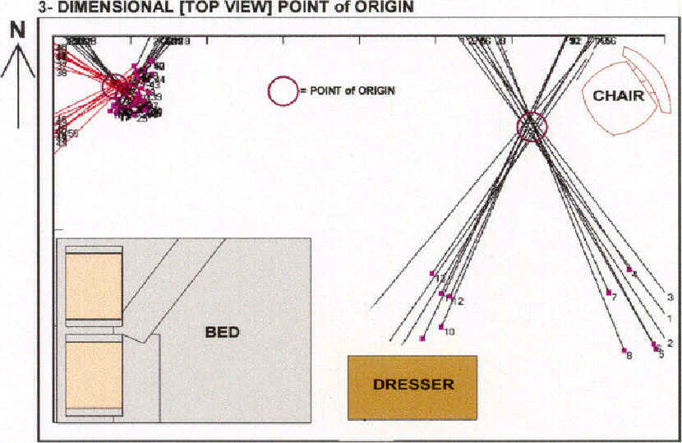

Slide 42
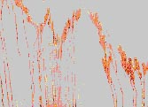
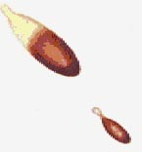
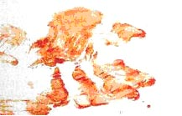
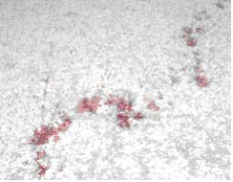
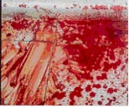
Blood spatter Analysis
passive drops
arterial gushes
splashes
smears
trails
pools

Slide 43
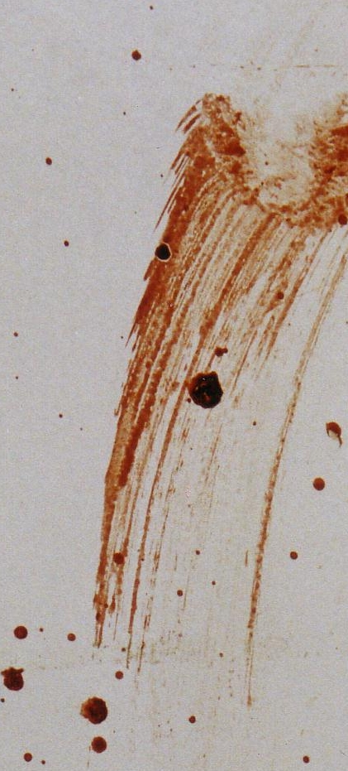
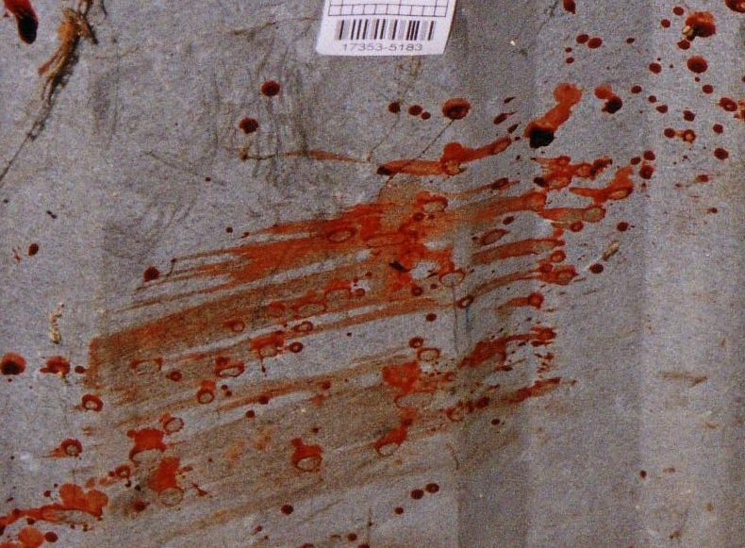
Contact stains Swipe vs wipe

Slide 44
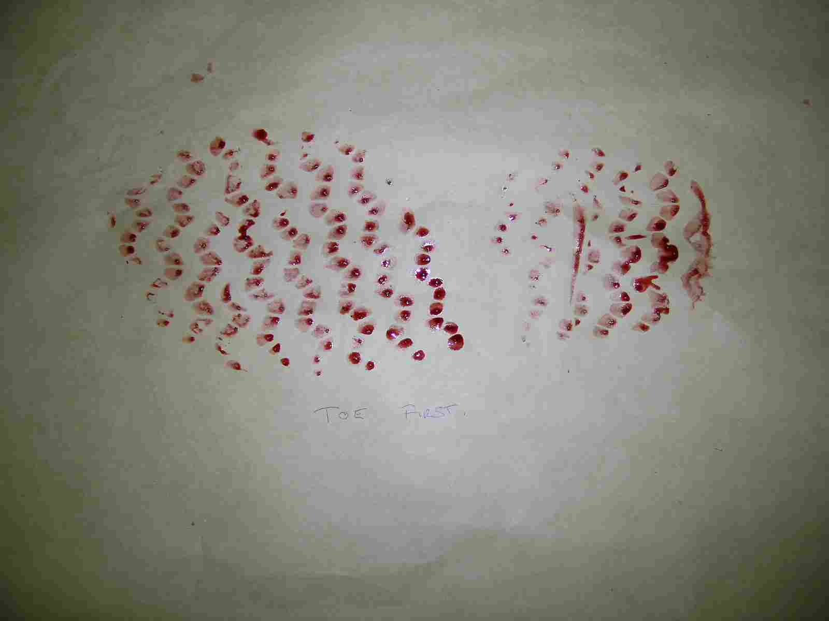
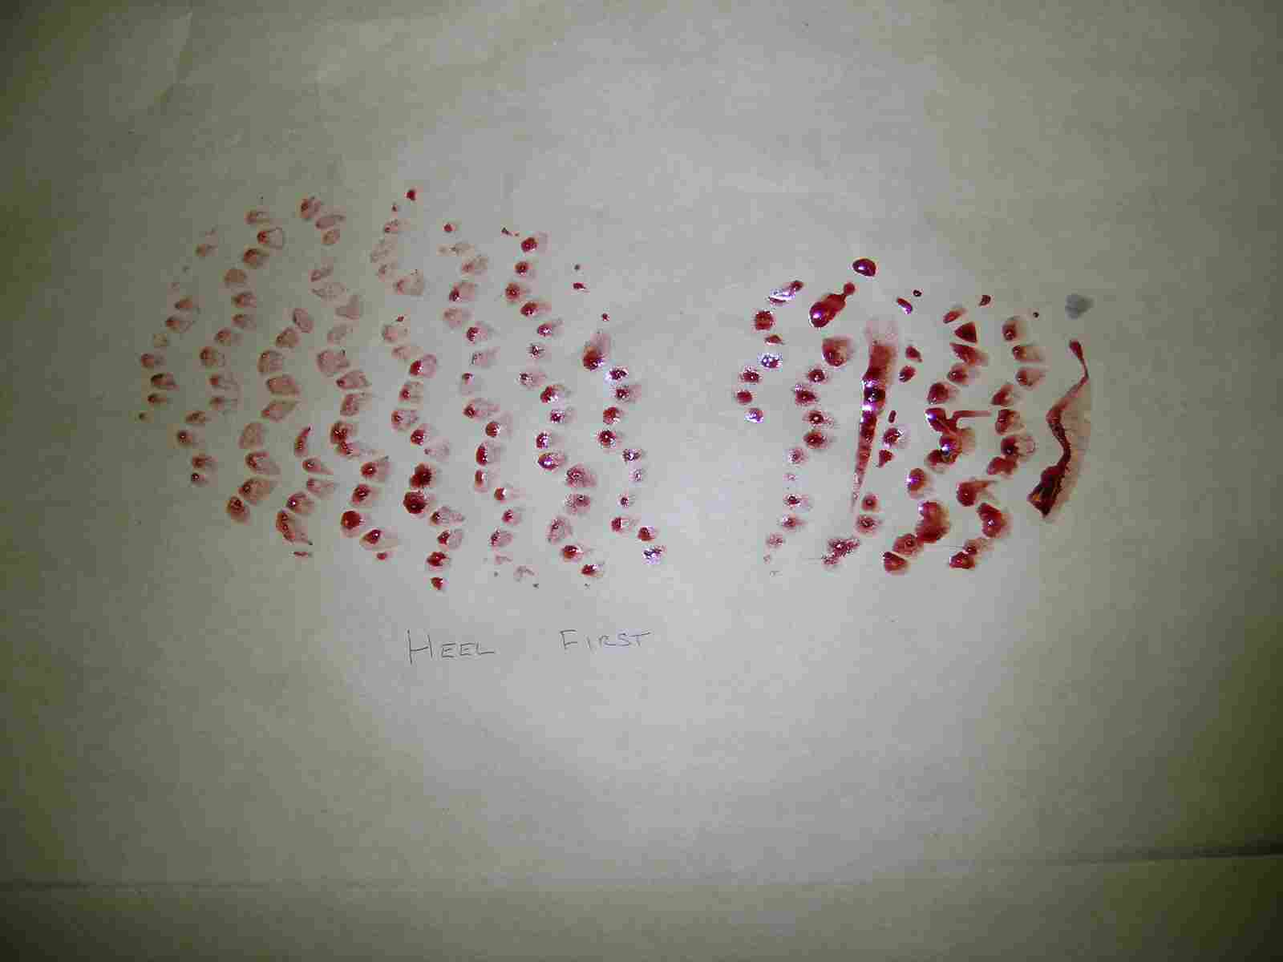
Advancing or retreating??
Toe first
Heel first

Slide 45
Presumptive Tests for Blood Determination
Kastle-Meyer color test—a mixture of phenolphthalein and hydrogen peroxide; the hemoglobin will cause the formation of a deep pink color if blood is present
Hematest® tablet—reacts with the heme group in blood causing a blue-green color
Luminol test—reaction with blood to produce light

Slide 46
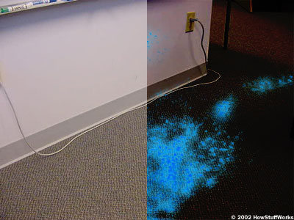
Luminol
The chief catalyst (esp. in old blood samples) is iron.
Can test large areas at once.
Does not degrade DNA or blood antigens

Slide 47
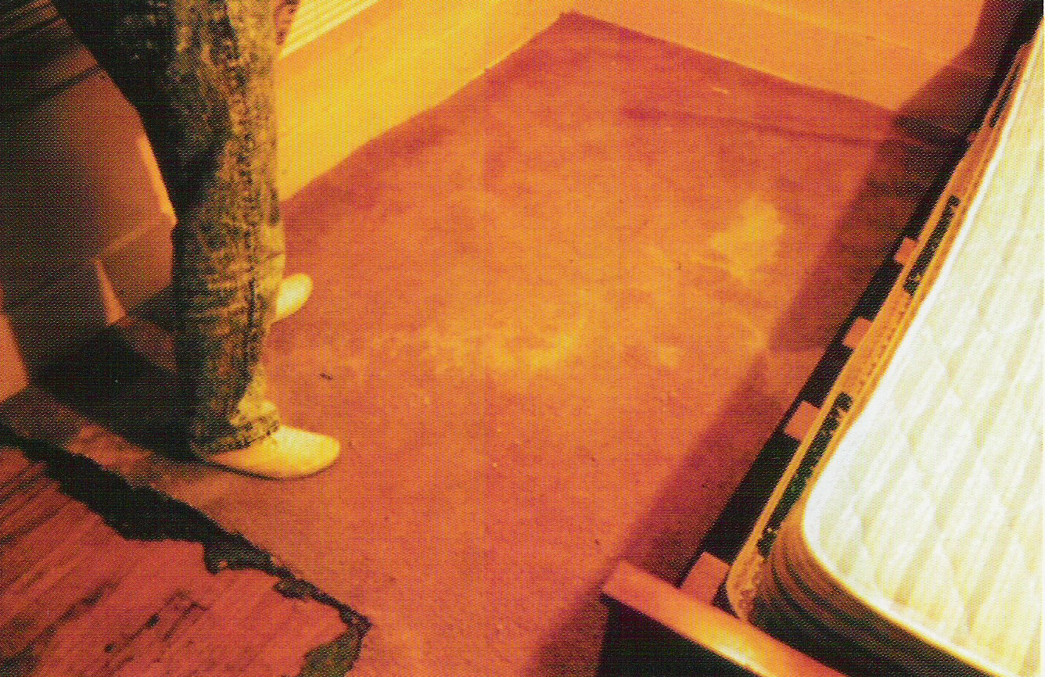
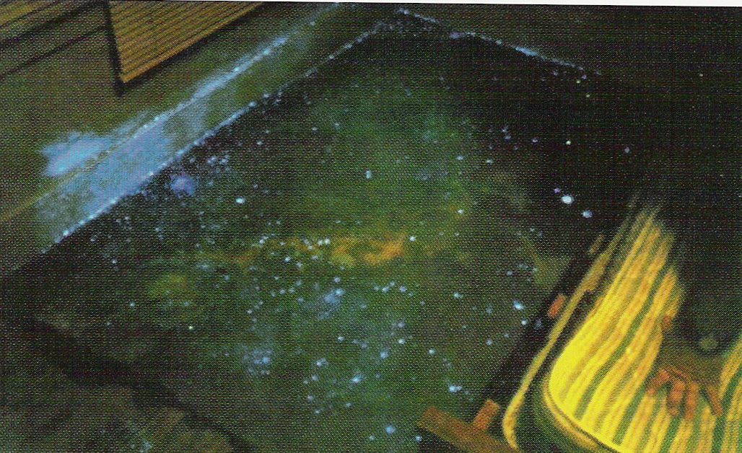
More About Luminol
Luminol also fluoresces in the presence of copper or an alloy of copper, horseradish and certain bleaches.
If a crime scene is thoroughly cleaned with a weak bleach solution, residual bleach will cause the entire crime scene to fluoresce, effectively camouflaging any organic evidence such as blood.

Slide 48
DNA Fingerprinting
Chapter 7
SFS1. Students will recognize and classify various types of evidence in relation to the definition and scope of Forensic Science
SFS3. Students will assess how the analysis of DNA, toxicology, serology, and illicit drugs are used for forensic investigations
Compare short tandem repeat patterns (STR) and relate to identifying the DNA of an individual.
Understand the use of the DNA database for DNA profiling.
most of this ppt comes from K. Kohli’s site

Slide 49
Historical Information
James Watson and Francis Crick—1953 discovered the configuration of the DNA molecule
Alec Jeffreys—1985 isolated DNA markers and called them DNA fingerprints
Kary Mullis—1985 developed PCR testing
1988—FBI starts DNA casework
1998—FBI launches CODIS database

Slide 50
Where Is DNA Found?
DNA is found in all nucleated body cells—white blood cells, semen, saliva, urine, hair root, teeth, bone, tissue
Red blood cells have no nuclei; and therefore, no nuclear DNA

Slide 51
Mitochondrial DNA
Analyzes DNA found in cell mitochondria rather than from the nucleus
Inherited maternally
Uses small amounts of DNA (hair shaft instead of root)
FBI does mitochondrial analysis on case by case basis
Private labs will process - $1500 or more per sample

Slide 52
DNA
DNA is typically a double stranded macromolecule because of nucleotide base pairing
A → T (Always)
C → G (Always)
In humans, the order of these bases is 99.9% the same.

Slide 53
DNA Typing
DNA typing is a method in which DNA is converted into a series of bands that ultimately distinguish each individual.
Only one-tenth of a single percent of DNA differs from one person to the next.
Scientists use these regions to generate a DNA profile of an individual.

Slide 54
Uses of DNA Profiling
To identify potential suspects
To exonerate individuals
To identify crime and casualty victims
To determine maternity or paternity
To match organ donors
To identify human remains

Slide 55
Packaging Biological Evidence
Dried blood is best removed from a surface by using a sterile cotton swab lightly moistened with distilled water.
Standard/reference DNA specimens must also be collected, such as blood or the buccal swab (swabbing the mouth and cheek).
DNA

Slide 56
Avoiding contamination
Use disposable gloves and collection instruments.
Avoid physical contact, talking, sneezing, and coughing in the evidence area.
Air-dry evidence and put it into new paper bags or envelopes.
If evidence cannot be dried, freeze it.
Keep evidence cool and dry during transportation and storage.

Slide 57
Step One: Extraction
Cells are treated with enzymes and detergents to separate the DNA from everything else.

Slide 58
Step Two: Restriction Fragments
DNA is cut in specific places with restriction enzymes.
Different restriction enzymes cut in different places. Several may be used at once.

Slide 59
Step Three: Amplification
Since DNA is usually in very small amounts, a process called polymerase chain reaction (PCR) is used to make more. This step is known as amplification.

Slide 60
Step Four: Gel Electrophoresis
DNA samples are loaded into wells in agar. The agar has tiny pores the DNA can move through.
The loaded agar is placed in a gel box and covered with buffer solution.

Slide 61
Step Four: Gel Electrophoresis (continued)
An electrical current is passed through the box. DNA has a negative charge, so the pieces start to move to the positive end of the gel.
Shorter pieces of DNA travel farther through the gel, leaving a banding pattern.
DNA is stained for viewing.

Slide 62
Step Five: Analyzing Results
Sometimes specific bands are radioactively tagged in a process called Southern blotting to allow specific fragments to be compared.

Slide 63
Step Five: Analyzing Results (continued)
Samples from children have bands that are also found in one or the other of their parents.

Slide 64
DNA Fingerprinting

Slide 65
Short Tandem Repeats
They serve as useful markers for identification because they are found in great abundance throughout the human genome.
STRs are locations on the chromosome that contain short sequences that repeat themselves within the DNA molecule.

Slide 66
STR Advantages
STRs are much less susceptible to degradation and may often be recovered from bodies or stains that have been subjected to extreme decomposition.
Because of their shortness, STRs are ideal candidates for multiplication by PCR, thus overcoming the limited-sample-size problem often associated with crime-scene evidence.

Slide 67
STR’s
A high degree of of individualism can be achieved by analyzing STR’s
Currently, the US has standardized 13 STR’s for entry into CODIS

Slide 68
CODIS
CODIS (Combined DNA Index System) is a computer software program developed by the FBI that maintains local, state, and national databases of DNA profiles from convicted offenders, unsolved crime scene evidence, and profiles of missing persons.

