Slide 1
Forensic Entomology

Slide 2
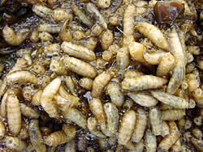
After Death
As the body decays, odors attract insects to the dead body.
The flies are the first to arrive. Blowflies and flesh flies are flesh feeders and will be the first in line.
If no trauma is present on the body, female blowflies will lay eggs in exposed body openings.

Slide 3
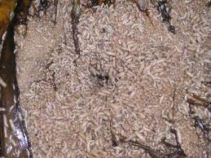
Estimating Time of Death
Factors affecting insect development
Temperature
Wind
Time of day
Season
Exposure to elements
Estimation of time of death obtained by raising insects from scene in same conditions at lab.
Process is known as Accumulated Degree Hours (ADH)
scienceinschool.org

Slide 4
Image: http://www.nlm.nih.gov/visibleproofs

Slide 5
Phormia regina
Spiracles are incomplete
Third-instar larvae

Slide 6
Phaenicia sp
Spiracles are complete
Third-instar larvae

Slide 7
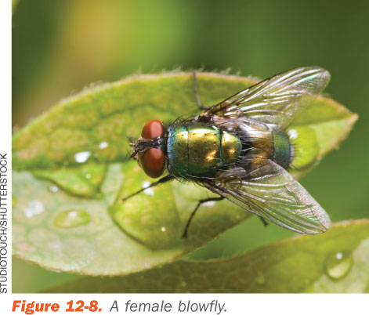
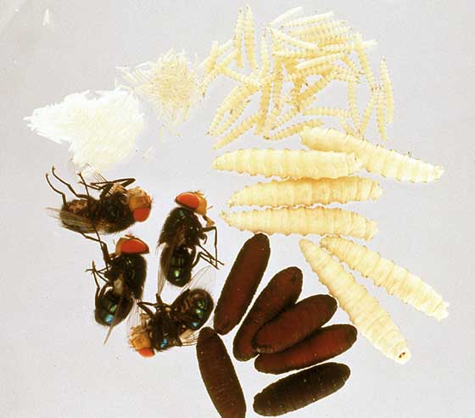
Postmortem Interval - PMI
Postmortem Interval- the time elapsed since a person died
When longer than 72 hours after death, entomology becomes important
Within 48 hours the female blowfly lays eggs in moist areas of the body

Slide 8
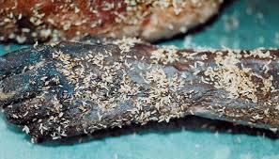
Postmortem Interval - PMI
Entomological evidence collection
Identify the species
Document larvae length
Determine the instar
Determine PMI
documentingreality.com

Slide 9
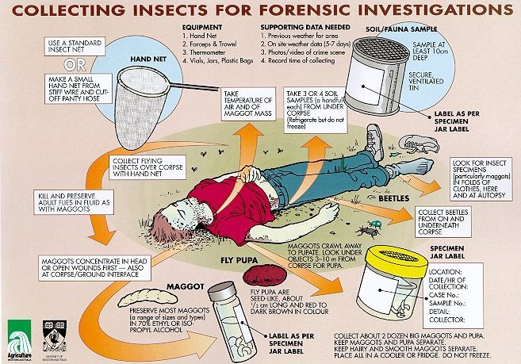

Slide 10
Applications
Time of injury vs. death
Estimation of time of death
Whether or not a corpse has been moved
Instances of insects as weapons
Child and elderly abuse and neglect
Single vehicle car accidents

