Slide 1
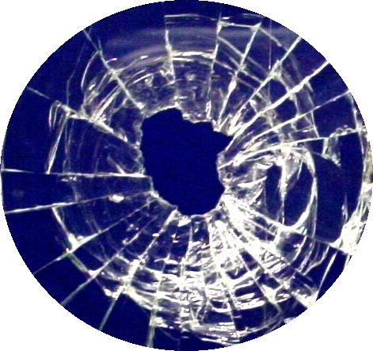
Glass Evidence

Slide 2
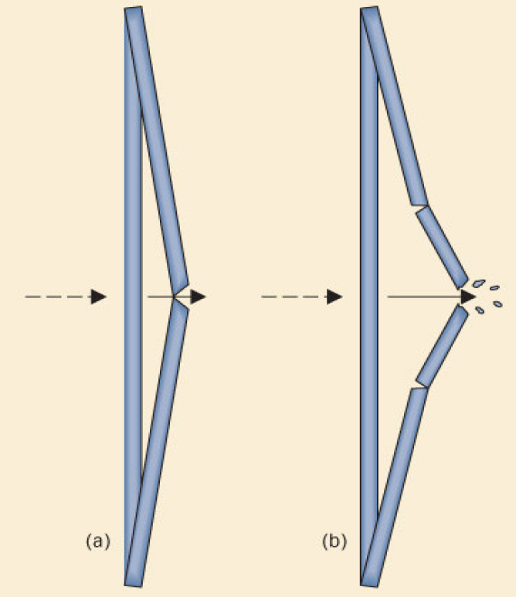
Crack patterns
Radial cracks are first to form. They are on the side opposite to force.
Concentric cracks form second, beginning on side of force.

Slide 3
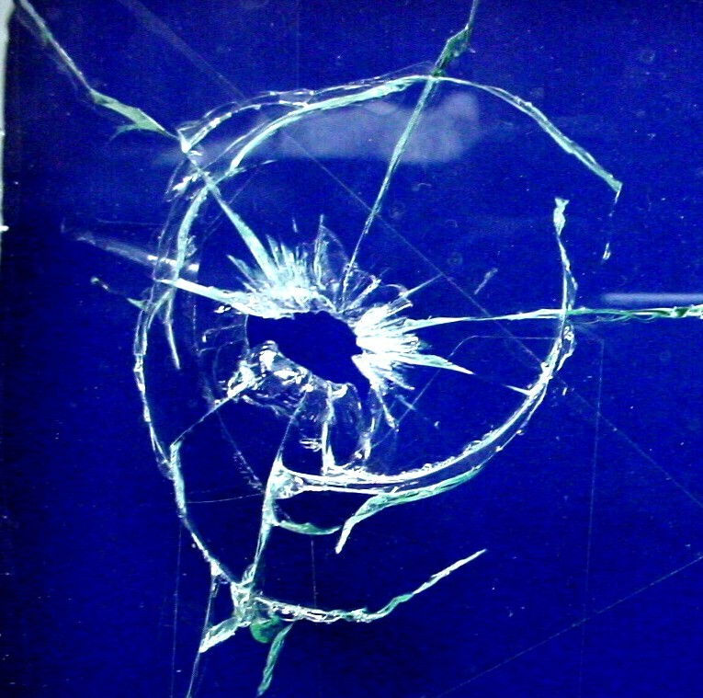
Fractures
Concentric
Radial
bsapp.com

Slide 4
Notes:
This is tempered glass. Used for things like windshield, patio doors, and shower doors. Also known as safety glass.

Slide 5
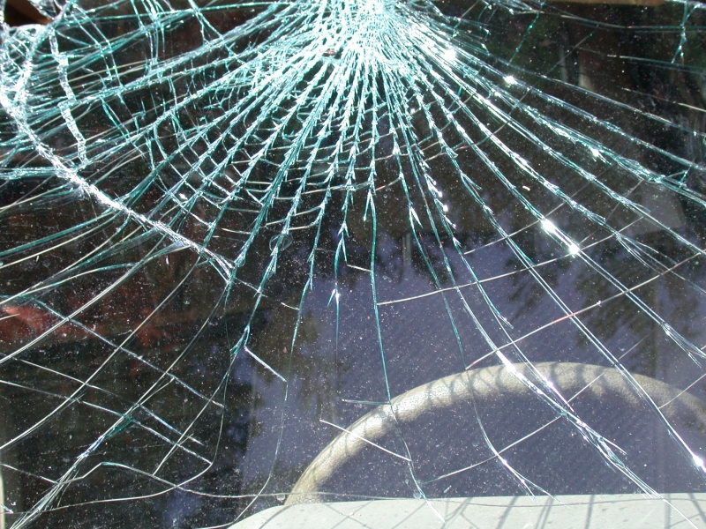
Notes:
Sometimes tempered glass breaks in a spiderweb pattern

Slide 6
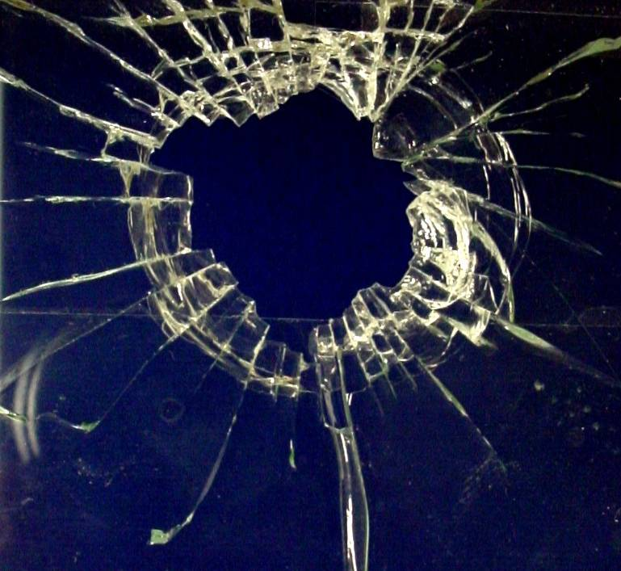
bsapp.com

Slide 7
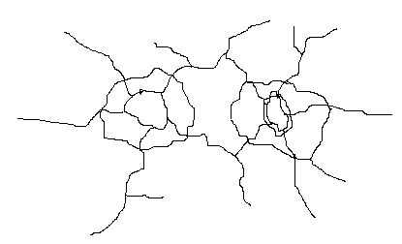
Determining Sequence
It is possible to determine the order cracks occurred in, because new cracks stop when they hit old cracks.

Slide 8
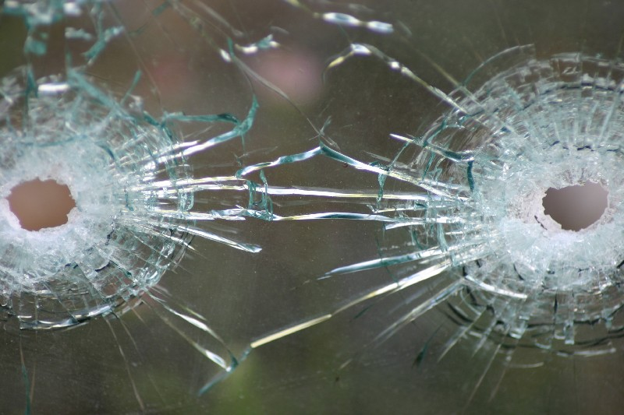
Which bullet was fired first?
1
2

Slide 9
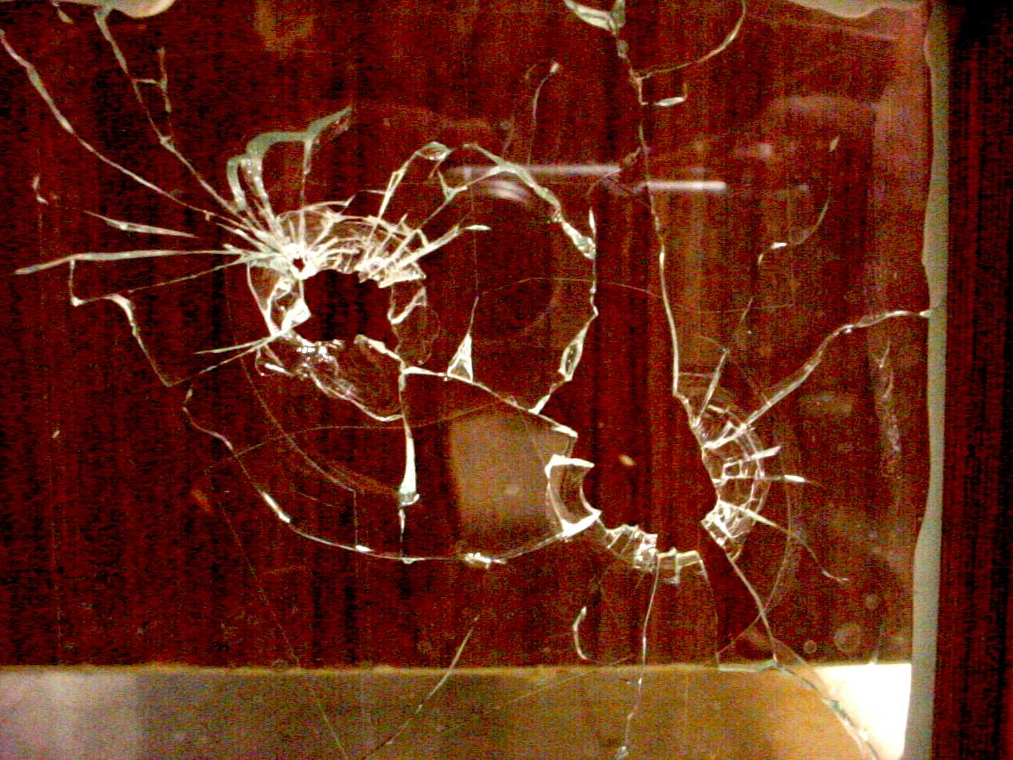
1
2
bsapp.com

Slide 10
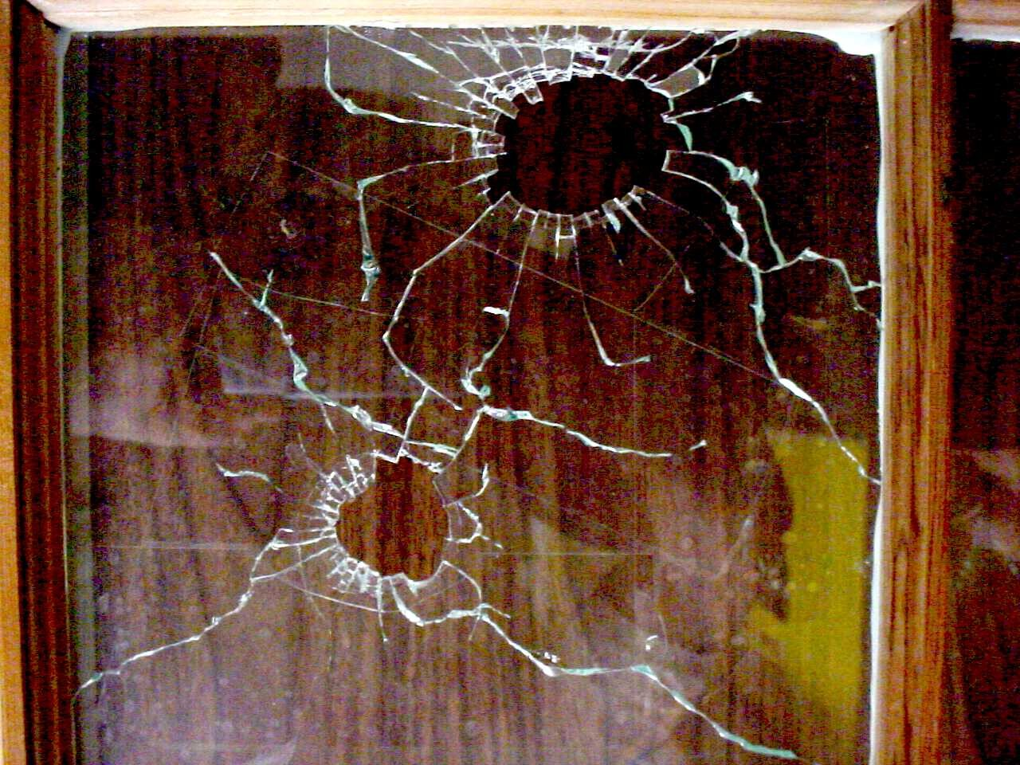
1
2
bsapp.com

Slide 11
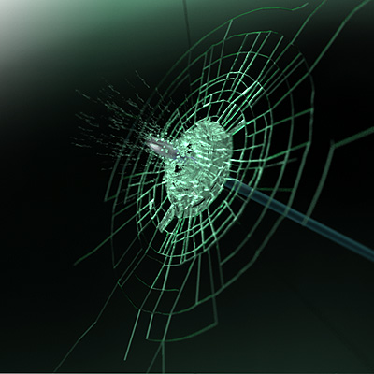
Determining Direction of Impact
High speed projectiles like bullets often leave holes that are wider at the exit side.

Slide 12
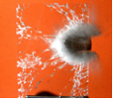
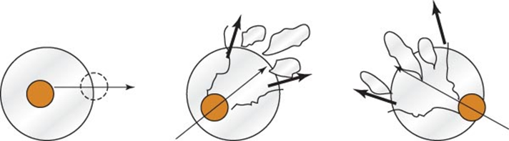
Path of a Bullet Passing through Window Glass
The entry hole will be round if the bullet was fired perpendicular to the pane.
If fired from an angle, glass pieces will be forced out to the opposite side from the shot.
The angles at which bullets enter window glass can help locate the position of the shooter.

Slide 13
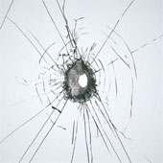
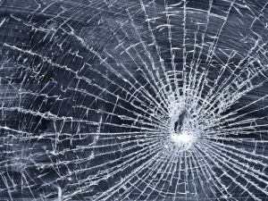
Speed of Impact
Higher speed impacts produce fewer concentric fractures than lower speed impacts.
Look at the hole in the glass. Can you tell which side is the entrance?

Slide 14
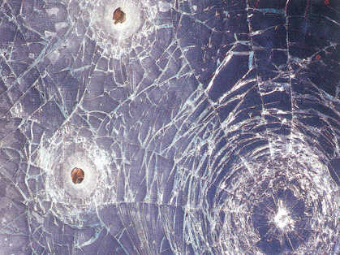
What direction, and in what order?
1
3
2

Slide 15
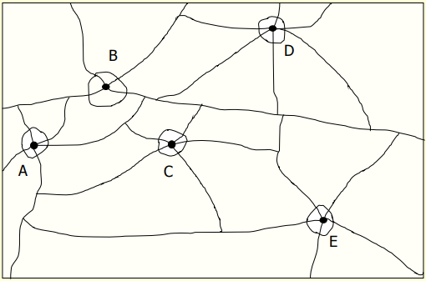

Slide 16
Backscatter
Most glass fragments will be carried forward during impact, showing the direction force came from.
Some will be projected backwards. This is backscatter, and is sometimes trace evidence found on the perpetrator.

Slide 17
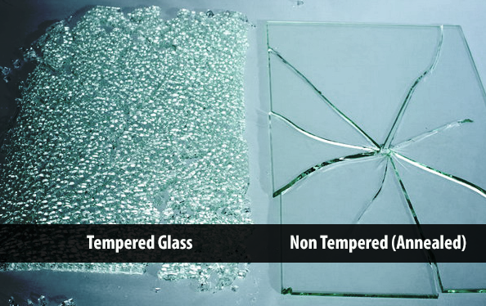
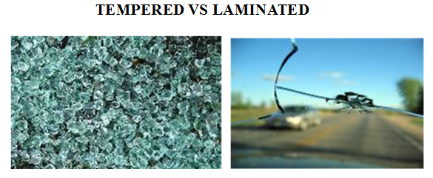
COMMON TYPES OF GLASS
  Soda-lime—used in plate and window glass, glass containers, and electric lightbulbs
  Soda-lead—fine tableware and art objects
  Borosilicate —heat-resistant, like Pyrex
  Silica —used in chemical ware
  Tempered —used in side windows of cars
  Laminated —used in the windshield of most cars

Slide 18
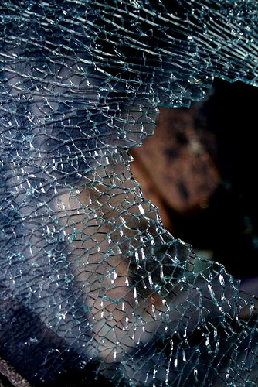
Tempered Glass
Glass is made stronger through the rapid heating and cooling of the glass surfaces. Chemicals can also be used to make this “toughened glass”.
Tempered glass does not shatter, it “dices” into small squares
Used in passenger windows

Slide 19
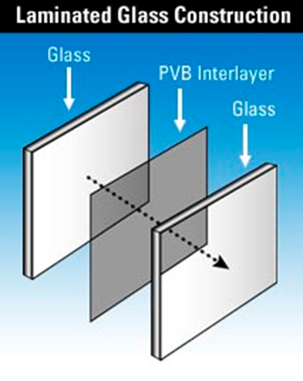
Laminated Glass
Two layers of glass with plastic in middle.
Used in windshields, patio doors, etc.
Harder to recognize fracture patterns.

Slide 20
Density - Common Examples
When glass is found, density is one of the physical characteristics measured. Different types have different densities
Type of Glass | Density (g/ml)
Bottle glass | 2.50
Window glass | 2.53
Lead crystal | 2.98-3.01
Pyrex | 2.27
Tempered (auto) | 2.98
Flint | 3.70
Crown | 2.50

Slide 21
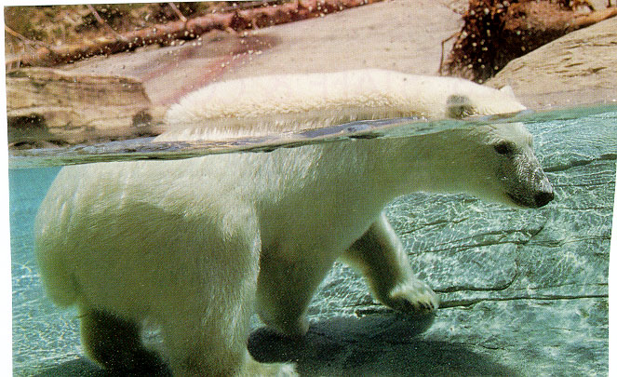
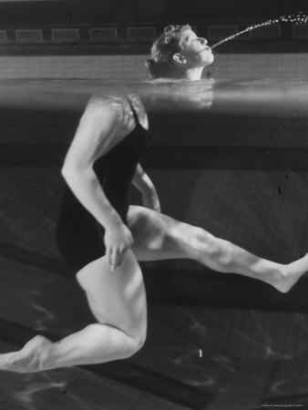
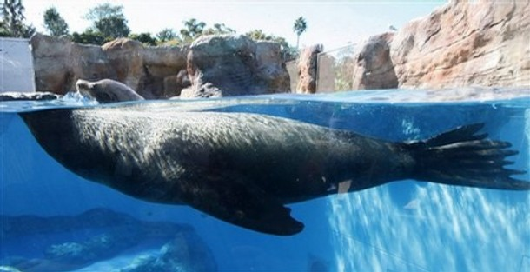
What is going on here?
Notes:
21

Slide 22
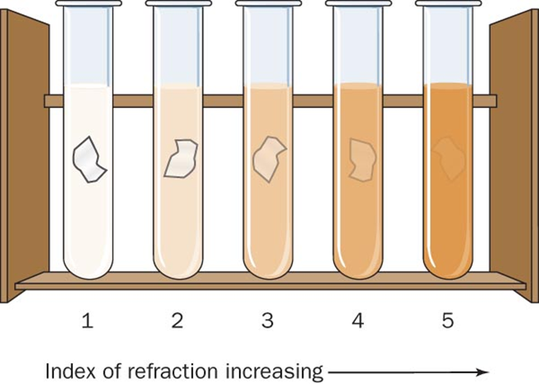
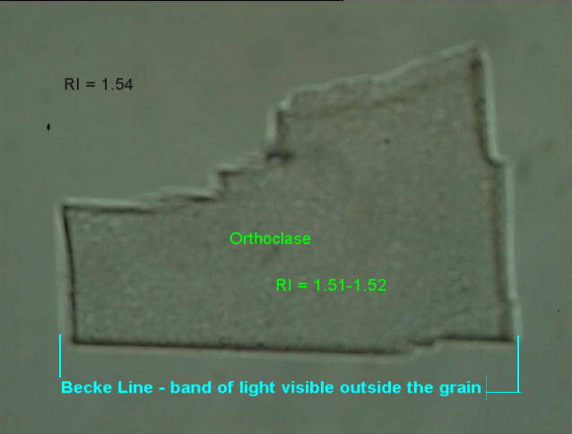
Refractive Index
Immersion – glass particles are immersed in liquid whose refractive index is varied until it is equal to that of the glass
The “match point” is noted by the disappearance of the Becke Line
Becke Line –a bright halo that is observed near the border of a particle immersed in a liquid of a different refractive index

Slide 23
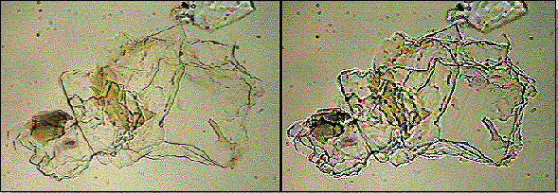
The glass starts to disappear as you get closer to its refractive index. Fewer halos are seen.

Slide 24
Handling of Crime Scene Glass Samples
Identify and photograph any glass samples before moving them.
Collect the largest fragments that can be reasonably collected.
Identify the outside and inside surface of any glass.
If multiple panes are involved, make a diagram.
Note trace evidence such as skin, hair, blood, or fibers.
Package all materials collected to maintain the chain of custody.

