Slide 1
Chapter 19
Global Change
Friedland and Relyea Environmental Science for AP®, second edition
© 2015 W.H. Freeman and Company/BFW
AP® is a trademark registered and/or owned by the College Board®, which was not involved in the production of, and does not endorse, this product.

Slide 2
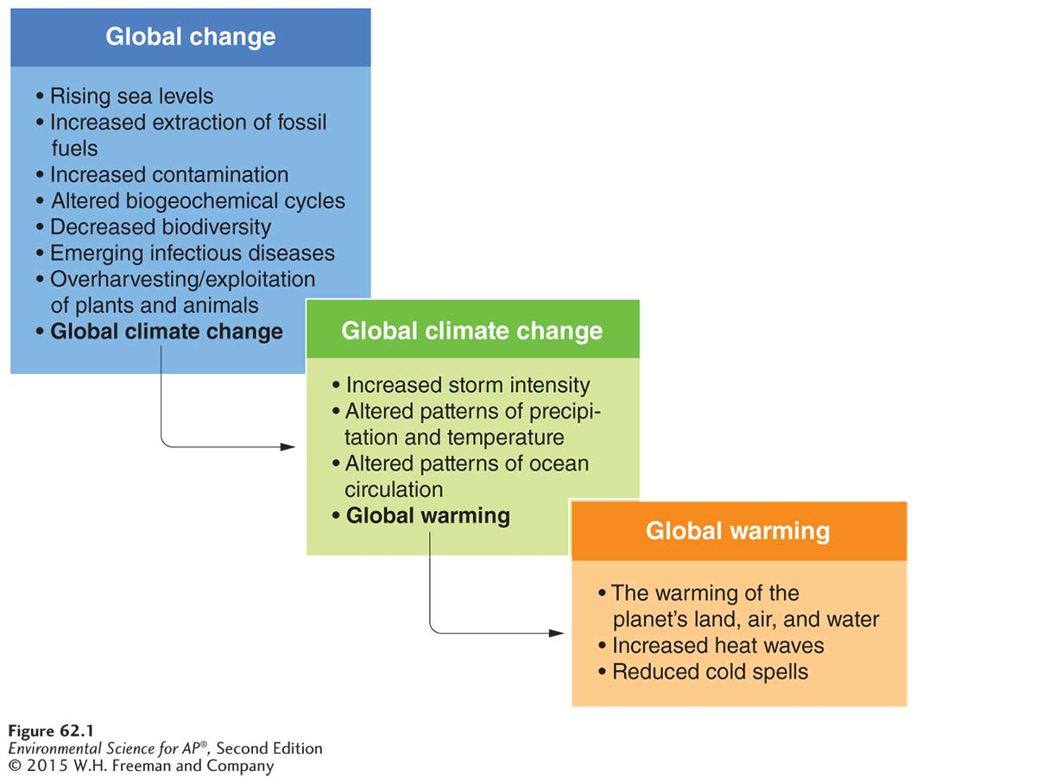
Global Change
Global change includes a wide variety of factors that are changing over time.
Global climate change refers to those factors that affect the average weather in an area of Earth.
Global warming refers to changes in temperature in an area.

Slide 3
Solar radiation and greenhouse gases make our planet warm
When radiation from the sun hits the atmosphere, one-third is reflected back.
Some of the UV radiation is absorbed by the ozone layer.
Remaining UV passes through the atmosphere and strikes the Earth where it is converted into low-energy infrared radiation.
The infrared radiation then goes back toward the atmosphere where it is absorbed by greenhouse gasses that radiate most of it back to the Earth.
Greenhouse effect Absorption of infrared radiation by atmospheric gases and reradiation of the energy back toward Earth.

Slide 4
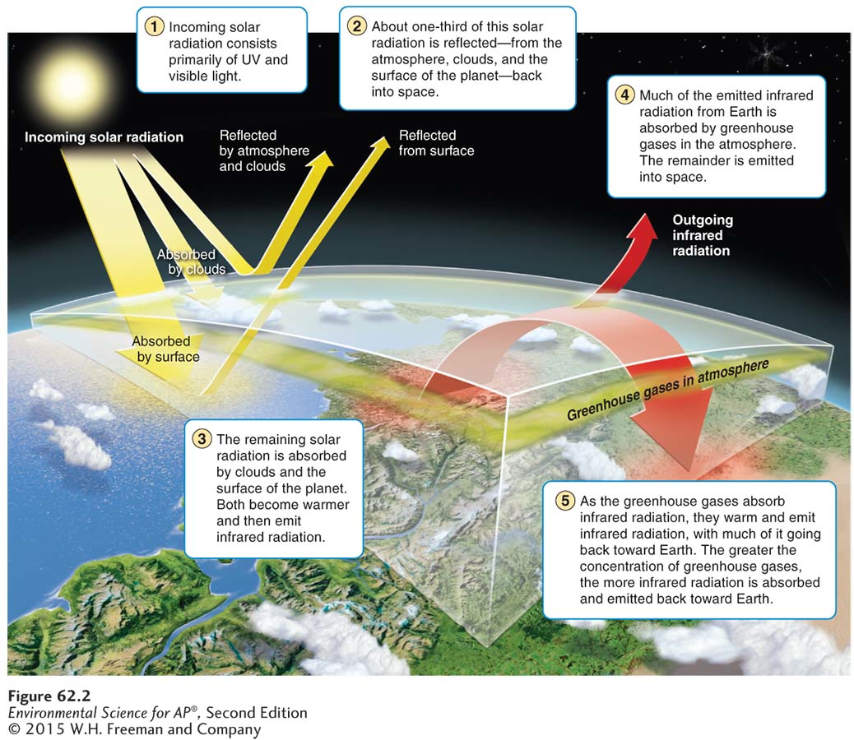
The Greenhouse Effect
The greenhouse effect. When the high-energy radiation from the Sun strikes the atmosphere, about one-third is reflected from the atmosphere, clouds, and the surface of the planet. Much of the high-energy ultraviolet radiation is absorbed by the ozone layer where it is converted to low-energy infrared radiation. Some of the ultraviolet radiation and much of the visible light strikes the land and water of Earth where it is also converted into low-energy infrared radiation. The infrared radiation radiates back toward the atmosphere where it is absorbed by greenhouse gases that radiate much of it back toward the
surface of Earth. Collectively, these processes cause warming of the planet.

Slide 5
The Gases That Cause the Greenhouse Effect
The major greenhouse gases are:
Water vapor (H₂O)
Carbon dioxide (CO₂)
Methane (CH₄)
Nitrous oxide (N₂O)
Fluorinated gases

Slide 6
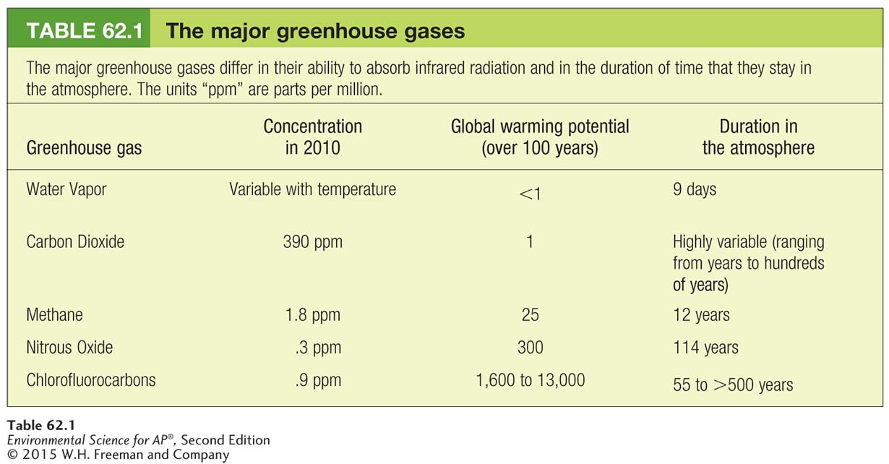
Greenhouse warming potential An estimate of how much a molecule of any compound can contribute to global warming over a period of 100 years relative to a molecule of CO₂.

Slide 7
Sources of greenhouse gases are both natural and anthropogenic
Some greenhouse gases are produced from natural sources:
Volcanic eruptions: ash, carbon dioxide,
Decomposition and digestion: methane
Denitrification: nitrous oxide
Evaporation and evapotranspiration: water vapor

Slide 8
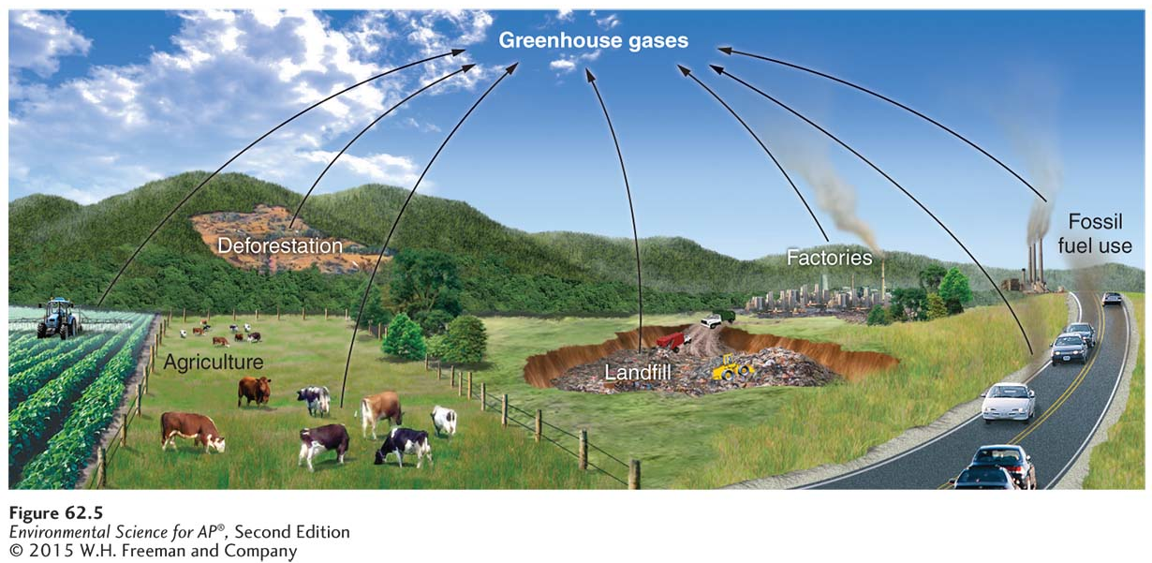
Anthropogenic Causes of Greenhouse Gases
Some greenhouse gases are produced by human activity:
Burning of fossil fuels
Agricultural practices
Deforestation
Landfills
Industrial production

Slide 9
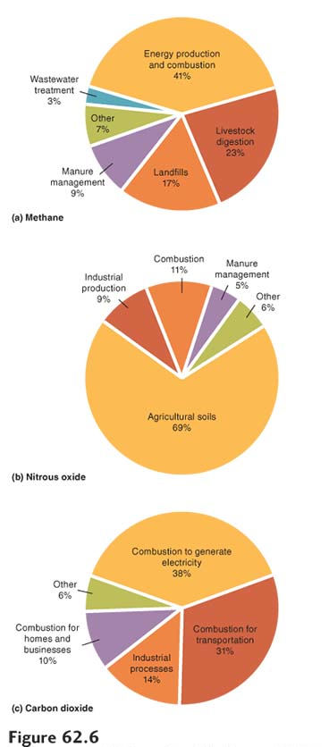
Anthropogenic Causes of Greenhouse Gases
Anthropogenic sources of greenhouse gases in the USA
(a) The largest contributions of methane in the atmosphere arise from gut bacteria that help many livestock species digest plant matter, landfills that experience decomposition in low-oxygen environments, and the production, storage, and transport of natural gas and petroleum products from which methane escapes.
(b) The largest contributions of nitrous oxide (N2O) in the atmosphere arise from the agricultural soils that obtain nitrogen from applied fertilizers, combustion, and industrial production of fertilizers and other products.
(c) Nearly all anthropogenic CO₂ emissions come from the burning of fossil fuels.

Slide 10
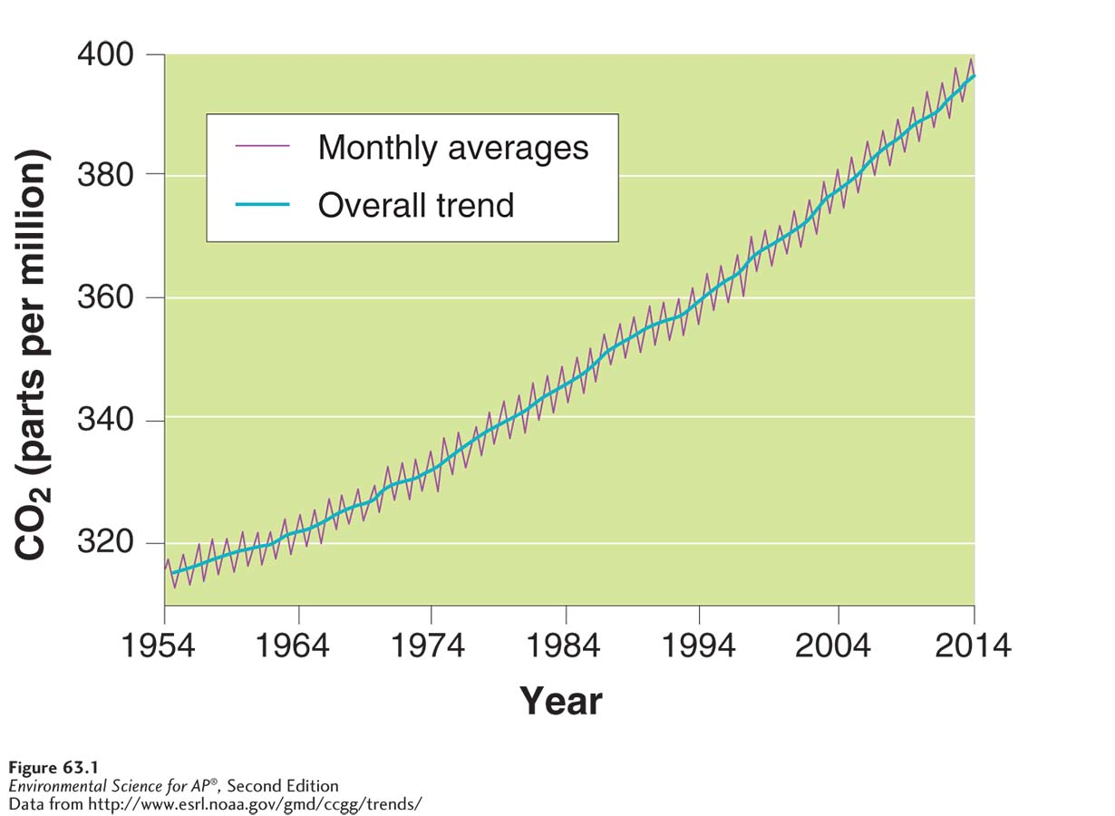
CO₂ concentrations have been increasing for the past 6 decades
Ocean acidification The process by which an increase in ocean CO₂ causes more CO₂ to be converted to carbonic acid, which lowers the pH of the water.
Changes in atmospheric CO₂ over time. Carbon dioxide levels have risen steadily since measurement
began in 1958.

Slide 11
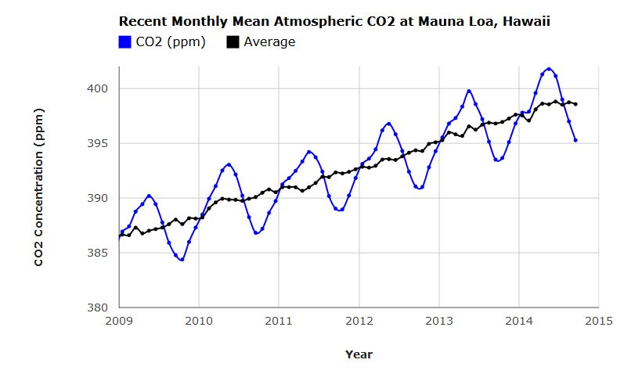

Slide 12
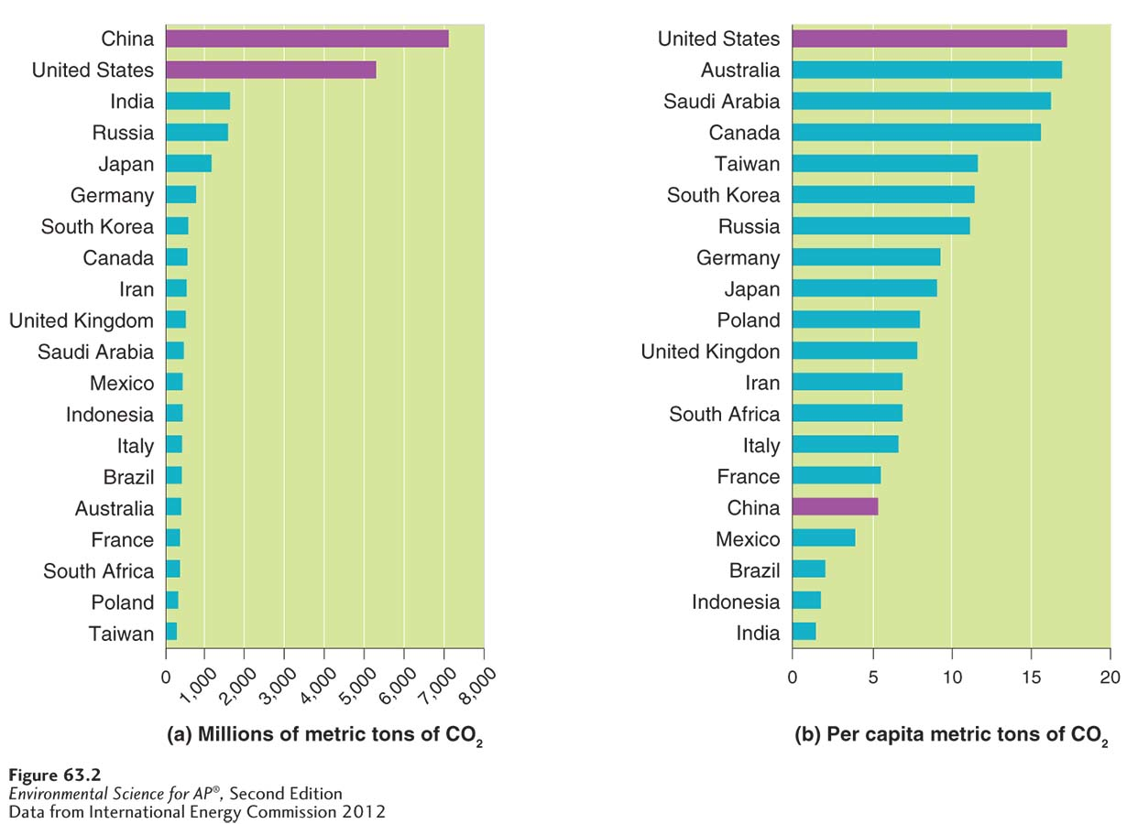
CO₂ emissions differ among nations
CO₂ emissions by country in 2010. (a) When we consider the total amount of CO₂ produced by a country, we see that the largest contributors are the developed and rapidly developing countries of the world. (b) On a per capita basis, some major CO₂ emitters have relatively low per capita CO₂ emissions.

Slide 13
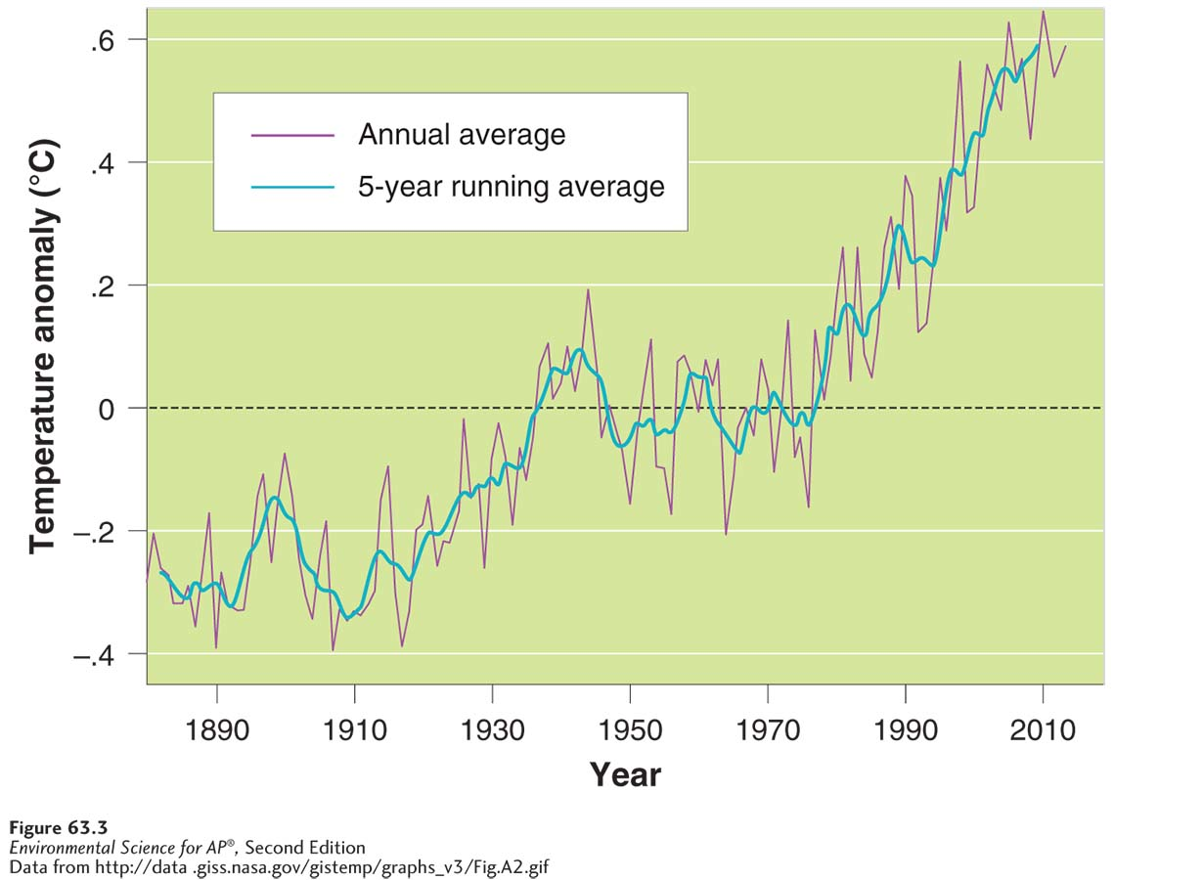
Global temperatures have steadily increased since records began in 1880
Changes in mean global temperatures over time. Although annual mean temperatures can vary from year to year, temperatures have exhibited a slow increase from 1880 to 2012. This pattern becomes much clearer when scientists compute the average temperature each year for the past 5 years.

Slide 14
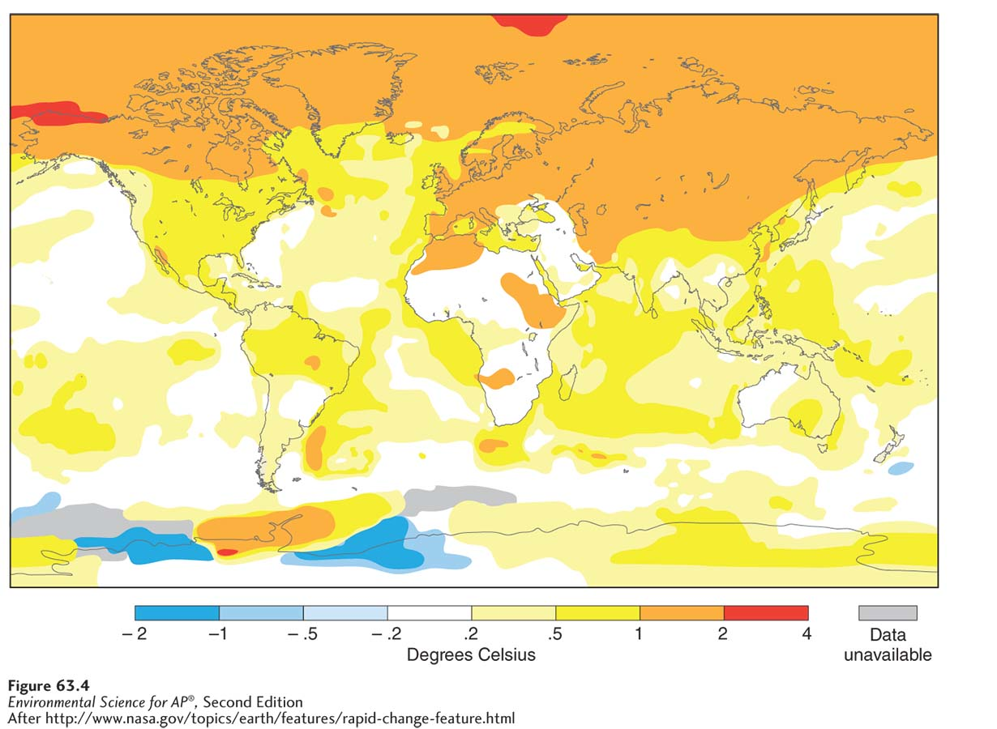
Global Temperatures Since 1880
Changes in mean annual temperature in different regions of the world. In 2010, some regions became cooler, some regions had no temperature change, and the northern latitudes became substantially warmer than the long term average temperature. The surface temperatures plotted on the map represent differences relative to the average temperature
from 1951 to 1980.

Slide 15
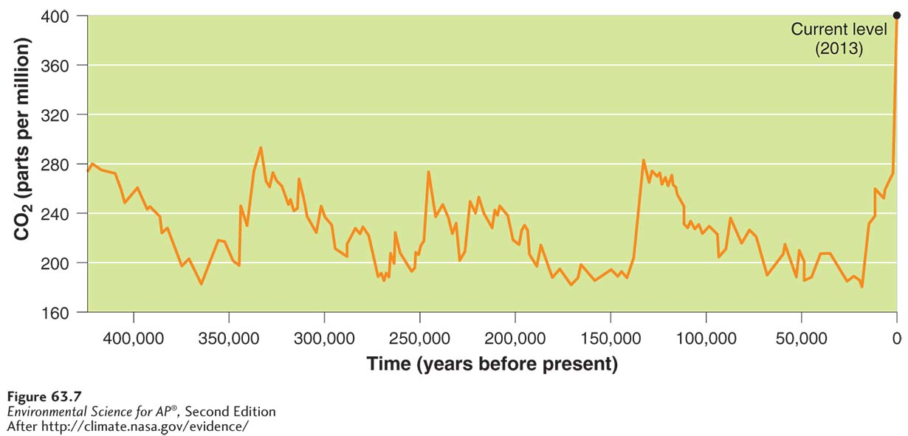
Scientists can estimate global temperatures and greenhouse gas concentrations for over 5,000 years
Historic CO₂ concentrations. Using a variety of indirect indicators including air bubbles trapped in ancient ice cores, scientists have found that for more than 400,000 years CO₂ concentrations never exceeded 300 ppm. After 1950, CO₂ concentrations have sharply increased to their current level of nearly 400 ppm.

Slide 16
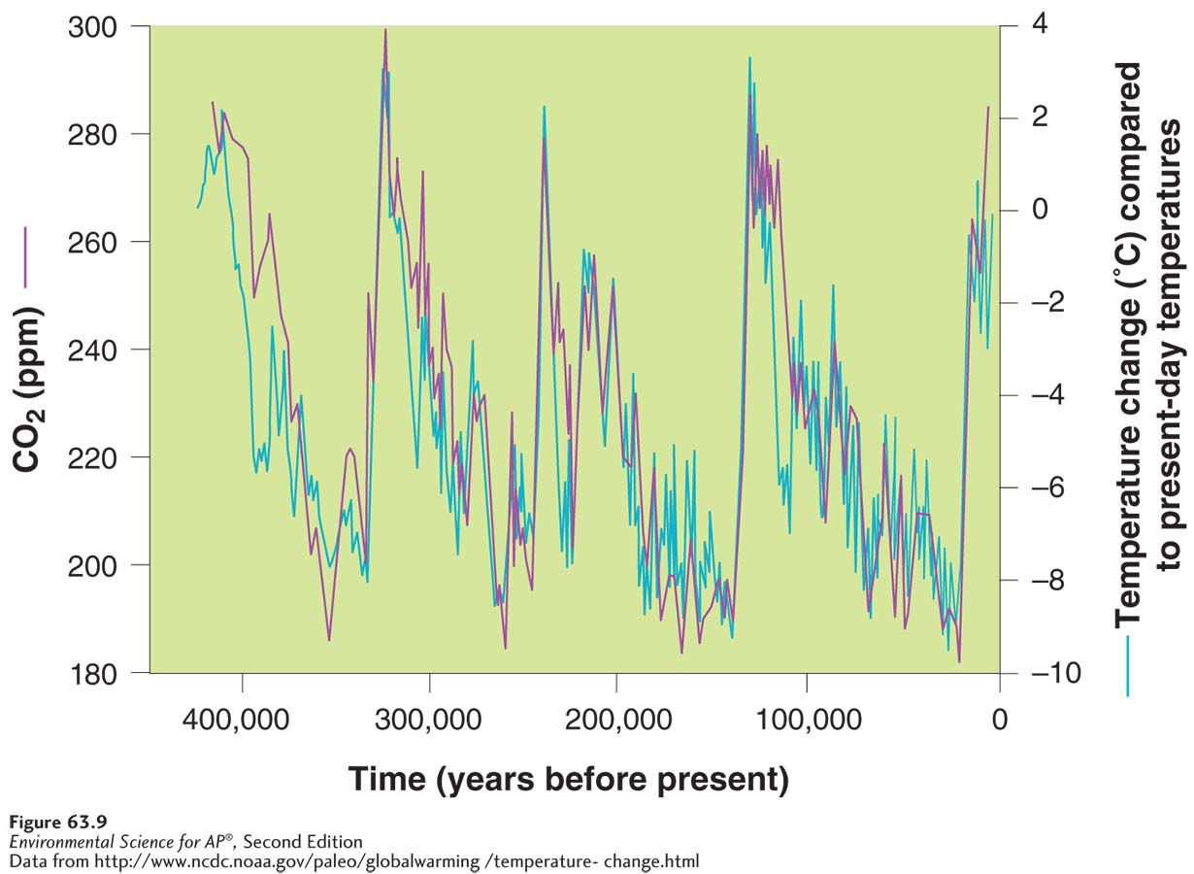
Historic Greenhouse Gas Concentrations
Historic temperature and CO₂ concentrations. Ice cores used to estimate historic temperatures and CO₂ concentrations indicate that the two factors vary together.

Slide 17
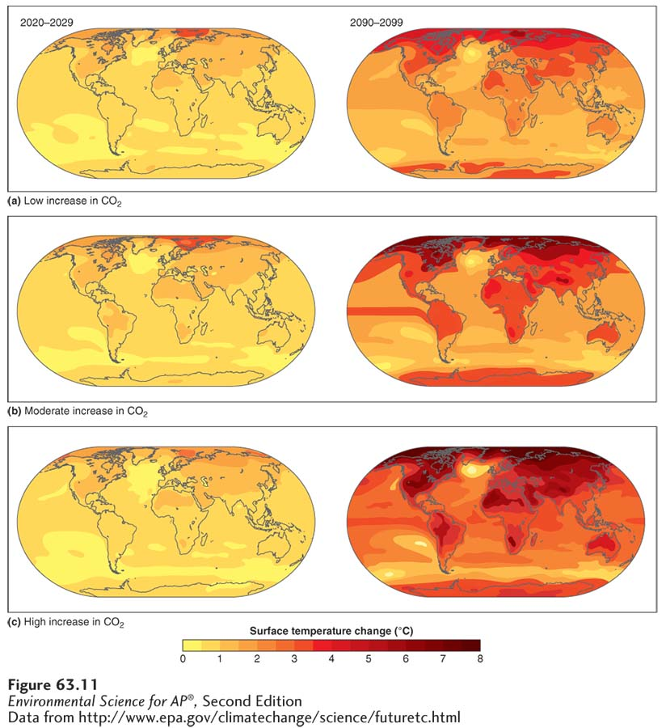
Climate Models and the Prediction of Future Global Temperatures
Predicted increase in global temperatures by 2100.
The predictions depend on whether we expect (a) low, (b) moderate, or (c) high increases in how much CO₂ the world emits during the current century. These changes in temperature are relative to the mean temperatures from 1961 to 1990.

Slide 18
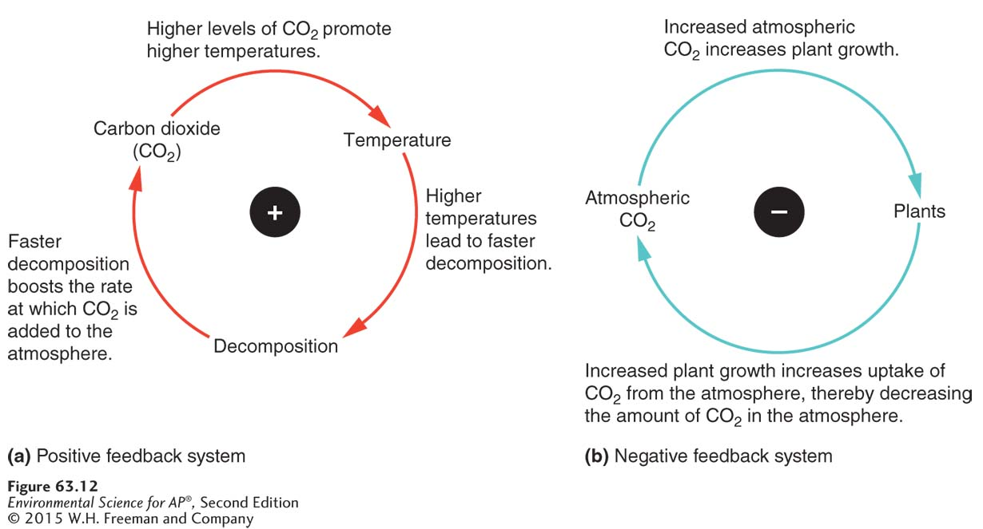
Feedbacks can increase or decrease the impact of climate change
Temperature and CO₂ represent a positive feedback system. When the concentration of CO₂ increases in the atmosphere, it can cause global temperatures to increase. This in turn can cause more rapid decomposition, thereby releasing even more CO₂ into the atmosphere.
(Carbon dioxide and producers represent a negative feedback system. Increased CO₂ in the atmosphere from anthropogenic sources can be partially removed by increased photosynthesis by producers.

Slide 19
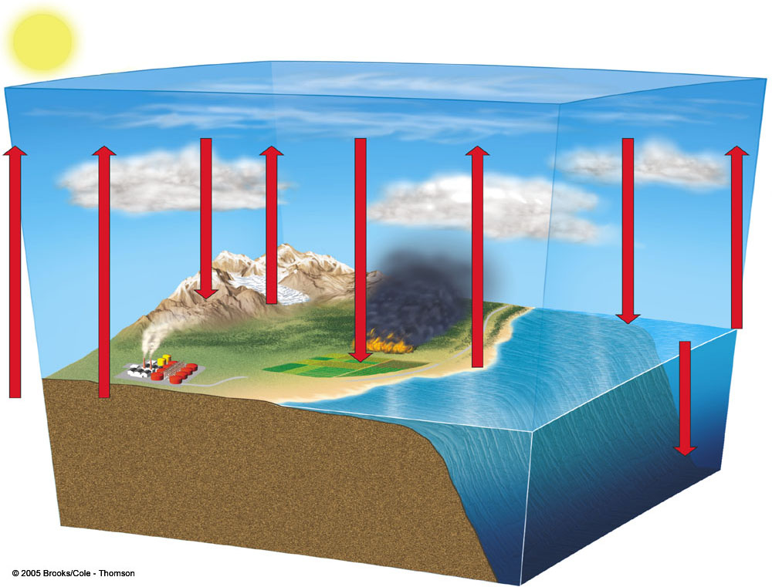
simplified climate model
Troposphere
Cooling from increase
CO₂ removal by plants and soil organisms
CO₂ emissions from land cleaning, fires, and decay
Aerosols
Warming
from
decrease
Heat and
CO₂ removal
Heat and
CO₂ emissions
Greenhouse
gases
Ice and snow cover
Shallow ocean
Land and soil biotoa
Long-term
storage
Natural and human emissions
Deep ocean

Slide 20
Global climate change is already affecting the environment:
Melting of polar ice caps, Greenland and Antarctica
Melting of many glaciers around the world
Melting of permafrost
Rising of sea levels due to the melting of glaciers and ice sheets and as water warms it expands
Heat waves
Cold spells
Change in precipitation patterns
Increase in storm intensity
Shift in ocean currents

Slide 21
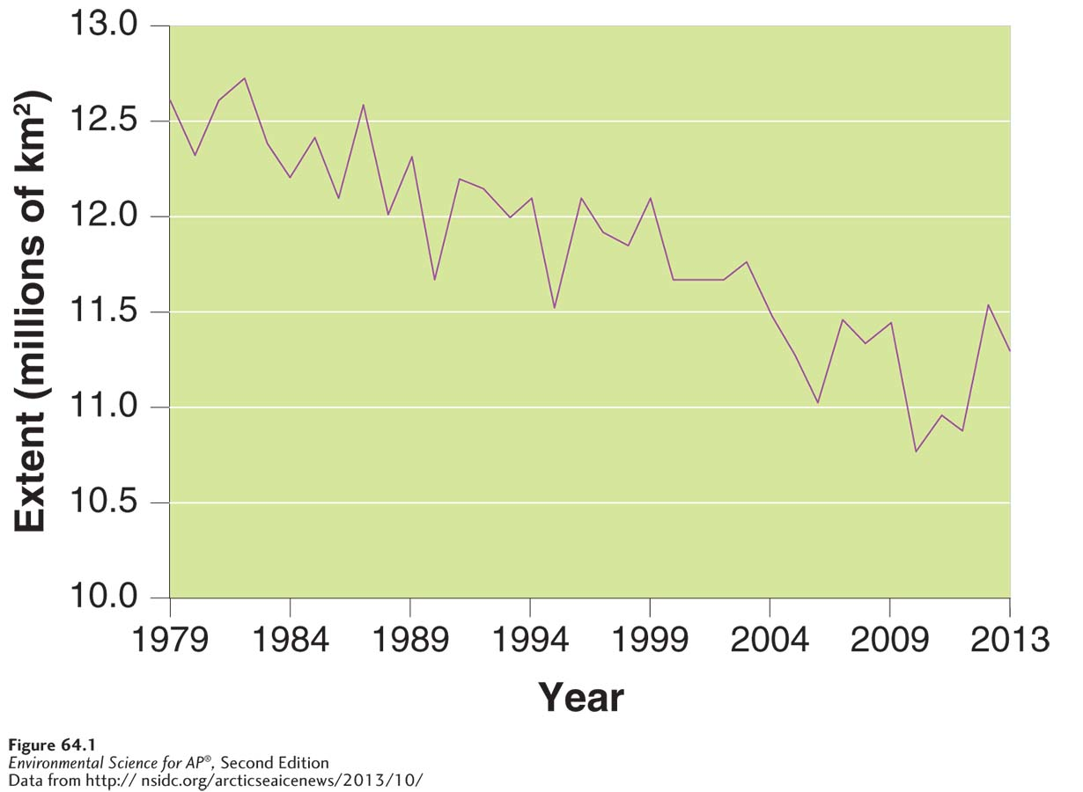
The Effects of Global Climate Change
The melting polar ice cap. Because northern latitudes have experienced the greatest amount of global warming, the extent of the ice cap near the North Pole has been declining over the past 3 decades. The polar ice cap reaches its minimum late in the summer of each year, so we can look for a trend by examining the extent of ice each September. From 1979 to 2013, the polar ice declined an average of 14 percent per decade.

Slide 22
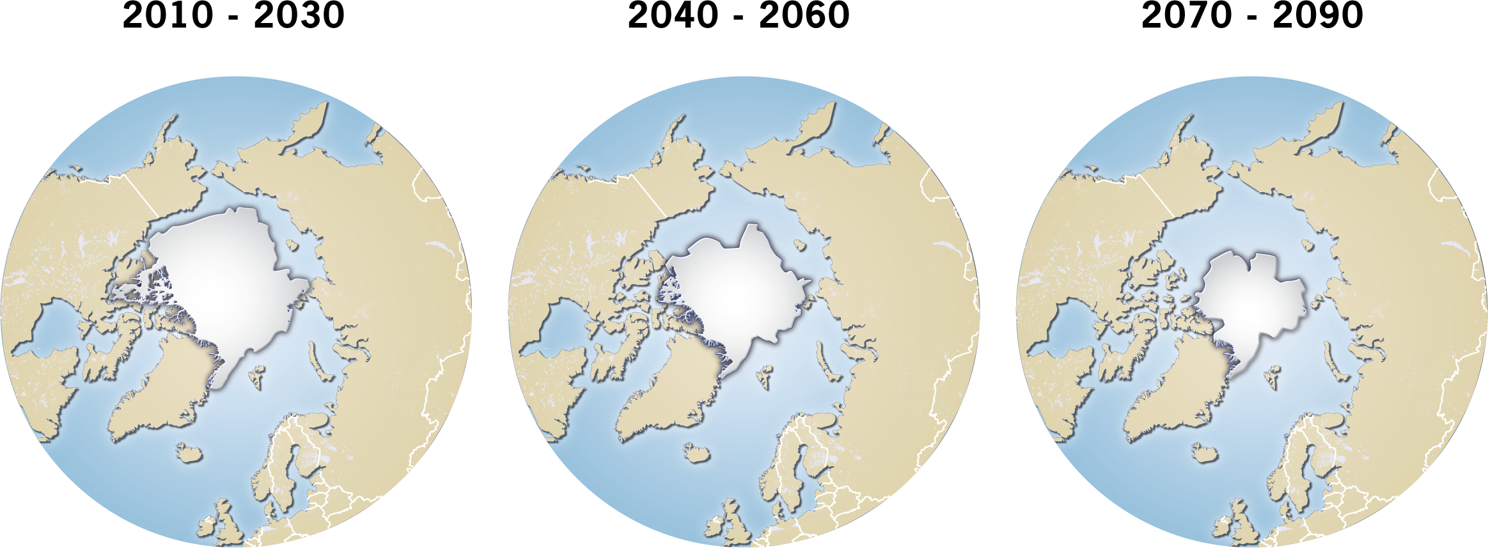
Pack ice predictions

Slide 23
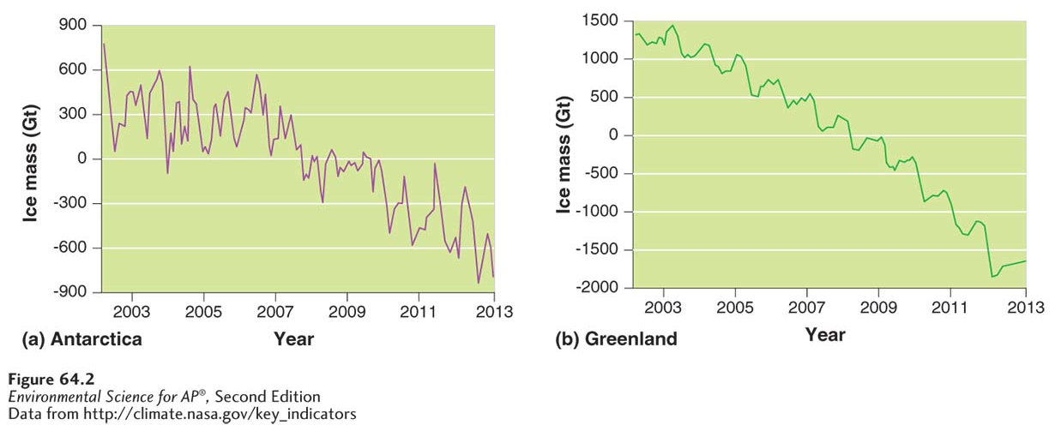
The Effects of Global Climate Change
Declining ice in Antarctica and Greenland. Measurements of ice mass from 2002 to 2013 have detected decline in both (a) Antarctica and (b) Greenland.

Slide 24
Global climate change is already affecting organisms
Wild plants and animals can be affected. The growing season for plants has changed and animals have the potential to be harmed if they can’t move to more appropriate climates.
Humans may have to relocate, some diseases like those carried by mosquitoes could increase and there could be economic consequences.
Corals are particularly sensitive to global warming because their rand of temperature tolerance is quite small.

Slide 25
The Kyoto Protocol addresses climate change at the international level
Kyoto Protocol An international agreement that sets a goal for global emissions of greenhouse gases from all industrialized countries to be reduced by 5.2 percent below their 1990 levels by 2012.
Although the United States signed the original Kyoto Protocol, the U.S. Congress never ratified the agreement and the protocol has never been legally binding on the United States.
In 2005 mayors from 141 U.S. cities and both major political parties gathered in San Francisco to organize their own efforts to reduce the causes and consequences of global warming.

Slide 26
Carbon Sequestration
Carbon sequestration An approach to stabilizing greenhouse gases by removing CO₂ from the atmosphere.
Some methods include storing carbon in agricultural soils or retiring agricultural land and allowing it to become pasture or forest.
Researchers are looking at cost-effective ways of capturing CO₂ from the air, from coal-burning power stations, and from other emission sources.
This captured CO₂ would be compressed and pumped into abandoned oil wells or the deep ocean.

Slide 27
What can we do?
Reduce deforestation
Plant trees
Reduce fossil fuel combustion
Conserve energy
Switch to renewable fuel sources
Eat lower on food chain!

Slide 28
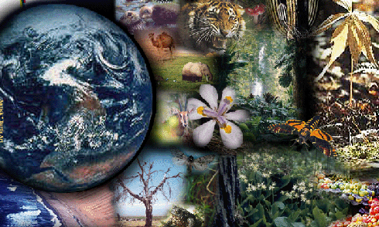
Global Biodiversity

Slide 29
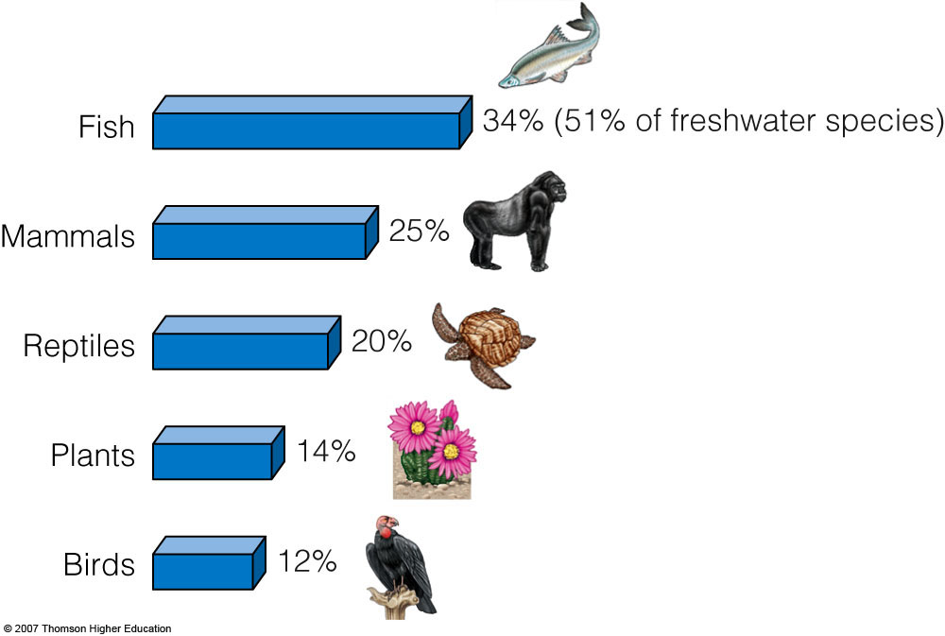
% of species involved in “6th Mass Extinction”
Notes:
29

Slide 30
causes of premature extinction
  H
  I
  P
  P
  C
  O
Notes:
30

Slide 31
  H abitat destruction, degradation, and fragmentation
  I
  P
  P
  C
  O
Notes:
31

Slide 32
  H abitat destruction, degradation, and fragmentation
  I nvasive species
  P
  P
  C
  O
Notes:
32

Slide 33
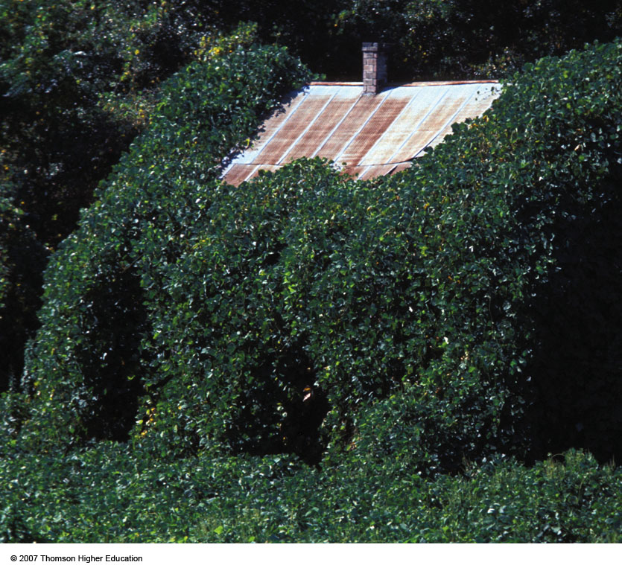

INVASIVE SPECIES
Non-native
r-selected
Kudzu vine was introduced in the southeastern U.S. to control erosion. It has taken over native species habitats.
Notes:
33

Slide 34
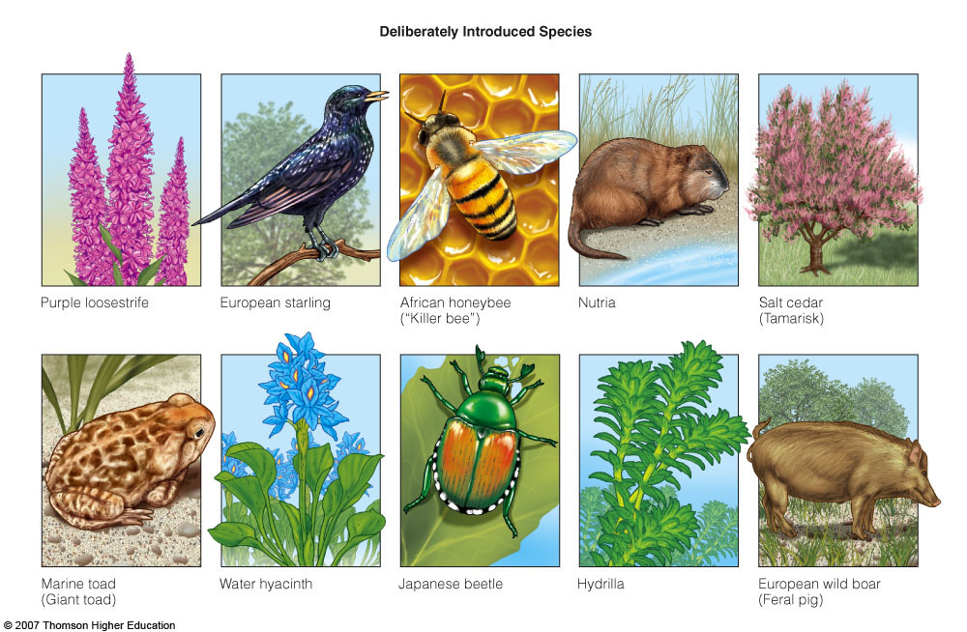
INVASIVE SPECIES
introduced intentionally.
Figure 11-11
Notes:
34

Slide 35
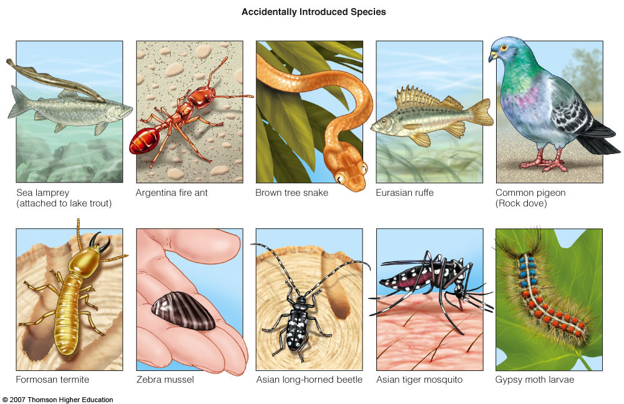
INVASIVE SPECIES
introduced unintentionally.
Figure 11-11
Notes:
35

Slide 36
  H abitat destruction, degradation, and fragmentation
  I nvasive species
  P opulation growth of humans
  P
  C
  O
Notes:
36

Slide 37
  H abitat destruction, degradation, and fragmentation
  I nvasive species
  P opulation growth of humans
  P ollution
  Climate change
  O
Notes:
37

Slide 38
  H abitat destruction, degradation, and fragmentation
  I nvasive species
  P opulation growth of humans
  P ollution
  Climate change
  O verharvest, overconsumption, overexploitation
Notes:
38

Slide 39
HUMAN IMPACTS
  approx 20% coral reefs gone
  past 100 years sea levels risen 10-25 cm.
  33% mangrove forests destroyed for shipping lanes.
Notes:
39

Slide 40
HIPPO in the ocean
Bio-invaders caused 66% of recent fish extinctions in the U.S.
50% world populations lives near a coast
80% of ocean pollution is from land-based human activities.
Notes:
40

Slide 41
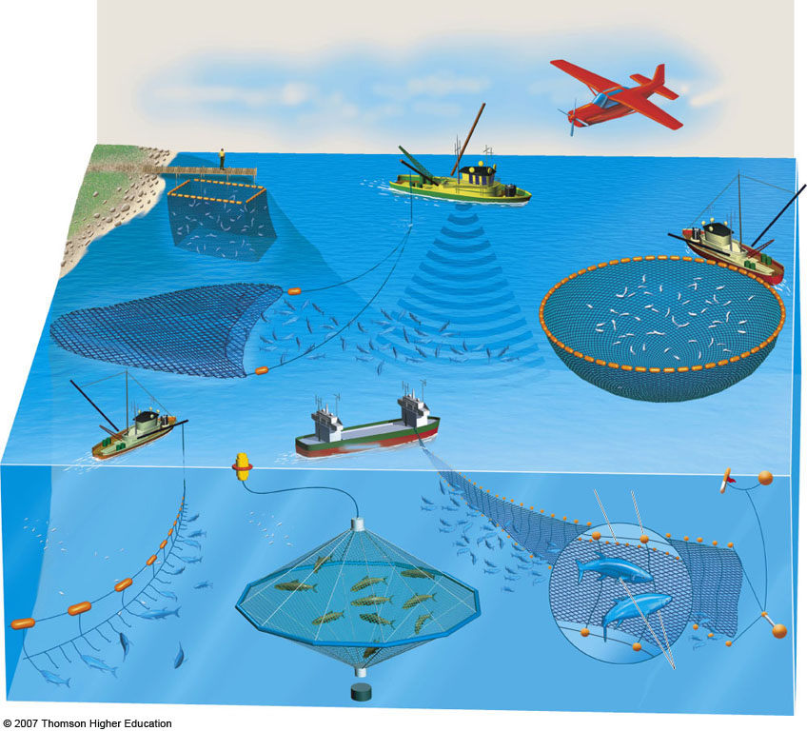
Overfishing
75% fish species overfished
-Big fish are becoming scarce
-Smaller fish are next
- 30% of all fish catch is bycatch
Notes:
41

