Slide 1
Handwriting Analysis, Forgery, and Counterfeiting

Slide 2
You need the following:
Everything is available up front if needed.
A sheet of lined paper
A pen
A transparency from the table up front
The worksheet from Tuesday
A handout with apples written all over it.

Slide 3
Copy the following on lined paper however you would normally write.
The quick brown fox jumped over the lazy dog. I am a student in Ms. Bisesi’s 4N6 class learning about different techniques scientists use to solve crimes. Today, I will learn about handwriting analysis and forgery. The quick brown fox jumped over the lazy dog and counted 1, 2, 3, 4, 5, 6, 7, 8, 9, 10.

Slide 4
Introduction
Document analysts examine and compare questioned documents with known material.
Experts in the field investigate such things as handwriting, computer printouts, commercial printing, paper, and ink.
They may study threatening, ransom, or suicide notes.
The uniqueness of handwriting makes this type of physical evidence one of the few definitive individual characteristics available.

Slide 5
History of Forensic Handwriting Analysis
In the 1930s, handwriting analysis played a role in the famous Lindbergh kidnapping case with 12 ransom notes.
In 1999, the United States Court of Appeals determined that handwriting analysis qualified as a form of expert testimony.
To be admissible in court, however, scientifically accepted guidelines must be followed.

Slide 6
Character of Handwriting
Document experts continually testify to the fact that no two individuals write exactly alike.
Many factors comprise the total character of a person’s writing.
The early stages of learning handwriting are characterized by a conscious effort to copy standard letter forms.
As writing skills improve, nerve and motor responses associated with the act of writing become subconscious.
The unconscious handwriting of two different individuals can never be identical.
6
FORENSIC SCIENCE: An Introduction by Richard Saferstein

Slide 7
12 Handwriting Characteristics –
Line Quality
Word and Letter Spacing
Ratio of the height, width and size of letters.
Pen Lifts
Connecting strokes
Beginning and ending strokes – letters complete
Cursive and/or Print
Shading or pen pressure
Slant
Baseline Habits
Flourishes or embellishments
Diacritic Placement (i’s and t’s)

Slide 8
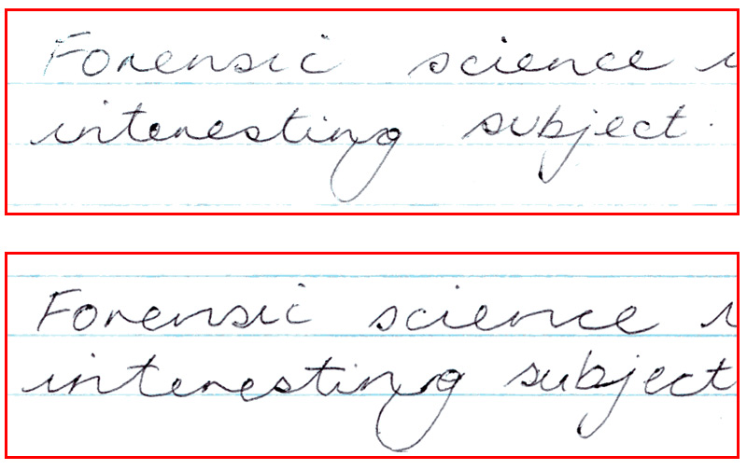
Line quality
Are the lines smooth or shaky? This can help determine speed.
Writing slowly can mean copying.
Original
Forgery

Slide 9
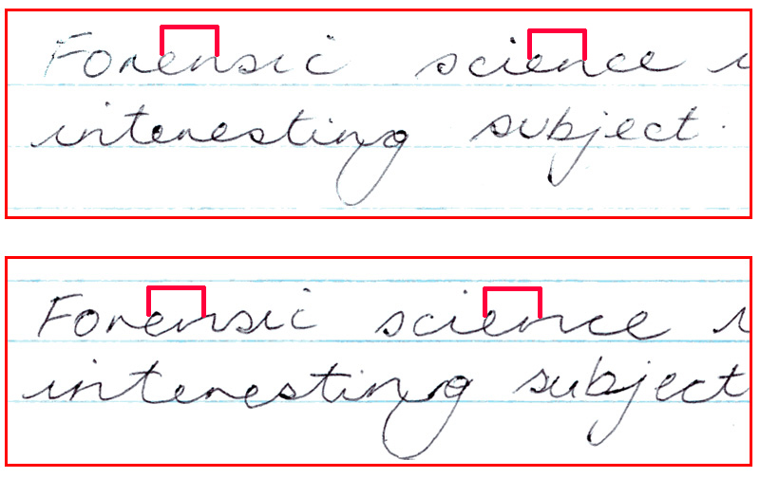
Spacing - words and letters
What is the spacing between letters and words? Close together? Far apart? Is the spacing size consistent?

Slide 10
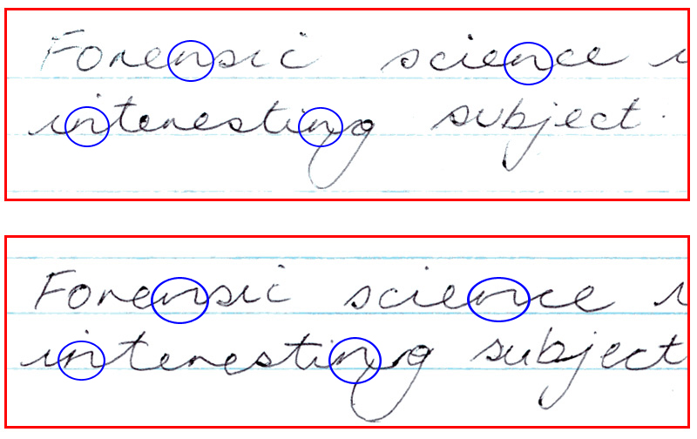
Ratio - height, width, size
Are the letters consistent in shape & size?
Original
Forgery

Slide 11
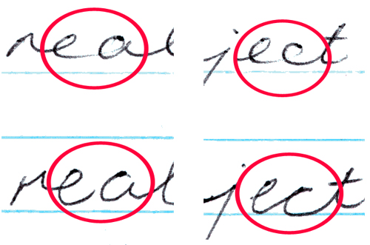
Pen lifts
Does the person stop to form new letters and begin words?
Are the pen lifts consistent? Forgeries may have lifts in unusual places.
Original
Forgery

Slide 12
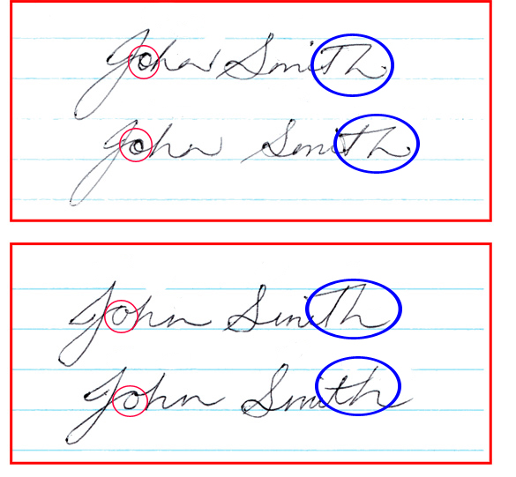
Connecting strokes
Compare how letters are linked. Are capitals connected to lowercase letters and are there connecting strokes between letters and words?
Original
Forgery

Slide 13
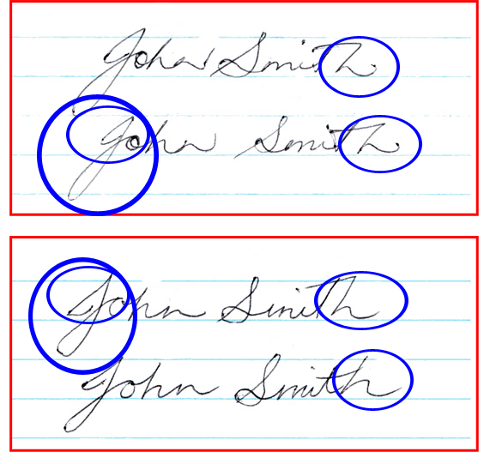
Letters complete
Are these straight, curled, long or short, an upstroke or a downstroke? Are the letters completely formed?
Original
Forgery

Slide 14
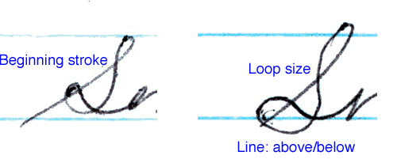
Cursive and/or Printed letters
Original
Forgery

Slide 15
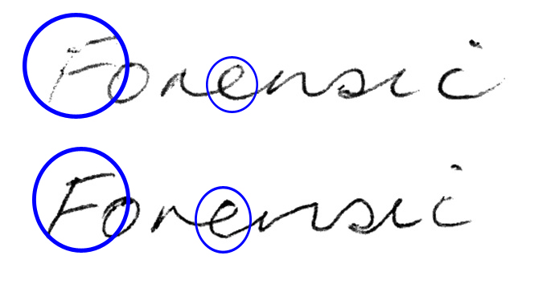
pen pressure
Differences in shading = differences in pen pressure
Is the pen pressure on the upward or the downward strokes?
Original
Forgery

Slide 16
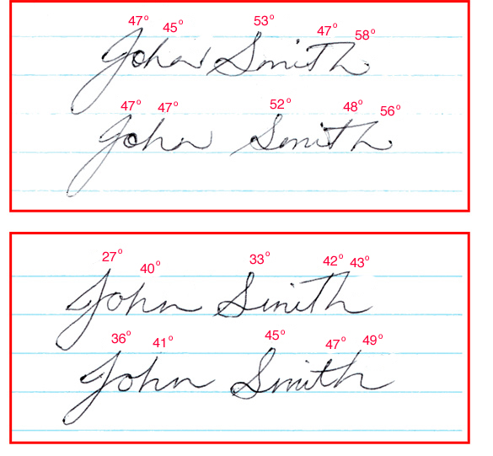
Slant
Is slant left or right or straight up and down?
Is there consistency between the slant of letters.
Original
Forgery

Slide 17
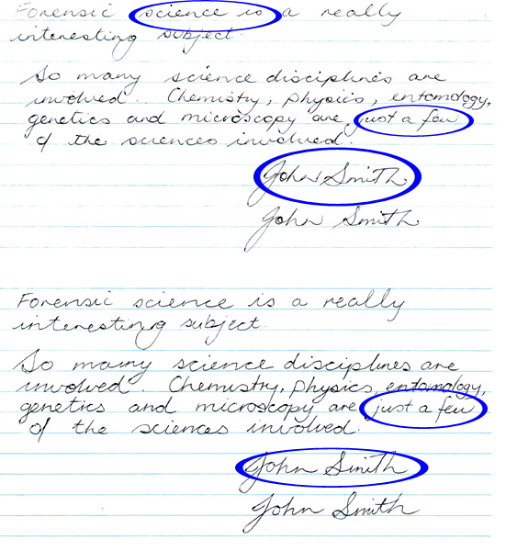
Baseline habits
Original
Is the writing above, below, or right on a line?
Forgery

Slide 18
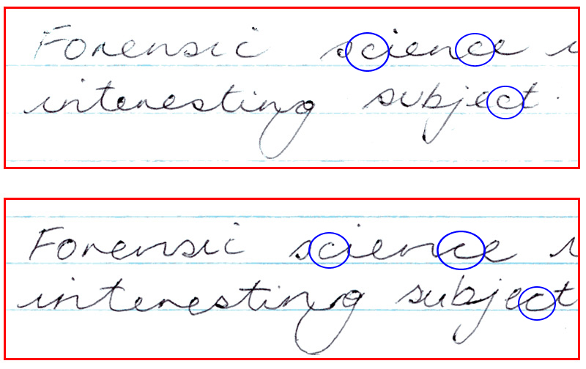
Flourishes and embellishments
Are there any? If so, what are they?
Original
Forgery

Slide 19
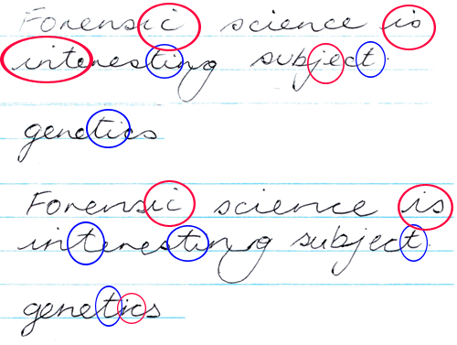
Diacritic placement - dot i, cross t
Is the line on the “t” in proportion? Are the “i’s” dotted left or right?
Original
The i dot and t cross tend to
the right of the letter.
Forgery
The i dot is varied.
The t cross is even.
The form of the letter
t is wider at the base.

Slide 20
Handwriting Samples
The subject should not be shown the questioned document
The subject is not told how to spell words or use punctuation
The subject should use materials similar to those of the document
The dictated text should match some parts of the document
The subject should be asked to sign the text
Always have a witness

Slide 21
Handwriting Identification
Analysis of the “knowns” with a determination of the characteristics found in the known
Analysis of the questioned writing and determination of its characteristics
Compare the questioned writing with the known writing.
The document examiner must have enough exemplars to make a determination of whether or not the two samples match.

Slide 22
Can handwriting predict personality??
https://www.pens.com/handwriting-infographic/

