Slide 2
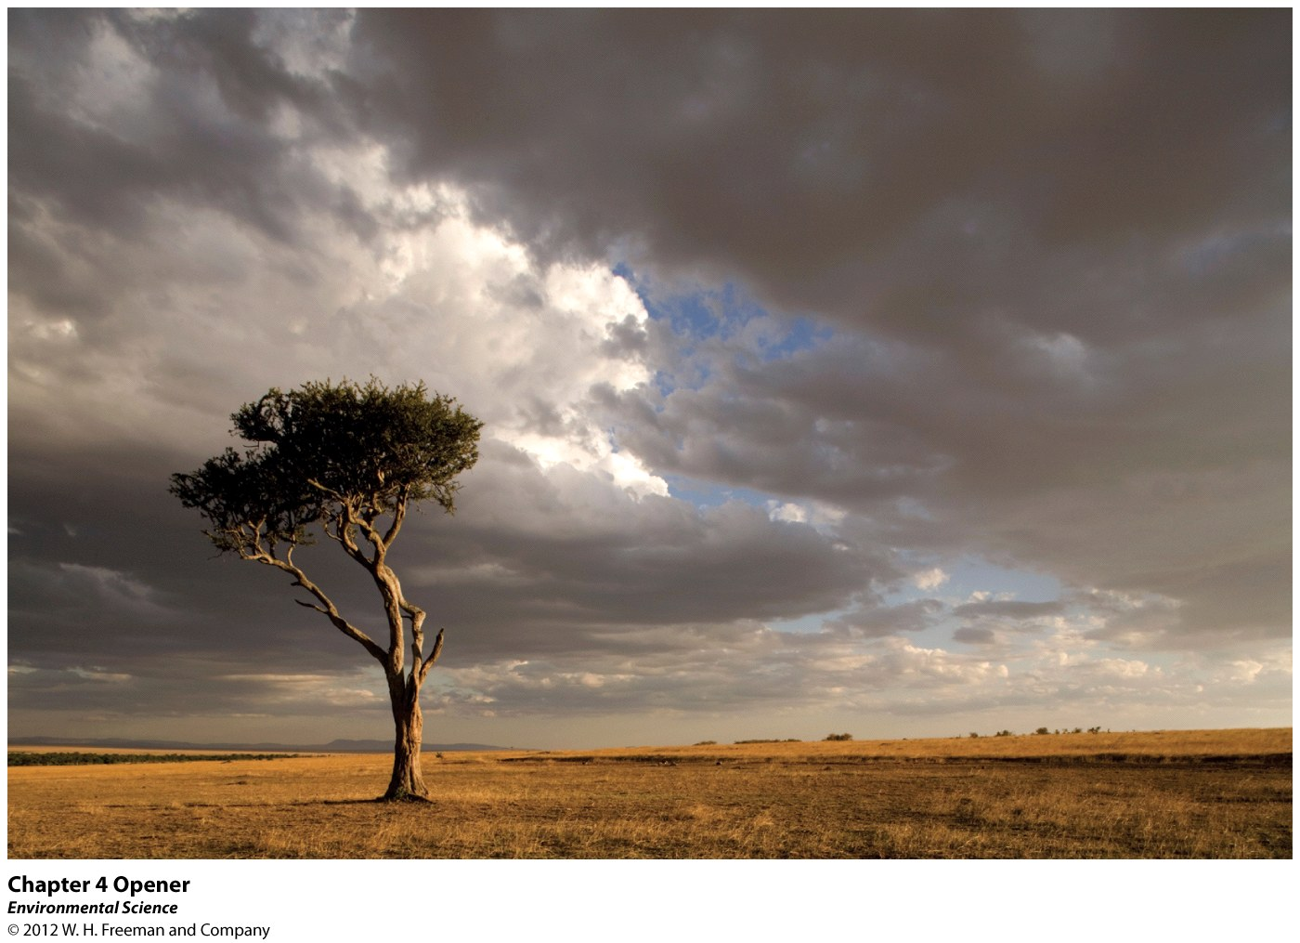
Global Climates and Biomes

Slide 3
Global Processes Determine Weather and Climate
Weather- the short term conditions of the atmosphere in a local area. These include temperature, humidity, clouds, precipitation, wind speed and atmospheric pressure.
Climate- The average weather that occurs in a given region over a long period- typically several decades.

Slide 4
Earth's Atmosphere
Troposphere- the layer closest to Earth's surface extending roughly 16 km (10 miles) above Earth.
Stratosphere- above the troposphere, this extends from roughly 16 to 50 km (10-31 miles).

Slide 5
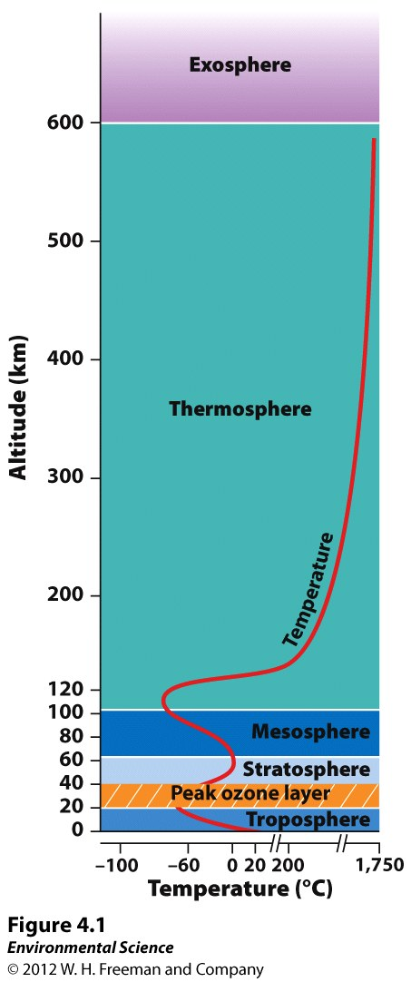

Slide 6
Unequal Heating of Earth
As the Sun's energy passes through the atmosphere and strikes land and water, it warms the surface of Earth. But this warming does not occur evenly across the planet.

Slide 7
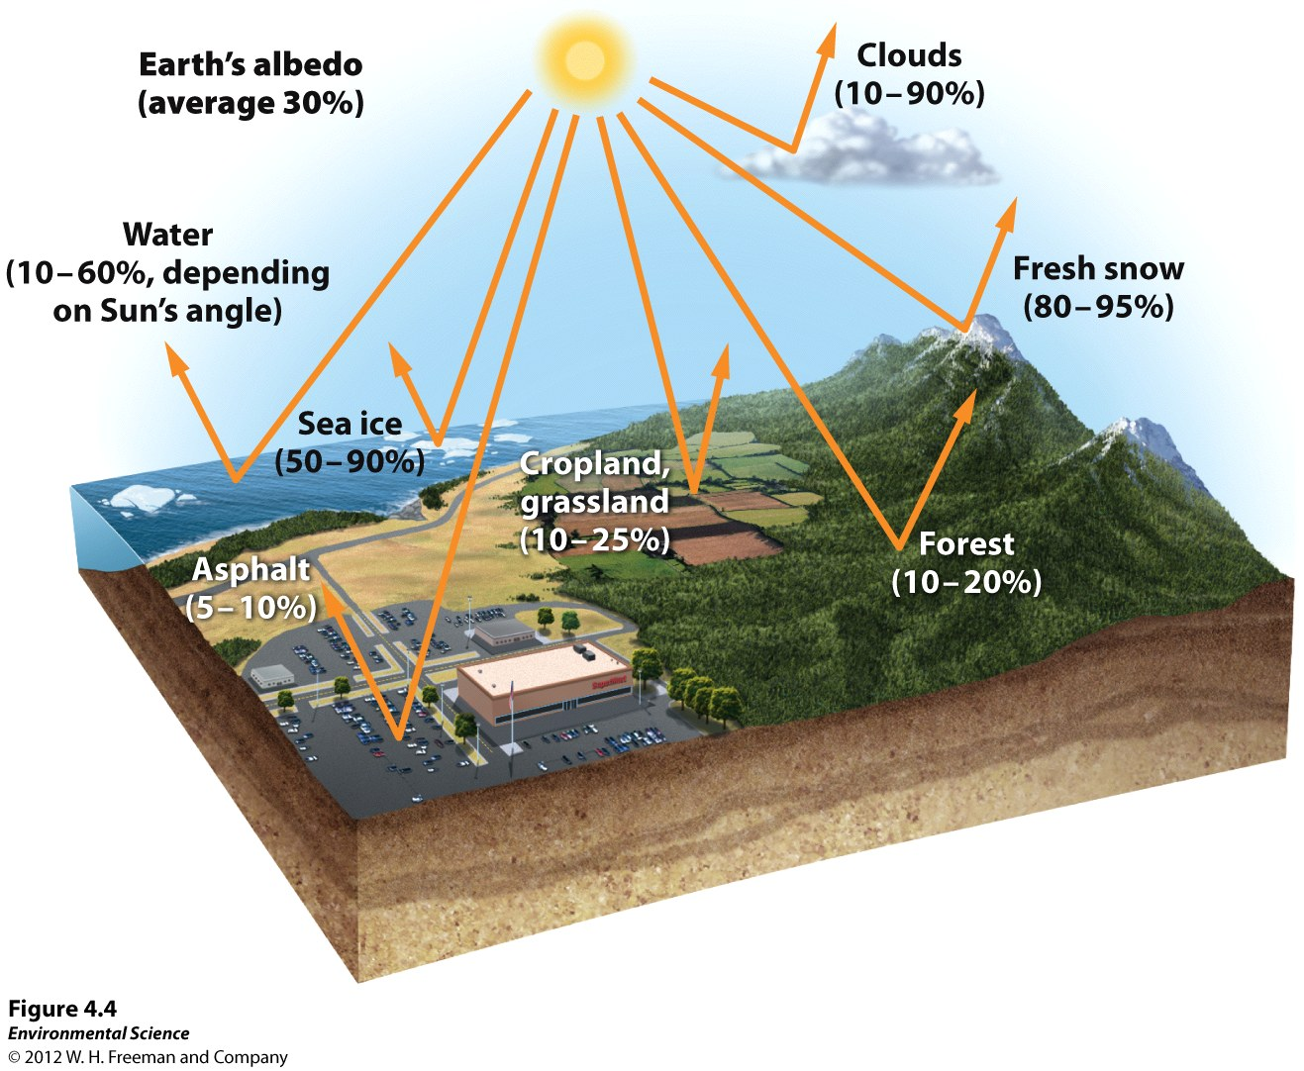

Slide 8
Unequal Heating of Earth
This unequal heating is because:
The variation in angle at which the Sun's rays strike
The amount of surface area over which the Sun's rays are distributed
Some areas of Earth reflect more solar energy than others. (Albedo)

Slide 9
Atmospheric Convection Currents
Air has four properties that determines its movement:
Density- less dense air rises, denser air sinks.
Water vapor capacity- warm air has a higher capacity for water vapor than cold air.
Adiabatic heating or cooling- as air rises in the atmosphere its pressure decreases and the air expands. Conversely, as air sinks, the pressure increases and the air decreases in volume.
Latent heat release- when water vapor in the atmosphere condenses into liquid water and energy is released.

Slide 10
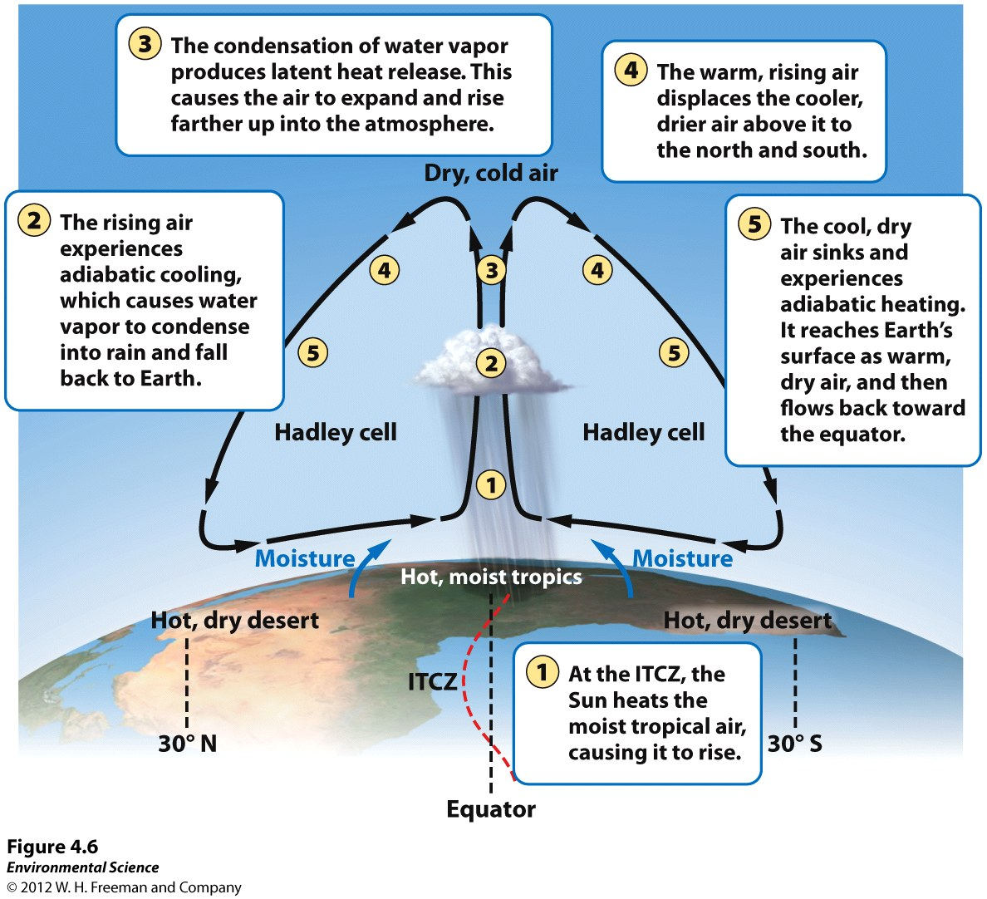
Formation of Convection Currents

Slide 11
Formation of Convection Currents
Atmospheric convection currents are global patterns of air movement that are initiated by the unequal heating of Earth.
Hadley cells- the convection currents that cycle between the equator and 30˚ north and south.
Intertropical convergence- the area of Earth that receives the most intense sunlight and where the ascending branches of the two Hadley cells converge.
Polar cells- the convection currents that are formed by air that rises at 60˚ north and south and sinks at the poles (90˚ north and south)

Slide 12
Earth's Rotation and the Coriolis Effect
As Earth rotates, its surface moves much faster at the equator than in mid-latitude and polar regions.
The faster rotation speeds closer to the equator cause a deflection of objects that are moving directly north or south.

Slide 13
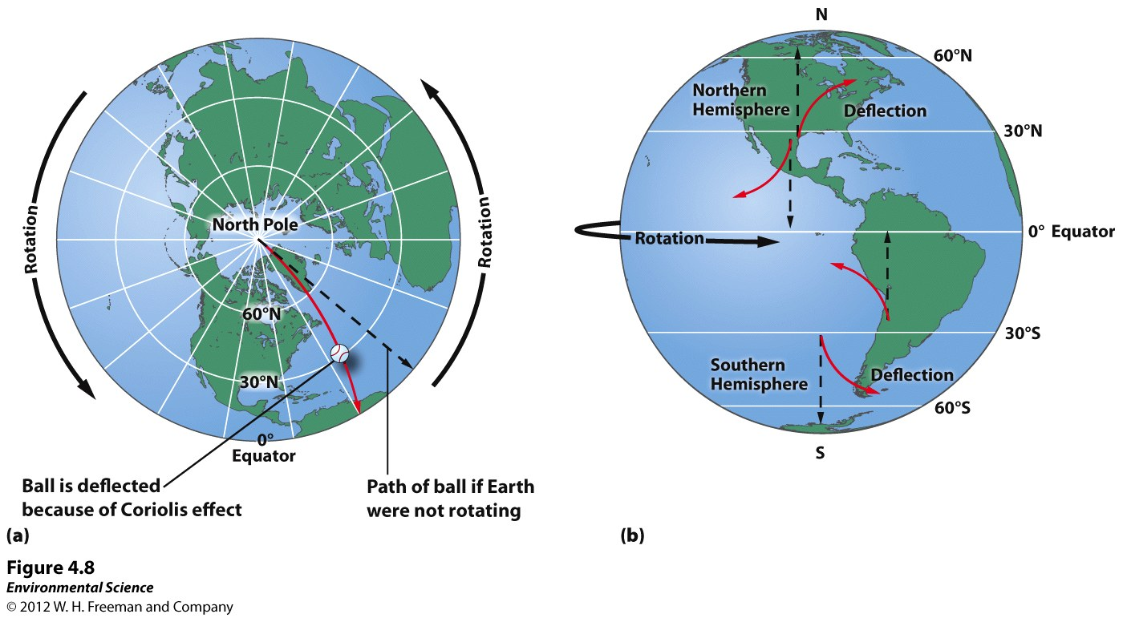

Slide 14
Earth's Rotation and the Coriolis Effect
Coriolis Effect- the deflection of an object's path due to Earth's rotation.
The prevailing winds of the world are produced by a combination of atmospheric convection currents and the Coriolis effect.

Slide 15
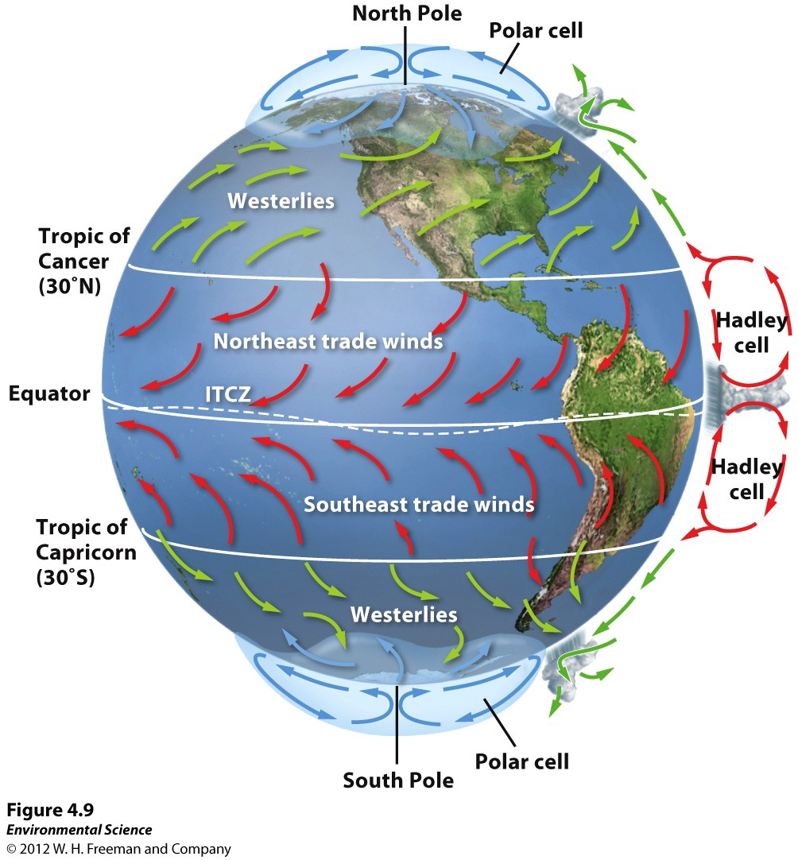

Slide 16
Earth's Tilt and the Seasons
The Earth's axis of rotation is tilted 23.5 ˚.
When the Northern Hemisphere is tilted toward the Sun, the Southern Hemisphere is tilted away from the Sun, and vice versa.

Slide 17
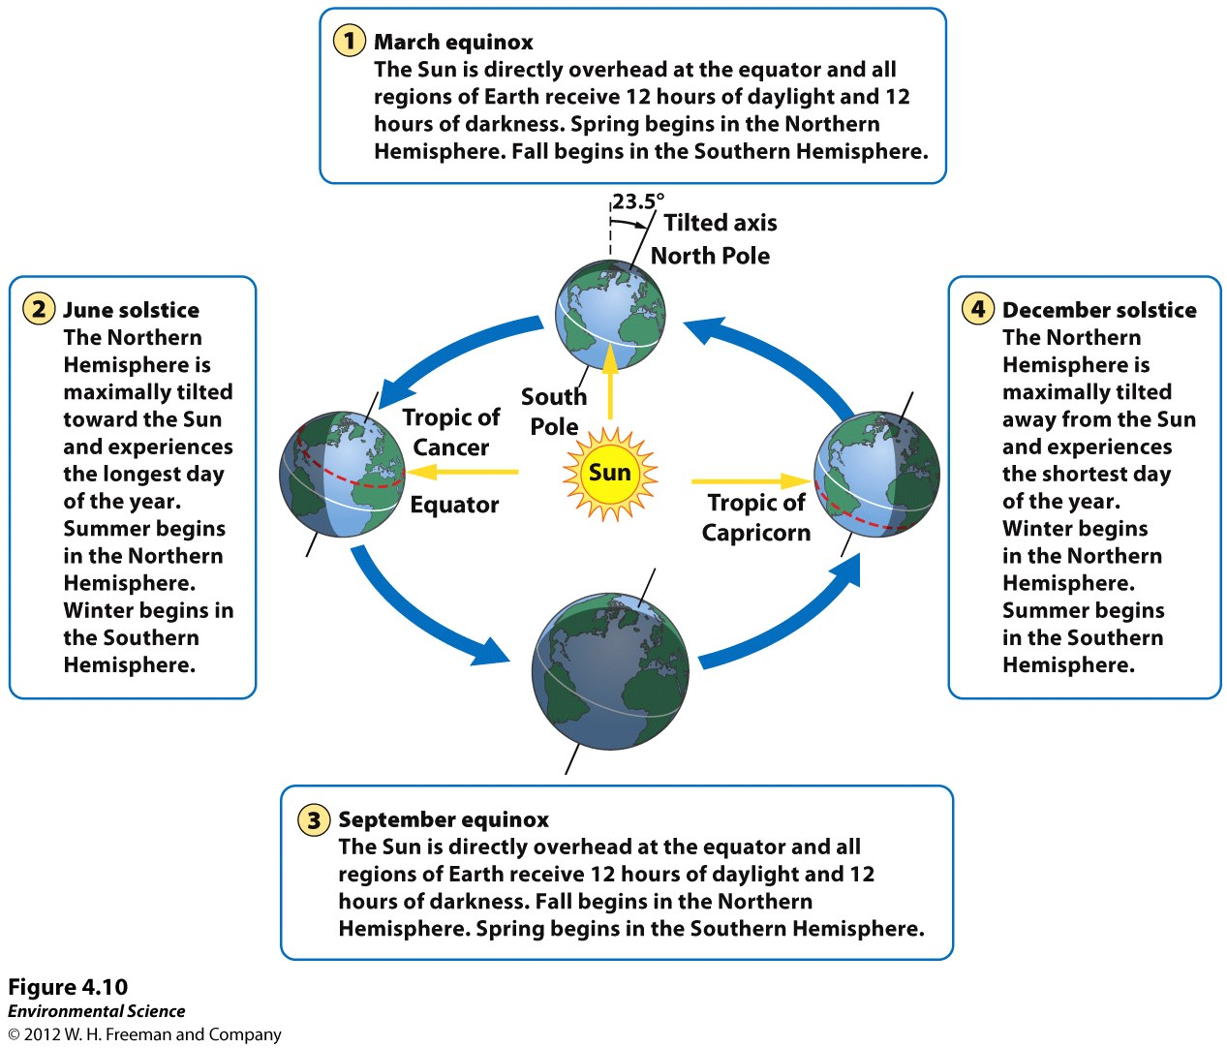

Slide 18
Ocean Currents
Ocean currents are driven by a combination of temperature, gravity, prevailing winds, the Coriolis effect, and the locations of continents.
Warm water, like warm air, expands and rises.
Gyres- the large-scale patterns of water circulation. The ocean surface currents rotate in a clockwise direction in the Northern Hemisphere and a counterclockwise direction in the Southern Hemisphere.

Slide 19
Upwelling
Upwelling- as the surface currents separate from one another, deeper waters rise and replace the water that has moved away.
This upward movement of water brings nutrients from the ocean bottom that supports the large populations of producers, which in turn support large populations of fish.

Slide 20
Thermohaline Circulation
Thermohaline circulation- another oceanic circulation that drives the mixing of surface water and deep water.
Scientists believe this process is crucial for moving heat and nutrients around the globe.
Thermohaline circulation appears to be driven by surface waters that contain unusually large amounts of salt.

Slide 21
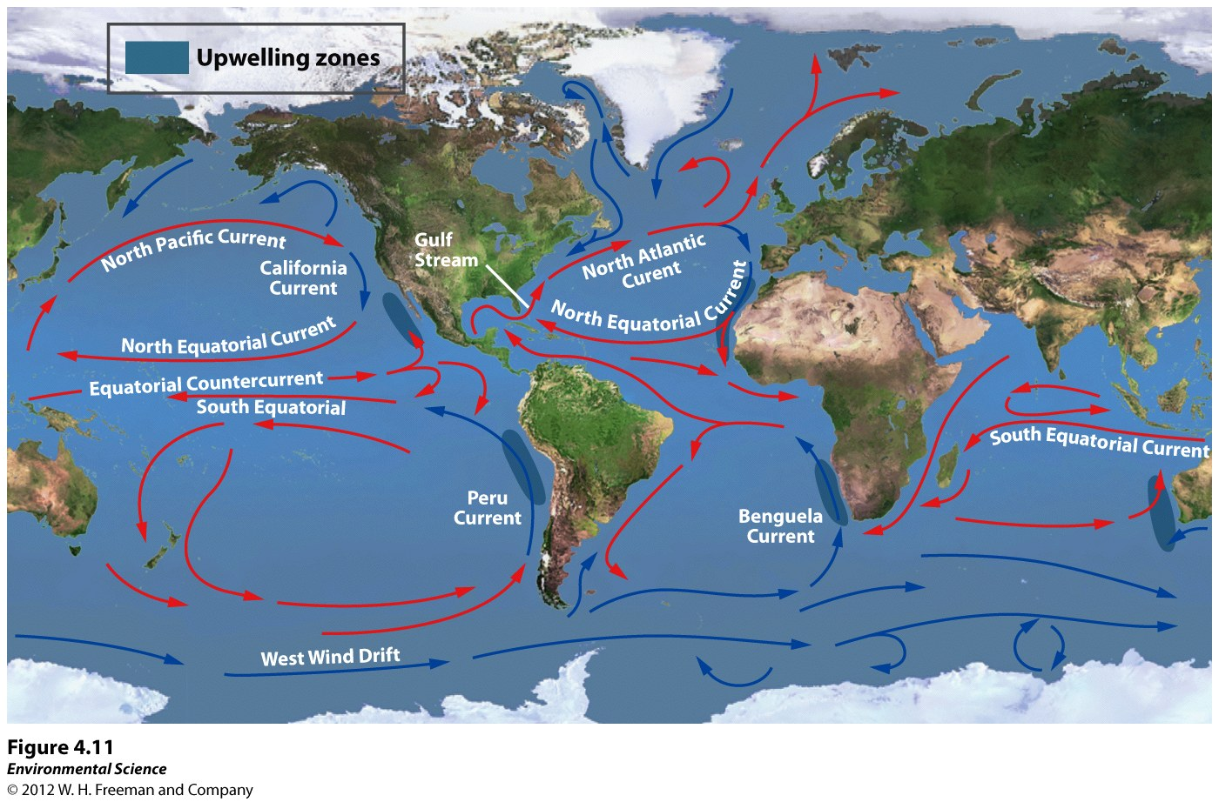
Thermohaline Circulation

Slide 22
Thermohaline Circulation
Some of the water that flows from the Gulf of Mexico to the North Atlantic freezes or evaporates, and the salt that remains behind increases the salt concentration of the water.
This cold, salty water is relatively dense, so it sinks to the bottom of the ocean, mixing with deeper ocean waters.
These two processes create the movement necessary to drive a deep, cold current that slowly moves past Antarctica and northward to the northern Pacific Ocean.

Slide 23
Heat Transport
Ocean currents can affect the temperature of nearby landmasses.
For example, England's average winter temperature is approximately 20 ˚ C (36˚F) warmer than Newfoundland, Canada, which is located at a similar latitude.

Slide 24
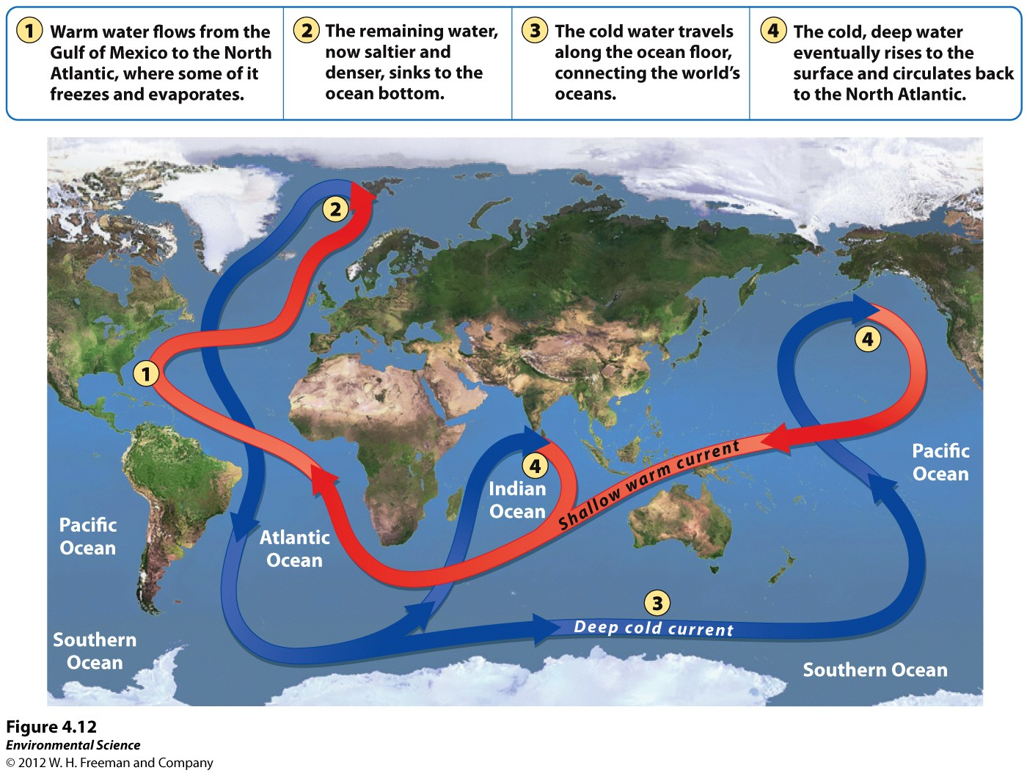

Slide 25
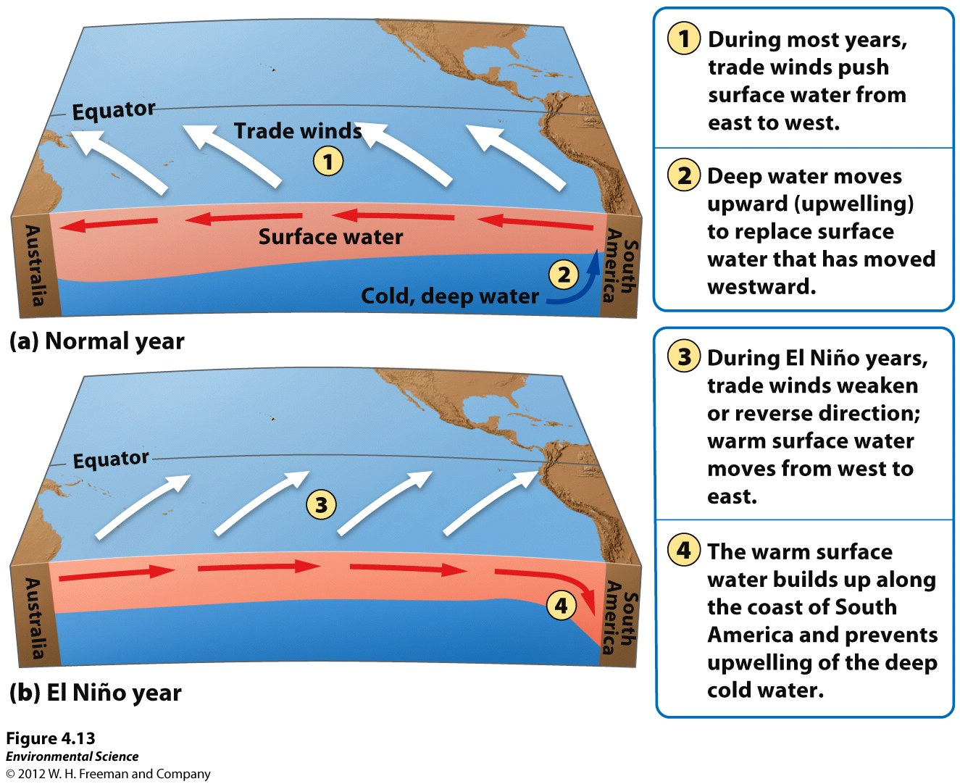
El Nino-Southern Oscillation
Every 3 to 7 years, the interaction of the Earth's atmosphere and ocean cause surface currents in the tropical Pacific Ocean to reverse direction.

Slide 26
El Nino-Southern Oscillation
First, the trade winds near South America weaken.
This weakening allows warm equatorial water from the western Pacific to move eastward toward the west coast of South America.
The movement of warm water and air toward South America suppresses upwelling off the coast of Peru and decreases productivity there, reducing fish populations near the coast.
These periodic changes in wind and ocean currents are collectively called the EL Nino-Southern Oscillation, or ENSO.

Slide 27
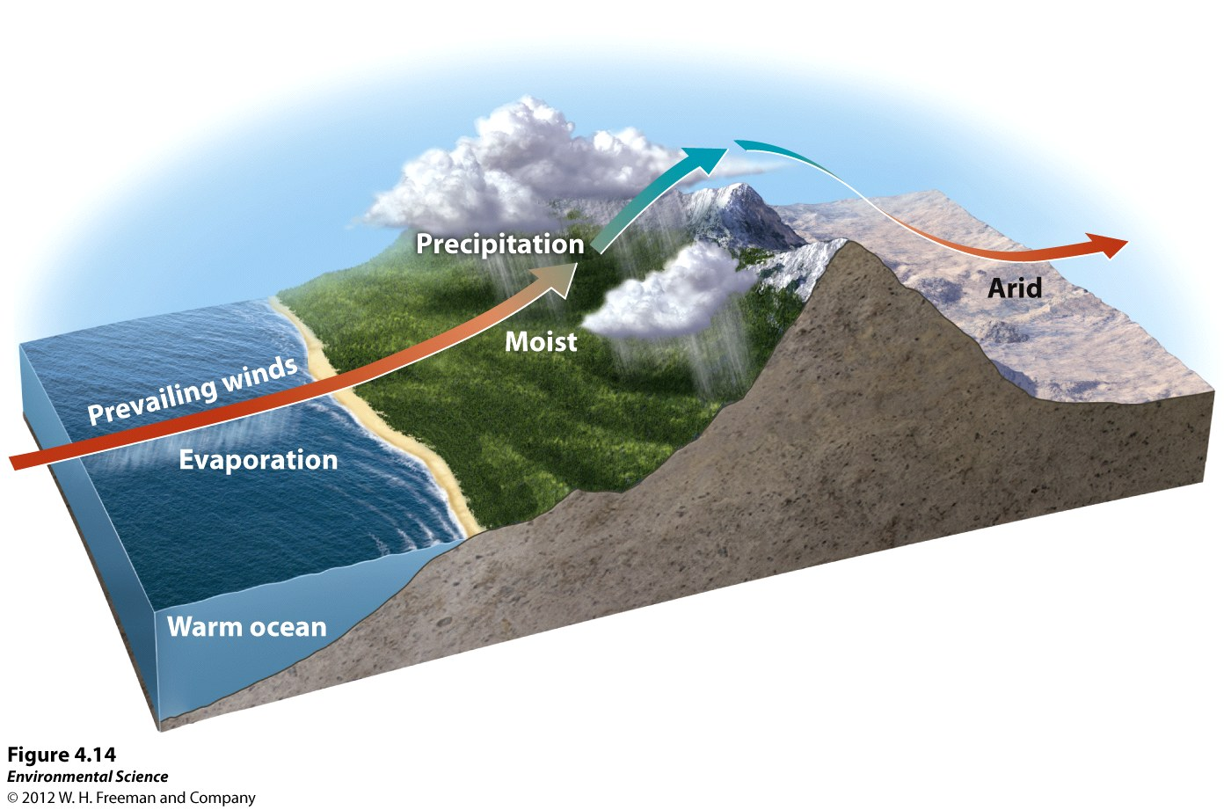
Rain Shadows

Slide 28
Rain Shadows
When air moving inland from the ocean that contains a large amount of water vapor meets the windward side of a mountain range (the side facing the wind), it rises and begins to experience adiabatic cooling.
Because water vapor condenses as air cools, clouds form and precipitation falls.
The presence of the mountain range causes large amounts of precipitin to fall on its windward side.
The cold, dry air then travels to the other side of the mountain range (the leeward side), where it descends and experiences higher pressures, which cause adiabatic heating.
This air is now warm and dry and causes arid conditions on the leeward side forming the region called a rain shadow.

Slide 29
Variations in Climate Determine the Dominant Plant Growth Forms of Terrestrial Biomes
Climate affects the distribution of species around the globe.
Organisms possess distinct growth forms due to adaptations to local temperature and precipitin patterns.
Biomes- The presence of similar plant growth forms in areas possessing similar temperature and precipitation patterns.

Slide 30
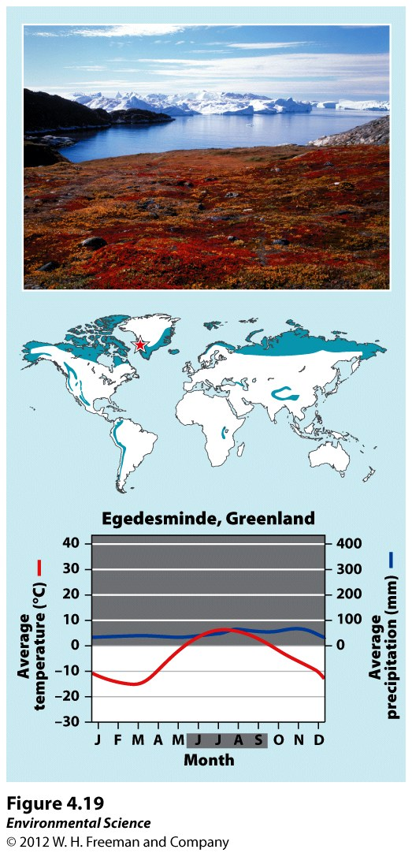
Tundra

Slide 31
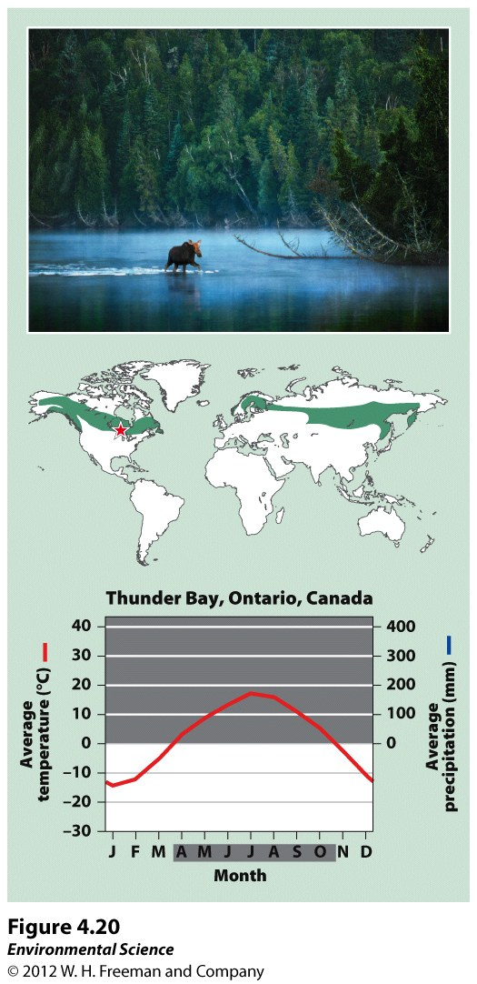
Boreal Forest

Slide 32
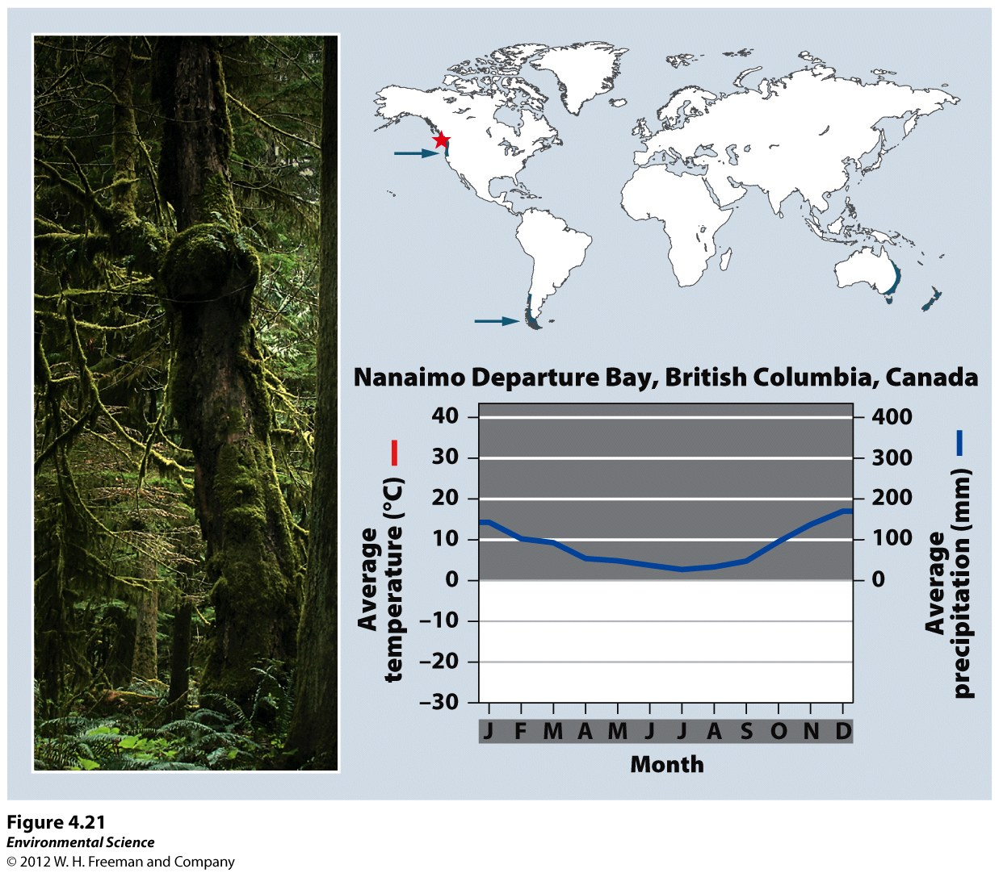
Temperate Rainforest

Slide 33
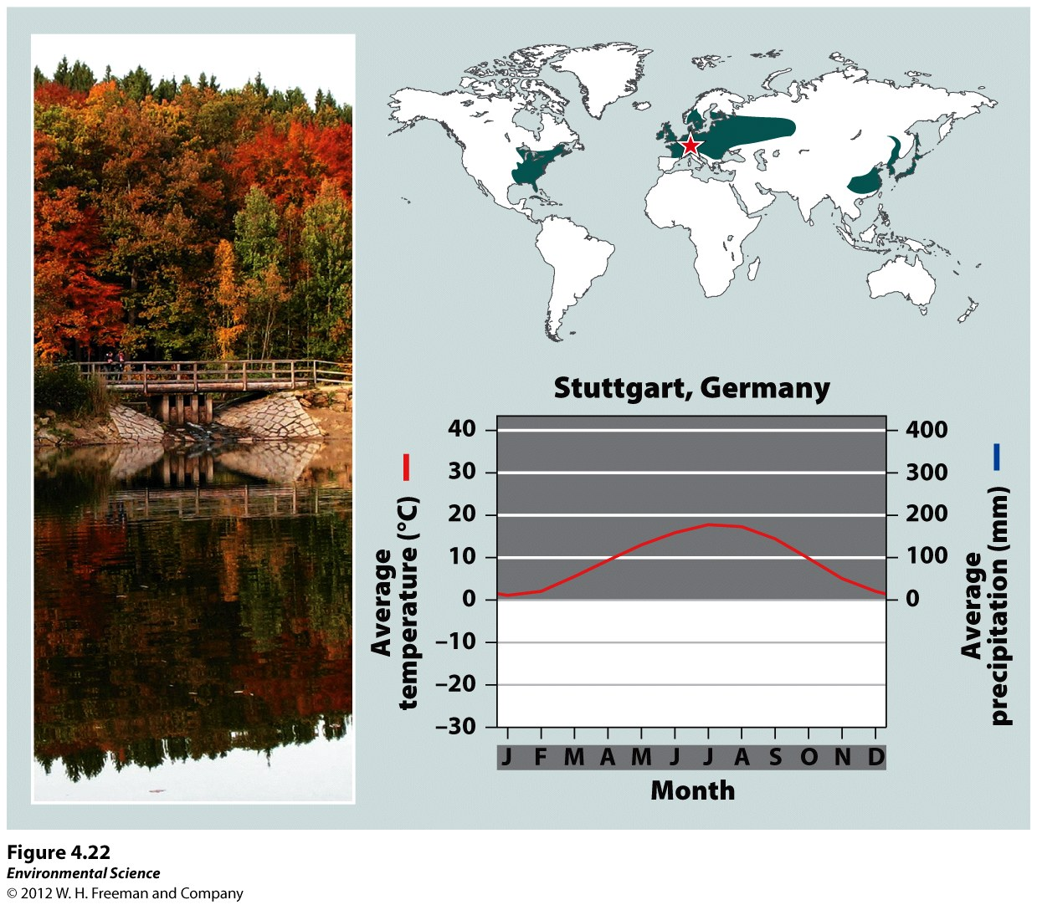
Temperate Seasonal Forest

Slide 34
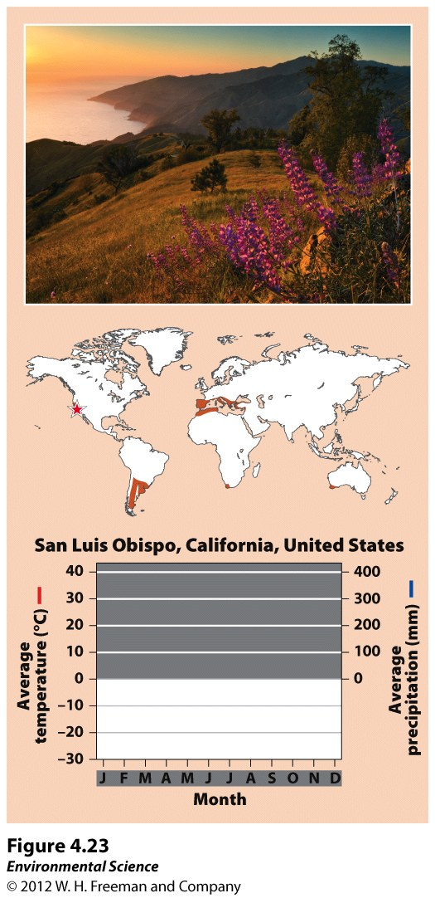
Woodland/Shrubland

Slide 35
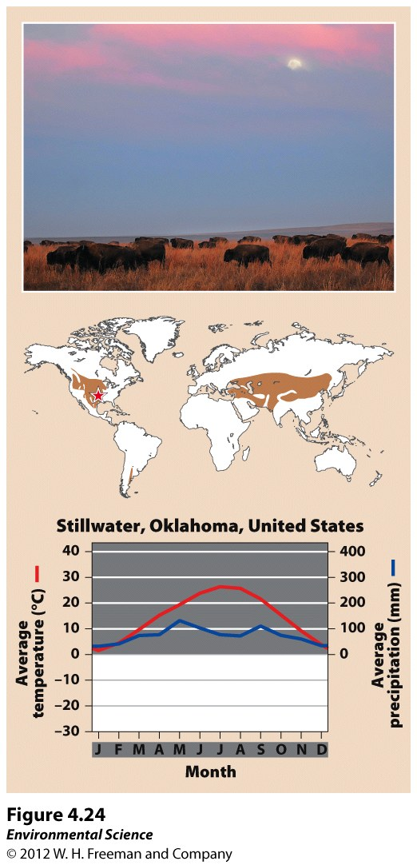
Temperate Grassland/Cold Desert

Slide 36
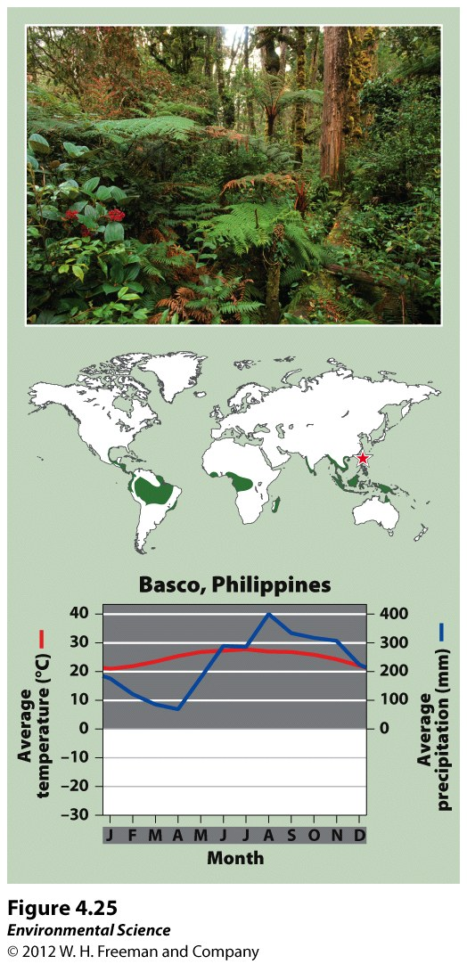
Tropical Rainforest

Slide 37
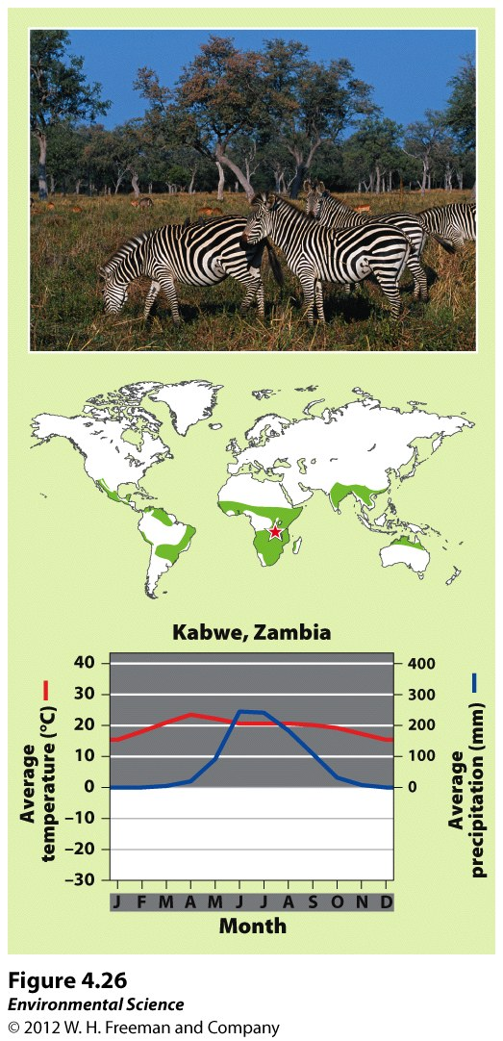
Tropical Seasonal Forest/Savanna

Slide 38
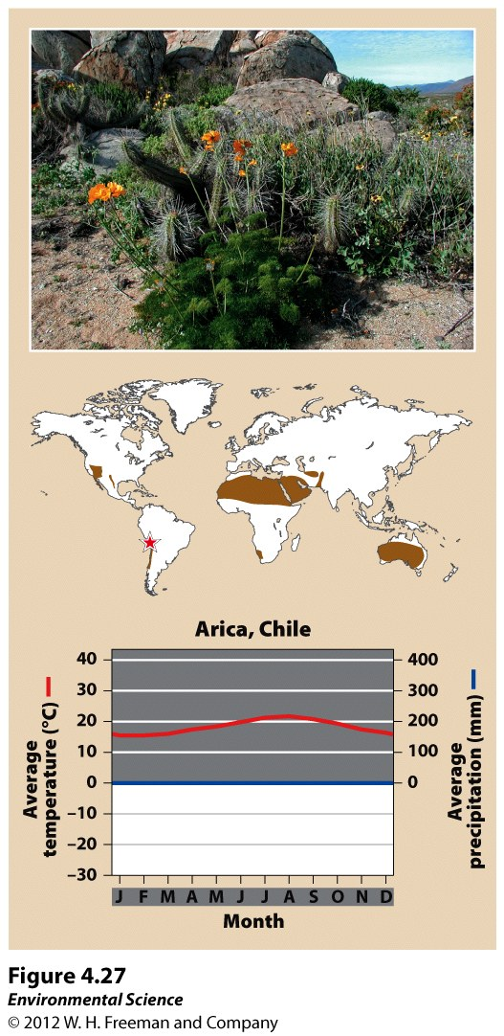
Subtropical Desert

Slide 39
Aquatic Biomes are Categorized by Salinity, Depth, and Water Flow

Slide 40
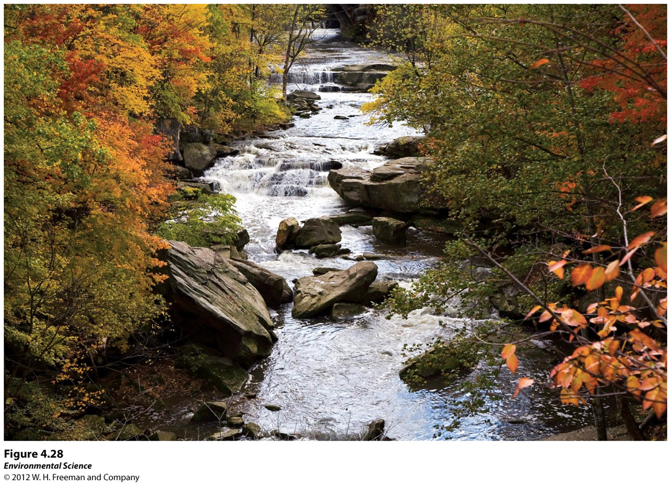
Streams and Rivers
Flowing fresh water that may originate from underground springs or as runoff from rain or melting snow.
Streams are typically narrow and carry relatively small amounts of water where rivers are usually wider and carry larger amounts of water.

Slide 41
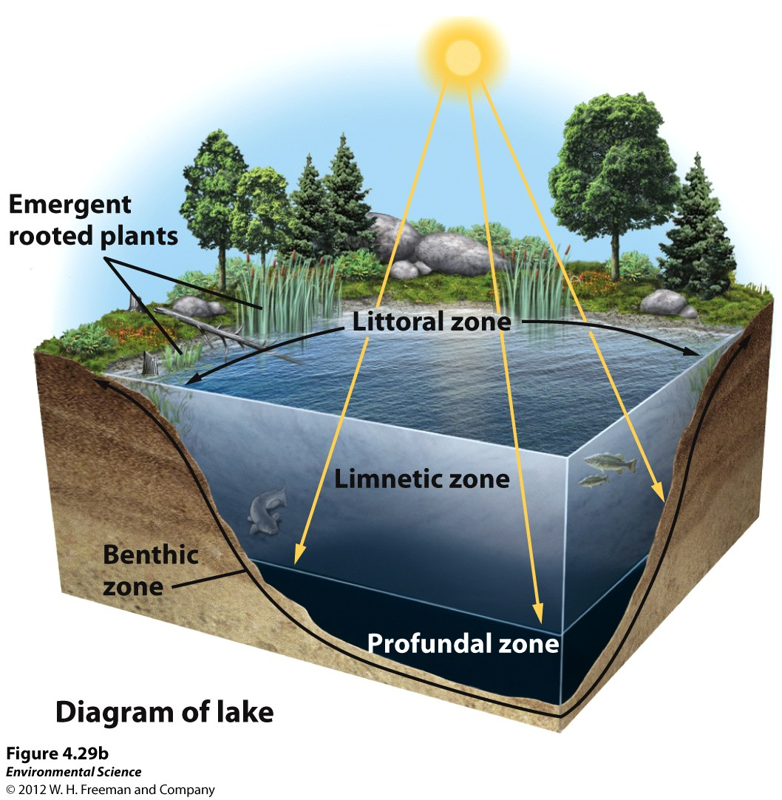
Lakes and Ponds
Standing water that some of which is too deep to support emergent vegetation.
Lakes are larger than ponds but there is no clear point at which a pond is considered large enough to be called a lake.

Slide 42
Lakes and Ponds
Littoral zone- the shallow area of soil and water near the shore where algae and emergent plants grow.
Limnetic zone- open water, where rooted plants can no longer survive. Phytoplankton are the only photosynthetic organisms. This zone extends to as deep as sunlight can penetrate.
Profundal zone- the zone where sunlight cannot penetrate and therefore producers cannot survive.
Benthic zone- the muddy bottom of a lake or bond beneath the limnetic and profundal zone.

Slide 43
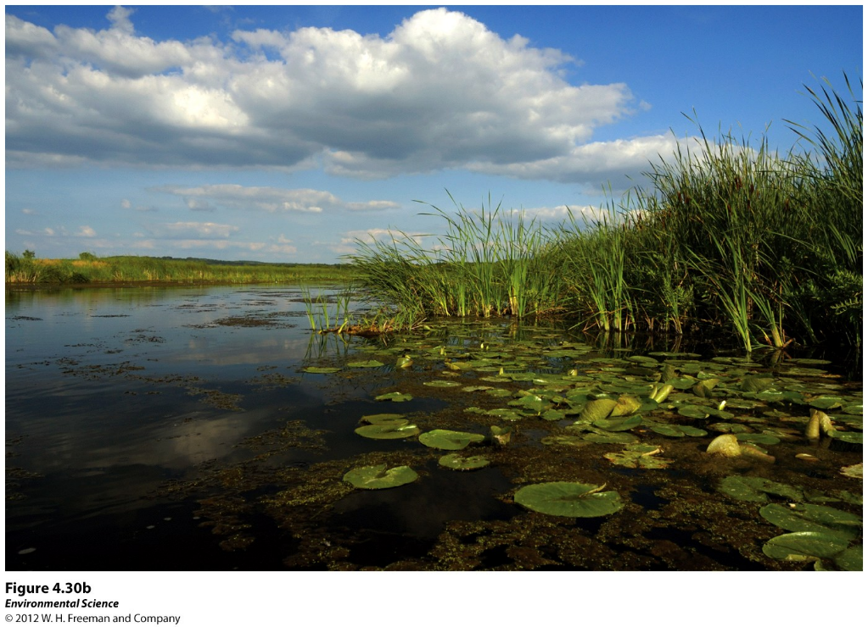
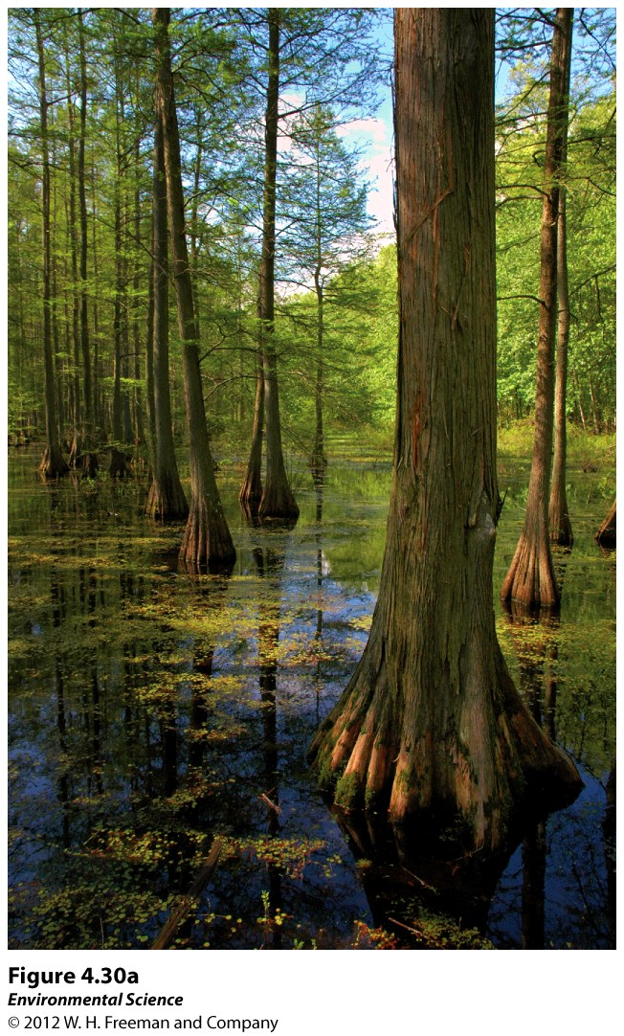
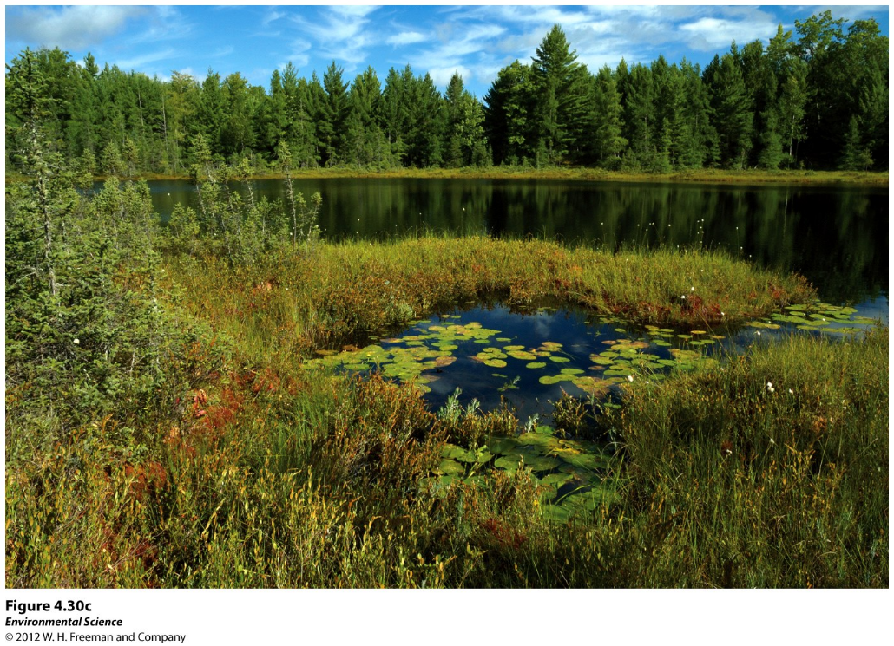
Freshwater Wetlands
Aquatic biomes that are submerged or saturated by water for at least part of each year, but shallow enough to support emergent vegetation.
These include swamps, marshes, and bogs.

Slide 44
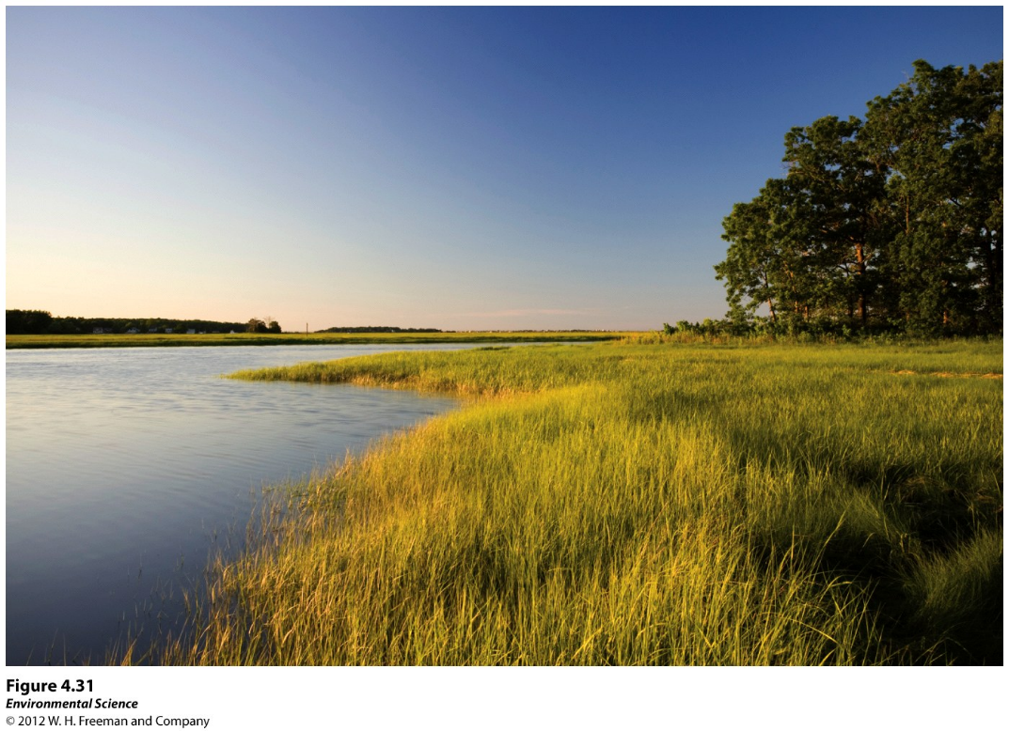
Salt Marshes
Found along the coast in temperate climates and contain non woody emergent vegetation.
The salt marsh is one of the most productive biomes in the world.

Slide 45
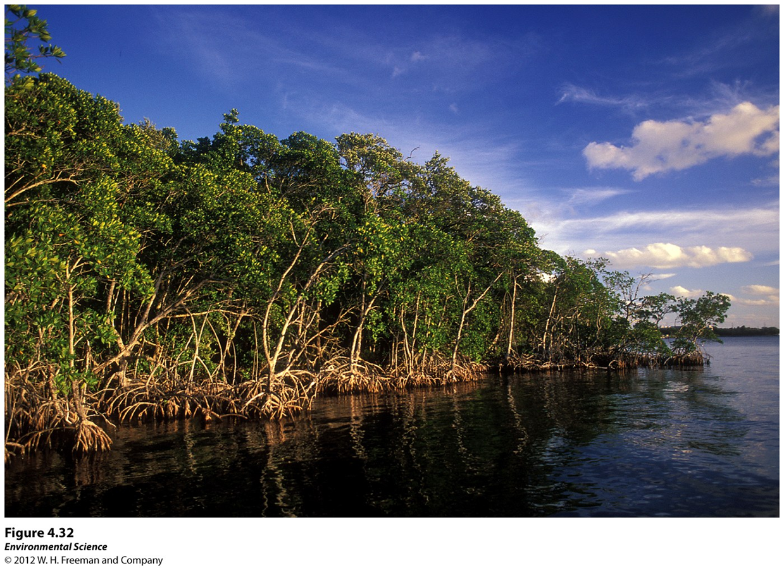
Mangrove Swamps
Found along tropical and subtropical coasts and contain trees whose roots are submerged in water.
Mangrove trees are salt tolerant and help protect the coastlines from erosion and storm damage.

Slide 46
The Open Ocean
The depth that light can penetrate in the open ocean is dependent on the amount of sediment and algae suspended in the water.
Photic zone- the zone that receives enough light to allow photosynthesis to occur.
Aphotic zone- the deeper water that lacks sufficient light for photosynthesis.
Chemosynthesis- The process that occurs in the aphotic zone when some species of bacteria use methane and hydrogen sulfide to generate energy.

Slide 49
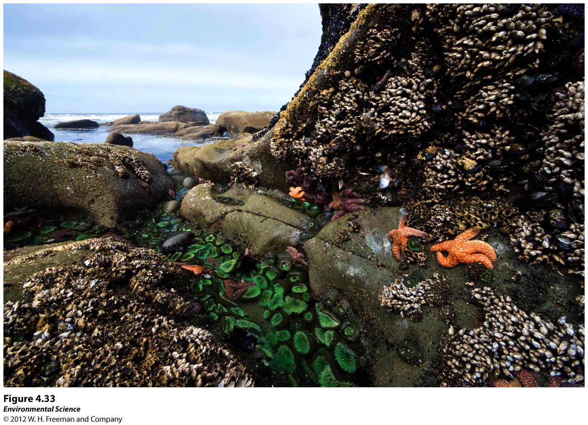
Intertidal Zone
Narrow band of coastline that exists between the levels of high tide an low tide.
Waves that crash onto the shore in this biome can make it a challenge for organisms to hold on and not get washed away.

Slide 50
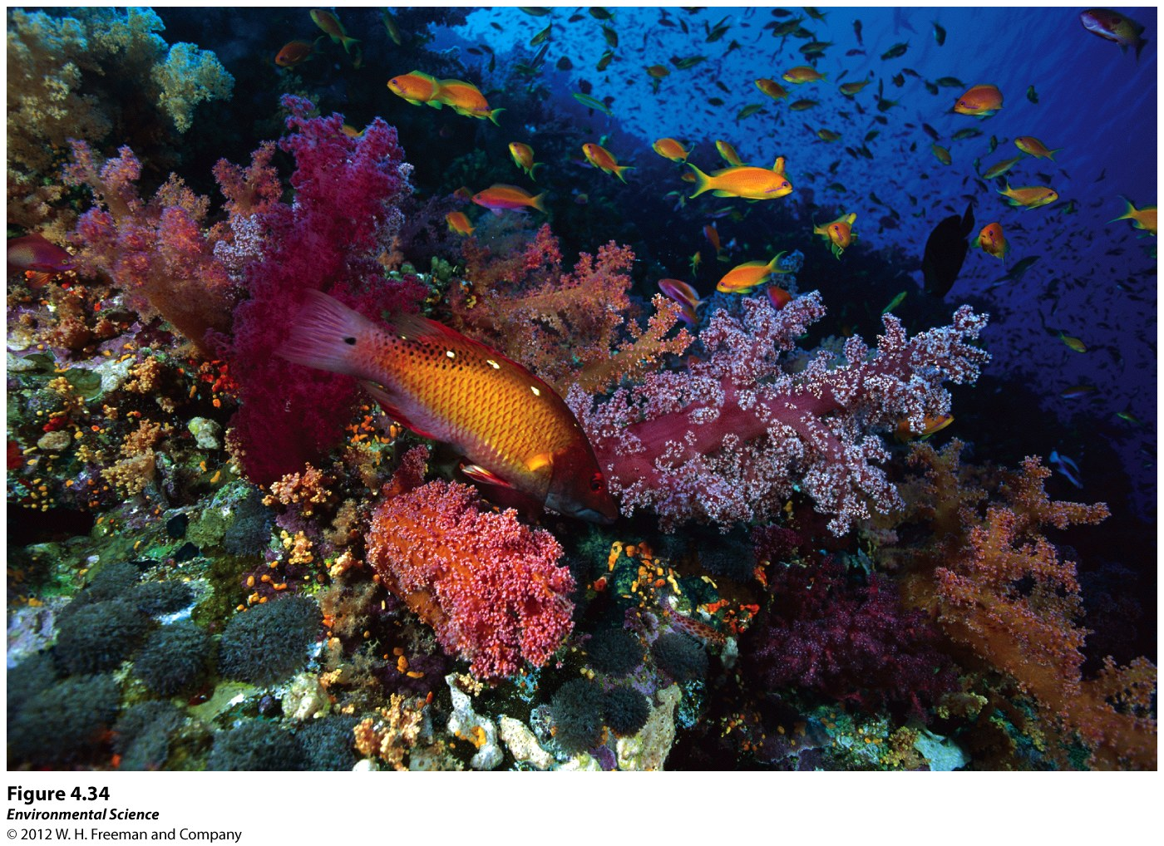
Coral Reefs
Found in warm, shallow waters beyond the shoreline.
Earth's most diverse marine biome even though coral reefs are found in water that is relatively poor in nutrients and food.
Coral bleaching- when the algae inside the coral dies. Scientists believe this is due to a combination of disease and environmental change.

