Slide 1
Impressions

Slide 2
Can you answer these??
What are the characteristics of writing handwriting analysts look at?
If you were collecting a known handwriting sample from a suspect, what are some things you would need to do?
What forensic databases do you remember?
What are the 3 types of fingerprints we learned (not the patterns)? These terms are used for tire and shoe prints too.
What type would dark skid marks on the road be? How about footprints in snow?
Give examples of individual and class evidence for shoes and tires.

Slide 3
NGI
Next Generation Identification
Began in 2014--FBI’s newest identification system, slated to replace IAFIS in the future
Uses wide array of biometric identification methods –scars, tattoos, facial, voice, and iris recognition
http://www.fbi.gov/about-us/cjis/fingerprints_biometrics/ngi

Slide 4
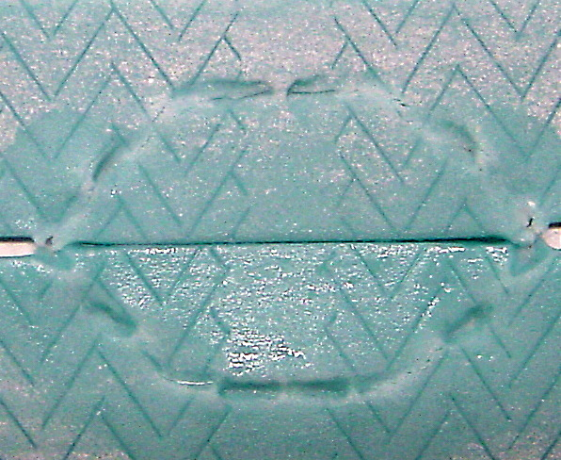
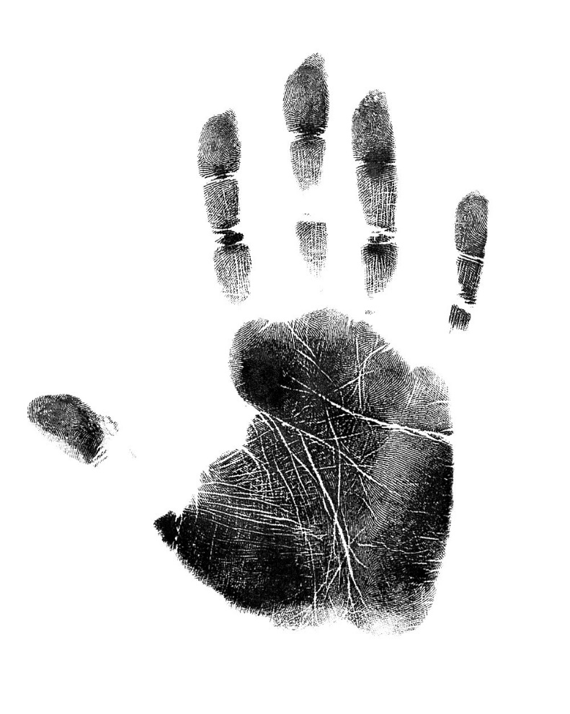
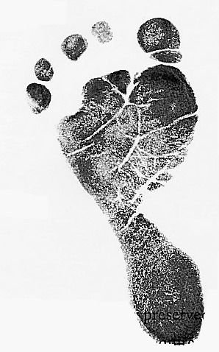
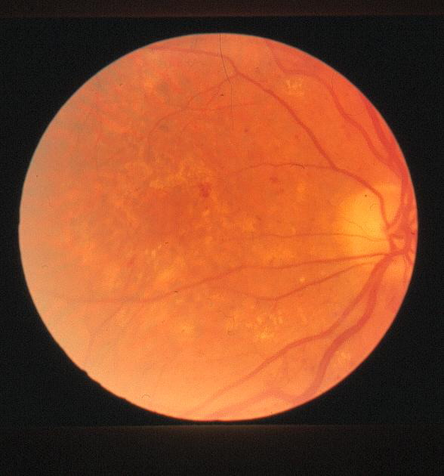
Other Prints
Ears—shape, length and width
Voice—electronic pulses measured on a spectrograph
Palm—friction ridges can be identified and may be used against suspects.
Blood vessel patterns in the eye may be unique to individuals. They are used today for various security purposes.
Teeth—bite marks are unique and can be used to identify suspects. These imprints were placed in gum and could be matched to crime scene evidence.

Slide 5
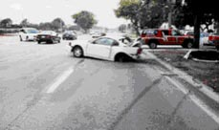
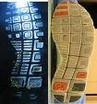
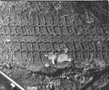
Tire and shoe Impressions
People, vehicles, and objects leave evidence of their presence at an accident or crime scene.
Patent impressions are two-dimensional.
Latent impressions are hidden to the eye.
Plastic impressions are three-dimensional.

Slide 6
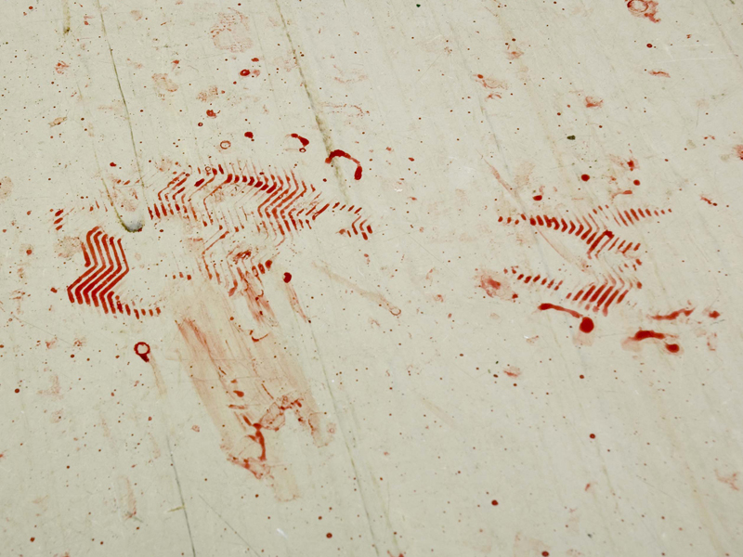
Photography Paul Ricketts, 2006

Slide 7
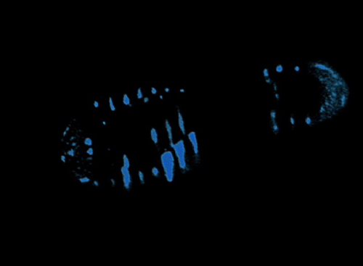
Photography Paul Ricketts, 2006

Slide 8
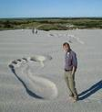
Individual or Class?
How can impressions be class evidence?
How can they be classified as individual evidence?

Slide 9
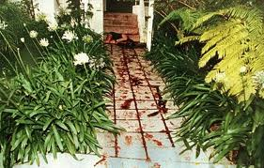
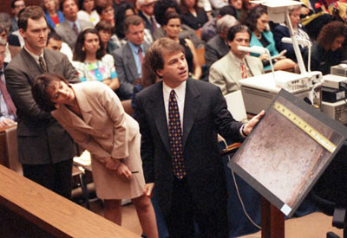
Footprint evidence at the OJ trial.

Slide 10
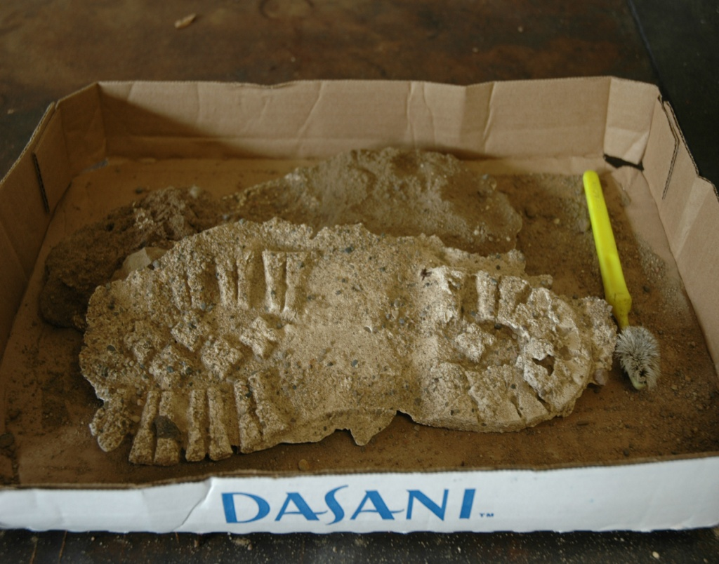
Shoe Impressions
The size of a shoeprint can tell the size of foot of the person.
The depth of a foot or shoe impression can tell something of the person’s weight.
The type of shoe can tell something of the person’s job or personality.
Database SoleMate contain the names of specific manufactures and tread patterns.
Database TreadMark contains impressions from criminals and crime scenes.

Slide 11
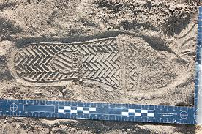
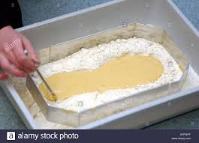
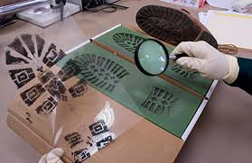
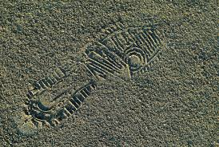
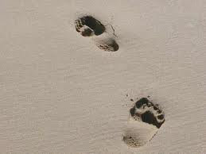

Slide 12
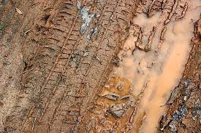
Recording Tread Impressions
Ridges and grooves of discovered tire impressions are counted across the entire width.
Unique characteristics such as wear or pebbles embedded in the grooves are noted.
A print of a suspect’s tire impressions through one revolution is taken.
Comparison with impressions from the crime scene, then, can be made.
The database TreadMate can be checked to find the tire type.

Slide 13
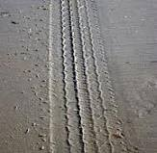
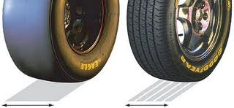
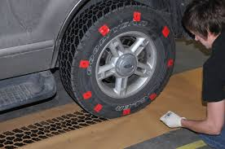
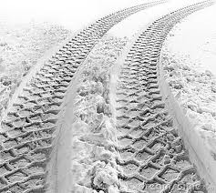
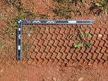

Slide 15
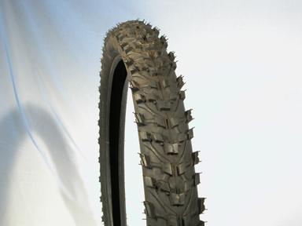
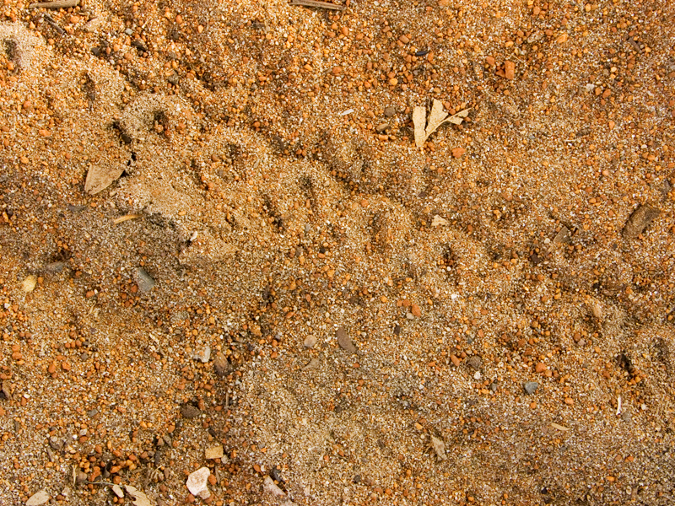
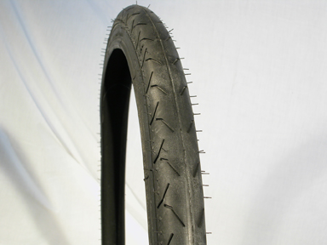
Bicycle Tire tread
Photography Paul Ricketts, 2006

Slide 16
Collection of Shoe or Tire Impression Evidence
Why would the following steps be important?
Take photos as soon as possible.
Take multiple photos of the impression from at least two different orientations.
Place an identifying label and a ruler in position with the impression for the photo.
Use oblique (not bright) lighting when possible.

Slide 17
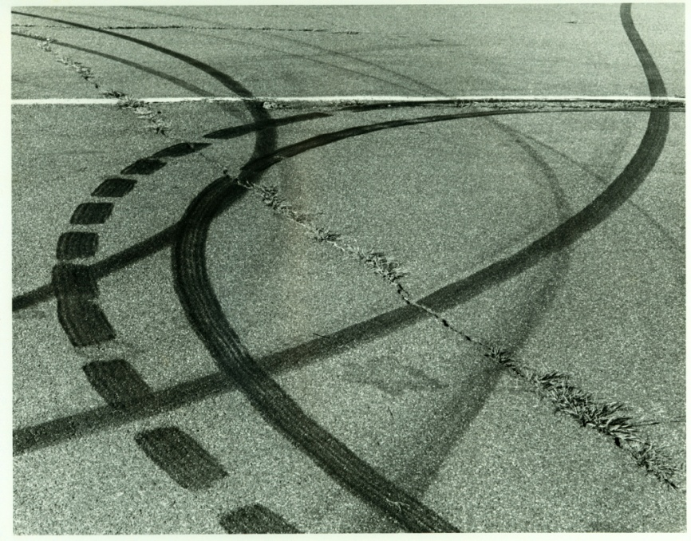
Establishing Car Movements
Direction of travel can be determined by:
Vegetation disturbed
Debris cast off
Splash patterns
Substance transfer
Tire marks

Slide 18
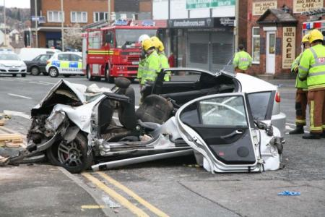
Accident Reconstruction
Using tire marks to determine:
What happened?
Where?
When?
Why?
How fast the cars were moving
Who was involved?
Who was at fault?

