Slide 2
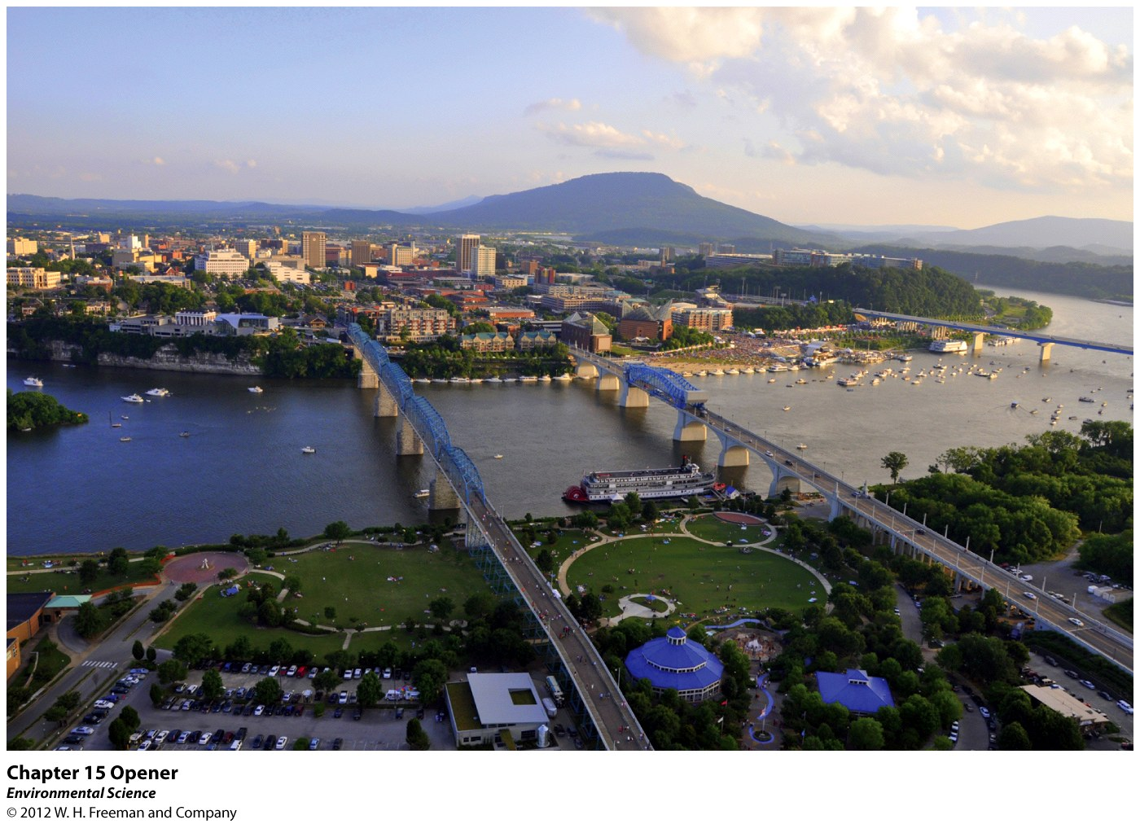
Chapter 15
Air Pollution and Stratospheric Ozone Depletion

Slide 3
Air Pollution
Air pollution- the introduction of chemicals, particulate matter, or microorganisms into the atmosphere at concentrations high enough to harm plants, animals, and materials such as buildings, or to alter ecosystems.
Sulfur Dioxide
Nitrogen Oxides
Carbon Oxides
Particulate Matter
Volatiles Organic Compounds
Ozone
Lead
Mercury

Slide 4
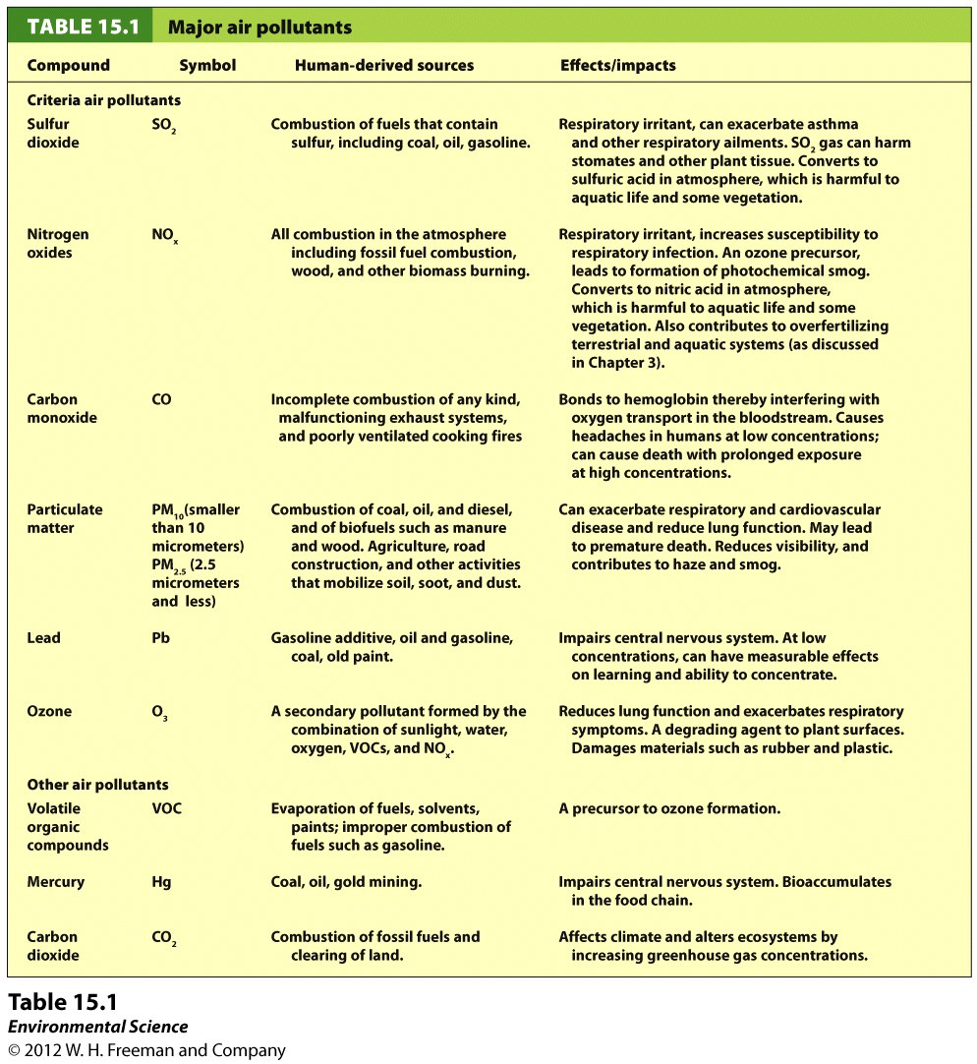

Slide 5
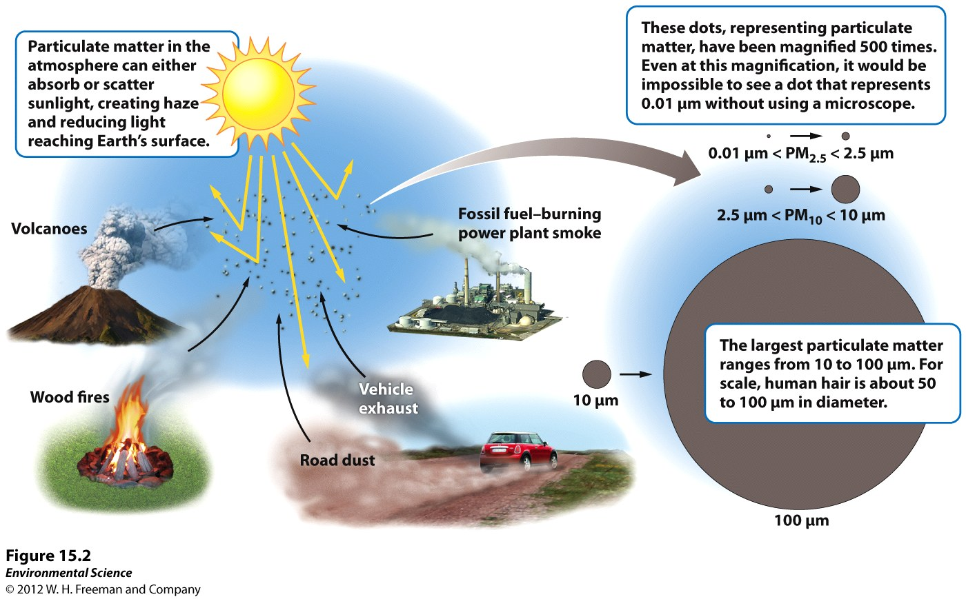

Slide 6
Primary and Secondary Pollutants
Primary pollutants- polluting compounds that come directly out of the smoke-stack, exhaust pipe, or natural emission source.
Examples: CO, CO2, SO2, NOx, and most suspended particulate matter.
Secondary pollutants- pollutants that have undergone transformation in the presence of sunlight, water, oxygen, or other compounds.
Examples: ozone, sulfate and nitrate

Slide 7
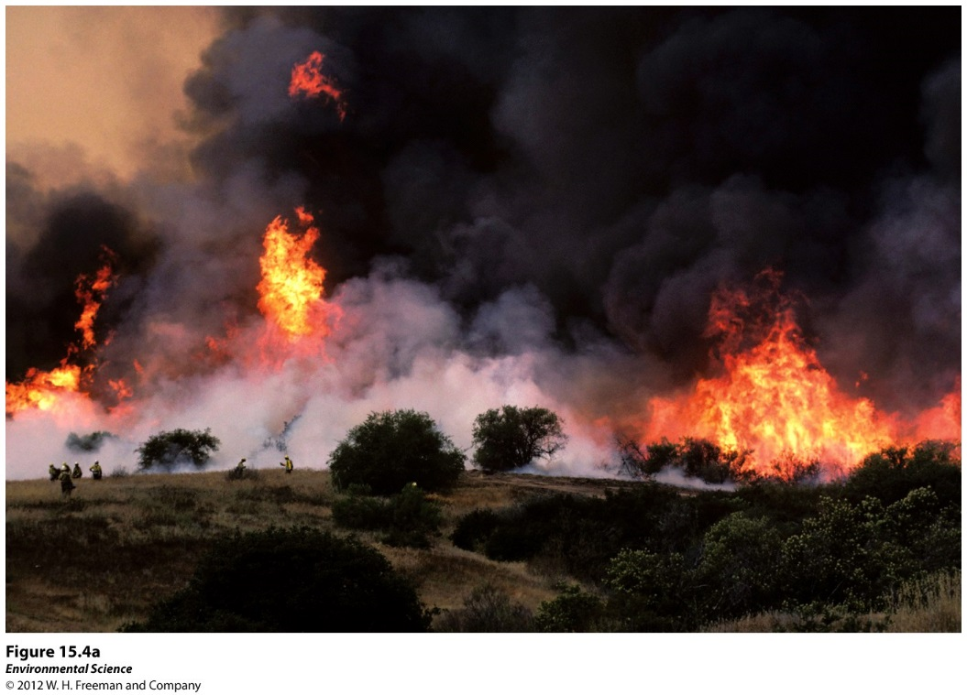
Natural Sources of Air Pollution
Anthropogenic Sources
of Air Pollution
Volcanoes
Lightning
Forest fires
Plants
On-road vehicles
Power plants
Industrial processes
Waste disposal

Slide 8
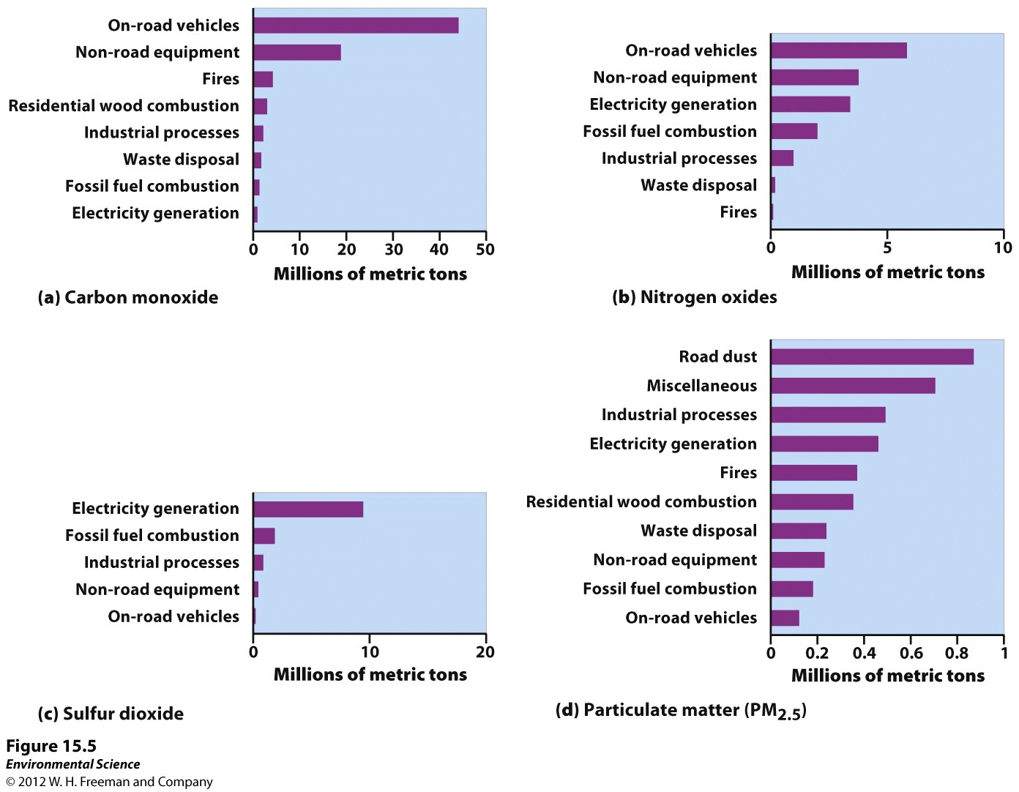

Slide 9
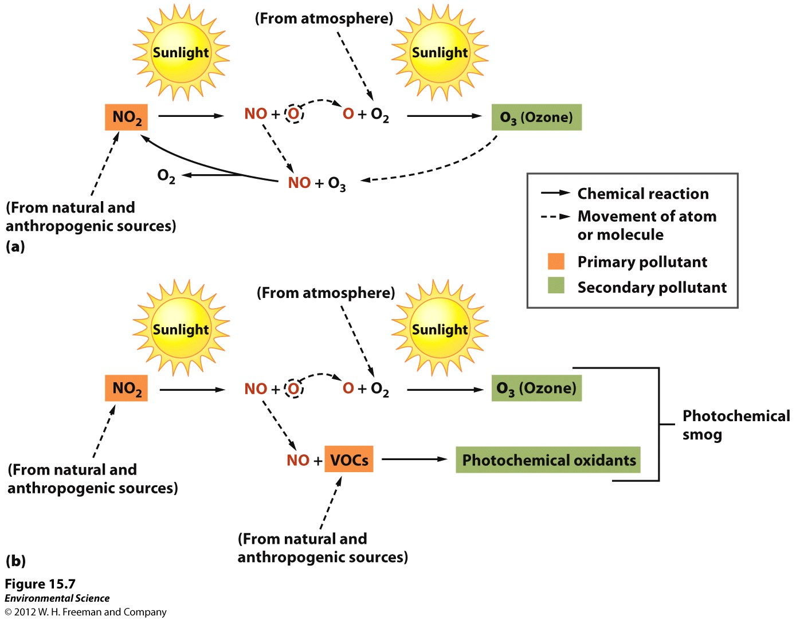
Photochemical Smog

Slide 10
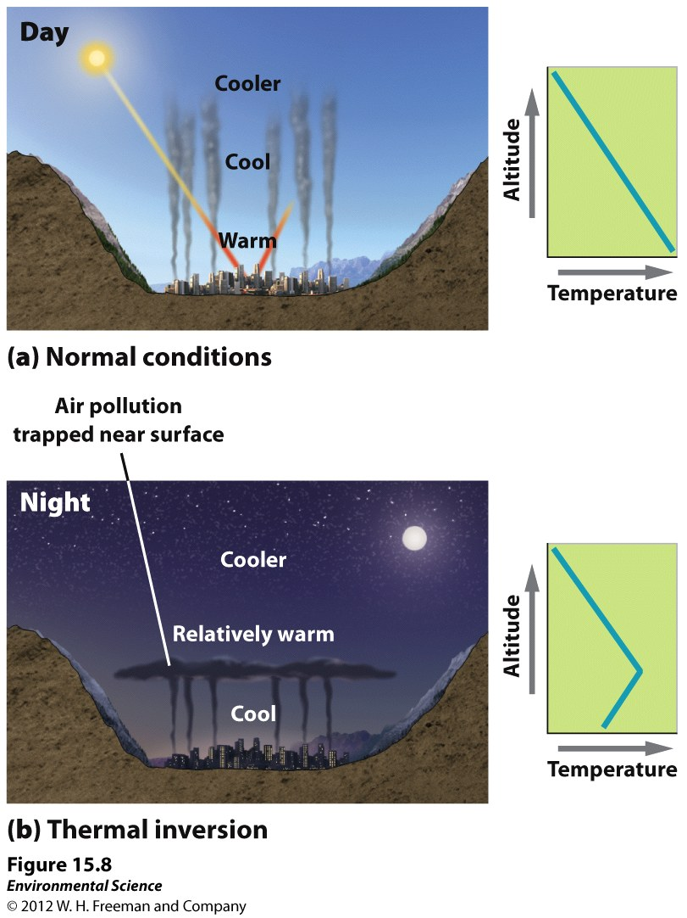
Thermal Inversions
Thermal Inversion- when a relatively warm layer of air at mid-altitude covers a layer of cold, dense air below.
The warm inversion layer traps emissions that then accumulate beneath it.

Slide 11
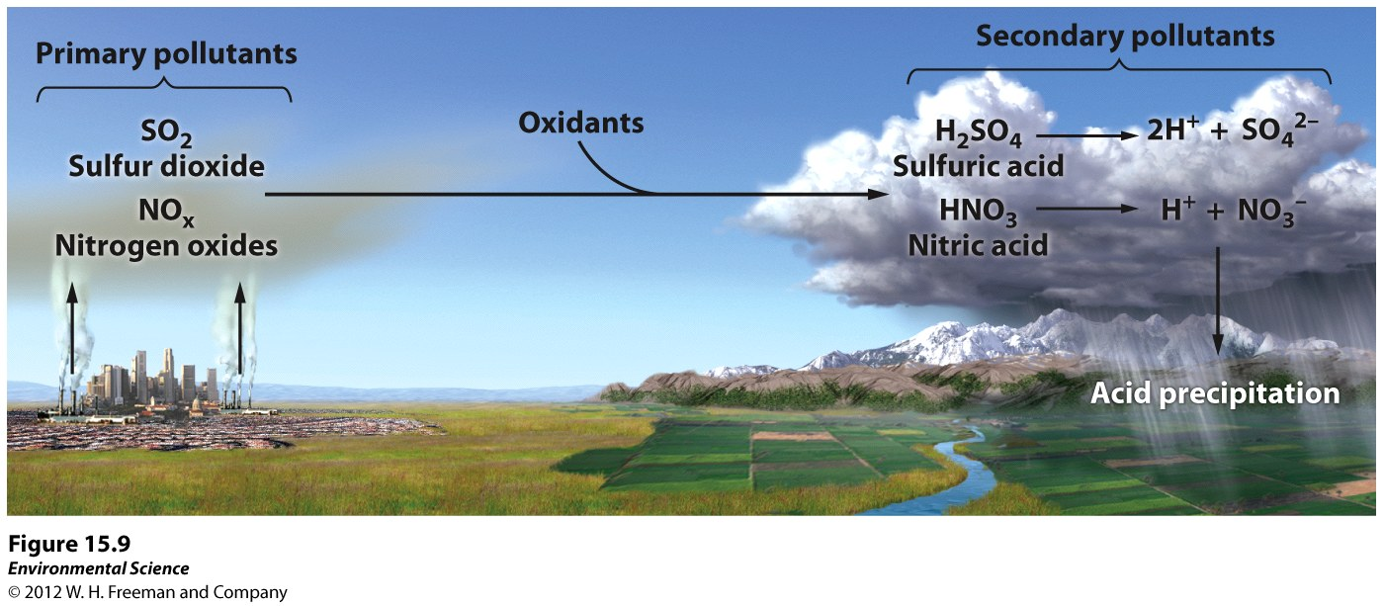
Acid Deposition
Acid deposition- occurs when nitrogen oxides and sulfur oxides are released into the atmosphere and combine with atmospheric oxygen and water. These form the secondary pollutants nitric acid and sulfuric acid.
These secondary pollutants further break down into nitrate and sulfate which cause the acid in acid deposition.

Slide 12
Effects of Acid Deposition
Lowering the pH of lake water
Decreasing species diversity of aquatic organisms
Mobilizing metals that are found in soils and releasing these into surface waters
Damaging statues, monuments, and buildings

Slide 13
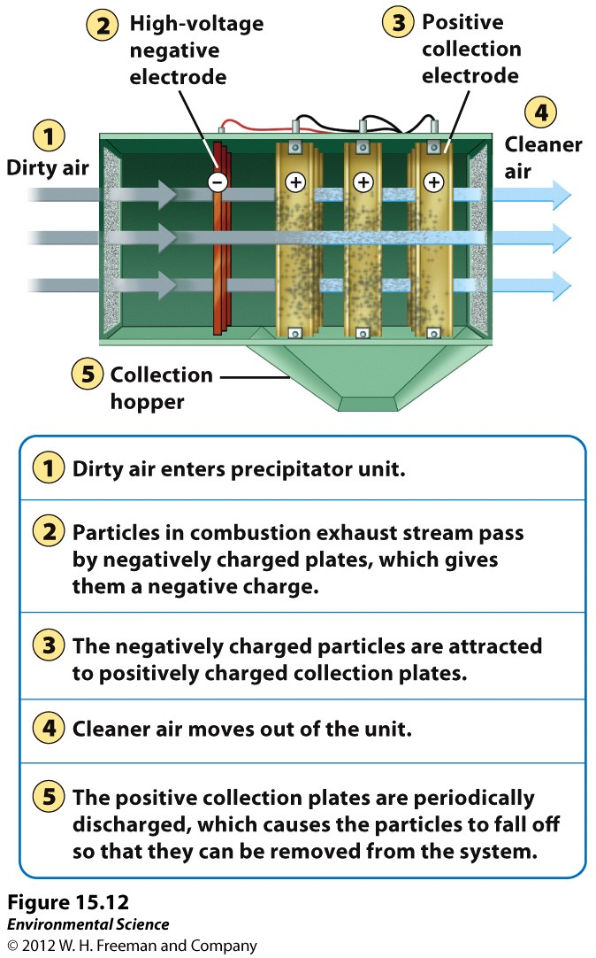
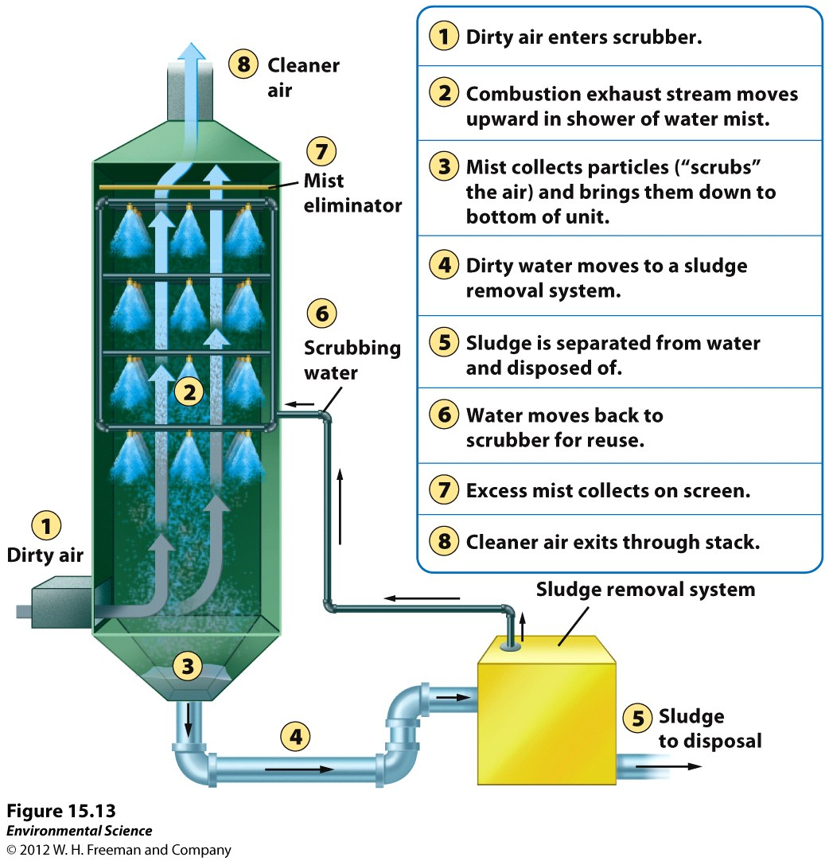
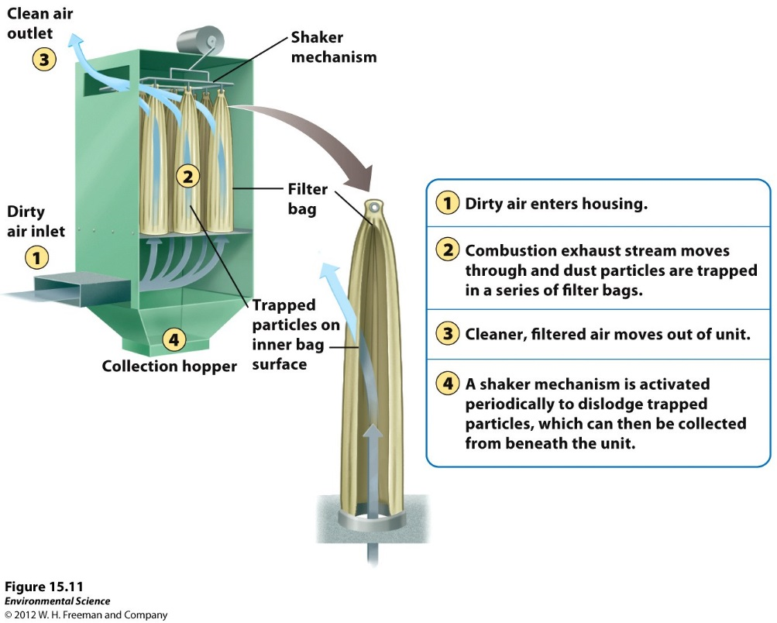
Ways to Prevent Air Pollution
Removing sulfur dioxide from coal by fluidized bed combustion
Catalytic converters on cars
Scrubbers on smoke stacks
Baghouse filters
Electrostatic precipitators

Slide 14
Stratospheric Ozone
The stratospheric ozone layer exists roughly 45-60 kilometers above the Earth.
Ozone has the ability to absorb ultraviolet radiation and protect life on Earth.

Slide 15
Formation and Breakdown of Ozone
First, UV-C radiation breaks the bonds holding together the oxygen molecule )2, leaving two free oxygen atoms: O2 + UV-C -> 2O
Sometimes the free oxygen atoms result in ozone: O2 + O -> O3
Ozone is broken down into O2 and free oxygen atoms when it absorbs both UV-C and UV-B ultraviolet light: O3 + UV-B or UV-C -> O2 + O

Slide 16
Anthropogenic Contributions to Ozone Destruction
Certain chemicals can break down ozone, particularly chlorine.
The major source of chlorine in the stratosphere is a compound known as chlorofluorocarbons (CFCs)
CFCs are used in refrigeration and air conditioning, as propellants in aerosol cans and as “blowing agents” to inject air into foam products like Styrofoam.

Slide 17
Anthropogenic Contributions to Ozone Destruction
When CFCs are released into the troposphere they make their way to the stratosphere.
The ultraviolet radiation present has enough energy to break the bond connecting chlorine to the CFC molecule.
which can then break apart the ozone molecules.

Slide 18
Anthropogenic Contributions to Ozone Destruction
First, chlorine breaks ozone’s bonds and pulls off one atom of oxygen, forming a chlorine monoxide molecule and O2: O3 + Cl -> ClO + O2
Next, a free oxygen atoms pulls the oxygen atom from ClO, liberating the chlorine and creating one oxygen molecule: ClO + O -> Cl + O2
One chlorine atom can catalyze the breakdown of as many as 100,000 ozone molecules before it leaves the stratosphere.

Slide 19
Depletion of the Ozone Layer
Global Ozone concentrations had decreased by more than 10%.
Depletion was greatest at the poles
Decreased stratospheric ozone has increased the amount of UV-B radiation that reaches the surface of Earth.

Slide 20
Indoor Air Pollutants
Wood, animal manure or coal used for cooking and heating in developing countries.
Asbestos
Carbon Monoxide
Radon
VOCs in home products

Slide 21
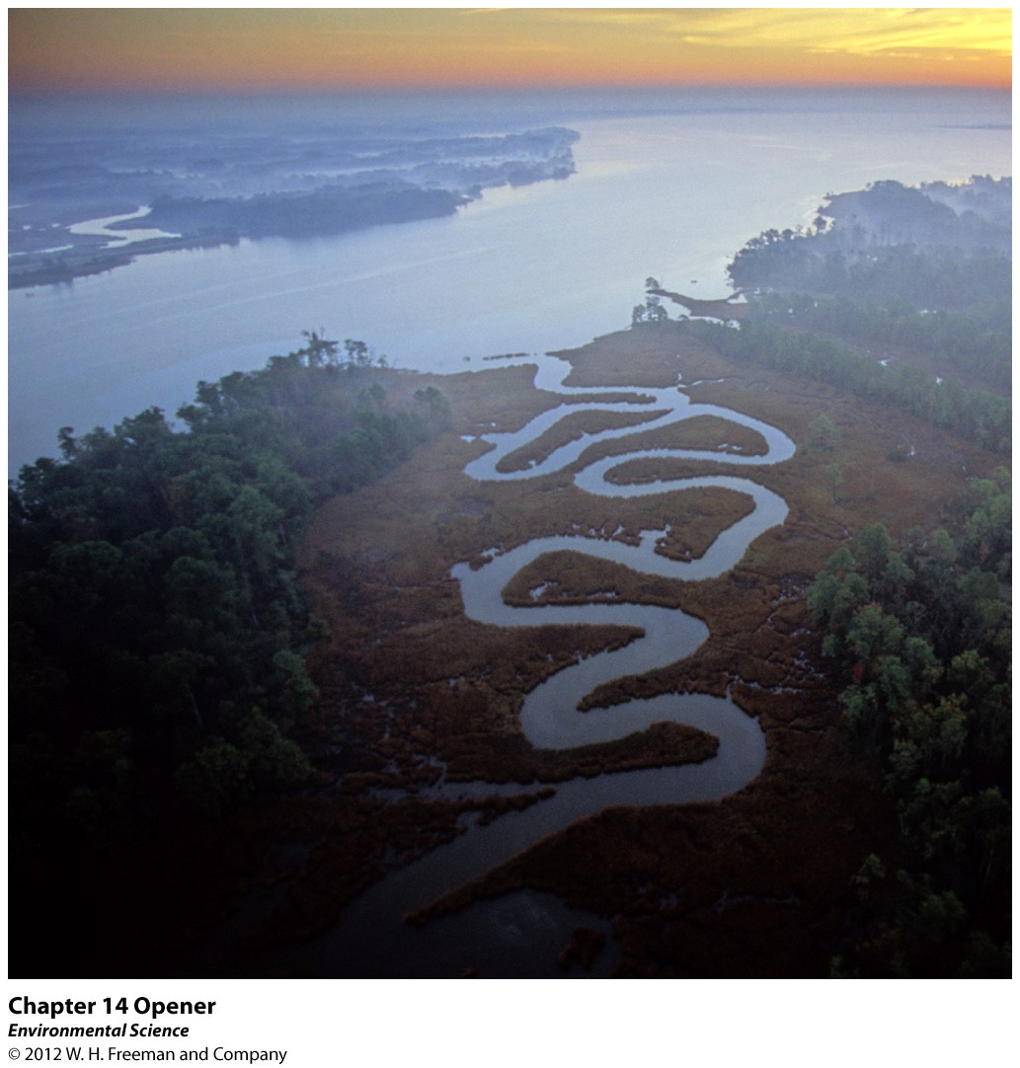
Chapter 14
Water Pollution

Slide 22
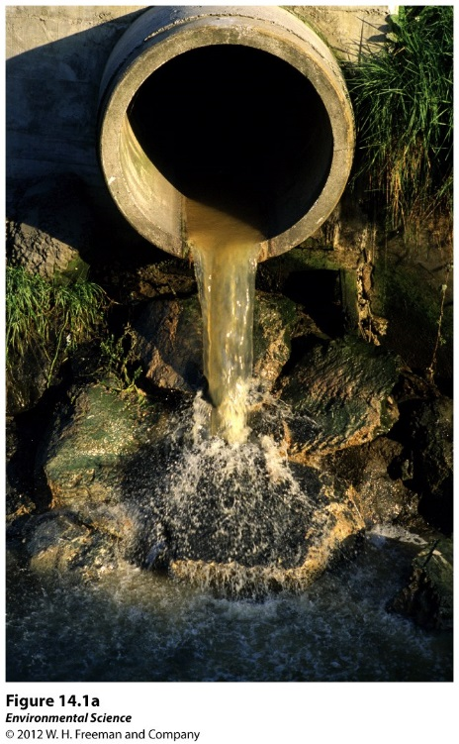
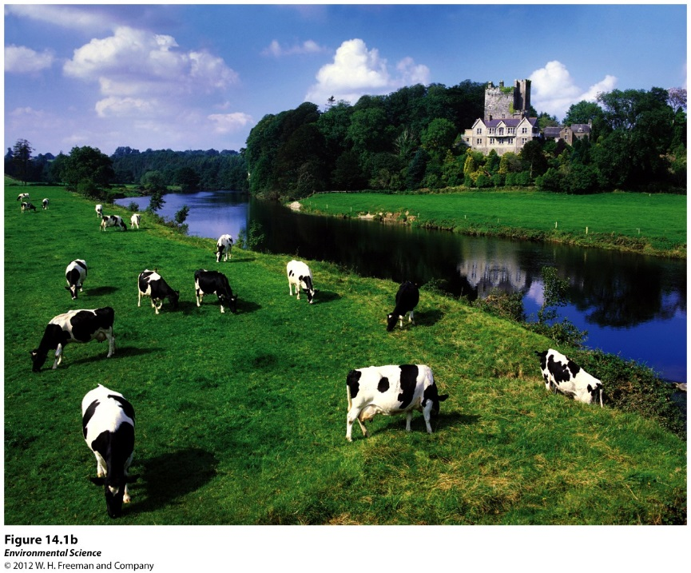
Water Pollution
Water pollution- the contamination of streams, rivers, lakes, oceans, or groundwater with substances produced through human activities and that negatively affect organisms.
Point sources- distinct locations that pump waste into a waterway.
Nonpoint sources- diffuse areas such as an entire farming region that pollutes a waterway.

Slide 23
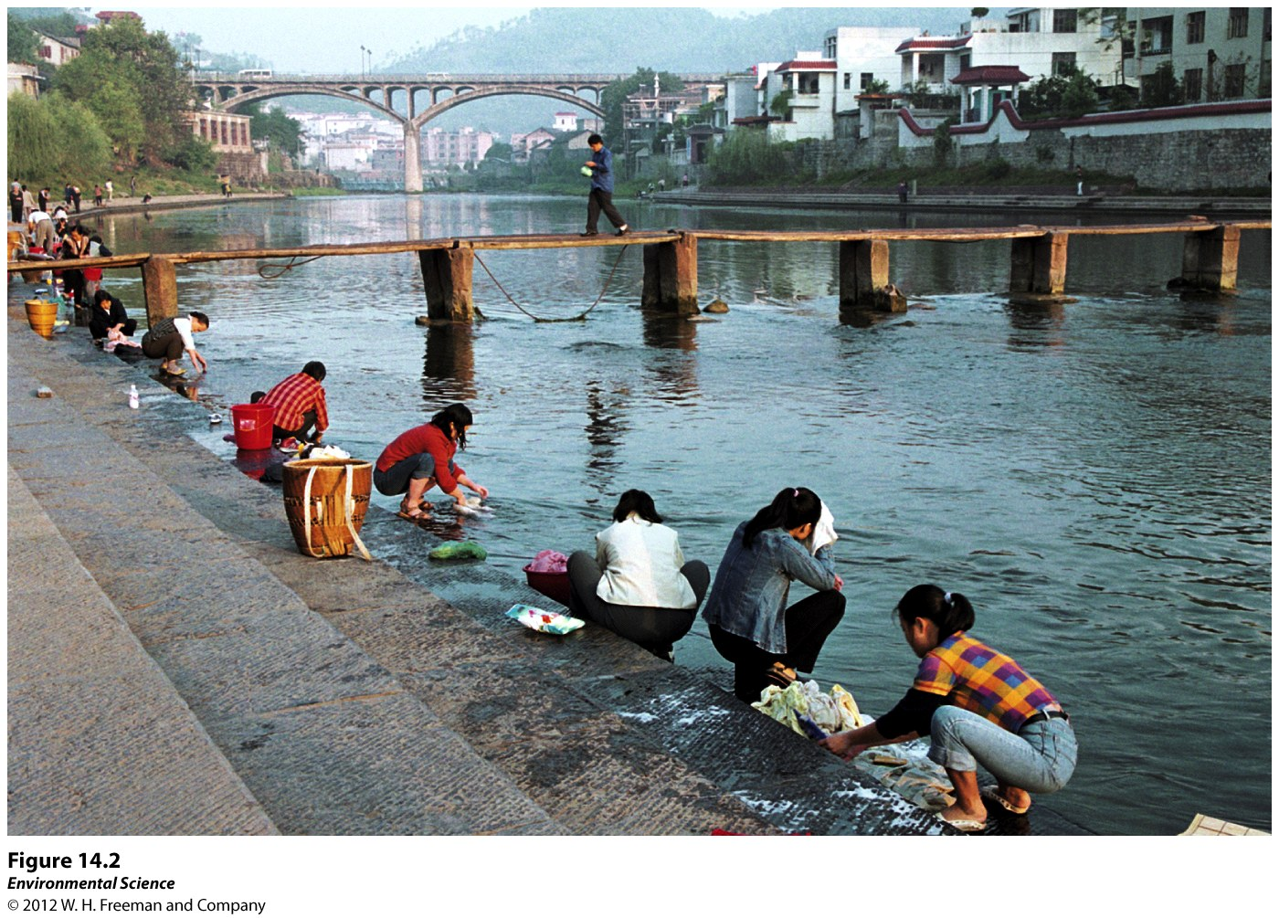
Human Wastewater
Water produced by human activities such as human sewage from toilets and gray water from bathing and washing clothes or dishes.
Common Diseases from Human Wastewater
Cholera
Typhoid fever
Stomach flu
Diarrhea
Cholera
Hepatitis

Slide 24
Three reasons scientists are concerned about human wastewater:
Oxygen-demanding wastes like bacteria that put a large demand for oxygen in the water
Nutrients that are released from wastewater decomposition can make the water more fertile causing eutrophication
Wastewater can carry a wide variety of disease-causing organisms.

Slide 25
Biochemical Oxygen Demand (BOD)
BOD- the amount of oxygen a quantity of water uses over a period of time at a specific temperature.
Lower BOD values indicate the water is less polluted and higher BOD values indicate it is more polluted by wastewater.

Slide 26
Eutrophication
Eutrophication is an abundance of fertility to a body of water.
Eutrophication is caused by an increase in nutrients, such as fertilizers.
Eutrophication can cause a rapid growth of algae which eventually dies, causing the microbes to increase the BOD.

Slide 27
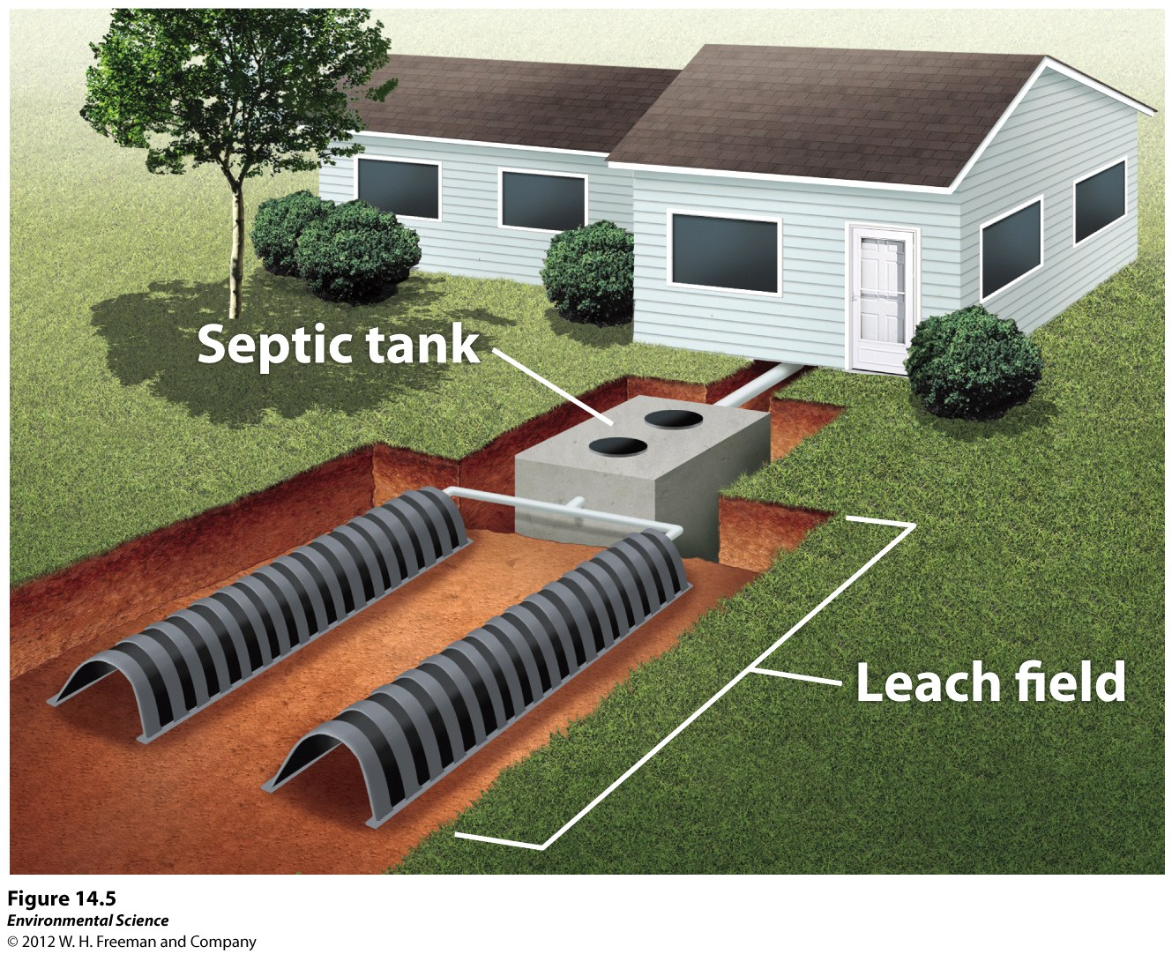
Treatments for Human and Animal Wastewater
Septic systems- a large container that receives wastewater from the house.

Slide 28
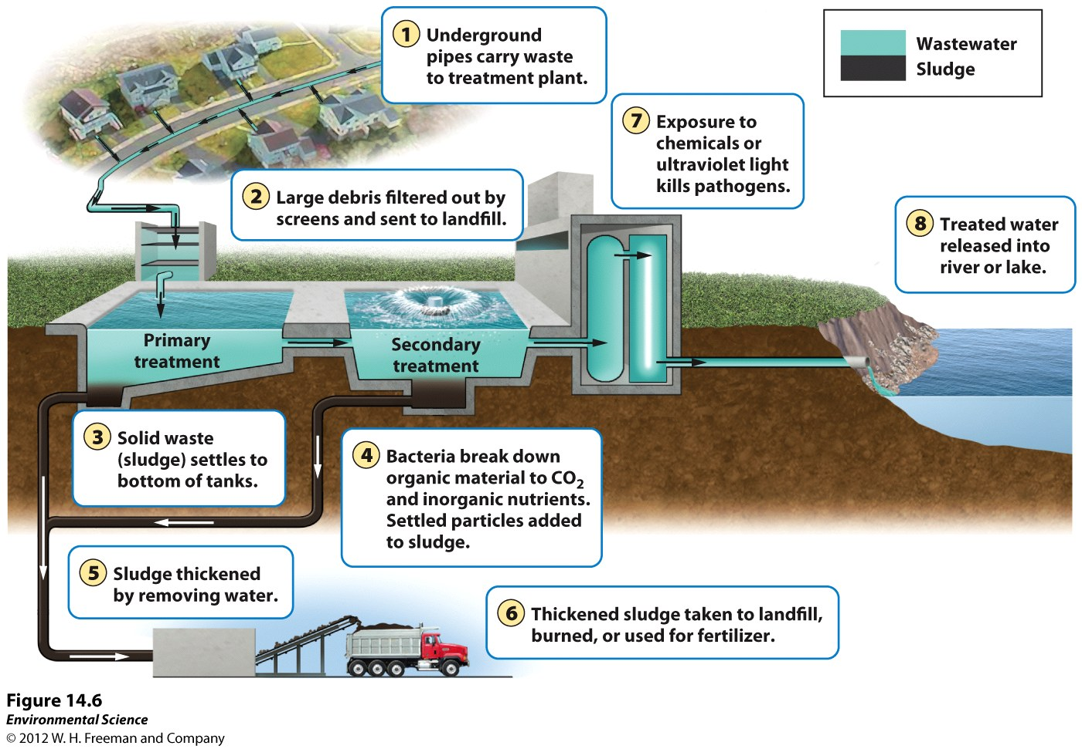
Treatments for Human and Animal Wastewater
Sewage Treatment Plants- centralized plants in areas with large populations that receive wastewater via a network of underground pipes.

Slide 29
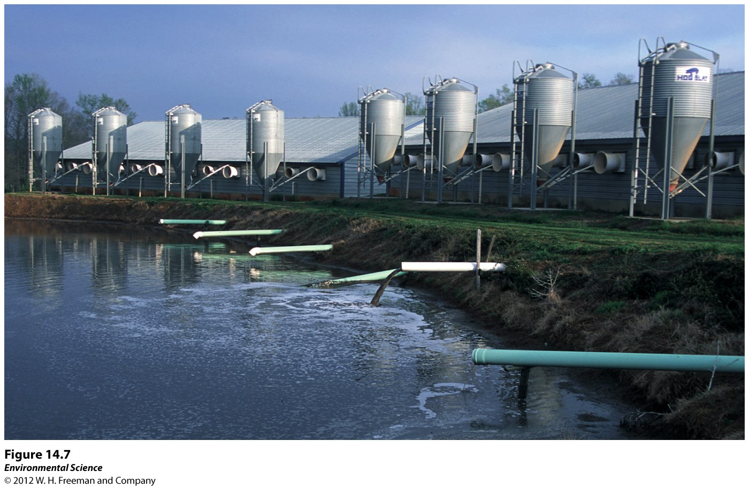
Treatments for Human and Animal Wastewater
Manure lagoons- large, human-made ponds line with rubber to prevent the manure from leaking into the groundwater. After the manure is broken down by bacteria, it is spread onto fields as fertilizers.

Slide 30
Heavy Metals and Other Substances that can threaten human Health and the Environment
Lead
Arsenic
Mercury
Acids
Synthetic compounds (pesticides, pharmaceuticals, and hormones)

Slide 31
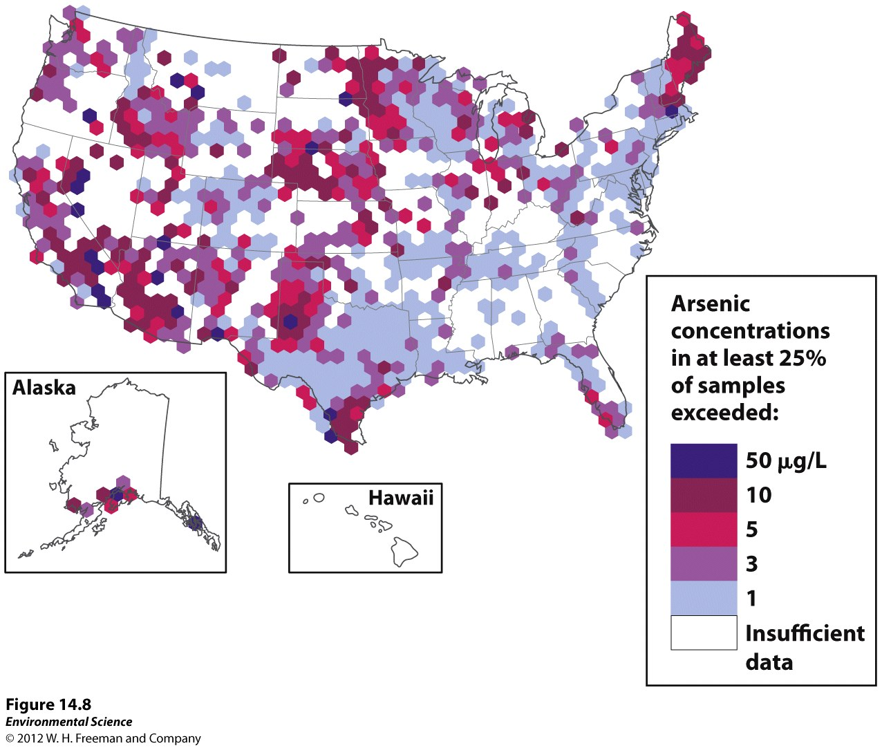

Slide 32
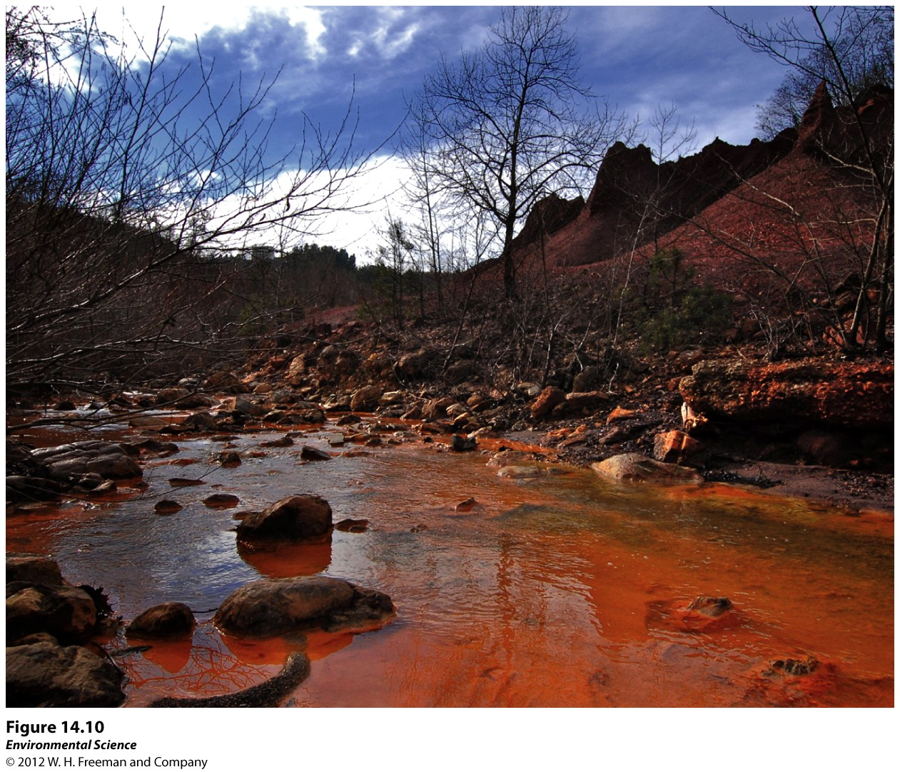

Slide 33
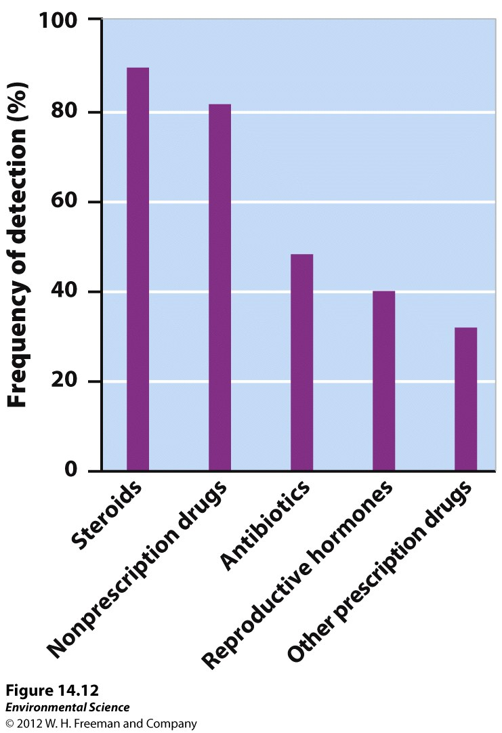

Slide 34
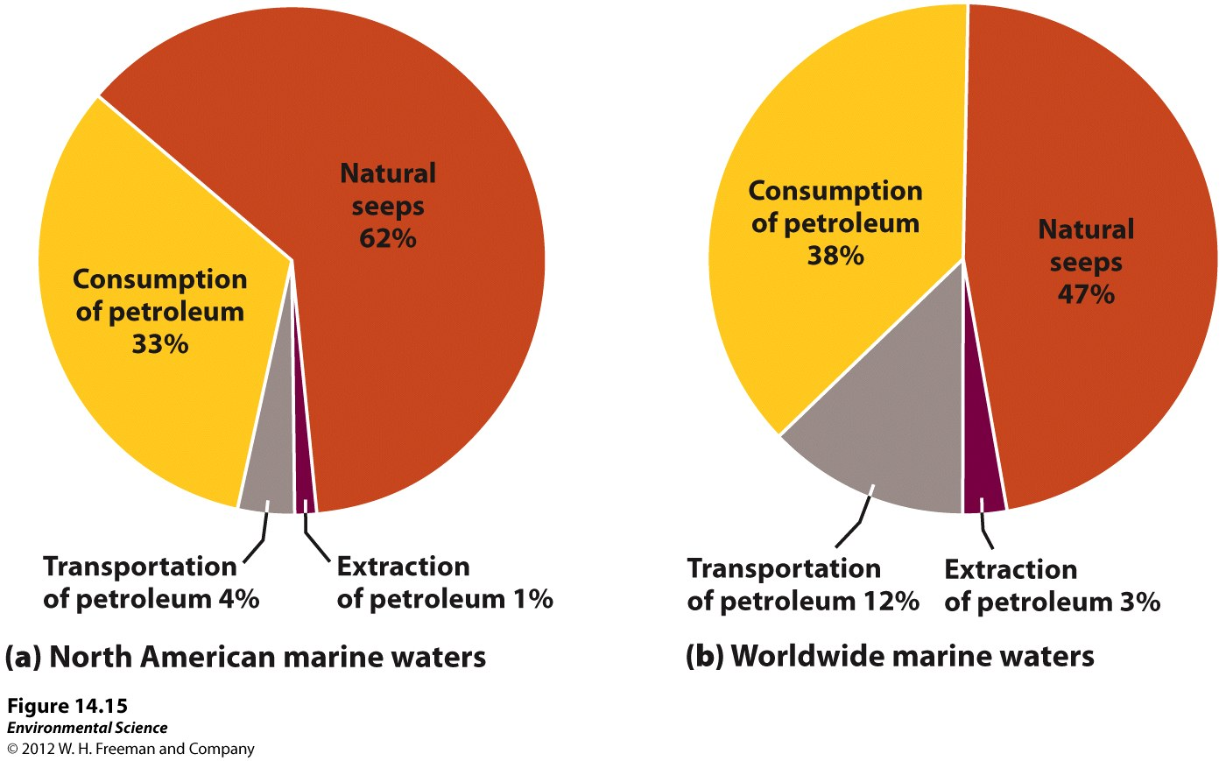
Oil Pollution

Slide 35
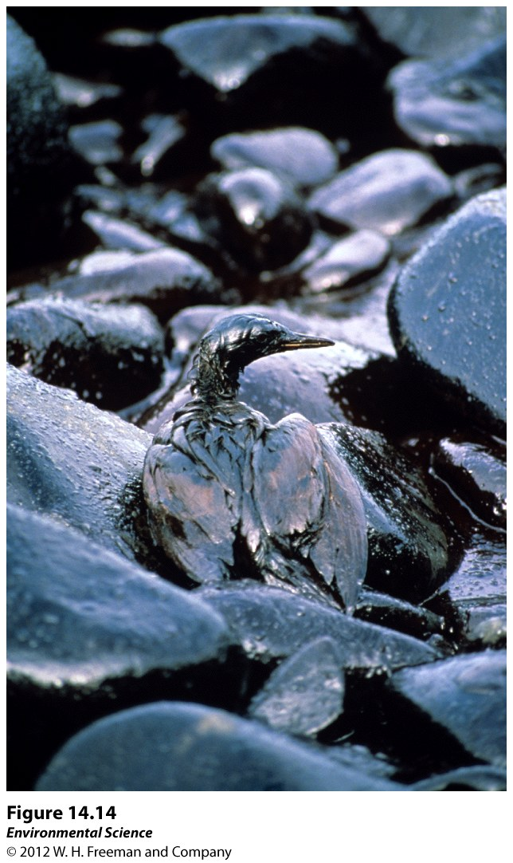

Slide 36
Ways to Remediate Oil Pollution
Containment using booms to keep the floating oil from spreading.
Chemicals that help break up the oil, making it disperse before it hits the shoreline.
Bacteria that are genetically engineered to consume oil

Slide 37
Other Water Pollutants
Solid waste pollution (garbage)
Sediment pollution (sand, silt and clay)
Thermal pollution
Noise pollution

Slide 38
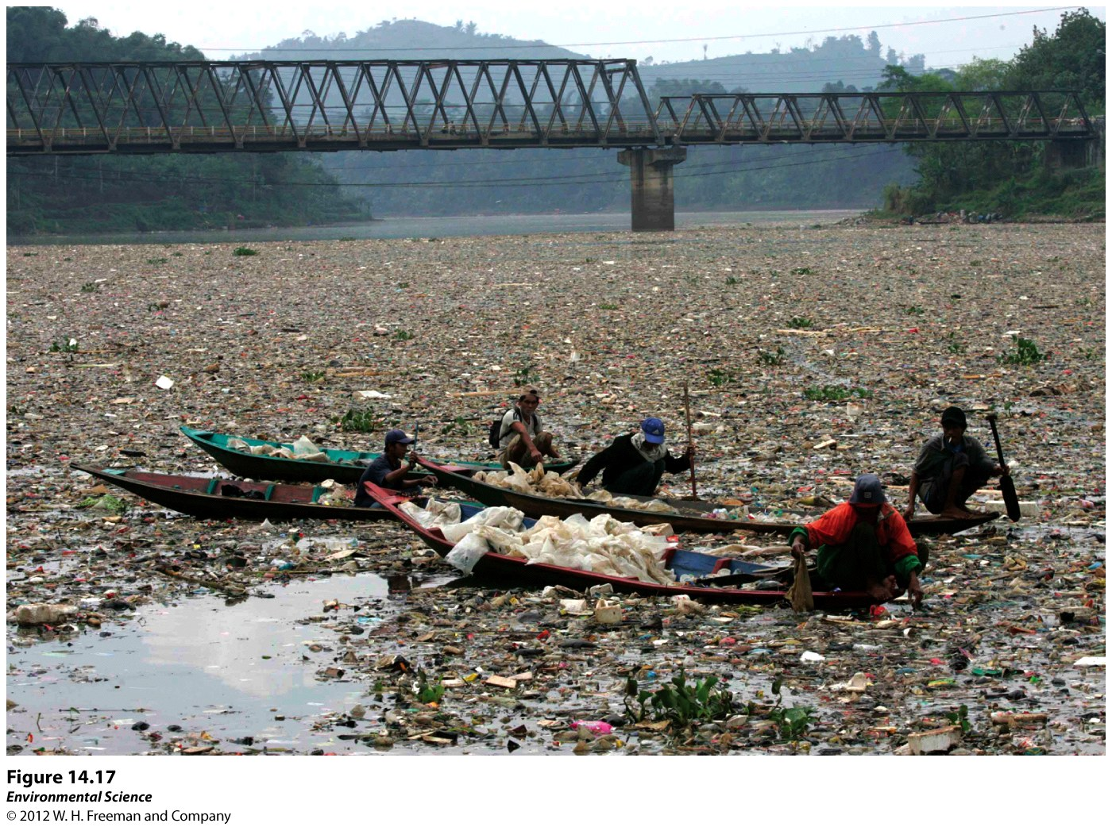

Slide 39
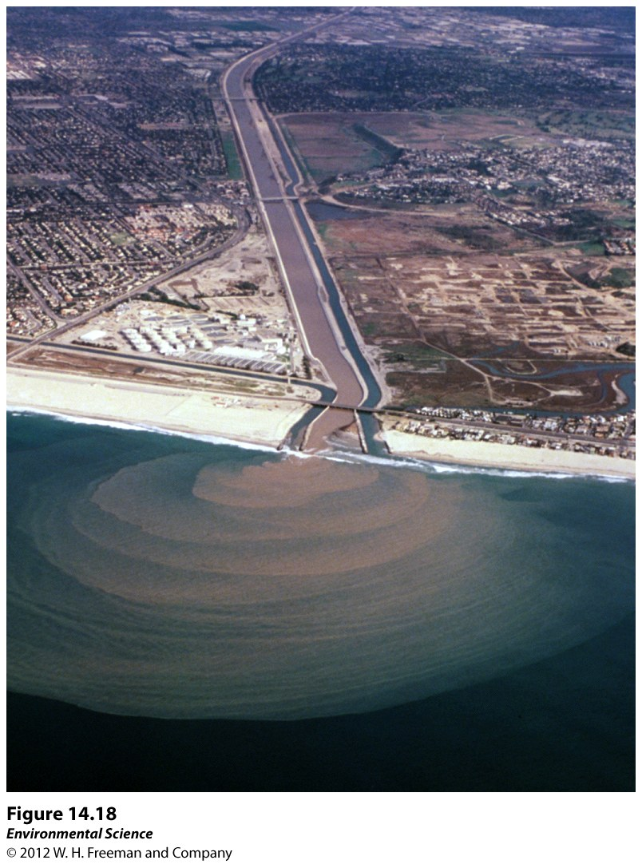

Slide 40
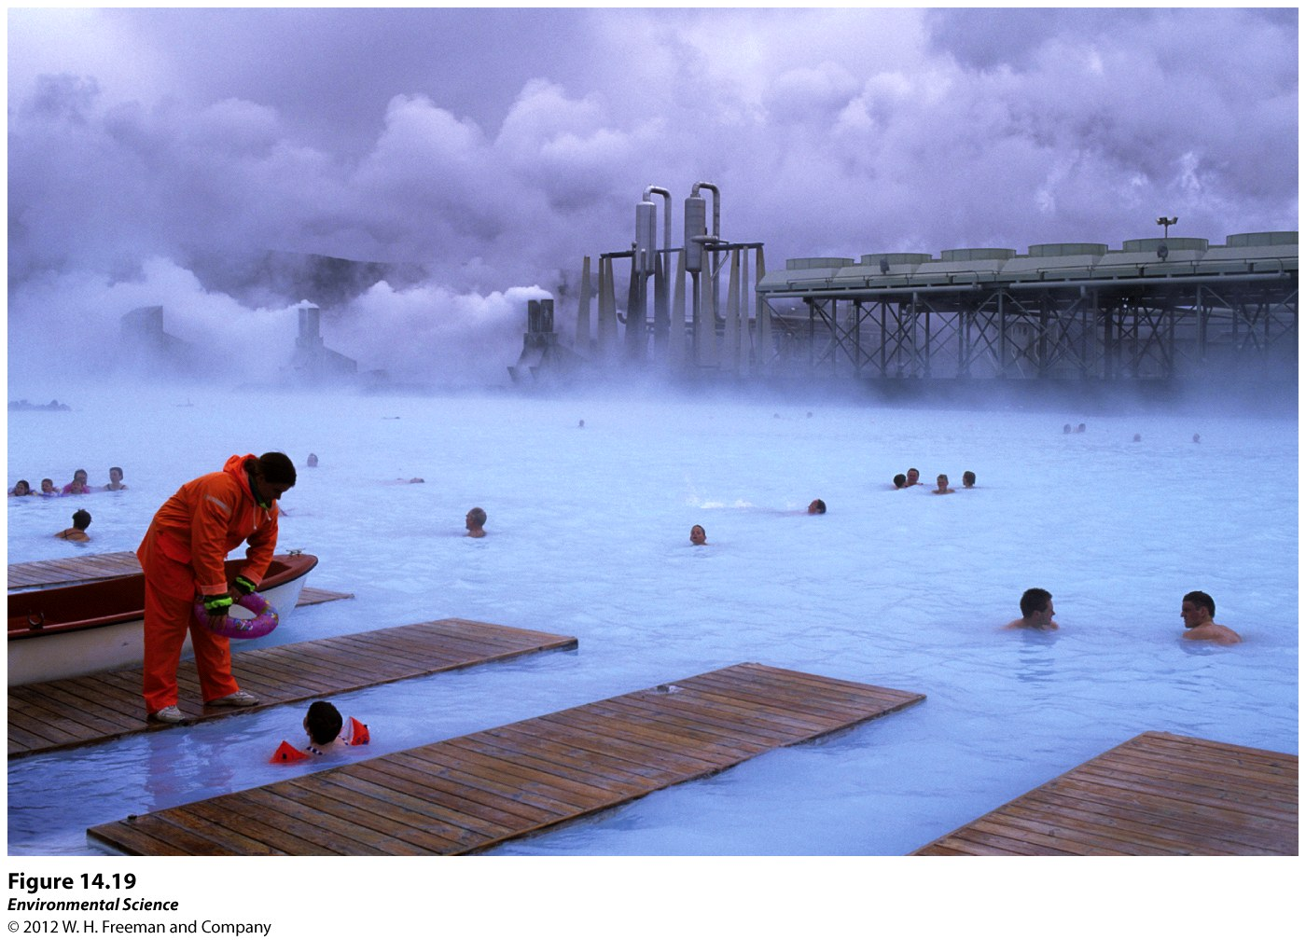

Slide 41
Water Laws
Clean Water Act- (1972) supports the “protection and propagation of fish, shellfish, and wildlife and recreation in and on the water”.
Issued water quality standards that defined acceptable limits of various pollutants in U.S. waterways.
Safe Drinking Water Act- (1974, 1986, 1996) sets the national standards for safe drinking water.
It is responsible for establishing maximum contaminant levels (MCL) for 77 different elements or substances in both surface water and groundwater.

Slide 42
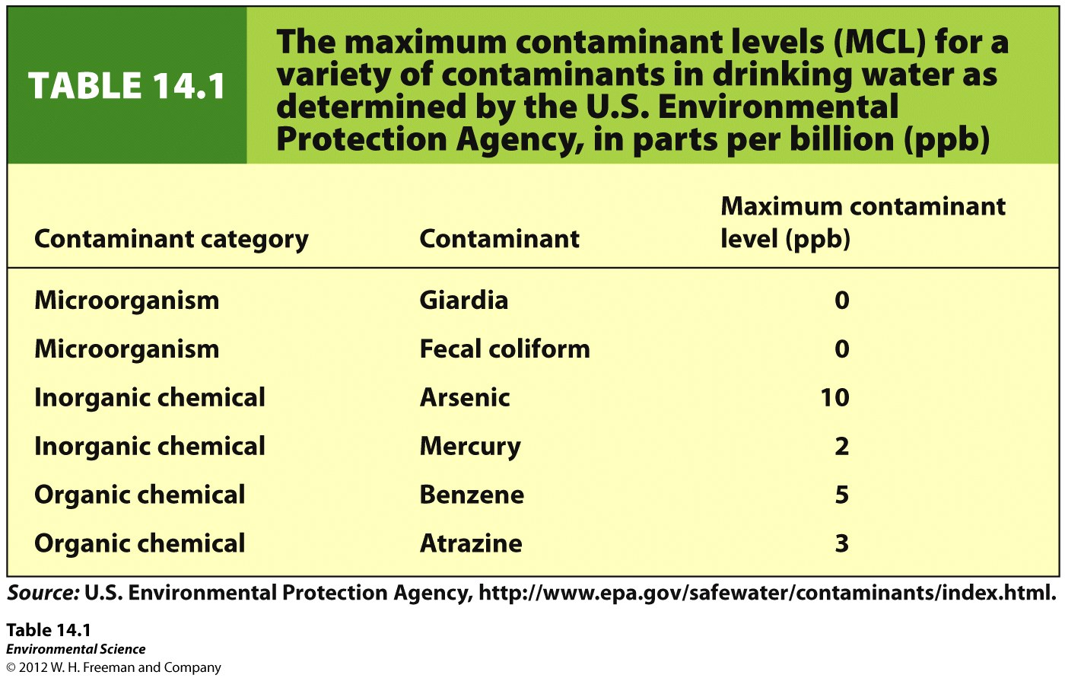

Slide 43
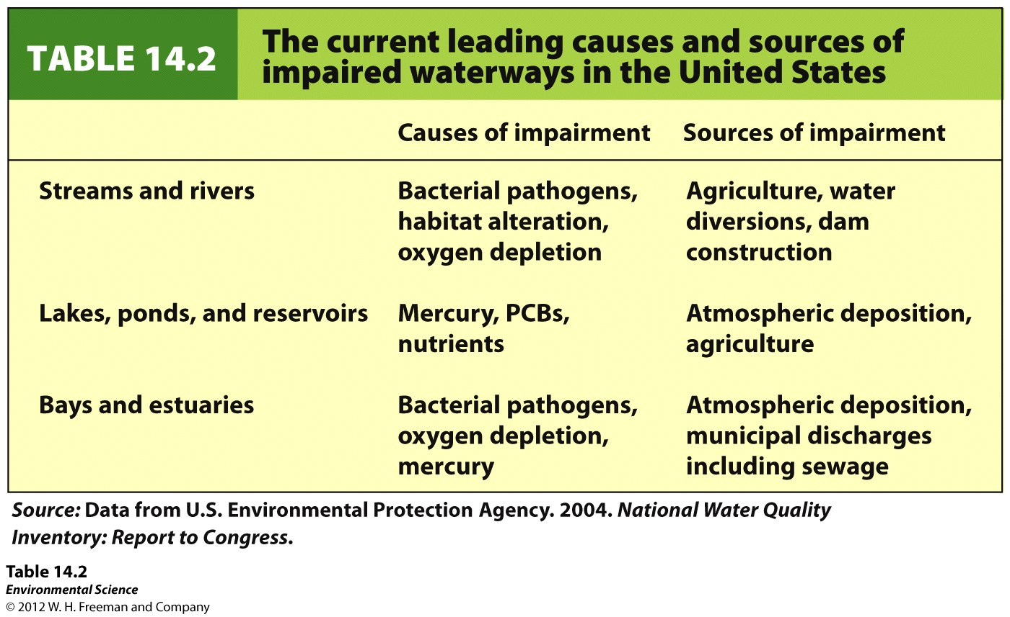

Slide 44
Chapter 16
Waste Generation and Waste Disposal
Friedland and Relyea Environmental Science for AP®, second edition
© 2015 W.H. Freeman and Company/BFW
AP® is a trademark registered and/or owned by the College Board®, which was not involved in the production of, and does not endorse, this product.

Slide 45
Humans generate waste that other organisms cannot use
Waste Material outputs from a system that are not useful or consumed.
Municipal solid waste (MSW) Refuse collected by municipalities from households, small businesses, and institutions.
Waste can be viewed as a system.

Slide 46
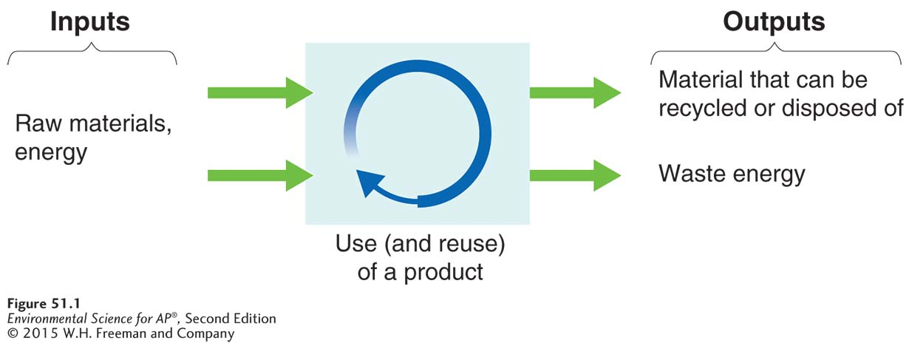
Waste as a System
The solid waste system. Waste is a component of a human-dominated system in which products are manufactured, used, and eventually disposed of (arrows are not proportional). At least some of the waste of this system may become the input of another system.

Slide 47
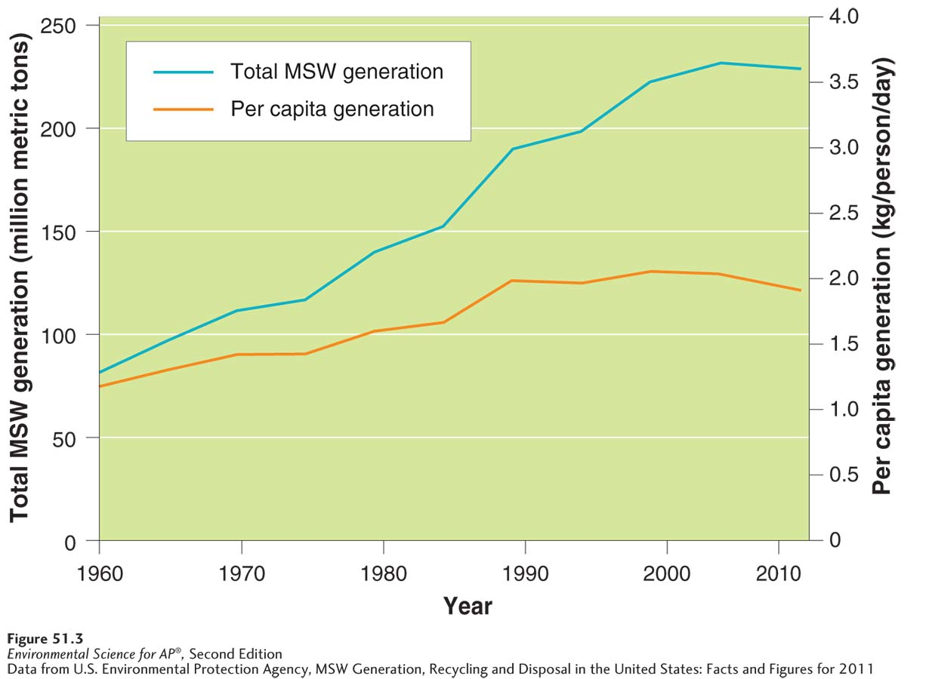
The Throw-Away Society
Municipal solid waste generation in the United States, 1960–2011. Total MSW
generation and per capita MSW generation had been increasing from 1960 through 2008. They have recently started to decrease.

Slide 48
The solid waste stream contains materials from many sources
Waste stream The flow of solid waste that is recycled, incinerated, placed in a solid waste landfill, or disposed of in another way.

Slide 49
E-Waste
Electronic waste, including televisions, computers, portable music players, and cell phones accounts for roughly 2 percent of the waste stream but its effect is greater than this amount indicates.
E-waste contains toxic metals such as mercury and cadmium which can leach out of landfills.
Even when e-waste is sent to be recycled, it is not always done so properly.

Slide 50
The three Rs divert materials from the waste stream
Reduce, reuse, recycle A popular phrase promoting the idea of diverting materials from the waste stream. Also known as the three Rs.

Slide 51
Reduce
Reduce is the first choice among the three Rs because reducing inputs is the optimal way to achieve a reduction in solid waste generation.
Source reduction An approach to waste management that seeks to cut waste by reducing the use of potential waste materials in the early stages of design and manufacture.
Source reduction can also increase energy efficiency; manufacturing produces less waste and can minimize disposal processes.
Source reduction may also involve substituting less toxic materials or products.

Slide 52
Reuse
Reuse Using a product or material that was intended to be discarded.
Optimally, no additional energy or resources are needed for the object to be reused.
Energy may be required to prepare or transport an object for reuse by someone other than the original user.

Slide 53
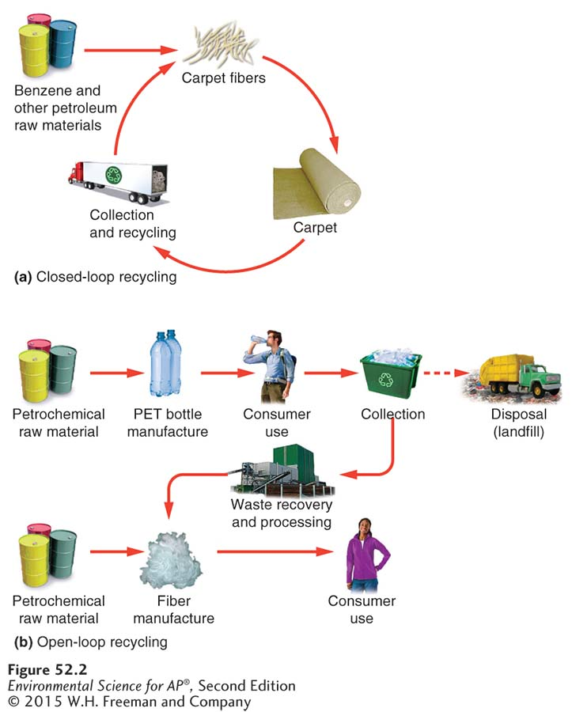
Recycle
Recycling The process by which materials destined to become municipal solid waste (MSW) are collected and converted into raw material that is then used to produce new objects.
Closed-loop recycling Recycling a product into the same product.
Open-loop recycling Recycling one product into a different product.

Slide 54
Composting is becoming more popular
Organic materials such as food and yard waste that end up in landfills are unstable; the absence of oxygen in landfills causes organic material to decompose anaerobically, which produces methane gas.
Composting Creation of organic matter (humus) by decomposition under controlled conditions to produce an organic-rich material that enhances soil structure, cation exchange capacity, and fertility.
Materials suitable for compositing include vegetables and vegetable by-products, animal manure, yard wastes, and paper fiber not destined for recycling.

Slide 55
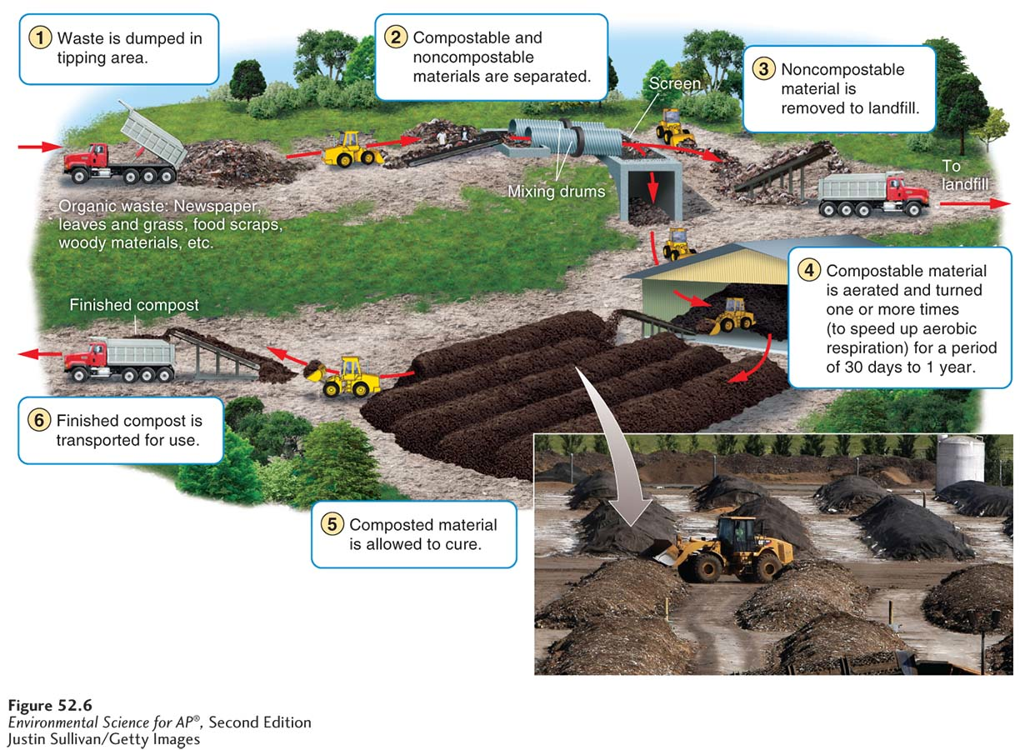
Composting
A municipal composting facility. A typical facility collects almost 100,000 metric
tons of food scraps and paper per year and turns it into usable compost. Most facilities have some kind of mechanized system to allow mixing and aeration of the organic material, which speeds conversion to compost.

Slide 56
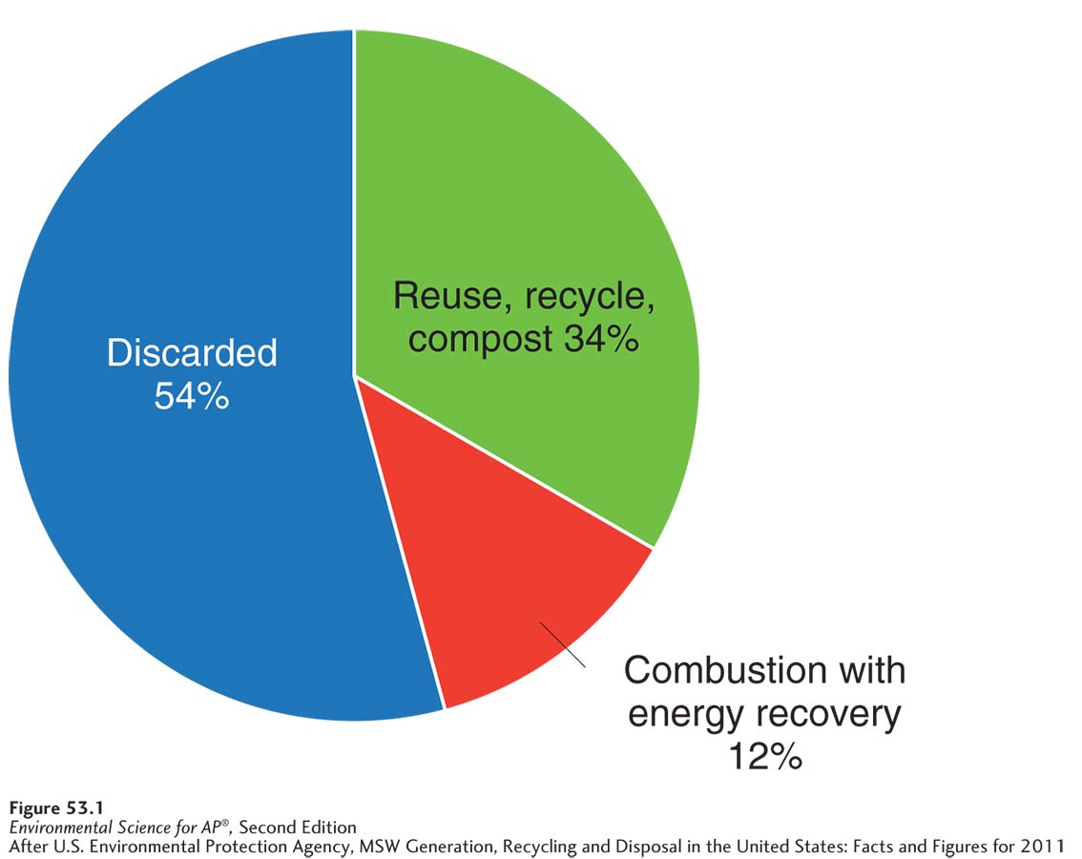
Landfills are the primary destination for MSW
The fate of municipal solid waste in the United States. The majority of MSW is disposed of in landfills.

Slide 57
Landfill Basics
Leachate Liquid that contains elevated levels of pollutants as a result of having passed through municipal solid waste (MSW) or contaminated soil.
Sanitary landfill An engineered ground facility designed to hold municipal solid waste (MSW) with as little contamination of the surrounding environment as possible.
Tipping fee A fee charged for disposing of material in a landfill or incinerator.

Slide 58
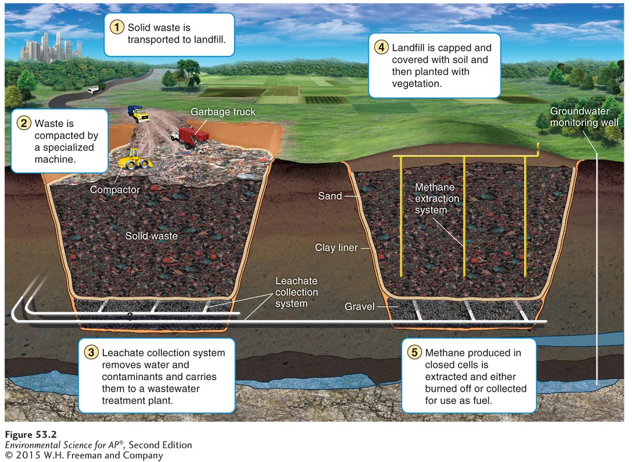
Landfill Basics
A modern sanitary landfill. A landfill constructed today has many features to keep
components of the solid waste from entering the soil, water table, or nearby streams.
Some of the most important environmental features are the clay liner, the leachate collection system, the cap—which prevents additional water from entering the landfill—
and, if present, the methane extraction system.

Slide 59
Incineration is another way to treat waste materials
Incineration The process of burning waste materials to reduce volume and mass, sometimes to generate electricity or heat.
Ash The residual nonorganic material that does not combust during incineration.
Bottom ash Residue collected at the bottom of the combustion chamber in a furnace.
Fly ash The residue collected from the chimney or exhaust pipe of a furnace.
Waste-to-energy A system in which heat generated by incineration is used as an energy source rather than released into the atmosphere.

Slide 60
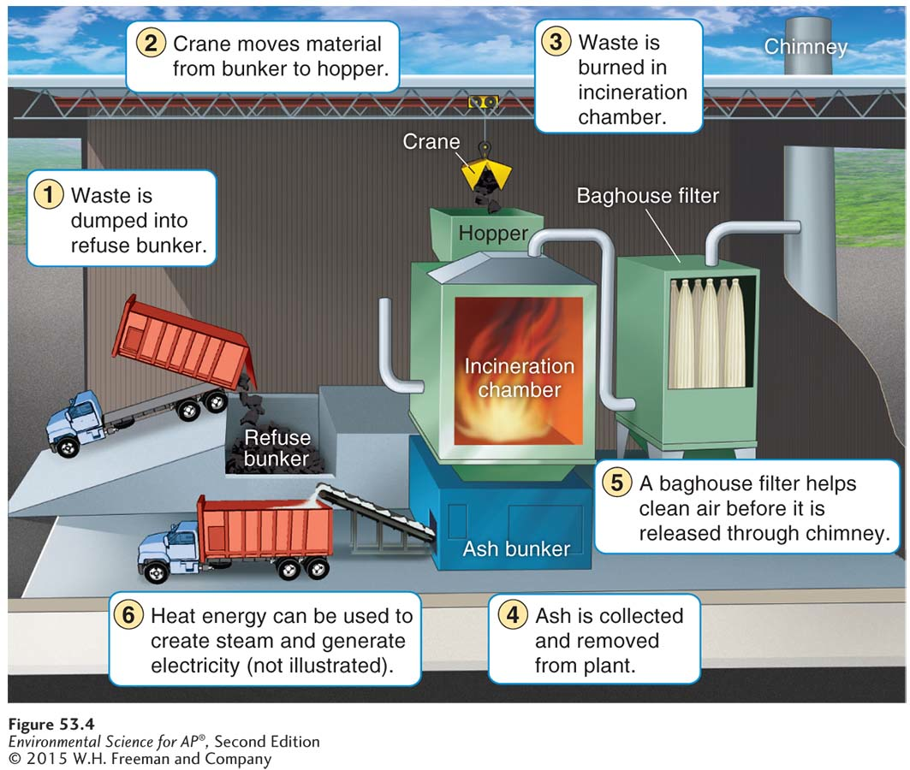
Incineration Basics
A municipal mass-burn waste-to-energy incinerator. In this plant, MSW is
combusted and the exhaust is filtered. Remaining ash is disposed of in a landfill. The resulting heat energy is used to make steam, which turns a generator that generates electricity in the same manner as was illustrated in Figure 34.7.

Slide 61
Environmental Consequences of Incineration
Tipping fees are higher at incinerators than at landfills.
An incinerator may release air pollutants from the incomplete combustion of plastics and metals.
Incinerators produce ash that is more concentrated and more toxic than the original MSW.
Incinerator ash that is deemed toxic must be disposed of in a special landfill for toxic materials.

Slide 62
Hazardous waste requires proper handling and disposal
Hazardous waste Liquid, solid, gaseous, or sludge waste material that is harmful to humans or ecosystems.
Collection sites for hazardous waste must be staffed with specially trained personnel.
Hazardous waste must be treated before disposal.

Slide 63
Legislation oversees and regulates the treatment of hazardous waste
A number of laws and acts specifically cover hazardous waste:
Resource Conservation and Recovery Act (RCRA) was designed to reduce or eliminate hazardous waste. Also know as “cradle-to-grave” tracking. RCRA ensures that hazardous waste is tracked and properly disposed of.

Slide 64
Regulation and Oversight of Handling Hazardous Waste
Superfund Act The common name for the Comprehensive Environmental Response, Compensation, and Liability Act (CERCLA); a 1980 U.S. federal act that imposes a tax on the chemical and petroleum industries, funds the cleanup of abandoned and nonoperating hazardous waste sites, and authorizes the federal government to respond directly to the release or threatened release of substances that may pose a threat to human health or the environment.

Slide 65
Legislation
Brownfields Contaminated industrial or commercial sites that may require environmental cleanup before they can be redeveloped or expanded.
Examples of Brownfields include old factories, industrial areas and waterfronts, dry cleaners, gas stations, landfills, and rail yards.
The brownfields legislation lacks legal liability controls to compel polluters to rehabilitate their properties.

