Slide 1
Soil, Sand, and Pollen Evidence

Slide 2
Soil Comparisons
May establish a relationship or link to the crime, the victim, or the suspect(s)
Physical properties—density, magnetism, particle size, mineralogy
Chemical properties—pH, trace elements

Slide 3
Probative Value of Soil
Types of earth material are virtually unlimited. They have a wide distribution and change over short distances.
As a result, the statistical probability of a given sample having properties the same as another is very small
Evidential value of soil can be excellent

Slide 4
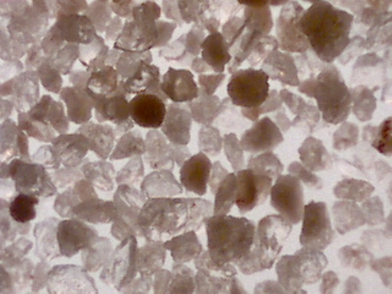
Increasing Probative Value
Rare or unusual minerals
Rocks
Fossils
Manufactured particles

Slide 5
Minerals
More than 2000 have been identified
Twenty or so are commonly found in soils; most soil samples contain only 3 to 5
Characteristics for identification—size, density, color, luster, fracture, streak, or magnetism

Slide 6
Rocks
Aggregates of minerals
Types
Natural—like granite
Man-made—like concrete
Formation
Igneous
Sedimentary
Metamorphic

Slide 7
Fossils
Remains of plants and animals
May help geologists to determine the age of rocks
Some are scarce and can be used to identify regions or locations

Slide 8
Soil Evidence
Class characteristics—the type of soil may have similar characteristics at the primary and/or secondary crime scene, on the suspect or on the victim
Individual characteristics—only if the soil has an unusual or specialized ingredient such as pollen, seeds, vegetation, or fragments.

Slide 9
Sand
Sand is the term applied to natural particles with a grain diameter between 1/16 mm and 2 mm.
Its color and contents are dependent upon the parent rock and surrounding plant and animal life.

Slide 10
Sand Types
Continental sands—formed from weathered continental rock, usually granite
Ocean floor sands—formed from volcanic material, usually basalt
Carbonate sands—composed of various forms of calcium carbonate
Tufa sands—formed when calcium ions from underground springs precipitate with carbonate ions in the salt water of a salt lake

Slide 11
Sand Evidence “In every grain of sand is a story of earth.” —Rachel Carson
Class characteristics—the type of sand may have similar characteristics to the primary and/or secondary crime scene, on the suspect or on the victim
Individual characteristics—only if the sand has an unusual ingredient or contaminant.

Slide 12
Palynology
The study of pollen and spores
Important to know:
What is produced in a given area
The dispersal pattern
Variation in size and weight

Slide 13
Pollen-Producing Plants
Forensic palynologists know each pollen-producing plant provides a pollen fingerprint—a specific type of pollen grain. They also know there will be a certain number of grains found in a specific geographical area during particular times of the year.
Examples of non-seed plants would be ferns, mosses, liverworts, and horsetails.
Examples of seed plants would be gymnosperms (cycads, ginkgoes, and conifers like an evergreen) and angiosperms (flowering plants like roses).

Slide 14
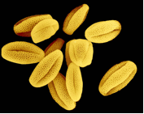
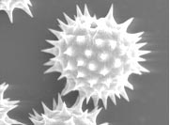
Pollen and Spore Identification in Solving Crimes
Angiosperm pollen grains Gymnosperm pollen grains
The outer shell of a pollen grain and spore has a complex and unique structure.
These are revealed under a microscope.
Identification can provide important trace evidence in solving crimes.

Slide 15
Forensic Geology in the News
A 9-year-old’s body was found in a wooded area along a river in Lincoln County, South Dakota. A forensic geologist collected soil samples from the fenders of a suspect’s truck and the area where the body was found. Both soils contained grains of a blue mineral that turned out to be gahnite, a rare mineral that had never been reported in South Dakota. As a result, the soil tied the suspect to the crime.
Check out other cases at: www.forensicgeology/science.htm

